Slide 1
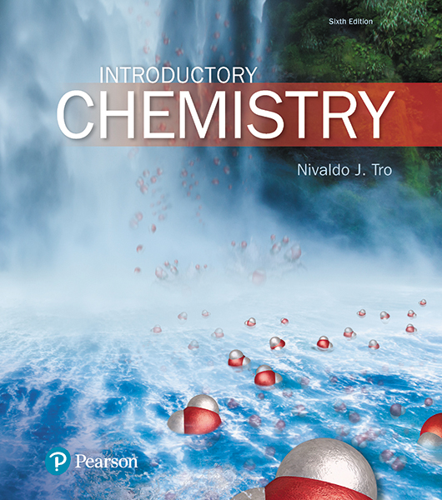
Lecture Presentation
Chapter 12
Liquids, Solids, and Intermolecular Forces

Slide 2
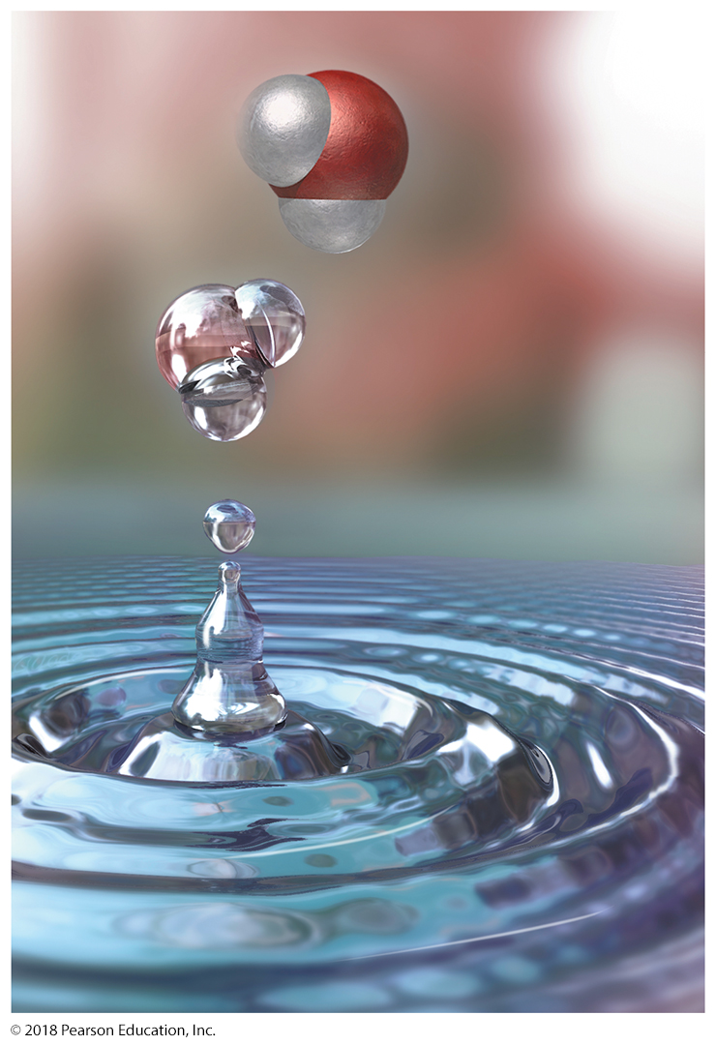
Interactions between Molecules
The spherical shape of the water drop in this image is caused by intermolecular forces, attractive forces that exist among the water molecules.

Slide 3
Intermolecular Forces
The specific interaction between the molecules in coffee that taste bitter and the taste receptors on the tongue is caused by intermolecular forces—attractive forces that exist between molecules.
Living organisms depend on intermolecular forces for many physiological processes.
Less-specific intermolecular forces exist between all molecules and atoms.
These intermolecular forces are responsible for the very existence of liquids and solids.

Slide 4
The state of a sample of matter—solid, liquid, or gas—depends on the magnitude of intermolecular forces relative to the amount of thermal energy in the sample.
The molecules and atoms that compose matter are in constant random motion that increases with increasing temperature.
The energy associated with this motion is called thermal energy.
The weaker the intermolecular forces relative to thermal energy, the more likely the sample will be gaseous.
The stronger the intermolecular forces relative to thermal energy, the more likely the sample will be liquid or solid.

Slide 5
Properties of Liquids and Solids
In contrast to gases—in which molecules or atoms are separated by large distances—the molecules or atoms that compose liquids and solids are in close contact with one another.
The difference between solids and liquids is in the freedom of movement of the constituent molecules or atoms.
In liquids, even though the atoms or molecules are in close contact, they are still free to move around each other.
In solids, the atoms or molecules are fixed in their positions, although thermal energy causes them to vibrate about a fixed point.

Slide 6
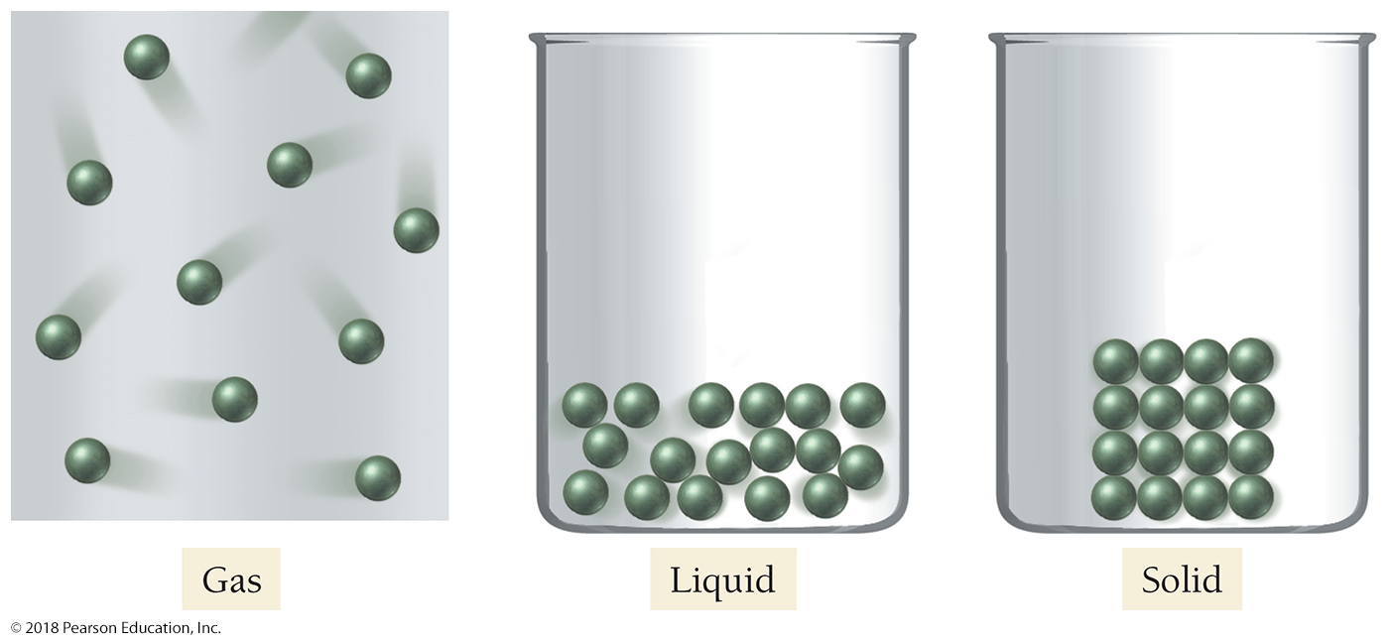
Gas, Liquid, and Solid States

Slide 7
Properties of Gases Recall from Chapter 11
• Gases have low densities in comparison to liquids and solids.
• Gases have indefinite shape; they assume the shape of their container.
• Gases have indefinite volume; they are easily compressed.
• Gases have weak intermolecular forces relative to thermal energy.
• Example: carbon dioxide gas (CO₂)

Slide 8
Properties of Liquids
• Liquids have high densities in comparison to gases.
• Liquids have indefinite shape; they assume the shape of their container.
• Liquids have definite volume; they are not easily compressed.
• Liquids have moderate intermolecular forces relative to thermal energy.
• Example: liquid water (H₂O)

Slide 9
Properties of Solids
• Solids have high densities in comparison to gases.
• Solids have definite shape; they do not assume the shape of their container.
• Solids have definite volume; they are not easily compressed.
• Solids have strong intermolecular forces relative to thermal energy.
• Example: sugar (C₁₂H₂₂O₁₁)
• Solids may be crystalline (ordered) or amorphous (disordered).

Slide 10
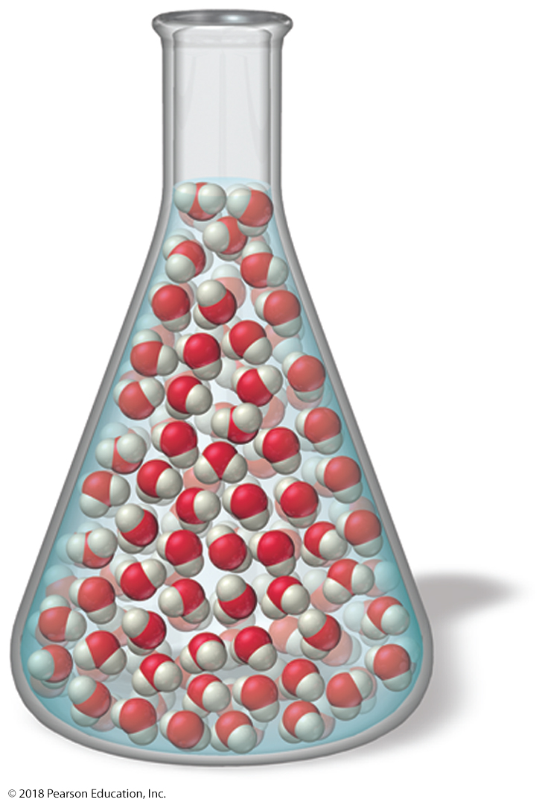
Shape of Liquids and Solids
Because the molecules in liquid water are free to move around each other, they flow and assume the shape of their container.

Slide 11
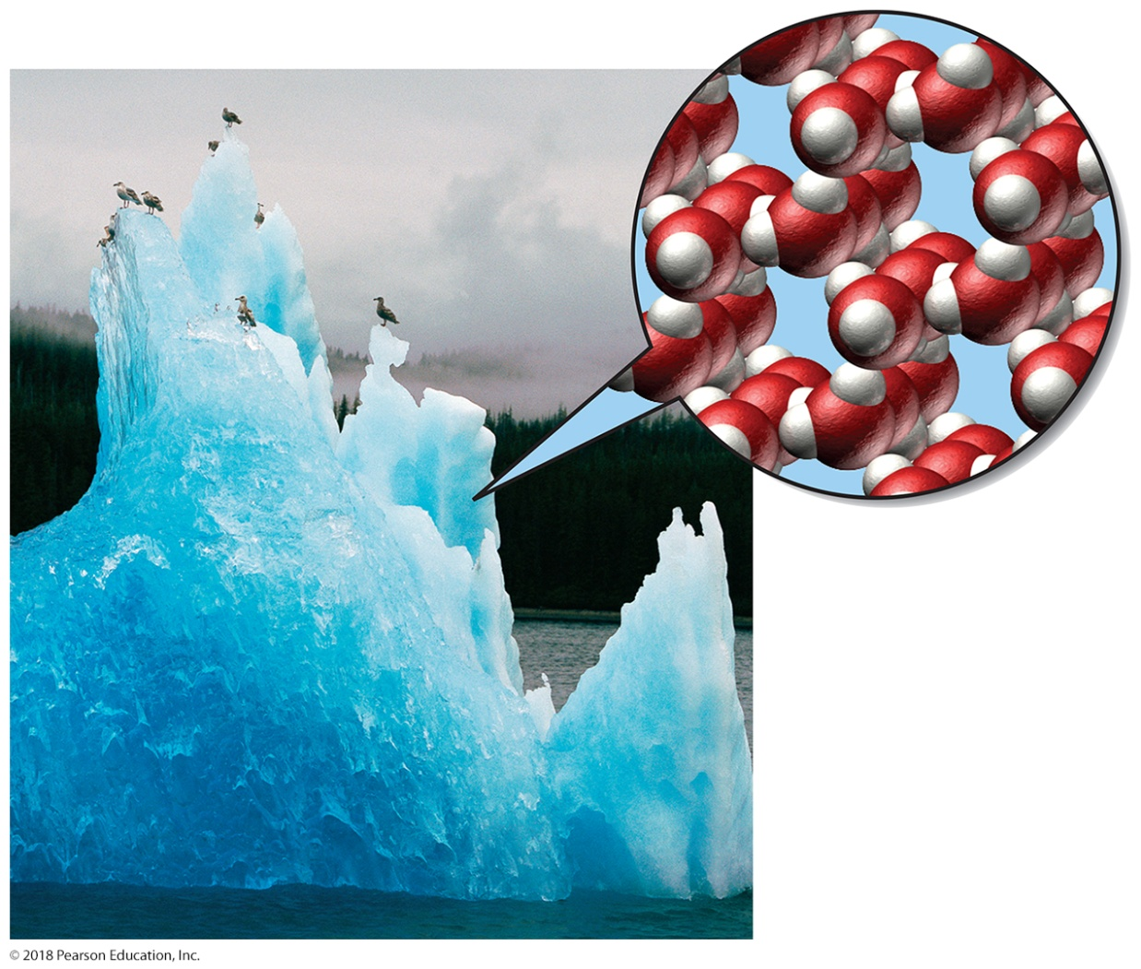
Shape of Liquids and Solids
In a solid such as ice, the molecules are fixed in place.
However, they do vibrate about those fixed points.

Slide 12
Intermolecular Forces in Action: Surface Tension and Viscosity
The most important manifestation of intermolecular forces is the very existence of liquids and solids.
Without intermolecular forces, solids and liquids would not exist and all matter would be gaseous.
In liquids, we can observe several other manifestations of intermolecular forces, including surface tension and viscosity.

Slide 13
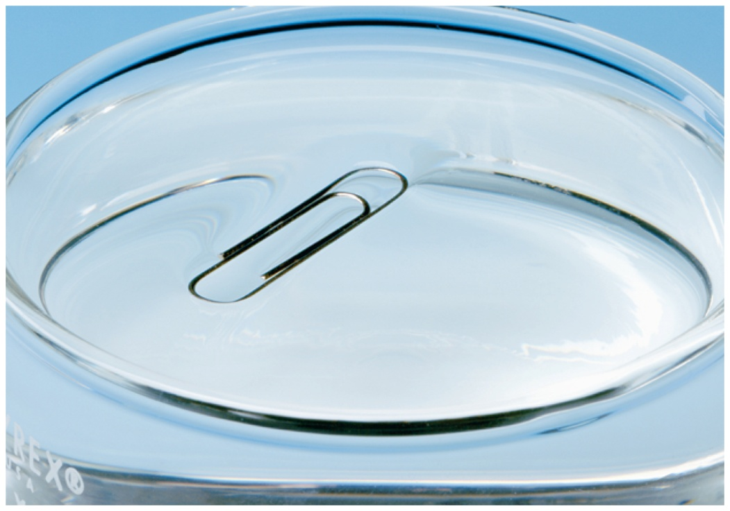
Surface Tension
A paper clip will float on water if it is carefully placed on the surface of the water. It is held up by surface tension.
You can’t float a paper clip on gasoline because the intermolecular forces among the molecules composing gasoline are weaker than the intermolecular forces among water molecules.

Slide 14
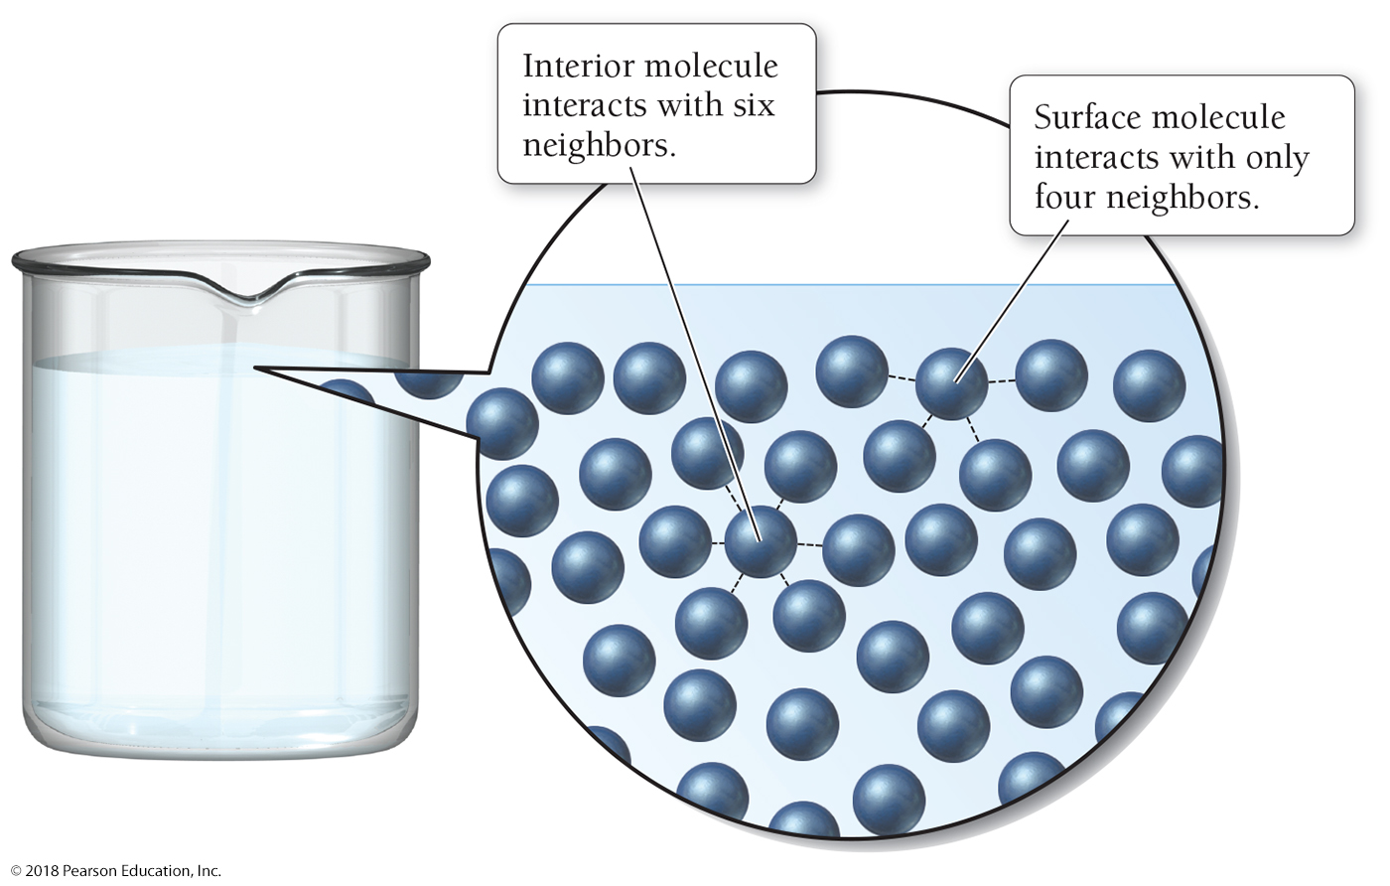
Figure 12.5 Origin of Surface Tension

Slide 15
Viscosity
Viscosity is the resistance of a liquid to flow.
Liquids that are viscous flow more slowly than liquids that are not viscous.
Motor oil is more viscous than gasoline.
Maple syrup is more viscous than water.
Viscosity is greater in substances with stronger intermolecular forces because molecules cannot move around each other as freely, hindering flow.
Long molecules, such as the hydrocarbons in motor oil, tend to form viscous liquids because of molecular entanglement.

Slide 16
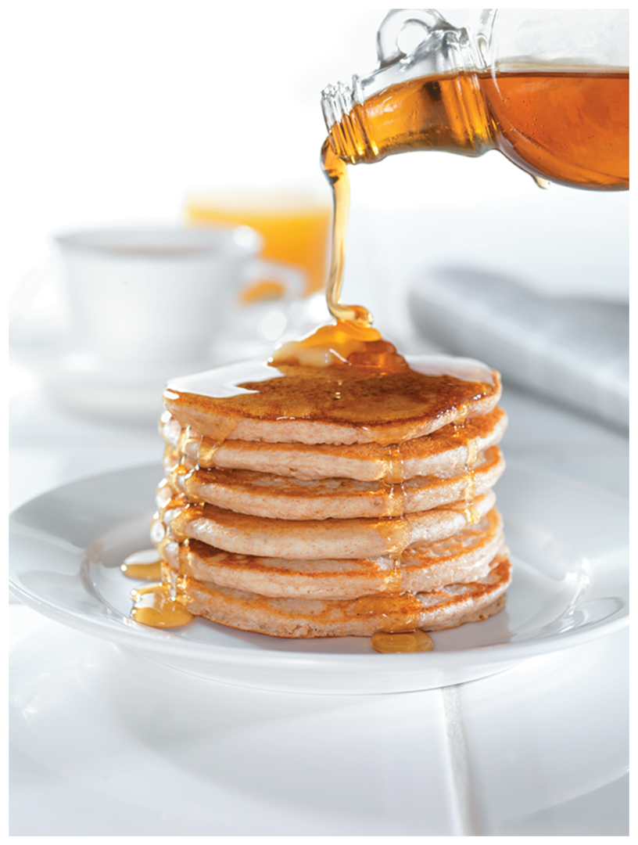
Viscosity
Maple syrup is more viscous than water because its molecules interact strongly, so they cannot flow past one another easily.

Slide 17
Evaporation, Condensation, and Thermal Energy
The rate of vaporization increases with the following:
• Increasing surface area
• Increasing temperature
• Decreasing strength of intermolecular forces
Liquids that evaporate easily are termed volatile, while those that do not vaporize easily are termed nonvolatile.

Slide 18
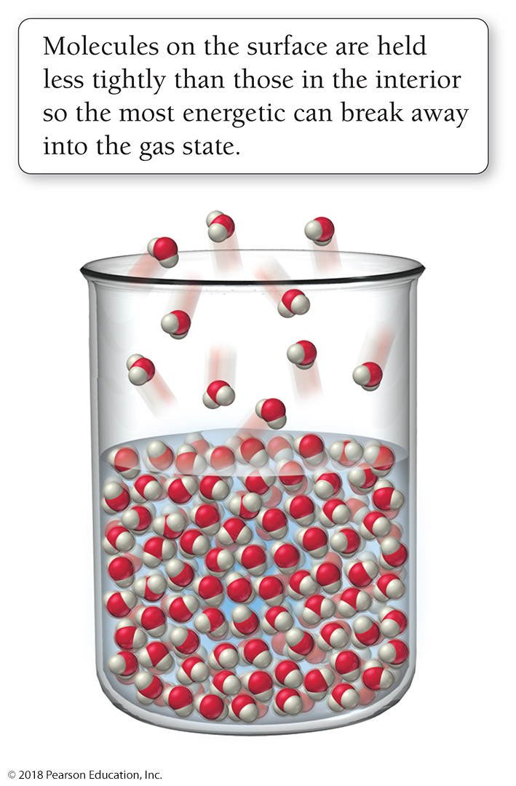
Evaporation
Because molecules on the surface of a liquid are held less tightly than those in the interior, the most energetic among them can break away into the gas state in the process called evaporation.
In evaporation or vaporization, a substance is converted from its liquid state into its gaseous state.

Slide 19
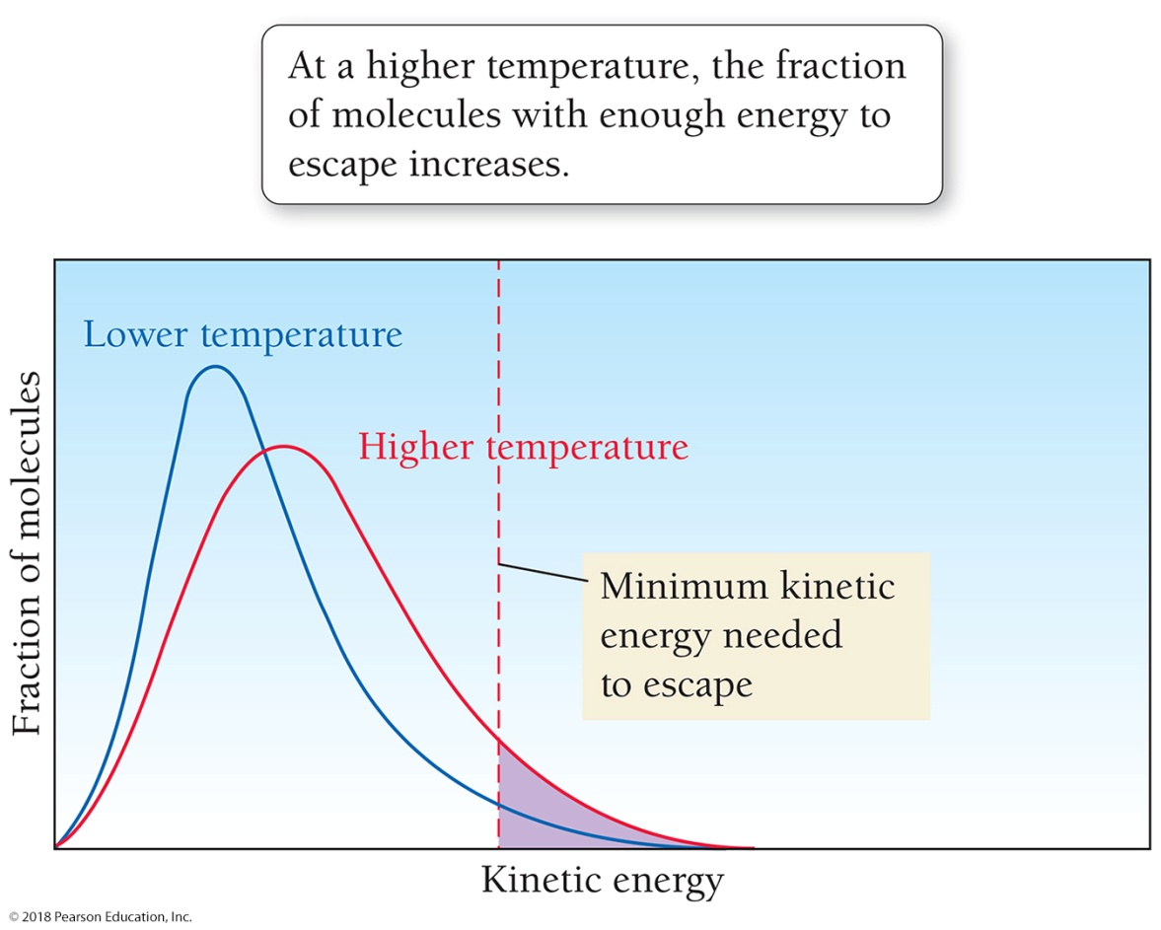
Evaporation, Condensation, and Thermal Energy
At a given temperature, a sample of molecules or atoms will have a distribution of kinetic energies.
Only a small fraction of molecules has enough energy to escape.
At a higher temperature, the fraction of molecules with enough energy to escape increases.

Slide 20
Evaporation and Condensation
Condensation is a physical change in which a substance is converted from its gaseous state to its liquid state.
Evaporation and condensation are opposites: Evaporation is a liquid turning into a gas, and condensation is a gas turning into a liquid.
At the point where the rates of condensation and evaporation become equal, dynamic equilibrium is reached and the number of gaseous water molecules above the liquid remains constant.
The vapor pressure of a liquid is the partial pressure of its vapor in dynamic equilibrium with its liquid.

Slide 21
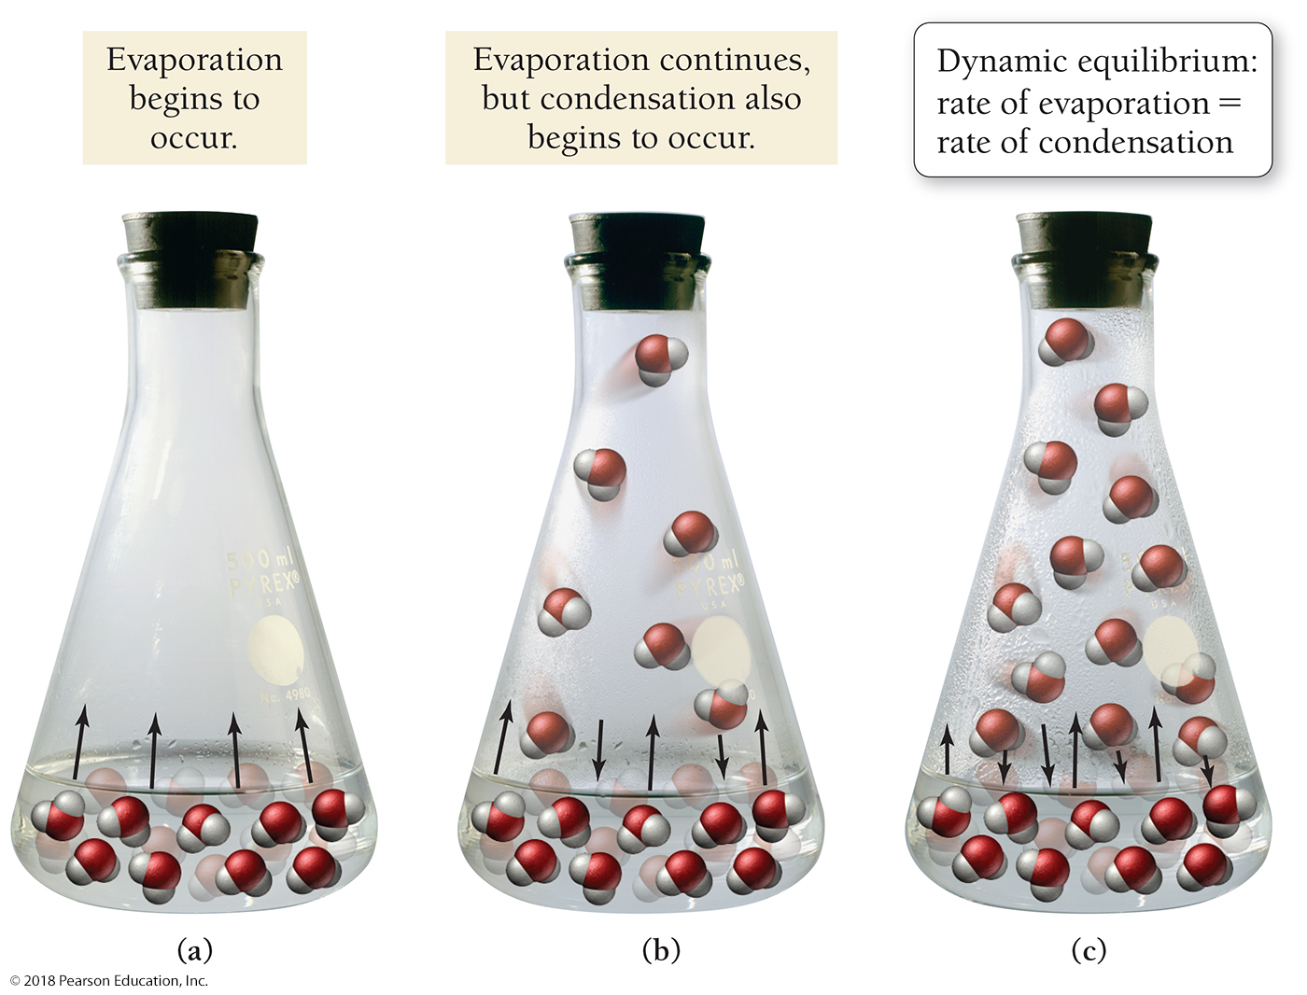
Evaporation and Condensation

Slide 22
Vapor Pressure
Vapor pressure increases with the following:
Increasing temperature
Decreasing strength of intermolecular forces
Vapor pressure is independent of surface area because an increase in surface area at equilibrium equally affects the rate of evaporation and the rate of condensation.

Slide 23
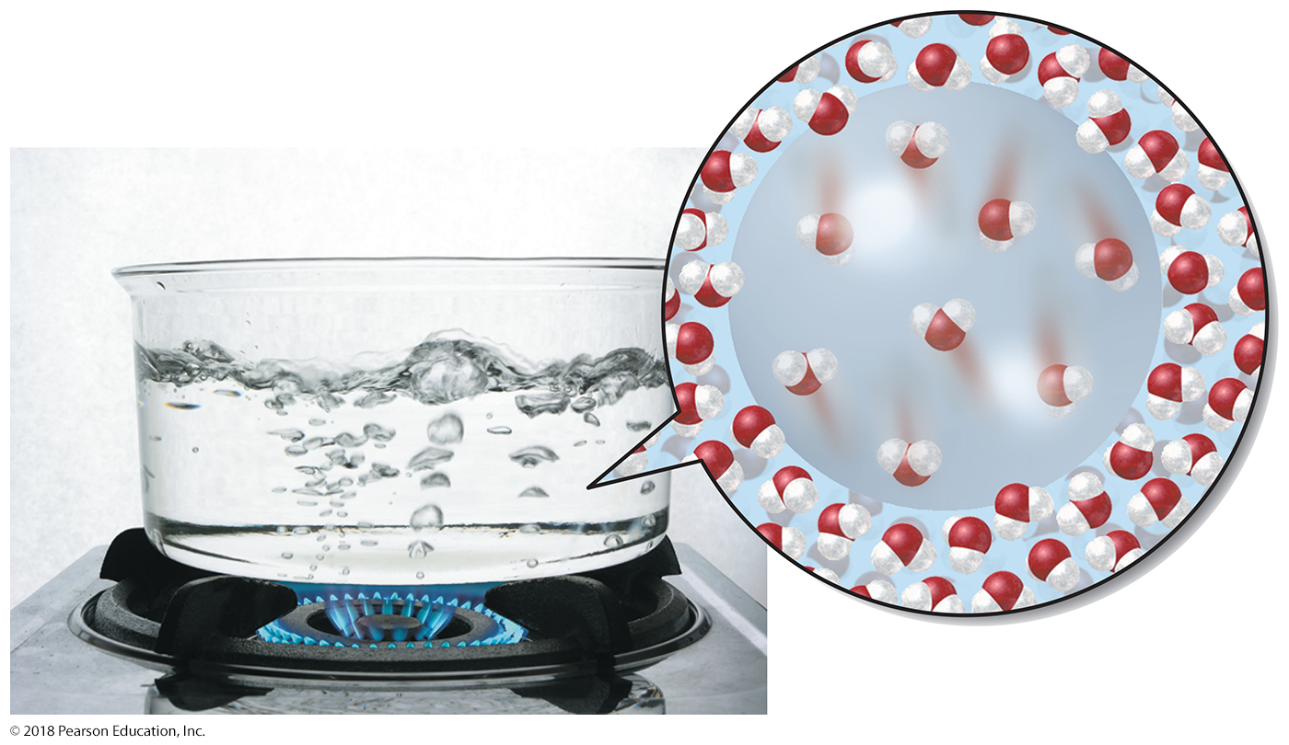
Boiling
During boiling, thermal energy is enough to cause water molecules in the interior of the liquid to become gaseous, forming bubbles containing gaseous water molecules.

Slide 24
Interpreting a Heating Curve
Once the boiling point of a liquid is reached, additional heating only causes more rapid boiling; it does not raise the temperature of the liquid above its boiling point.
A mixture of boiling water and steam will always have a temperature of 100 °C (at 1 atm pressure).
Only after all the water has been converted to steam can the temperature of the steam rise beyond 100 °C.

Slide 25
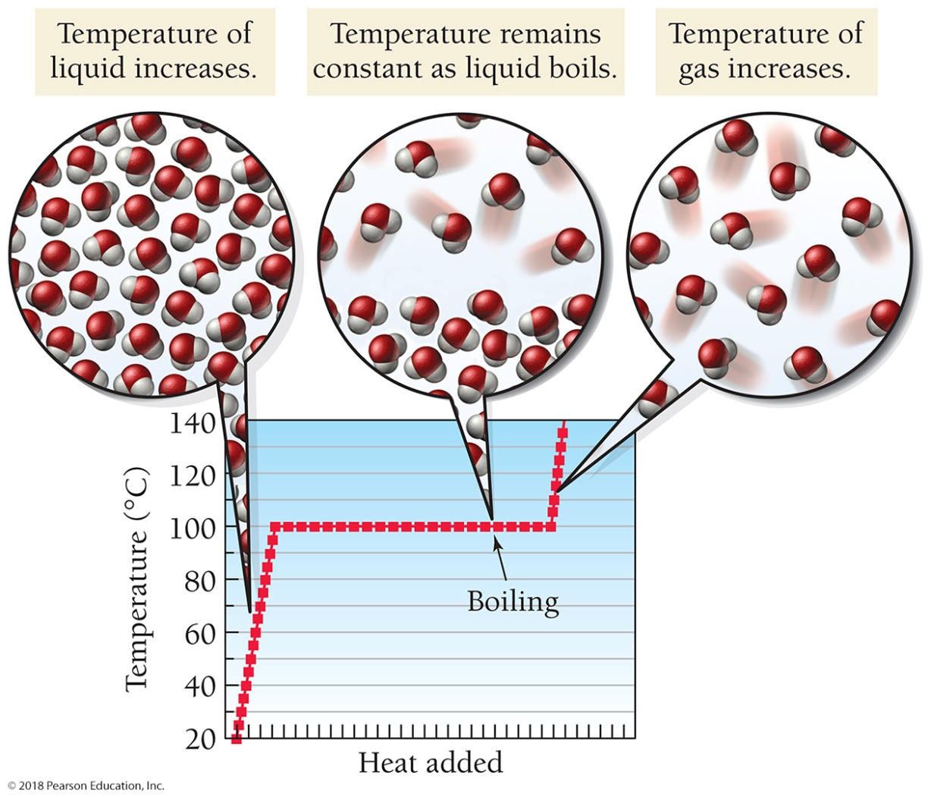
Heating Curve
The temperature of water as it is heated from room temperature through boiling
During boiling, the temperature remains at 100 °C until all the liquid is evaporated.

Slide 26
Energetics of Evaporation
Evaporation is endothermic—when a liquid is converted into a gas, it absorbs heat because energy is required to break molecules away from the rest of the liquid.
Our bodies use the endothermic nature of evaporation for cooling.
When we overheat, we sweat, causing our skin to be covered with liquid water.
As this water evaporates, it absorbs heat from our bodies, cooling us down.
High humidity slows down evaporation, preventing cooling. When the air already contains high amounts of water vapor, sweat does not evaporate as easily, making our cooling system less efficient.

Slide 27
Energetics of Condensation
Condensation, the opposite of evaporation, is exothermic—heat is released when a gas condenses to a liquid.
As steam condenses to a liquid on your skin, it releases heat, causing a severe burn.
The exothermic nature of condensation is also the reason that winter overnight temperatures in coastal cities, which tend to have water vapor in the air, do not get as low as those in deserts, which tend to have dry air.
As the air temperature in a coastal city drops, water condenses out of the air, releasing heat and preventing the temperature from dropping further.
In deserts, there is little moisture in the air to condense, so the temperature drop is greater.

Slide 28
Heat of Vaporization
The amount of heat required to vaporize 1 mol of liquid is the heat of vaporization (ΔH_{vap}).
The heat of vaporization of water at its normal boiling point (100 °C) is 40.7 kJ/mol.
ΔH_{vap} is positive because vaporization is endothermic; energy must be added to the water to vaporize it.
The same amount of heat is involved when 1 mol of gas condenses, but the heat is emitted rather than absorbed.
Δh_{vap} is negative because condensation is exothermic; energy is given off as the water condenses.

Slide 29
Heat of Vaporization of Water

Slide 30
Heats of Vaporization
Use the heat of vaporization of a liquid to calculate the amount of heat energy required to vaporize a given amount of that liquid.
Use the heat of vaporization as a conversion factor between moles of the liquid and the amount of heat required to vaporize it.

Slide 31
Example 12.1 Using the Heat of Vaporization in Calculations
Calculate the amount of water in grams that can be vaporized at its boiling point with 155 kJ of heat.
SORT You are given the number of kilojoules of heat energy and asked to find the mass of water that can be vaporized with the given amount of energy.
GIVEN 155 kJ
FIND g H₂O
STRATEGIZE Draw the solution map beginning with the energy in kilojoules and converting to moles of water and then to grams of water.
SOLUTION MAP
RELATIONSHIPS USED
ΔH_{vap} = 40.7 kJ/mol at 100 °C (Table 12.2)
18.02 g H₂O = 1 mol H₂O (molar mass of water)
SOLVE Follow the solution map to solve the problem.

Slide 32
Example 12.1 Using the Heat of Vaporization in Calculations
Continued
SOLUTION
CHECK Check your answer. Are the units correct? Does the answer make physical sense?
The units (g) are correct. The magnitude of the answer makes sense because each mole of water absorbs about 40 kJ of energy upon vaporization. Therefore 155 kJ should vaporize close to 4 mol of water, which is consistent with the answer (4 mol of water has a mass of about 72 g).
Skillbuilder 12.1 | Using the Heat of Vaporization in Calculations
Calculate the amount of heat in kilojoules required to vaporize 2.58 kg of water at its boiling point.
Skillbuilder Plus
A drop of water weighing 0.48 g condenses on the surface of a 55-g block of aluminum that is initially at 25 °C. If the heat released during condensation goes only toward heating the metal, what is the final temperature in Celsius of the metal block? (The specific heat capacity of aluminum is listed in Table 3.4 and is 0.903 J/g °C. Use 40.7 kJ/mol as the heat of vaporization of water.)
For More Practice
Example 12.7; Problems 49, 50, 51, 52, 53, 54.

Slide 33
Melting and Freezing
As the temperature of a solid increases, thermal energy causes the molecules and atoms composing the solid to vibrate faster.
At the melting point, atoms and molecules have enough thermal energy to overcome the intermolecular forces that hold them at their stationary points, and the solid turns into a liquid.

Slide 34
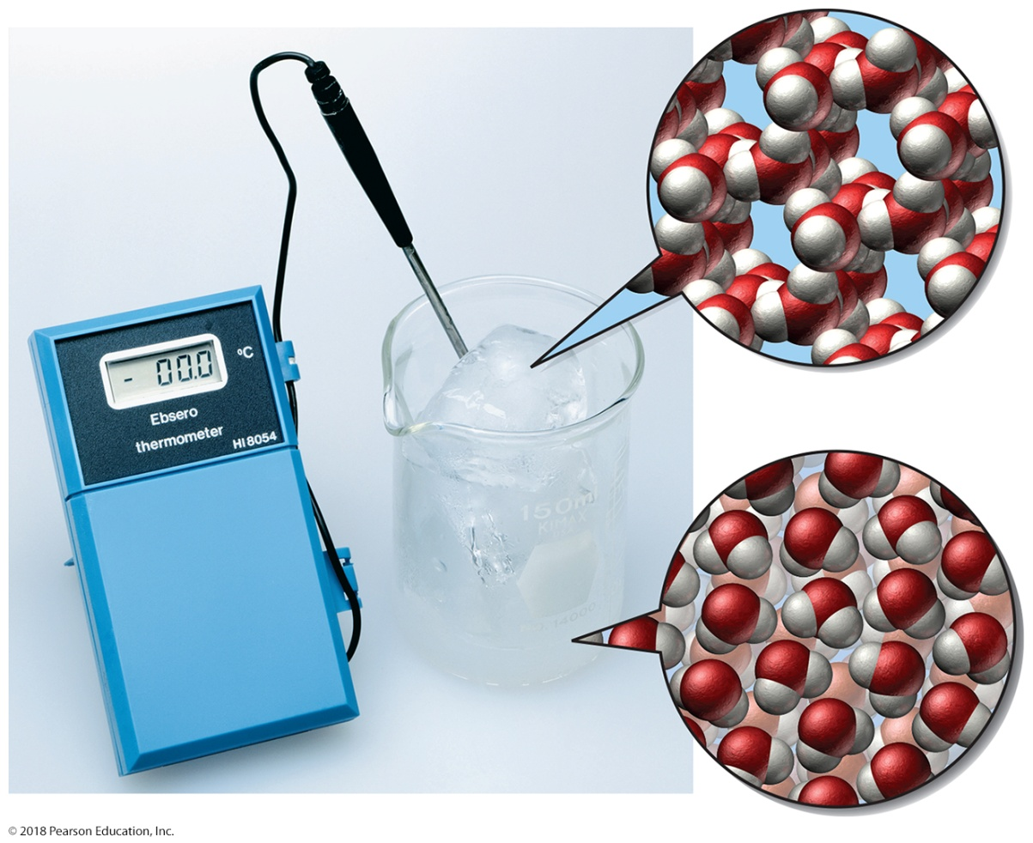
Melting and Freezing
When ice melts, water molecules break free from the solid structure and become liquid.
As long as ice and water are both present, the temperature will be 0 °C.

Slide 35
Interpreting a Heating Curve
A mixture of water and ice will always have a temperature of 0 °C (at 1 atm pressure).
Only after all of the ice has melted will additional heating raise the temperature of the liquid water past 0 °C.

Slide 36
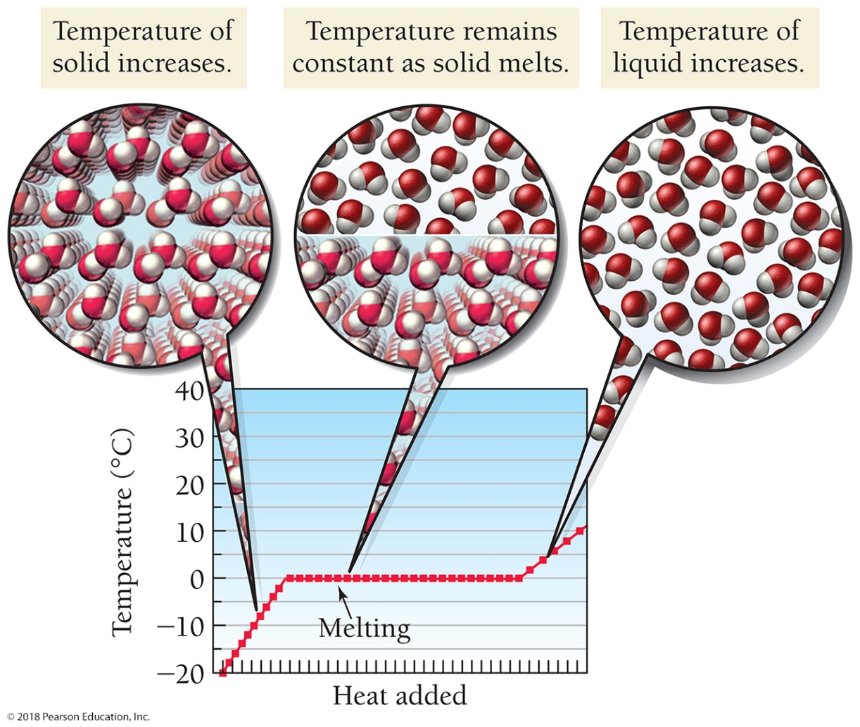
Heating Curve
A graph of the temperature of ice as it is heated from −20 °C to 35 °C
During melting, the temperature of the solid and the liquid remains at 0 °C until the entire solid is melted.

Slide 37
Energetics of Melting and Freezing
A way to cool down a drink is to drop several ice cubes into it.
As the ice melts, the drink cools because melting is endothermic—heat is absorbed when a solid is converted into a liquid. The melting ice absorbs heat from the liquid in the drink and cools the liquid.
Melting is endothermic because energy is required to partially overcome the attractions between molecules in the solid and free them into the liquid state.
Freezing is exothermic—heat is released when a liquid freezes into a solid.
As water in your freezer turns into ice, it releases heat, which must be removed by the refrigeration system of the freezer.
If the refrigeration system did not remove the heat, the heat released would warm the freezer, preventing further freezing.

Slide 38
Heat of Fusion
The amount of heat required to melt 1 mol of a solid is the heat of fusion (ΔH_{fus}).
The heat of fusion for water is 6.02 kJ/mol.
ΔH_{fus} is positive because melting is endothermic; energy must be added to the ice to melt it.
The same amount of heat is involved when 1 mol of liquid water freezes, but the heat is emitted rather than absorbed.
ΔH_{fus} is negative because freezing is exothermic; energy is given off as the water freezes.

Slide 39
Heat of Fusion of Water

Slide 40
Use the heat of fusion to calculate the amount of heat energy required to melt a given amount of a solid.
Use the heat of fusion as a conversion factor between moles of a solid and the amount of heat required to melt them.

Slide 41
Example 12.2 Using the Heat of Fusion in Calculations
Calculate the amount of ice in grams that, upon melting (at 0 °C), absorbs 237 kJ of heat.
SORT You are given the number of kilojoules of heat energy and asked to find the mass of ice that absorbs the given amount of energy upon melting.
GIVEN 237 kJ
FIND g H₂O (ice)
STRATEGIZE Draw the solution map beginning with the energy in kilojoules and converting to moles of water and then to grams of water.
SOLUTION MAP
RELATIONSHIPS USED
ΔH_{fus} = 6.02 kJ/mol (Table 12.3)
1 mol H₂O = 18.02 g H₂O (molar mass of water)
SOLVE Follow the solution map to solve the problem.

Slide 42
Example 12.2 Using the Heat of Fusion in Calculations
Continued
SOLUTION
CHECK Check your answer. Are the units correct? Does the answer make physical sense?
The units (g) are correct. The magnitude of the answer makes sense because each mole of water absorbs about 6 kJ of energy upon melting. Therefore, 237 kJ should melt close to 40 mol of water, which is consistent with the answer (40 mol of water has a mass of about 720 g).
Skillbuilder 12.2 | Using the Heat of Fusion in Calculations
Calculate the amount of heat absorbed when a 15.5-g ice cube melts (at 0 °C).
Skillbuilder Plus
A 5.6-g ice cube (at 0 °C) is placed into 195 g of water initially at 25 °C. If the heat absorbed for melting the ice comes only from the 195 g of water, what is the temperature change of the 195 g of water?
For More Practice
Example 12.8; Problems 57, 58, 59, 60.

Slide 43
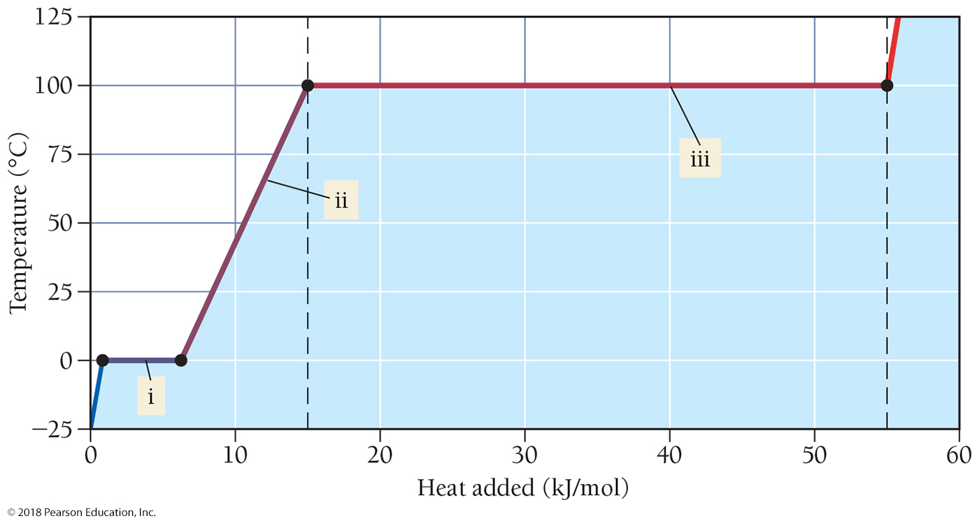
A Heating Curve for Ice
The diagram shows a heating curve for ice beginning at –25 °C and ending at 125 °C. Correlate sections i, ii, and iii with the correct states of water.

Slide 44
Sublimation
Sublimation is a physical change in which a substance changes from its solid state directly to its gaseous state.
When a substance sublimes, molecules leave the surface of the solid, where they are held less tightly than in the interior, and become gaseous.
Dry ice, which is solid carbon dioxide, does not melt under atmospheric pressure (at any temperature).
At −78 °C, the CO₂ molecules have enough energy to leave the surface of the dry ice and become gaseous.

Slide 45
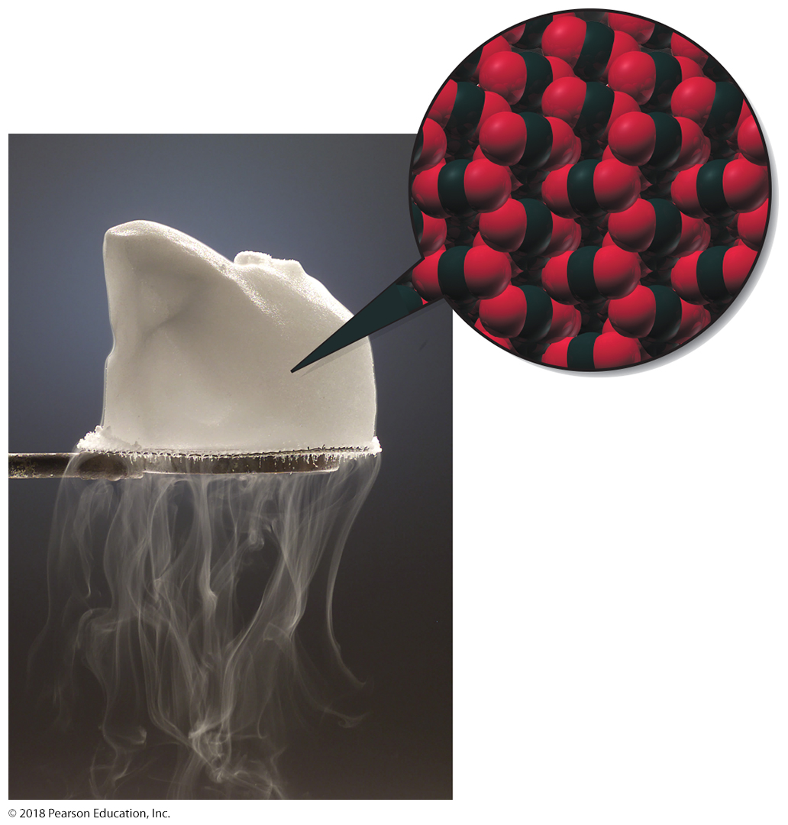
Sublimation
Dry ice is solid carbon dioxide. The solid does not melt but rather sublimes. It transforms directly from solid carbon dioxide to gaseous carbon dioxide.

Slide 46
Sublimation
Regular ice will slowly sublime at temperatures below 0 °C.
In cold climates, ice or snow lying on the ground gradually disappears, even if the temperature remains below 0 °C.
Similarly, ice cubes left in the freezer for a long time slowly become smaller, even though the freezer is always below 0 °C.

Slide 47
Sublimation
Ice sublimes out of frozen foods.
You can see this in food that has been frozen in an airtight plastic bag for a long time.
The ice crystals that form in the bag are water that has sublimed out of the food and redeposited on the surface of the bag.
Food that remains frozen for too long becomes dried out.
This can be avoided by freezing foods to colder temperatures (further below 0 °C), a process called deep-freezing.
The colder temperature lowers the rate of sublimation and preserves the food longer.

Slide 48
Types of Intermolecular Forces: Dispersion, Dipole–Dipole, and Hydrogen Bonding
The strength of the intermolecular forces between the molecules or atoms that compose a substance determines the state—solid, liquid, or gas—of the substance at room temperature.
Strong intermolecular forces tend to result in liquids and solids (with high melting and boiling points).
Weak intermolecular forces tend to result in gases (with low melting and boiling points).
Here we focus on three fundamental types of intermolecular forces.
In order of increasing strength, they are the dispersion force, the dipole–dipole force, and the hydrogen bond.

Slide 49
Dispersion Forces
The default intermolecular force, present in all molecules and atoms, is the dispersion force (also called the London force).
Dispersion forces are caused by fluctuations in the electron distribution within molecules or atoms.
Since all atoms and molecules have electrons, they all have dispersion forces.
The electrons in an atom or molecule may, at any one instant, be unevenly distributed.

Slide 50
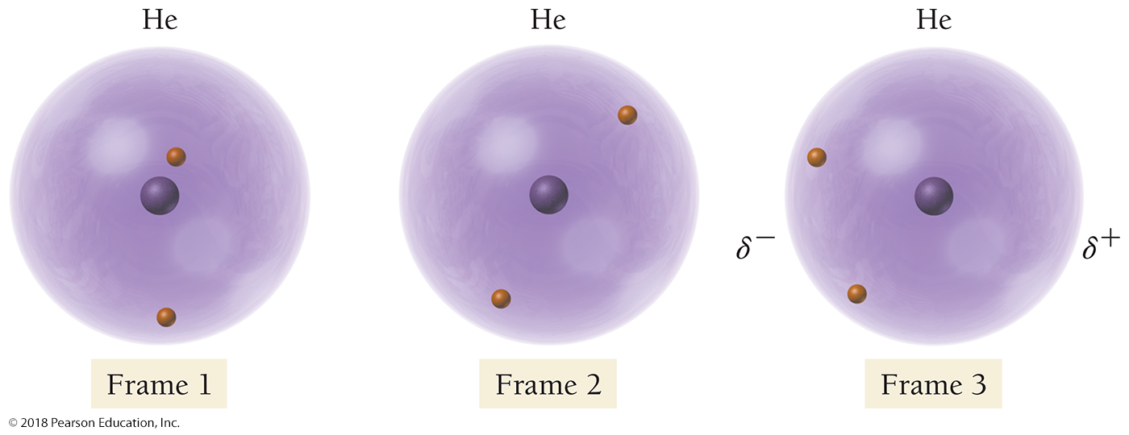
Instantaneous Dipoles
Random fluctuations in the electron distribution of a helium atom cause instantaneous dipoles to form.

Slide 51
Dispersion Forces
The nature of dispersion forces was first recognized by Fritz W. London (1900–1954), a German-American physicist.
This fleeting charge separation is called an instantaneous dipole (or temporary dipole).
An instantaneous dipole on one helium atom induces an instantaneous dipole on its neighboring atoms because the positive end of the instantaneous dipole attracts electrons in the neighboring atoms.
The dispersion force occurs as neighboring atoms attract one another—the positive end of one instantaneous dipole attracts the negative end of another.
The dipoles responsible for the dispersion force are transient, constantly appearing and disappearing in response to fluctuations in electron clouds.

Slide 52
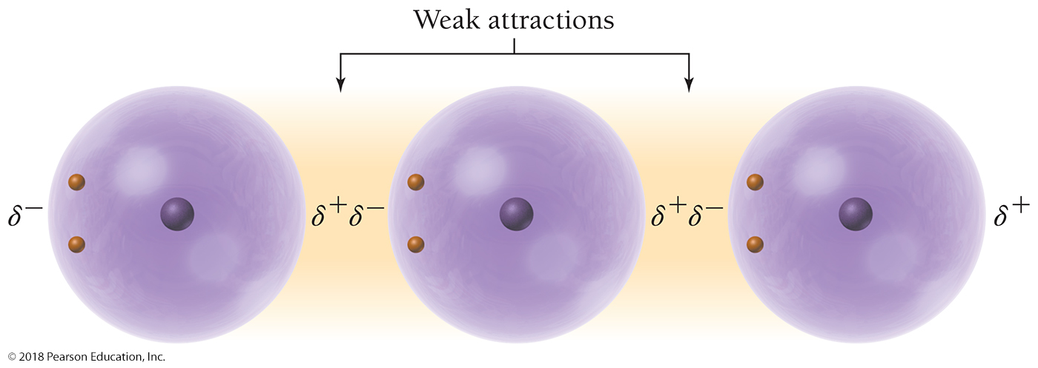
Dispersion Forces
An instantaneous dipole on any one helium atom induces instantaneous dipoles on neighboring atoms. The neighboring atoms then attract one another. This attraction is called the dispersion force.

Slide 53
Dispersion Forces
The magnitude of the dispersion force depends on how easily the electrons in the atom or molecule can polarize in response to an instantaneous dipole, which depends on the size of the electron cloud.
To polarize means to form a dipole moment.
A larger electron cloud results in a greater dispersion force because the electrons are held less tightly by the nucleus and therefore can polarize more easily.
While molar mass alone does not determine the magnitude of the dispersion force, it can be used as a guide when comparing dispersion forces within a family of similar elements or compounds.

Slide 54
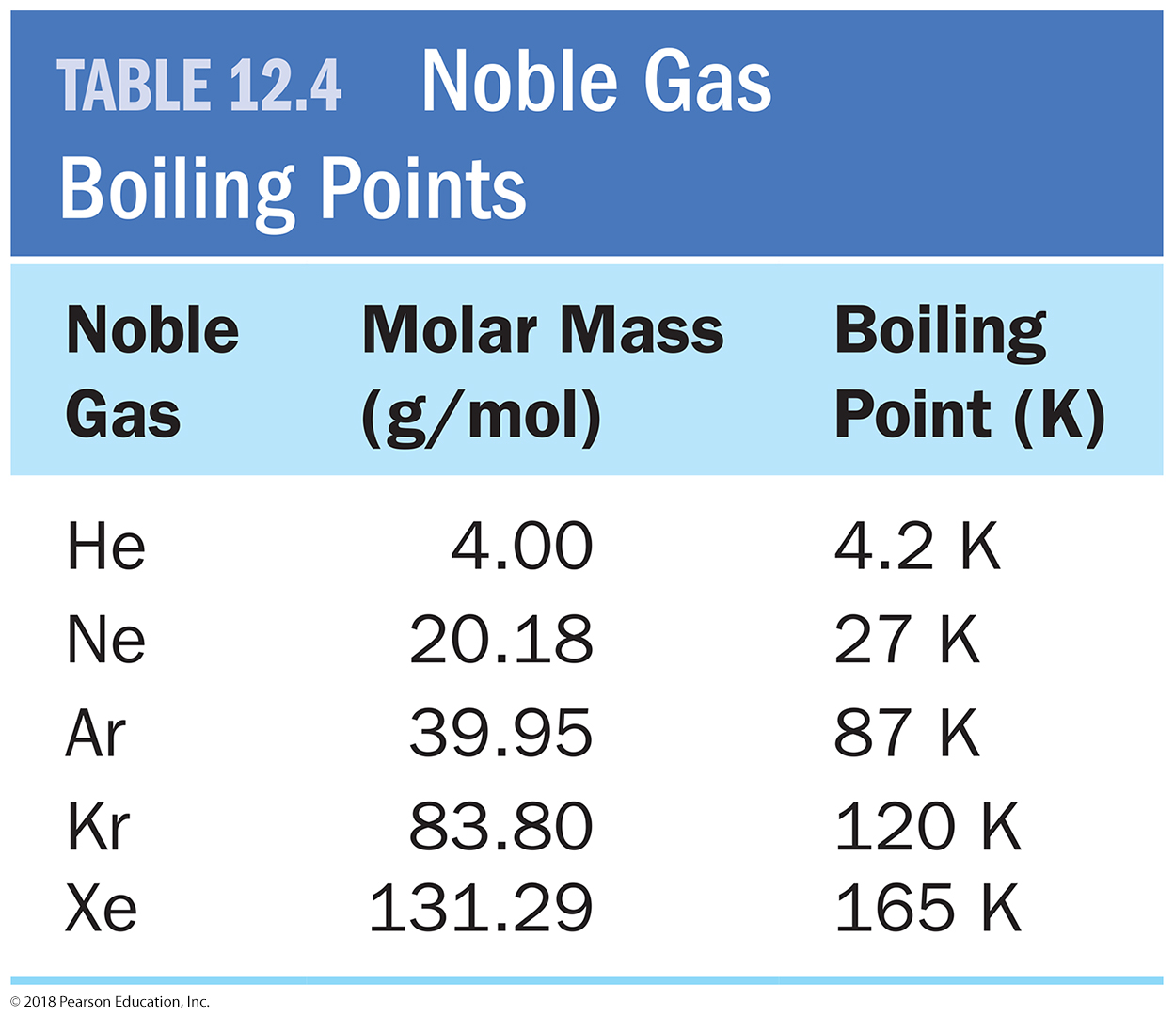
Effect of Differences in Dispersion Forces on Boiling Points of the Noble Gases

Slide 55
Dipole–Dipole Force
The dipole–dipole force exists in all polar molecules.
Polar molecules have permanent dipoles that interact with the permanent dipoles of neighboring molecules.
The positive end of one permanent dipole is attracted to the negative end of another; this attraction is the dipole–dipole force.
Remember that all molecules (including polar ones) have dispersion forces.
In addition, polar molecules have dipole–dipole forces.
These additional attractive forces raise their melting and boiling points relative to nonpolar molecules of similar molar mass.

Slide 56
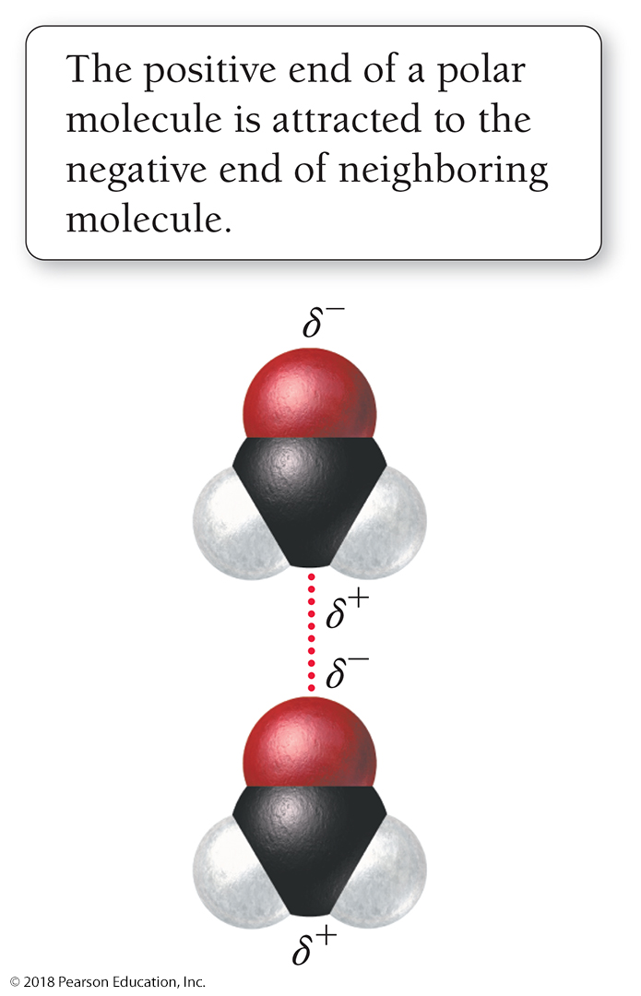
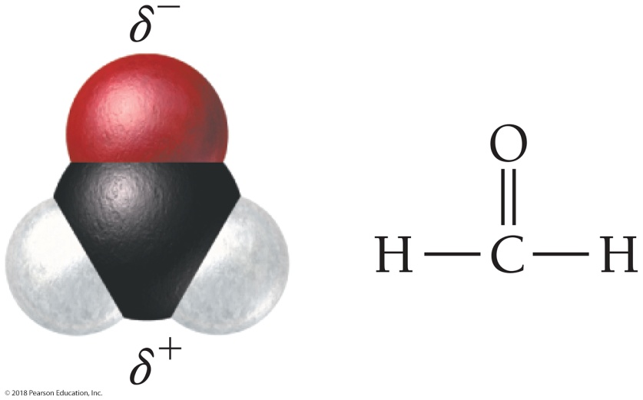
Permanent Dipoles
Molecules such as formaldehyde are polar and therefore have a permanent dipole.
The positive end of a polar molecule is attracted to the negative end of its neighbor, giving rise to the dipole–dipole force.

Slide 57
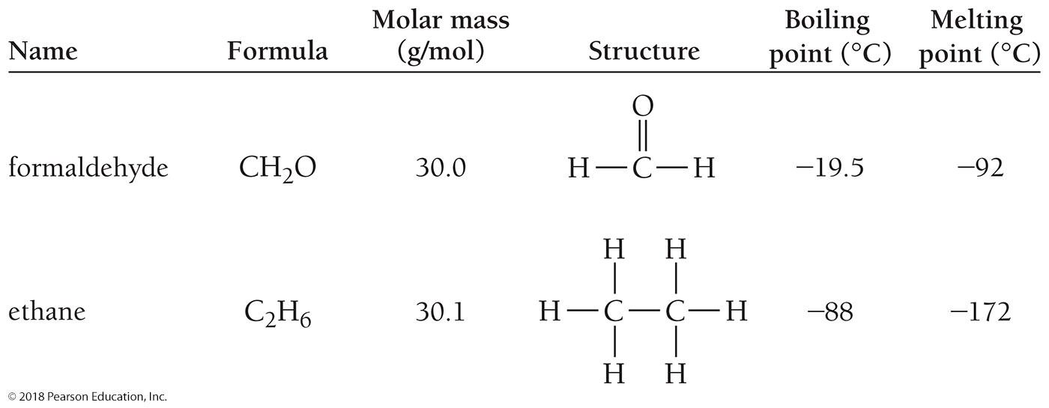
Effect of Difference in Polarity on Melting and Boiling Points for Two Compounds of Similar Molar Mass

Slide 58
Miscibility—a Liquid’s Ability to Mix with Another Liquid without Separating into Two Phases
In general, polar liquids are miscible with other polar liquids but are not miscible with nonpolar liquids.
For example, water, a polar liquid, is not miscible with pentane (C₅H₁₂), a nonpolar liquid. Similarly, water and oil (also nonpolar) do not mix.
Consequently, oily hands or oily stains on clothes cannot be washed away with plain water.

Slide 59
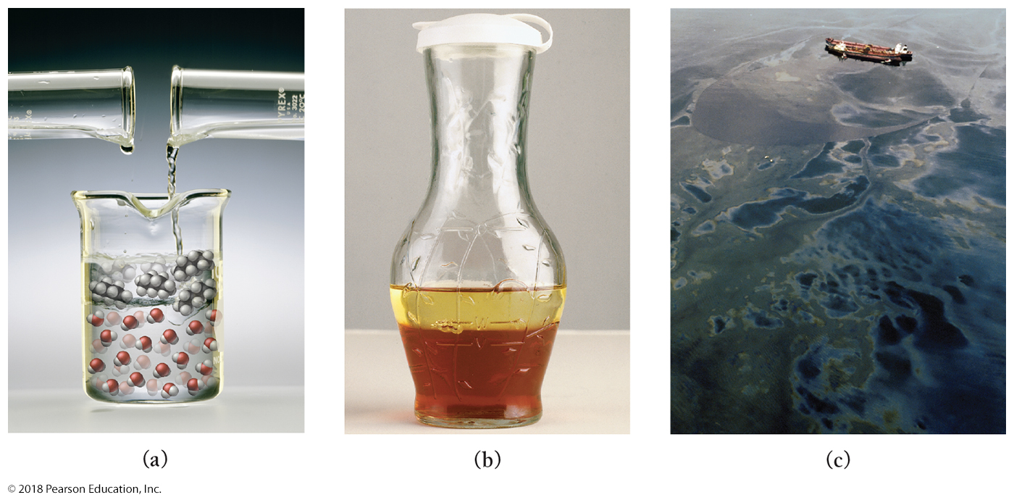
Polar and Nonpolar Compounds Are Not Miscible
(a) Pentane does not mix with water. (b) The oil and vinegar in salad dressing separate into distinct layers. (c) An oil spill from a tanker demonstrates that petroleum and seawater are not miscible.

Slide 60
A Molecule Has Dipole–Dipole Forces if It Is Polar
To determine whether a molecule is polar, you must:
1. determine whether the molecule contains polar bonds;
2. determine whether the polar bonds add together to form a net dipole moment.

Slide 61
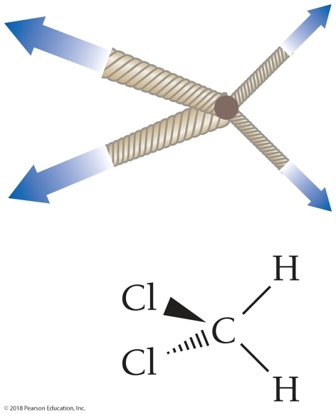
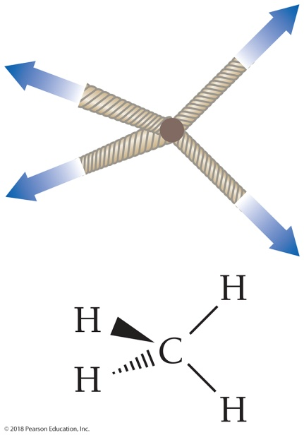
To Determine if a Molecule Is Polar
Check electronegativity differences to determine bond polarity.
CO₂ has polar bonds.
(2.5, 3.5) CO₂ is linear.
CH₂Cl₂ has polar bonds.
(2.5, 2.1, 3.5) CH₂Cl₂ is tetrahedral. C — Cl bonds are more polar than C — H bonds.
CH₄ has nearly nonpolar bonds. (2.5, 2.1) CH₄ is tetrahedral.

Slide 62
Hydrogen Bonding
Polar molecules containing hydrogen atoms bonded directly to fluorine, oxygen, or nitrogen exhibit an additional intermolecular force called a hydrogen bond.
HF, NH₃, and H₂O all undergo hydrogen bonding.
A hydrogen bond is a sort of super dipole–dipole force.
Factors:
A large electronegativity difference between hydrogen and these electronegative elements (F, O, N)
Small size of these atoms allows neighboring molecules to get very close to each other.
Result: A strong attraction between the hydrogen in each of these molecules and the F, O, or N on neighboring molecules.

Slide 63
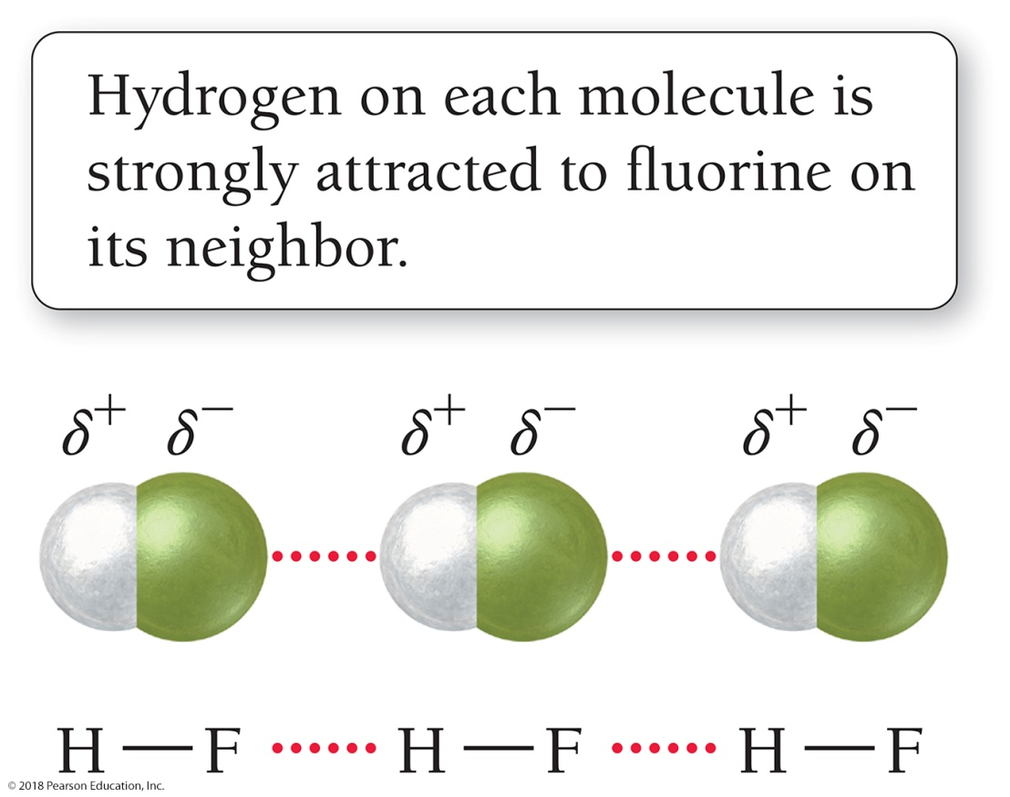
The Intermolecular Attraction of a Hydrogen Atom to an Electronegative Atom is Called a Hydrogen Bond
In HF, the hydrogen on each molecule is strongly attracted to the fluorine on its neighbor.

Slide 64
Hydrogen Bonding in Methanol
Since methanol contains hydrogen atoms directly bonded to oxygen, methanol molecules form hydrogen bonds to one another.
The hydrogen atom on each methanol molecule is attracted to the oxygen atom of its neighbor.

Slide 65
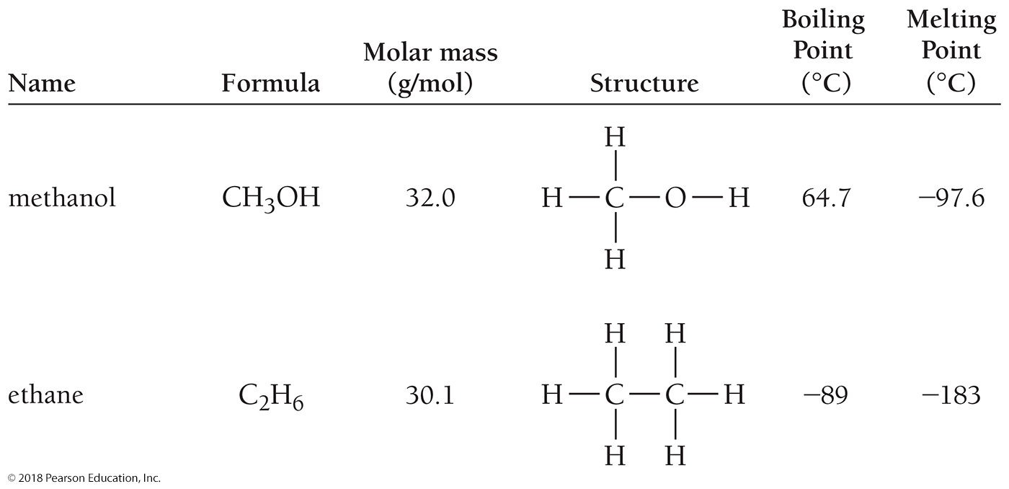
Effect of Hydrogen Bonding on Melting and Boiling Points for Two Compounds of Similar Molar Mass

Slide 66
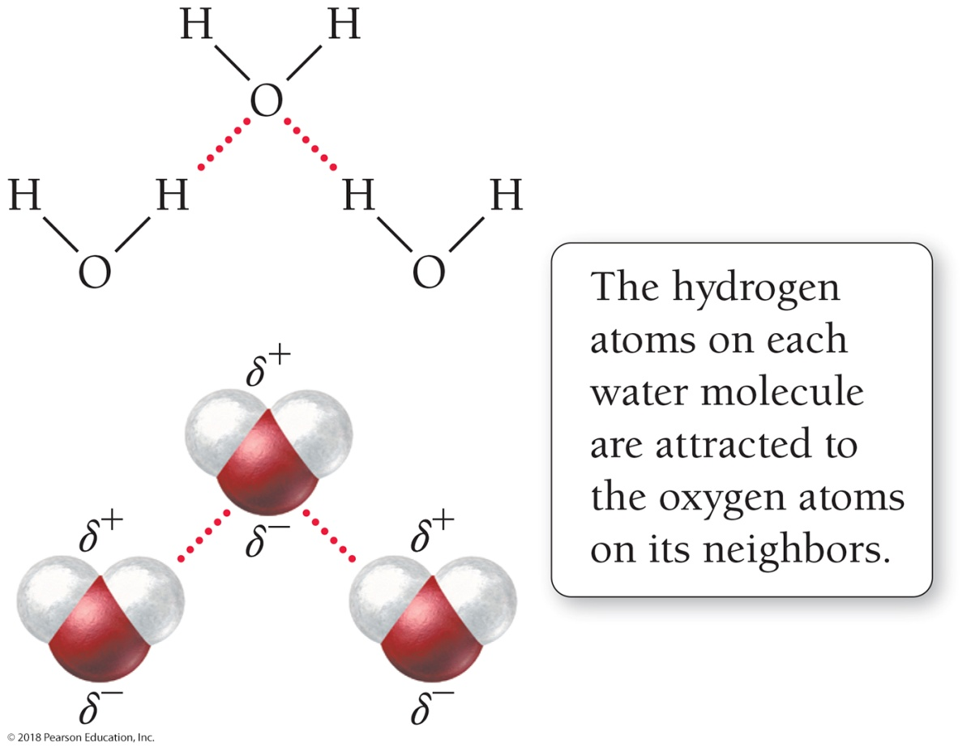
Hydrogen Bonding in Water
Water molecules form strong hydrogen bonds with one another.
The boiling point of water (100 °C) is remarkably high for a molecule with such a low molar mass (18.02 g/mol).

Slide 67
Ion–Dipole Forces
Ion–dipole forces exist between Na⁺ and the negative ends of H₂O molecules and between Cl– and the positive ends of H₂O molecules.

Slide 68
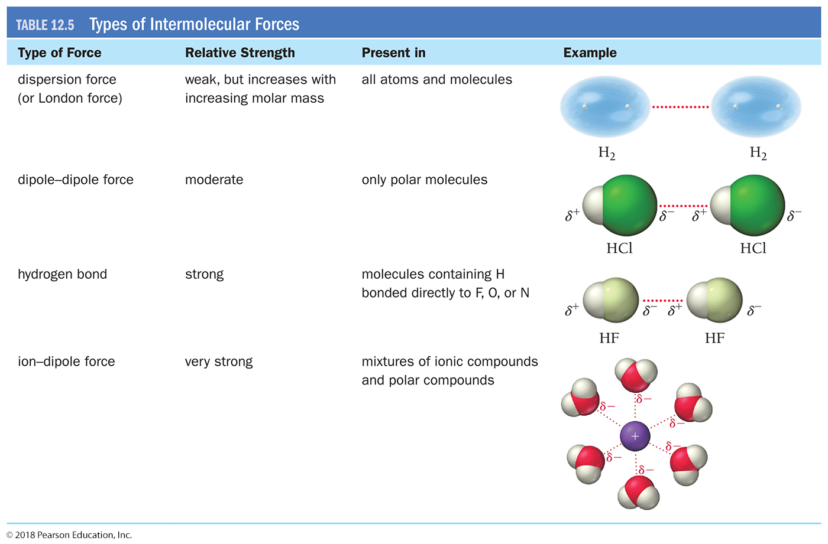
Table 12.5 Types of Intermolecular Forces

Slide 69
Chemistry and Health: Hydrogen Bonding in DNA
A DNA molecule is composed of thousands of repeating units called nucleotides.
Each nucleotide contains a base: adenine, thymine, cytosine, or guanine (abbreviated A, T, C, and G).
The order of these bases along DNA encodes the instructions that specify how proteins are made in each cell of the body.
DNA consists of two complementary strands wrapped around each other in the now-famous double helix.
Each strand is held to the other by hydrogen bonds that occur between the bases on each strand.

Slide 70
Chemistry and Health: Hydrogen Bonding in DNA
DNA replicates because each base (A, T, C, and G) has a complementary partner with which it hydrogen-bonds.
Adenine (A) hydrogen-bonds with thymine (T).
Cytosine (C) hydrogen-bonds with guanine (G).
The hydrogen bonds are so specific that each base will pair only with its complementary partner.

Slide 71
Chemistry and Health: Hydrogen Bonding in DNA
When a cell is going to divide, the DNA unzips across the hydrogen bonds that run along its length.
New bases, complementary to the bases in each half, add along each of the halves, forming hydrogen bonds with their complement.
The result is two identical copies of the original DNA.

Slide 72
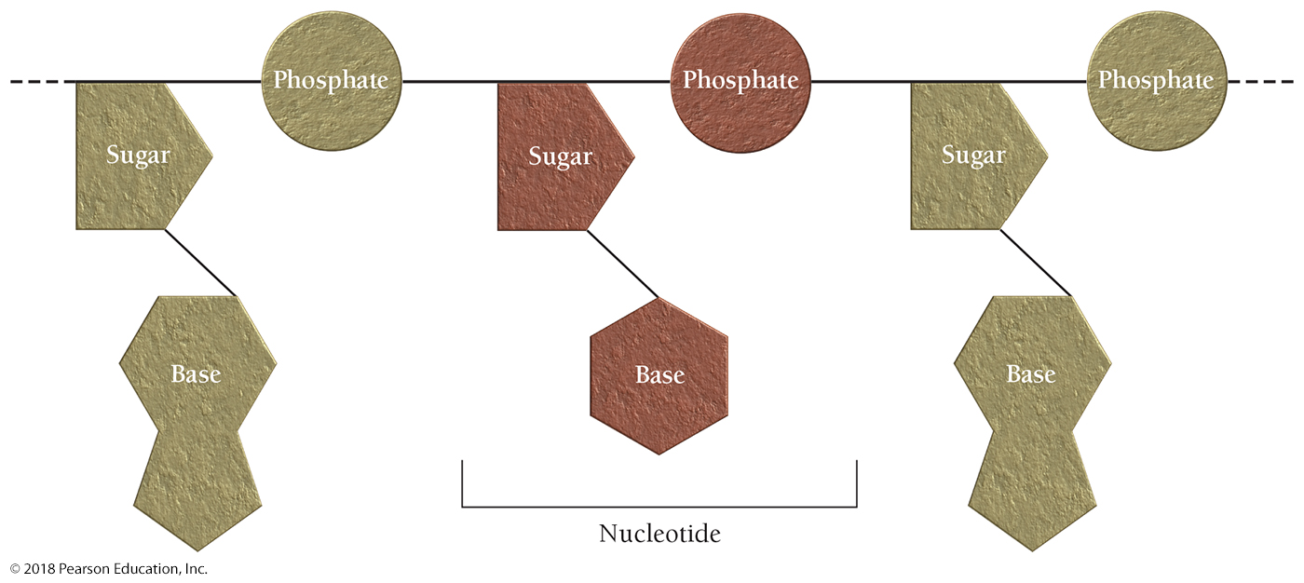
Structure of DNA Nucleotides

Slide 73
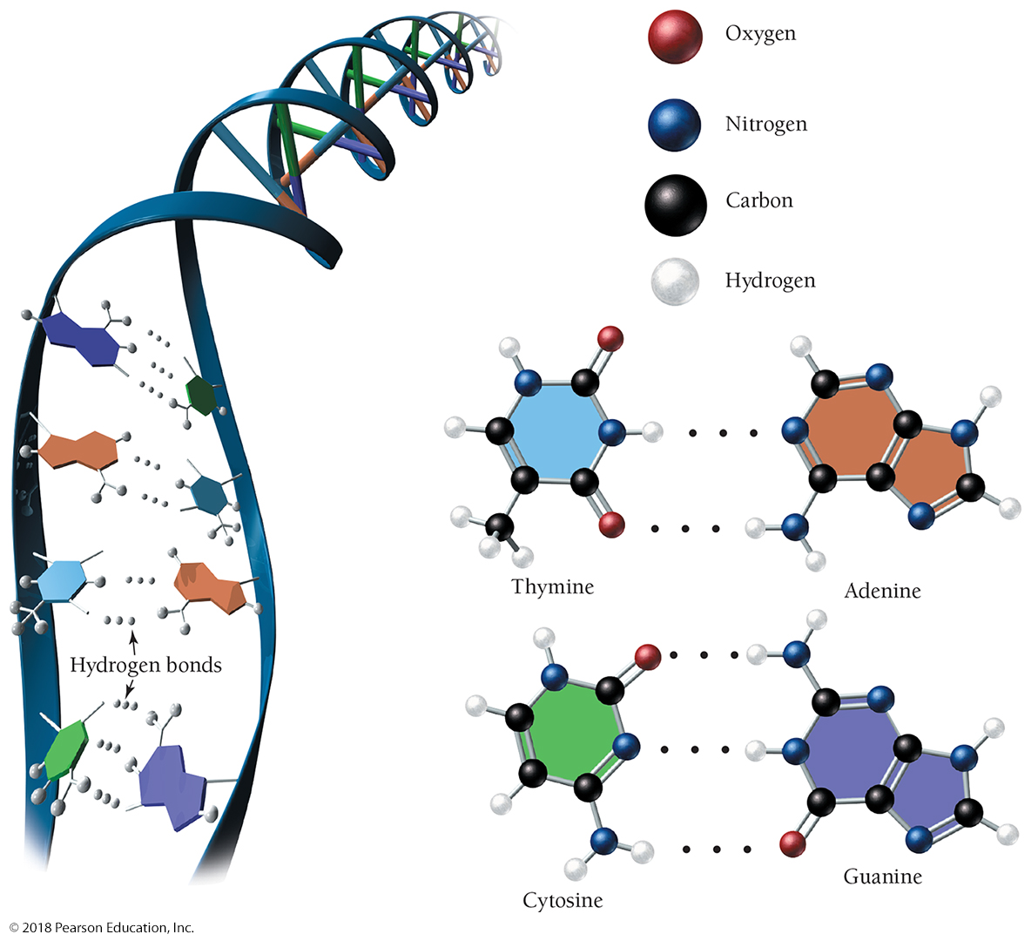
Hydrogen Bonding in DNA

Slide 74
Types of Crystalline Solids: Molecular, Ionic, and Atomic
Solids may be crystalline (a well-ordered array of atoms or molecules) or amorphous (having no long-range order).
Crystalline solids can be divided into three categories—molecular, ionic, and atomic—based on the individual units that compose the solid.

Slide 75
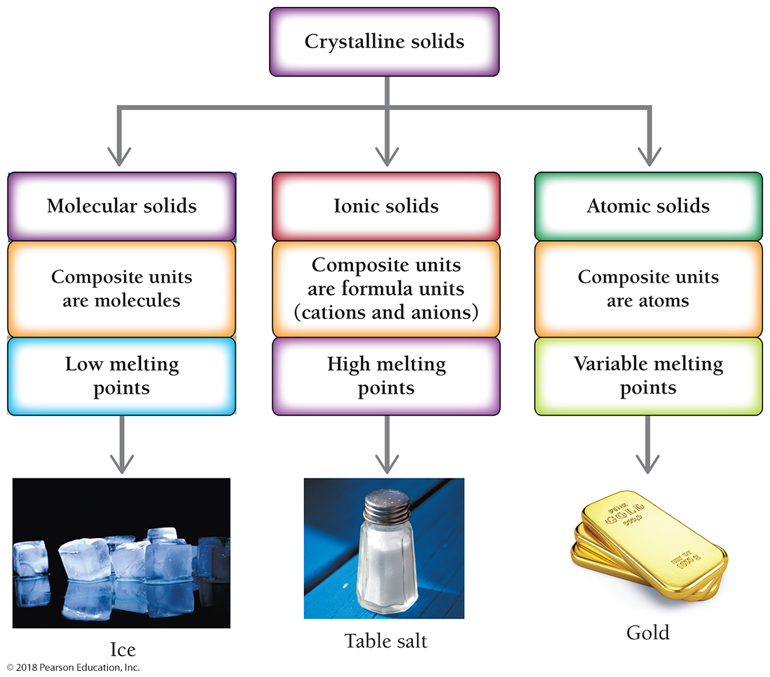
Types of Crystalline Solids

Slide 76
Molecular Solids
Molecular solids are solids whose composite units are molecules.
Ice (solid H₂O) and dry ice (solid CO₂) are examples of molecular solids.
Molecular solids are held together by intermolecular forces—dispersion forces, dipole–dipole forces, and hydrogen bonding.
Ice is held together by hydrogen bonds, and dry ice is held together by dispersion forces.
Molecular solids as a whole tend to have low to moderately low melting points.
Ice melts at 0 °C and dry ice sublimes at −78 °C.

Slide 77
Ionic Solids
Ionic solids are solids composed of formula units, the smallest electrically neutral collection of cations and anions that compose the compound.
Table salt (NaCl) and calcium fluoride (CaF₂) are good examples of ionic solids.
Ionic solids are held together by electrostatic attractions between cations and anions.
In NaCl, the attraction between the Na⁺ cation and the Cl– anion holds the solid lattice together because the lattice is composed of alternating cations and anions in a three-dimensional array.

Slide 78
Ionic Solids
The forces that hold ionic solids together are actual ionic bonds.
Since ionic bonds are much stronger than any of the intermolecular forces discussed previously, ionic solids tend to have much higher melting points than molecular solids.
Sodium chloride, an ionic solid, melts at 801 °C, while carbon disulfide, a molecular solid with a higher molar mass, melts at −110 °C.

Slide 79
Atomic Solids
Atomic solids are solids whose composite units are individual atoms.
Diamond (C), iron (Fe), and solid xenon (Xe) are good examples of atomic solids.
Atomic solids can be divided into three categories—covalent atomic solids, nonbonding atomic solids, and metallic atomic solids—each held together by a different kind of force.

Slide 80
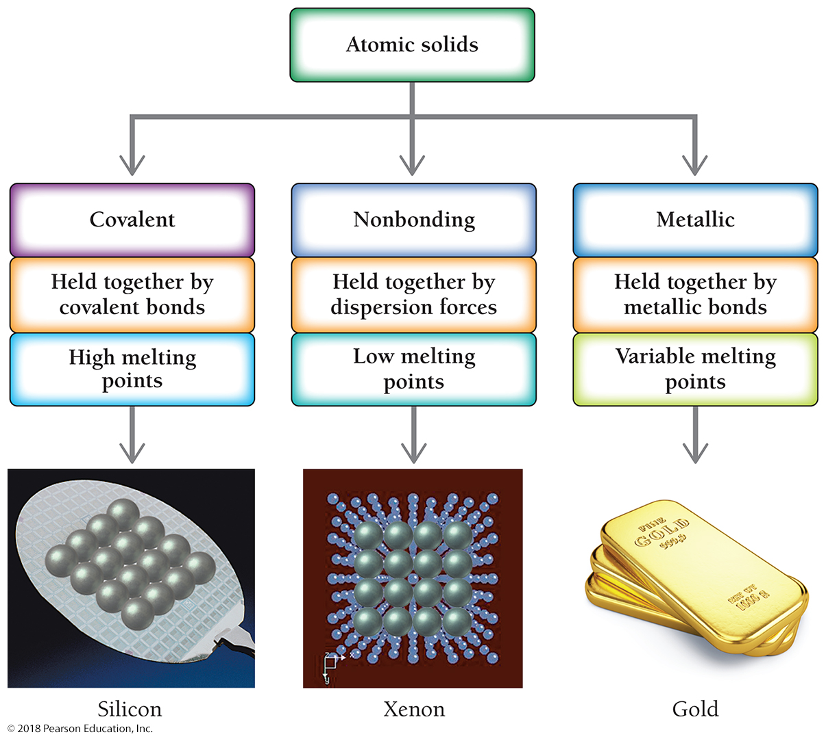
Types of Atomic Solids

Slide 81
Covalent Atomic Solids
Covalent atomic solids, such as diamond, are held together by covalent bonds.
In diamond, each carbon atom forms four covalent bonds to four other carbon atoms in a tetrahedral geometry.
This structure extends throughout the entire crystal, so that a diamond crystal can be thought of as a giant molecule held together by these covalent bonds.
Since covalent bonds are very strong, covalent atomic solids have high melting points. Diamond is estimated to melt at about 3800 °C.

Slide 82
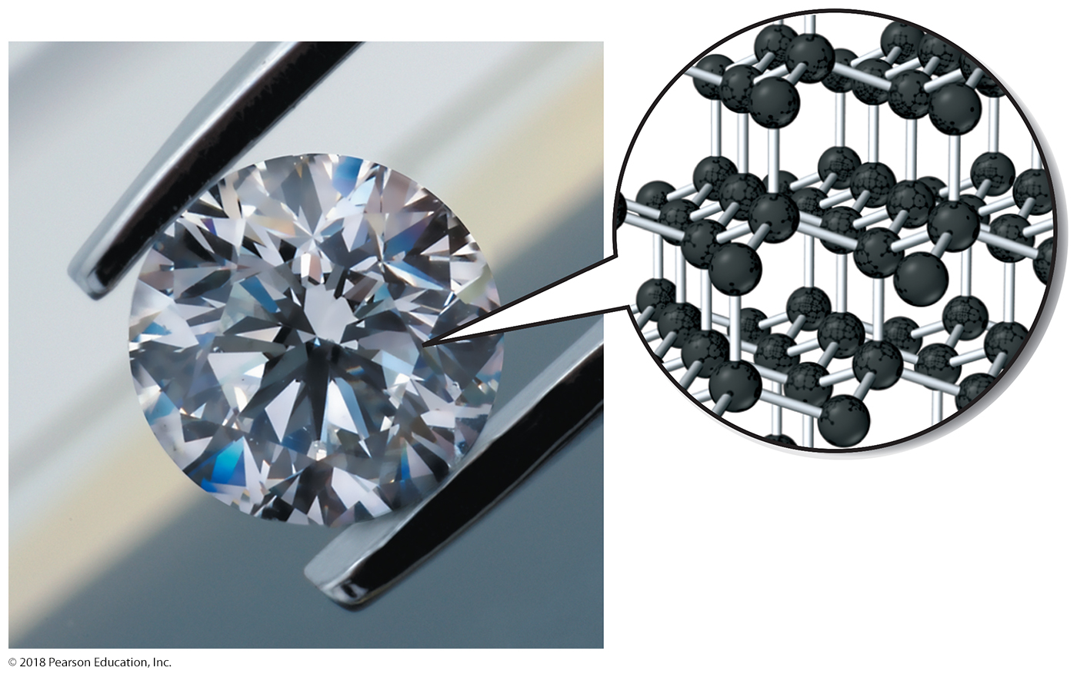
Diamond: A Covalent Atomic Solid
In diamond, carbon atoms form covalent bonds in a three-dimensional hexagonal pattern.

Slide 83
Nonbonding Atomic Solids
Nonbonding atomic solids, such as solid xenon, are held together by relatively weak dispersion forces.
Xenon atoms have stable electron configurations and therefore do not form covalent bonds with each other.
Consequently, solid xenon, like other nonbonding atomic solids, has a very low melting point (about −112 °C).

Slide 84
Metallic Atomic Solids
Metallic atomic solids, such as iron, silver, and lead, have variable melting points.
Metals are held together by metallic bonds that, in the simplest model, consist of positively charged ions in a sea of electrons.
Metallic bonds are of varying strengths, with some metals, such as mercury, having melting points below room temperature (−39 °C) and other metals, such as iron, having relatively high melting points (iron melts at 1809 °C).

Slide 85
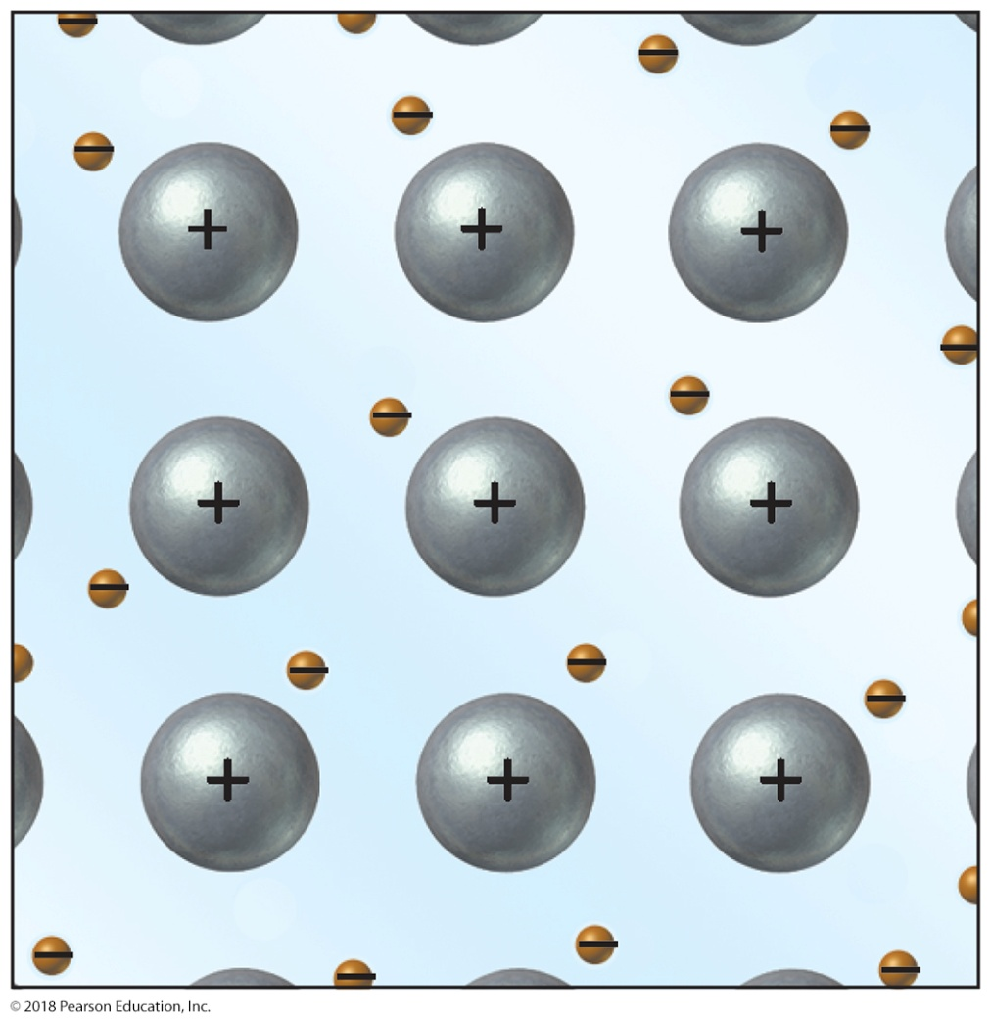
Structure of a Metallic Atomic Solid
In the simplest model of a metal, each atom donates one or more electrons to an “electron sea.”
The metal consists of the metal cations in a negatively charged electron sea.

Slide 86
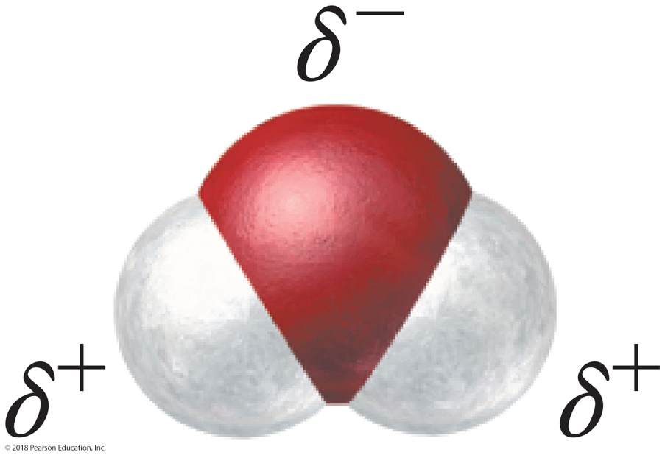
Water: A Remarkable Molecule
Water has a low molar mass (18.02 g/mol), yet it is a liquid instead of a gas at room temperature.
Water’s relatively high boiling point can be understood by examining the structure of the water molecule.

Slide 87
Water: A Remarkable Molecule
The bent geometry of the water molecule and the highly polar nature of the O — H bonds result in a molecule with a significant dipole moment.
Water’s two O — H bonds (hydrogen directly bonded to oxygen) allow water molecules to form strong hydrogen bonds with other water molecules, resulting in a relatively high boiling point.
Water’s high polarity also allows it to dissolve many other polar and ionic compounds.
Consequently, water is the main solvent of living organisms, transporting nutrients and other important compounds throughout the body.

Slide 88
Water: A Remarkable Molecule
Life is impossible without water, and in most places on Earth where liquid water exists, life exists.
Recent evidence of water on Mars—that either existed in the past or exists in the present—has fueled hopes of finding life or evidence of life there.
Water is remarkable.

Slide 89
Water: A Remarkable Molecule
The way water freezes is unique. Unlike other substances, which contract upon freezing, water expands upon freezing.
Because liquid water expands when it freezes, ice is less dense than liquid water. Water reaches its maximum density at 4.0 °C.
Consequently, ice cubes and icebergs float.
The frozen layer of ice at the surface of a winter lake insulates the water in the lake from further freezing.
If this ice layer were to sink, it could kill bottom-dwelling aquatic life and could allow the lake to freeze solid, eliminating virtually all aquatic life in the lake.

Slide 90
Water: A Remarkable Molecule
The expansion of water upon freezing is one reason that most organisms do not survive freezing.
When the water within a cell freezes, it expands and often ruptures the cell, just as water freezing within a pipe bursts the pipe.
Many foods, especially those with high water content, do not survive freezing very well either.
Industrial flash-freezing of fruits and vegetables happens so rapidly that the water molecules cannot align into the expanded phase and so the cells are not ruptured.

Slide 91
Chemistry in the Environment: Water Pollution
Many human diseases are caused by poor water quality.
Pollutants, including biological contaminants, can get into water supplies.
Biological contaminants are microorganisms that cause diseases such as hepatitis, cholera, dysentery, and typhoid.
Drinking water in developed nations is usually treated to kill microorganisms.
Most biological contaminants can be eliminated from untreated water by boiling.
Water containing biological contaminants poses an immediate danger to human health and should not be consumed.

Slide 92
Chemistry in the Environment: Water Pollution
Pollutants, including chemical contaminants, can get into water supplies.
Chemical contaminants get into drinking water from sources such as industrial dumping, pesticide and fertilizer use, and household dumping.
These contaminants include organic compounds, such as carbon tetrachloride and dioxin, and inorganic elements and compounds, such as mercury, lead, and nitrates.
Since many chemical contaminants are neither volatile nor alive like biological contaminants, they are not eliminated through boiling.

Slide 93
Chapter 12 in Review
Properties of liquids
Properties of solids
Manifestations of intermolecular forces: surface tension and viscosity
Evaporation and condensation
Melting, freezing, and sublimation

Slide 94
Chapter 12 in Review
Types of Intermolecular Forces:
Dispersion forces—Dispersion forces occur between all molecules and atoms due to instantaneous fluctuations in electron charge distribution.
Dipole–dipole forces—Dipole–dipole forces exist between molecules that are polar.
Hydrogen bonding—Hydrogen bonding exists between molecules that have H-bonded directly to F, O, or N. Hydrogen bonds are the strongest of the three intermolecular forces.

Slide 95
Chapter 12 in Review
Types of Crystalline Solids:
Molecular solids
Ionic solids
Atomic solids
Water: Because of its strong hydrogen bonding, water is a liquid at room temperature. Unlike most liquids, water expands when it freezes. Water is highly polar, making it a good solvent for many polar substances.

Slide 96
Chemical Skills Learning Objectives
LO: Use the heat of vaporization in calculations.
LO: Use the heat of fusion in calculations.
LO: Determine the types of intermolecular forces in a compound.
LO: Use intermolecular forces to determine melting and/or boiling points.

