Slide 1
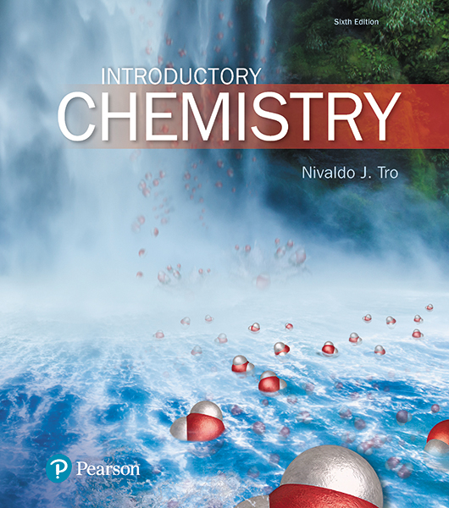
Lecture Presentation
Chapter 11
Gases

Slide 2
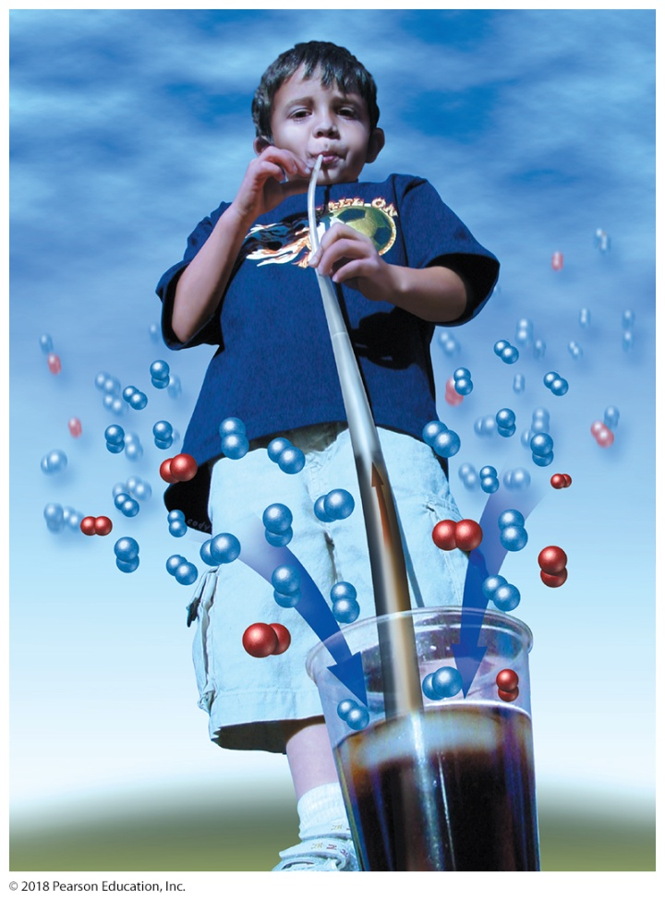
Extra-Long Straws
How long is too long when making long straws for drinking soda?
We need to know how a straw works.
When you drink from a straw, you remove some of the molecules from inside the straw.
This creates a pressure difference between the inside of the straw and the outside of the straw that results in the liquid being pushed up the straw.
The pushing is done by molecules in the atmosphere—primarily nitrogen and oxygen—as shown here.

Slide 3
Extra-Long Straws
If we had the perfect straw material and there were perfect seals between the straws, how long could the straw be?
Even if the extended straw had perfect seals and rigid walls, and even if there were a perfect vacuum (the absence of all air), a straw longer than about 10.3 m (34 ft) would not work.
Why?

Slide 4
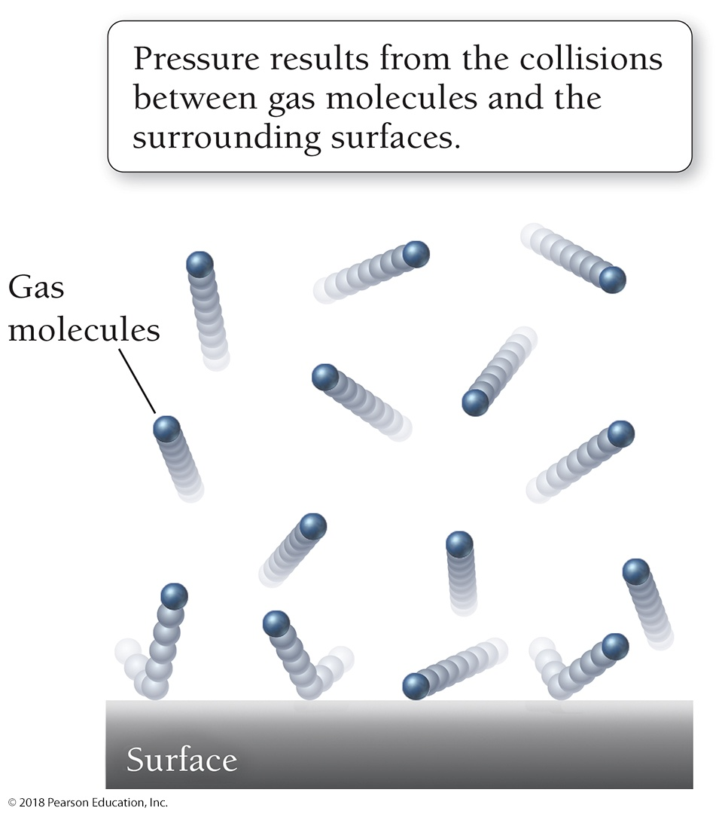
Extra-Long Straws
Pressure is the force exerted per unit area by gas molecules as they collide with the surfaces around them.
A molecule exerts a force when it collides with a surface. The result of many of these collisions is pressure.
On Earth at sea level, the gas molecules in our atmosphere exert an average pressure of 101,325 N/m² or, in English units, 14.7 lb/in.² (psi).

Slide 5
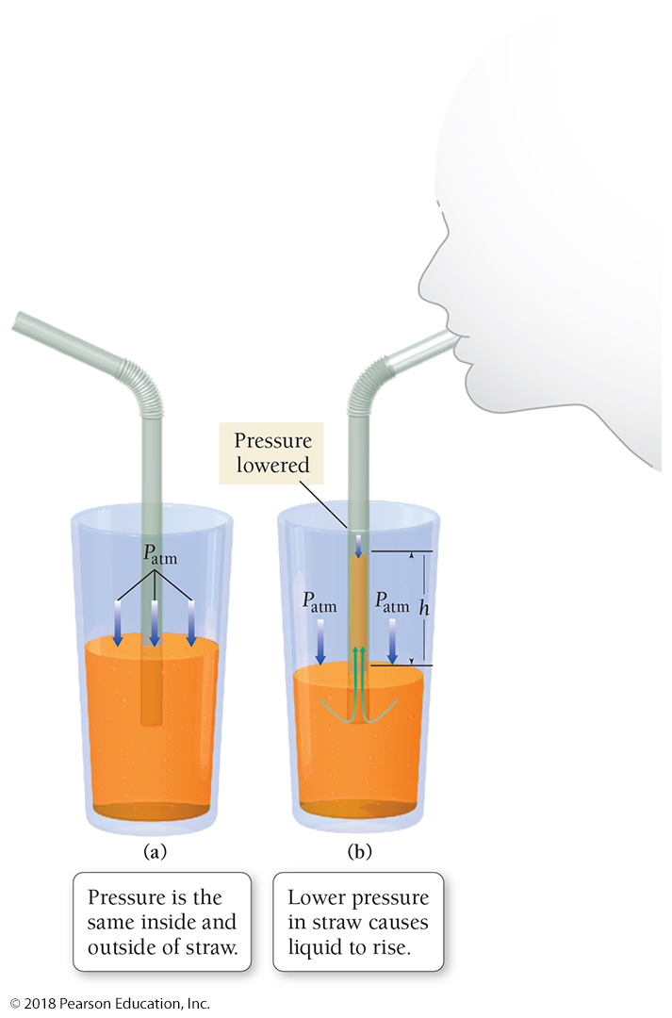
Extra-Long Straws
When a straw is put into a glass of orange soda, the pressure inside and outside the straw is the same, so the liquid levels inside and outside the straw are the same.
When a person sucks on the straw, the pressure inside the straw is lowered. The greater pressure on the surface of the liquid outside the straw pushes the liquid up the straw.

Slide 6
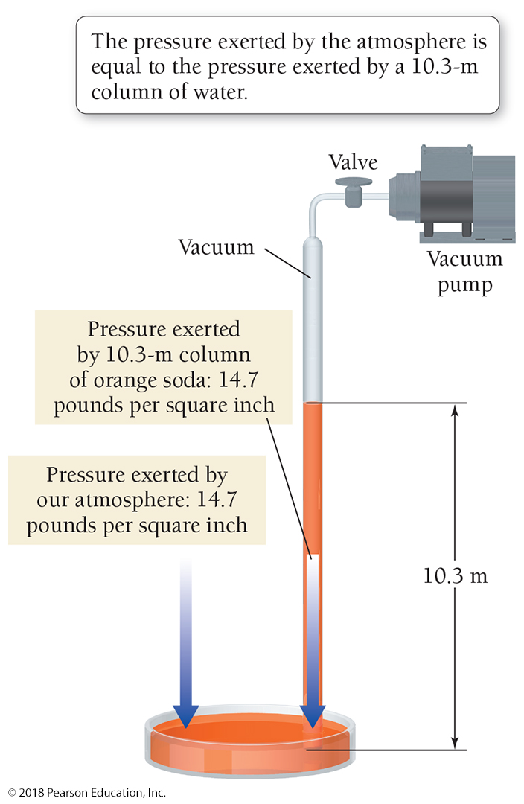
Extra-Long Straws
Even if you formed a perfect vacuum with a pump, atmospheric pressure could only push orange soda to a total height of about 10 m.
A column of water (or soda) 10.3 m high exerts the same pressure (14.7 lb/in.²) as the gas molecules in our atmosphere.

Slide 7
Extra-Long Straws
Straws work because sucking creates a pressure difference between the inside of the straw and the outside.
The external pressure pushes the liquid up the straw and into your mouth.
If you formed a perfect vacuum within the straw, the pressure outside of the straw at sea level would be enough to push the orange soda (which is mostly water) to a total height of about 10.3 m.
A 10.3 m column of water exerts the same pressure— 101,325 N/m² or 14.7 lb/in.² (psi)—as do the gas molecules in our atmosphere.
In other words, the orange soda would rise up the straw until the pressure exerted by its weight equaled the pressure exerted by the molecules in our atmosphere.

Slide 8
Kinetic Molecular Theory: A Model for Gases
A model for understanding the behavior of gases is the kinetic molecular theory.
This model predicts the correct behavior for most gases under many conditions.
Like other models, the kinetic molecular theory is not perfect and breaks down under certain conditions.
We focus on conditions where it works well.

Slide 10
Kinetic Molecular Theory: A Model for Gases
1. A gas is a collection of particles in constant, straight-line motion.
2. Gas particles do not attract or repel each other—they do not interact.
3. There is a lot of space between gas particles compared with the size of the particles themselves.
4. The average kinetic energy—energy due to motion—of gas particles is proportional to the temperature of the gas in kelvins. This means that as the temperature increases, the particles move faster and therefore have more energy.

Slide 11
Kinetic Molecular Theory: A Model for Gases
Kinetic molecular theory is consistent with the properties of gases.
• Gases are compressible.
• Gases assume the shape and volume of their container.
• Gases have low densities in comparison with liquids and solids.

Slide 12
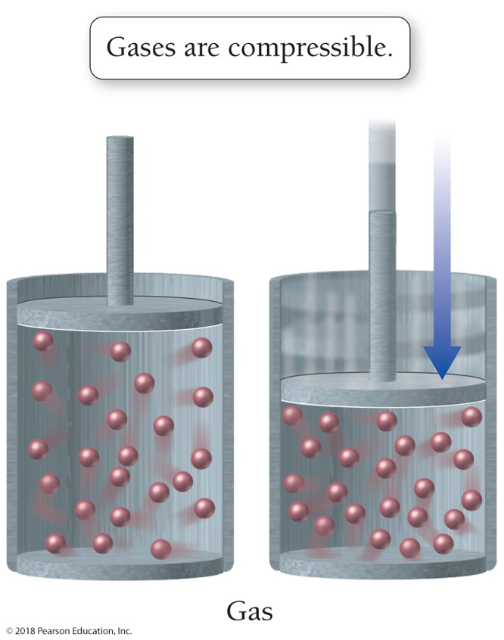
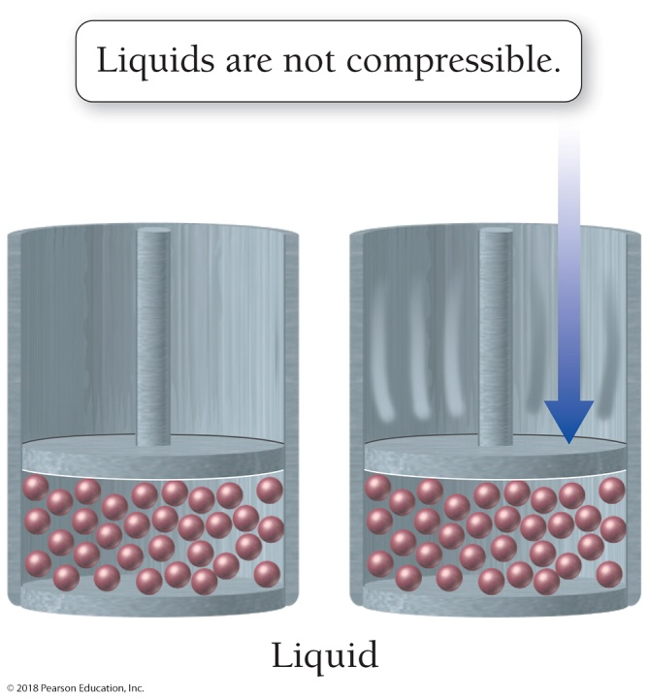
Kinetic Molecular Theory: A Model for Gases
Gases are compressible because there is so much empty space between gas particles.
Liquids are not compressible because there is so little space between the liquid particles.

Slide 13
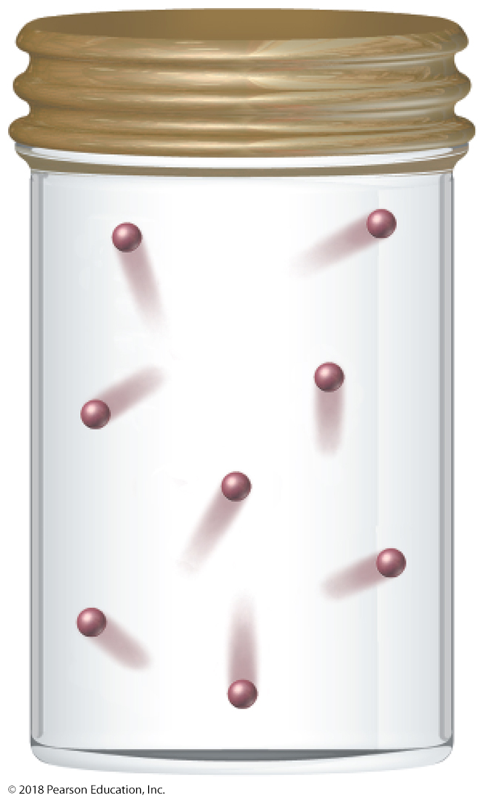
Kinetic Molecular Theory: A Model for Gases
A gas assumes the shape of its container.
Since the attractions between molecules in a gas are negligible, and since the particles are in constant motion, a gas expands to fill the volume of its container.

Slide 14
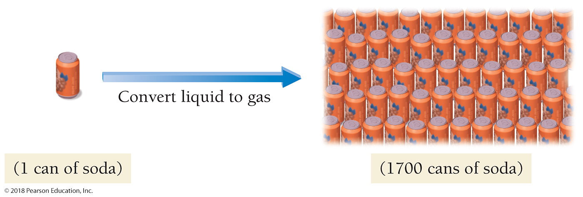
Kinetic Molecular Theory: A Model for Gases
Gases have a low density in comparison with solids and liquids because there is so much empty space between the atoms or molecules in a gas.
If the liquid water in a 350 mL (12 oz) can of soda were converted to steam (gaseous water), the steam would occupy a volume of 595 L (the equivalent of 1700 soda cans).
The density of steam at 1 atm pressure and 100 °C is about 0.0006 g/cm³.

Slide 15
Pressure: The Result of Constant Molecular Collisions
Pressure is the result of the constant collisions between the atoms or molecules in a gas and the surfaces around them.
Because of pressure, we can drink from straws, inflate basketballs, and move air into and out of our lungs.
Variation in pressure in Earth’s atmosphere creates wind, and changes in pressure help predict weather. Pressure is all around us and even inside us.

Slide 16
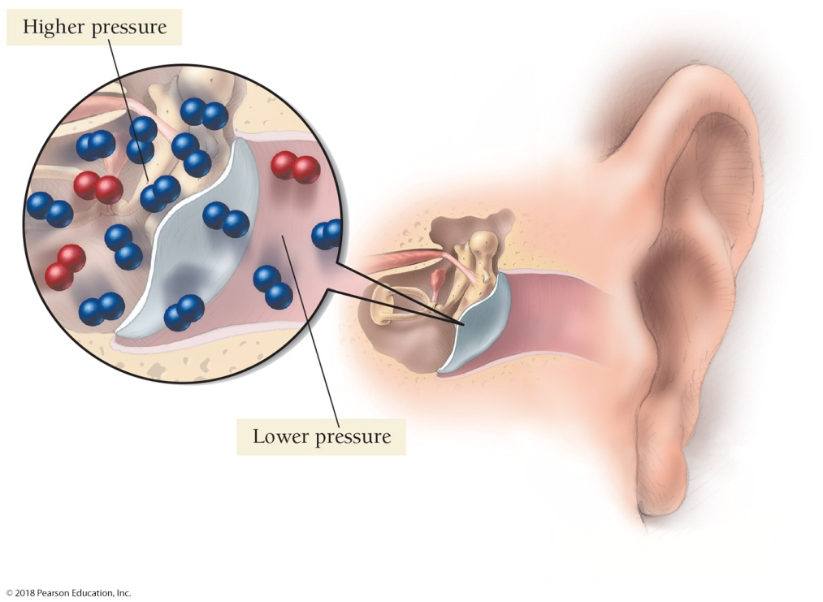
Pressure: The Result of Constant Molecular Collisions
As we climb a mountain or ascend in an airplane, there are fewer molecules per unit volume in air and the pressure drops.
You may feel the effect of a drop in pressure as a pain in your ears. The external pressure drops, while the pressure of the air within your ear cavities remains the same. This creates an imbalance—the lower external pressure causes your eardrum to bulge outward, causing pain.
With time, the excess air within your ears’ cavities escapes, equalizing the internal and external pressure and relieving the pain.

Slide 17
Pressure: The Result of Constant Molecular Collisions
The pressure exerted by a gas sample is defined as the force per unit area
that results from the collisions of gas particles with surrounding surfaces.
The pressure exerted by a gas depends on several factors, including the number of gas particles in a given volume.

Slide 18
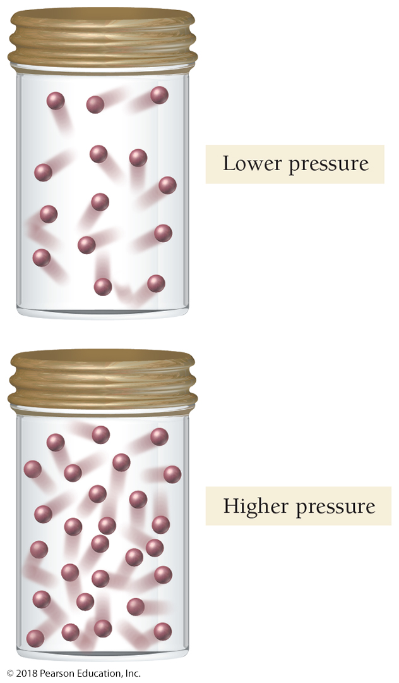
Pressure
Since pressure is a result of collisions between gas particles and the surfaces around them, the amount of pressure increases when the number of particles in a given volume increases.
The fewer the gas particles, the lower the pressure.

Slide 19
Units of Pressure
The simplest unit of pressure is the atmosphere (atm), the average pressure at sea level.
The SI unit of pressure is the pascal (Pa), defined as 1 newton (N) per square meter.
The pascal is a much smaller unit of pressure; 1 atm is equal to 101,325 Pa.

Slide 20
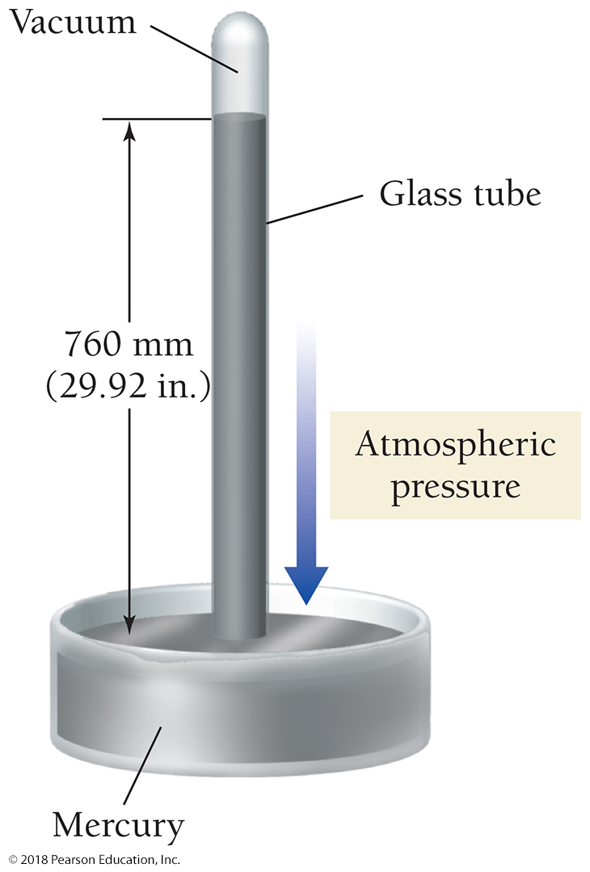
Units of Pressure
A third unit of pressure, the millimeter of mercury (mm Hg), originates from how pressure is measured with a barometer.
Average atmospheric pressure at sea level pushes a column of mercury to a height of 760 mm (29.92 in.).
Since mercury is 13.5 times as dense as water, it is pushed up (1/13.5) times as high as water by atmospheric pressure.

Slide 21
Units of Pressure
Since 1 atm of pressure pushes a column of mercury in a barometer to a height of 760 mm, 1 atm and 760 mm Hg are equal.
A millimeter of mercury is also called a torr after Italian physicist Evangelista Torricelli (1608–1647), who invented the barometer.
Other common units of pressure include inches of mercury (in. Hg) and pounds per square inch (psi).

Slide 22
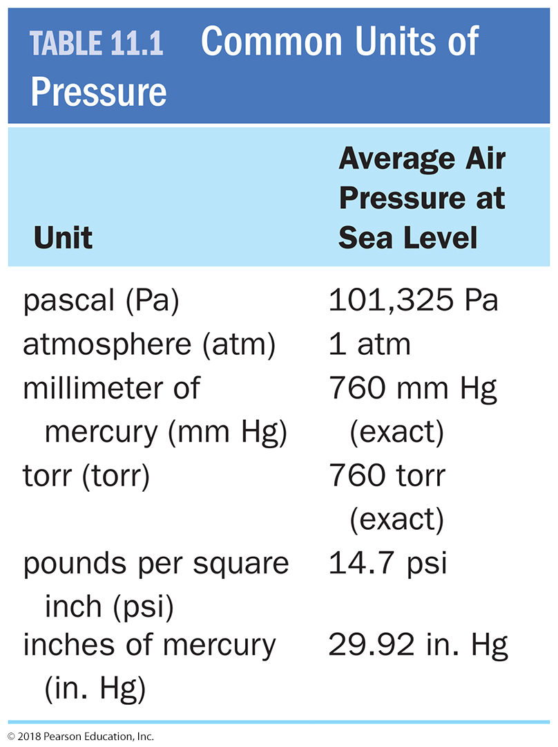
Units of Pressure
Common Units of Pressure
The units of pressure are summarized in Table 11.1 and inside the back cover of the textbook.
They are useful when completing homework problems.

Slide 23
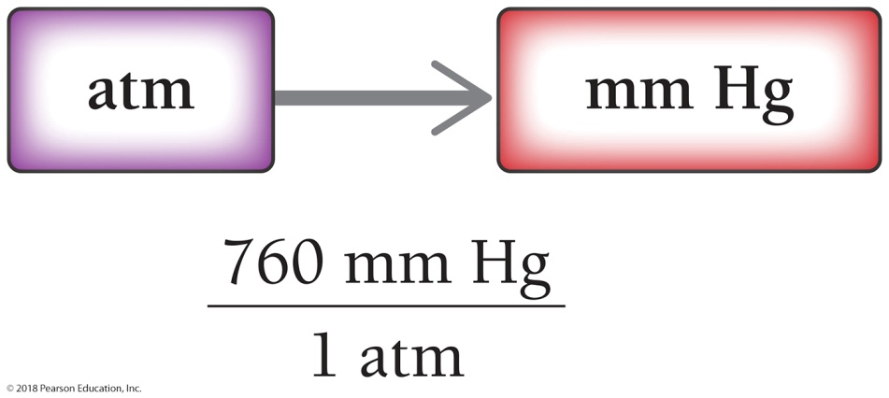
Pressure Unit Conversion
Convert 0.311 atm to millimeters of mercury (mm Hg).
SOLUTION MAP:
SOLUTION:

Slide 24
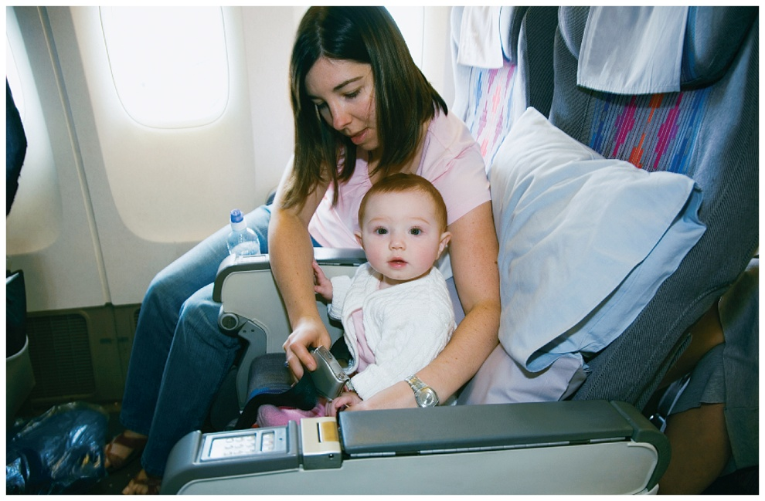
Everyday Chemistry: Why Airplane Cabins Are Pressurized
Most commercial airplanes fly at elevations between 25,000 and 40,000 ft, where atmospheric pressure is below 0.50 atm, which is much less than the normal atmospheric pressure to which our bodies are accustomed.
The physiological effects of these lowered pressures—and the correspondingly lowered oxygen levels—include dizziness, headache, shortness of breath, and even unconsciousness.
Commercial airplanes pressurize the air in their cabins. If, for some reason, an airplane cabin should lose its pressurization, passengers are directed to breathe oxygen through an oxygen mask.

Slide 25
Everyday Chemistry: How Airplane Cabins Are Pressurized
Cabin air pressurization is accomplished as part of the cabin’s overall air circulation system.
As air flows into the plane’s jet engines, the large turbines at the front of the engines compress it.
Most of this compressed (pressurized) air exits out the back of the engines, creating the thrust that drives the plane forward.
Some of the pressurized air is directed into the cabin, where it is cooled and mixed with existing cabin air.
The air leaves the cabin through ducts that direct it into the lower portion of the airplane. About half of this exiting air is mixed with incoming, pressurized air to circulate again. The other half is vented out of the plane through an outflow valve. This valve is adjusted to maintain the desired cabin pressure.
Federal regulations require that cabin pressure in commercial airliners be greater than the equivalent of outside air pressure at 8000 ft.
Atmospheric pressure at elevations of 8000 ft averages about 0.72 atm.

Slide 26
Boyle’s Law: Pressure and Volume
The pressure of a gas sample depends, in part, on its volume.
If the temperature and the amount of gas are constant, the pressure of a gas sample increases for a decrease in volume and decreases for an increase in volume.

Slide 27
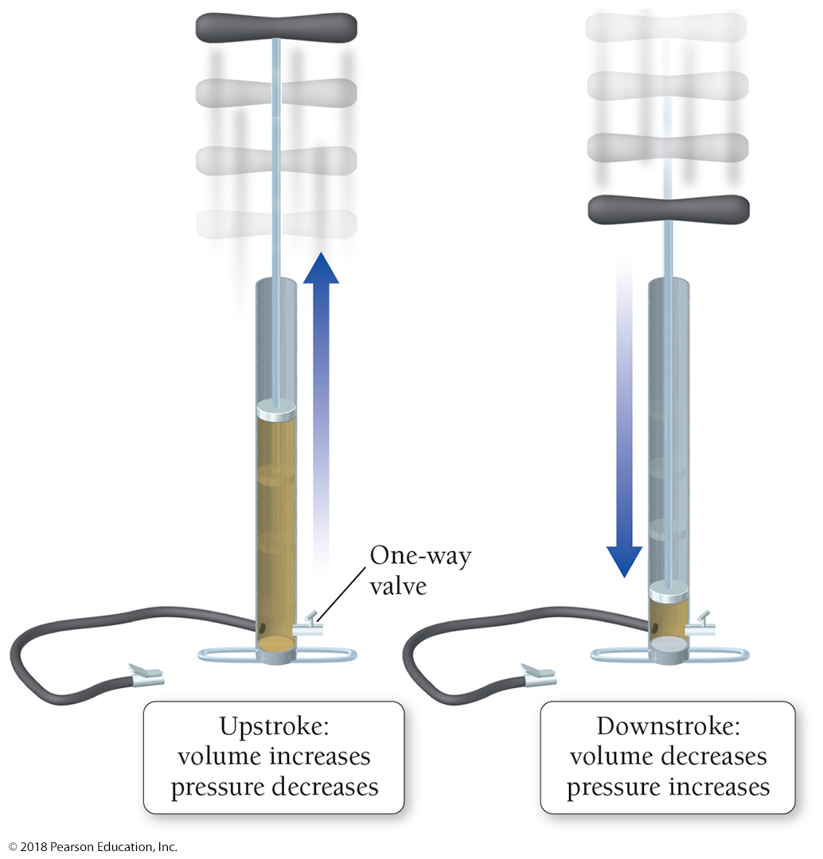
Boyle’s Law: Pressure and Volume
On the upstroke, the increasing volume causes a decrease in the internal pressure (the pressure within the pump’s cylinder). This draws air into the pump’s cylinder through a one-way valve.
On the downstroke, the decreasing volume causes an increase in the internal pressure. This increase forces the air out of the pump, through a different one-way valve, and into what is being inflated.

Slide 28
Boyle’s Law: Pressure and Volume
The relationships between gas properties are described by gas laws.
The relationship between volume and pressure was discovered by Robert Boyle (1627–1691) and is called Boyle’s law.
Boyle’s law assumes constant temperature and a constant number of gas particles.
Boyle’s law: The volume of a gas and its pressure are inversely proportional.

Slide 29
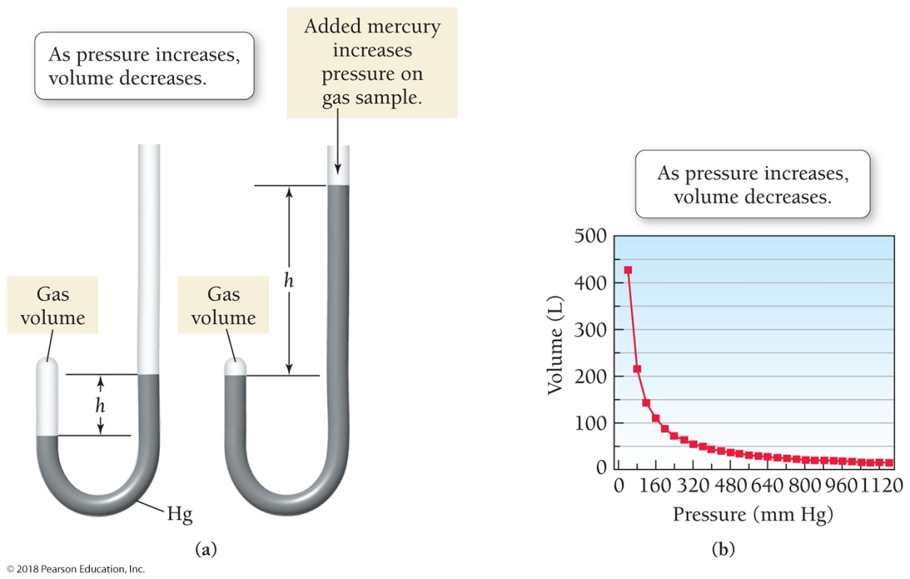
Volume Versus Pressure
(a) Adding mercury to the J-tube causes the pressure on the gas sample to increase and its volume to decrease.
(b) A plot of the volume of a gas as a function of pressure.

Slide 30
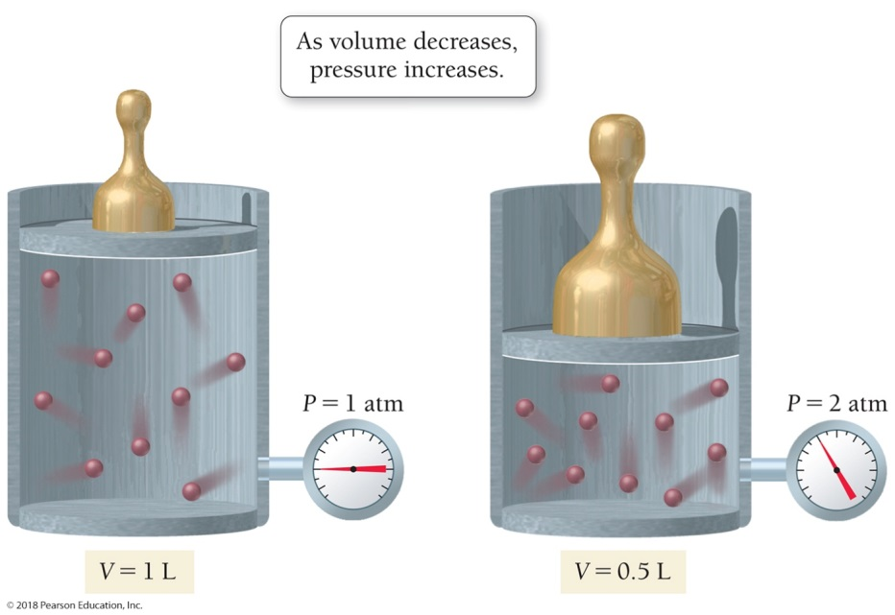
Volume Versus Pressure: A Molecular View
Kinetic molecular theory explains the observed change in pressure. If the volume of a gas sample is decreased, the same number of gas particles is crowded into a smaller volume, causing more collisions with the walls of the container and therefore increasing the pressure.

Slide 31
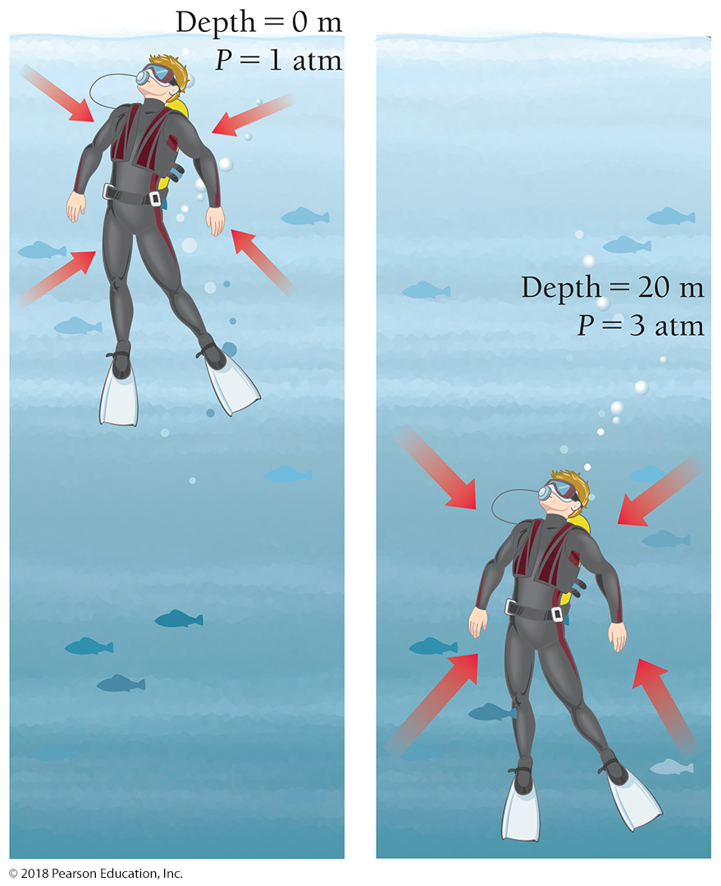
Pressure at Depth
Scuba divers learn about Boyle’s law because it explains why ascending too quickly toward the surface is dangerous.
The pressure regulator used in scuba diving delivers air at a pressure that matches the external pressure at depth; otherwise, the diver could not inhale the air.

Slide 32
Pressure at Depth
When a diver is at 20 m of depth, the regulator delivers air at a pressure of 3 atm to match the 3 atm of pressure around the diver—1 atm due to normal atmospheric pressure and 2 additional atmospheres due to the weight of the water at 20 m.

Slide 33
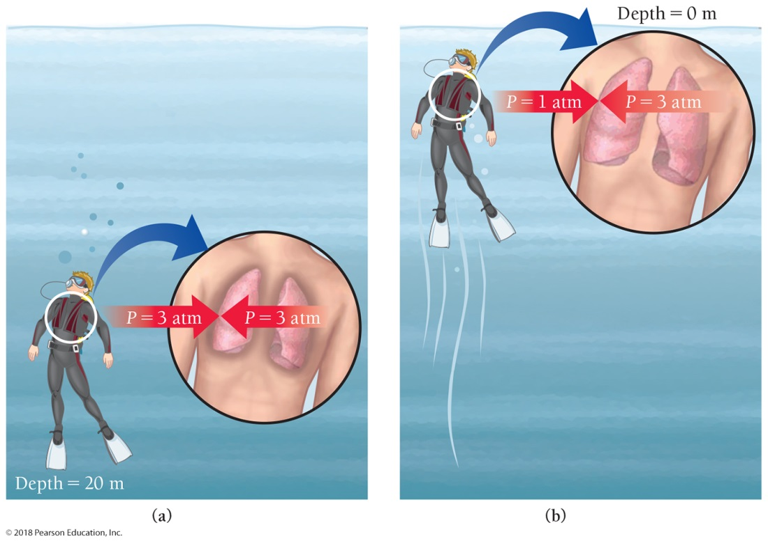
The Dangers of Decompression
(a) A diver at 20 m experiences an external pressure of 3 atm and breathes air pressurized at 3 atm.
(b) If the diver shoots toward the surface with lungs full of 3 atm air, his lungs will expand as the external pressure drops to 1 atm.

Slide 34
Boyle’s Law Can Be Used to Calculate the Volume of a Gas Following a Pressure Change
A diver inhaled a lungful of 3 atm air and swam quickly to the surface (where the pressure drops to 1 atm) while holding his breath.
What happens to the volume of air in his lungs?
Boyle’s law tells us that since the pressure decreases by a factor of 3, the volume of the air in his lungs would increase by a factor of 3, severely damaging his lungs and possibly killing him.
Divers must ascend slowly and breathe continuously, allowing the regulator to bring the air pressure in their lungs back to 1 atm by the time they reach the surface.

Slide 35
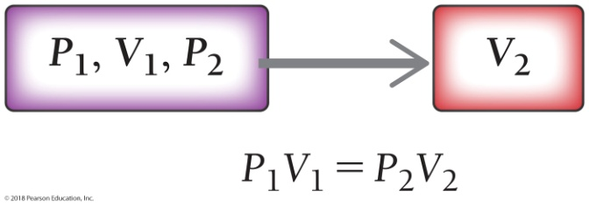
Example 11.2 Boyle’s Law
A cylinder equipped with a moveable piston has an applied pressure of 4.0 atm and a volume of 6.0 L. What is the volume of the cylinder if the applied pressure is decreased to 1.0 atm?
SORT You are given an initial pressure, an initial volume, and a final pressure. You are asked to find the final volume.
GIVEN P₁ = 4.0 atm
V₁ = 6.0 L
P₂ = 1.0 atm
FIND V₂
STRATEGIZE Draw a solution map beginning with the given quantities. Boyle’s law shows the relationship necessary to determine the quantity you need to find.
SOLUTION MAP
RELATIONSHIPS USED
P₁V₁ = P₂V₂ (Boyle’s law, presented in this section)
SOLVE Solve the equation for the quantity you are trying to find (V₂), and substitute the numerical quantities into the equation to calculate the answer.

Slide 36
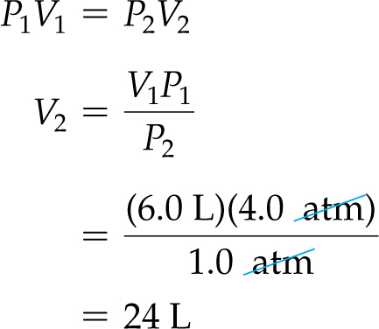
Example 11.2 Boyle’s Law
Continued
SOLUTION
CHECK Check your answer. Are the units correct? Does the answer make physical sense?
The answer has units of volume (L) as expected. The answer is reasonable because you expect the volume to increase as the pressure decreases.
Skillbuilder 11.2 | Boyle’s Law
A snorkeler takes a syringe filled with 16 mL of air from the surface, where the pressure is 1.0 atm, to an unknown depth. The volume of the air in the syringe at this depth is 7.5 mL. What is the pressure at this depth? If pressure increases by an additional 1 atm for every 10 m of depth, how deep is the snorkeler?
For More Practice
Example 11.14; Problems 33, 34, 35, 36.

Slide 37
Everyday Chemistry: Extra-Long Snorkels
Several episodes of The Flintstones featured Fred Flintstone and Barney Rubble snorkeling. Their snorkels were long reeds that stretched from the surface of the water down to many meters of depth. Fred and Barney swam around in deep water while breathing air provided to them by these extra-long snorkels.
Would this work? Why do people bother with scuba diving equipment if they could simply use 10-m snorkels the way Fred and Barney did?

Slide 38
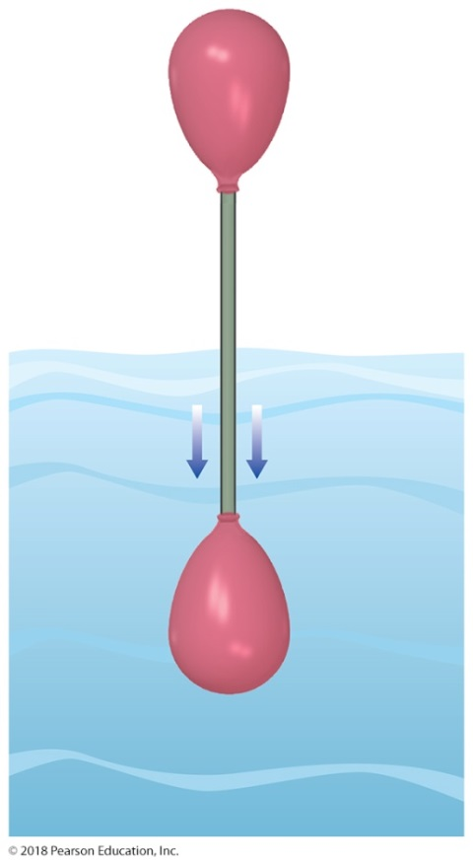
Extra-Long Snorkels
A diver at 10 m experiences a pressure of 2 atm that compresses the air in his lungs to a pressure of 2 atm. If the diver had a snorkel that went to the surface—where the air pressure is 1 atm—air would flow out of his lungs, not into them. It would be impossible to breathe.

Slide 39
Charles’s Law: Volume and Temperature
Why does hot air rise?
Hot air rises because the volume of a gas sample at constant pressure increases with increasing temperature.
As long as the amount of gas (and therefore its mass) remains constant, warming a gas decreases its density because density is mass divided by volume.
A lower-density gas floats in a higher-density gas just as wood floats in water.

Slide 40
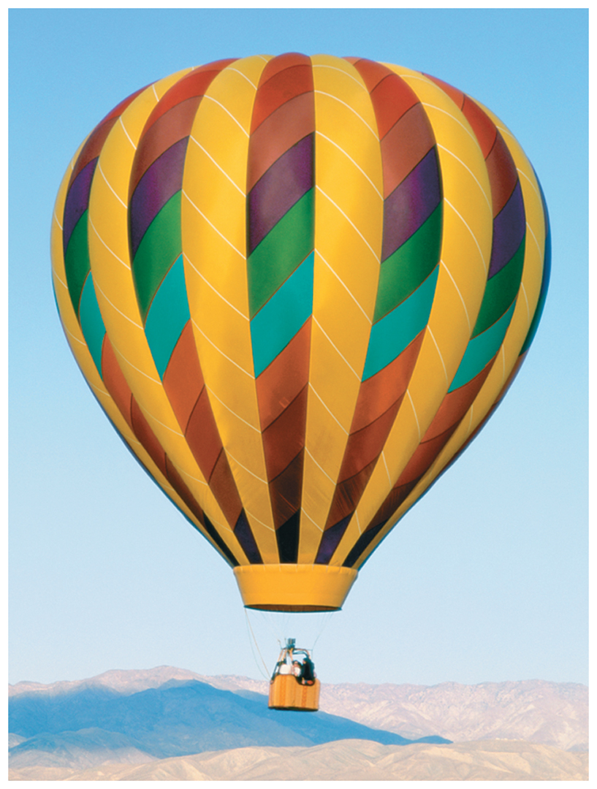
Charles’s Law: Volume and Temperature
Heating the air in a balloon makes it expand (Charles’s law).
As the volume occupied by the hot air increases, its density decreases, allowing the balloon to float in the cooler, denser air that surrounds it.

Slide 41
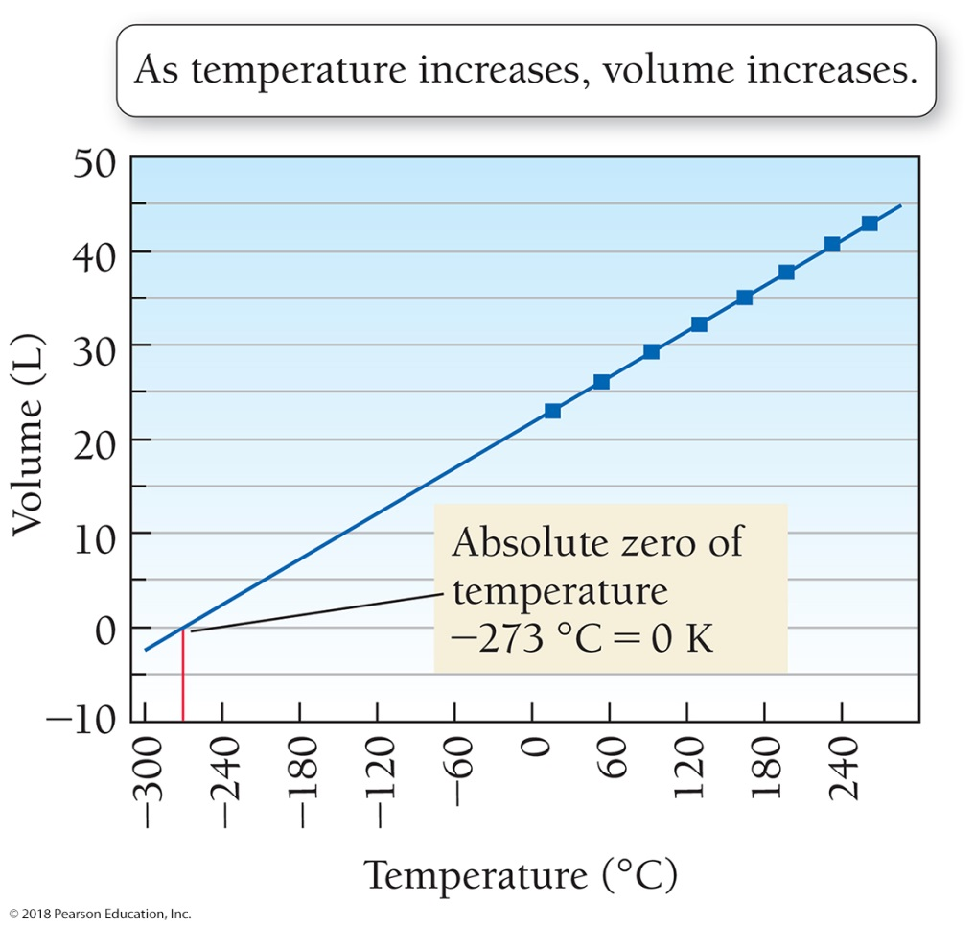
Volume Versus Temperature
Keep the pressure of a gas sample constant and measure its volume at a number of different temperatures.

Slide 42
The volume of a gas increases linearly with increasing temperature. The volume of a gas decreases linearly with decreasing temperature.
We can predict an important property of matter by extending the line on our plot backward from the lowest measured point—a process called extrapolation.
Our extrapolated line shows that the gas should have a zero volume at –273 °C, which corresponds to 0 K, the coldest possible temperature.
Our extrapolated line shows that below –273 °C our gas would have a negative volume, which is physically impossible.
For this reason, we refer to 0 K as absolute zero—colder temperatures do not exist.

Slide 43
Charles’s Law: Volume and Temperature
J. A. C. Charles (1746–1823), a French mathematician and physicist, was the first person to carefully quantify the relationship between the volume of a gas and its temperature. Charles was among the first people to ascend in a hydrogen-filled balloon.
The law he formulated is called Charles’s law.
Charles’s law assumes constant pressure and a constant amount of gas.
Charles’s law: The volume (V) of a gas and its Kelvin temperature (T) are directly proportional.

Slide 44
Charles’s Law: Volume and Temperature
If two variables are directly proportional, then increasing one by some factor increases the other by the same factor.
When the temperature of a gas sample (in kelvins) is doubled, its volume doubles.
When the temperature is tripled, its volume triples, and so on.
The observed relationship between the temperature and volume of a gas follows from kinetic molecular theory.
If the temperature of a gas sample is increased, the gas particles move faster, and if the pressure is to remain constant, the volume must increase.

Slide 45
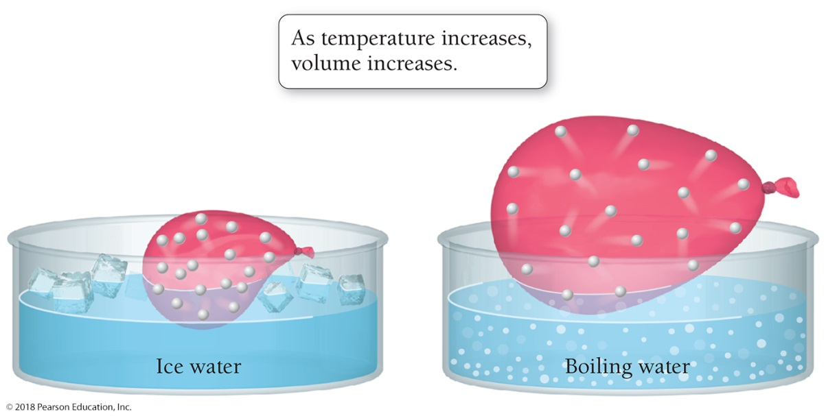
Volume Versus Temperature: A Molecular View
If temperature is changed when a balloon is moved from an ice-water bath into a boiling-water bath, the gas molecules inside it move faster due to the increased temperature.
If the external pressure remains constant, the volume will change when the molecules expand the balloon and collectively occupy a larger volume.

Slide 46
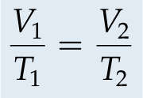
Charles’s Law: Volume and Temperature
Charles’s law can be used to calculate the volume of a gas following a temperature change.
Charles’s law can be used to calculate the temperature of a gas following a volume change.
The pressure and the amount of gas are constant. All temperatures must be expressed in kelvins.

Slide 47
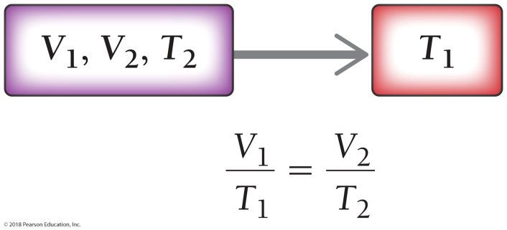
Example 11.3 Charles’s Law
A sample of gas has a volume of 2.80 L at an unknown temperature. When the sample is submerged in ice water at t = 0 °C, its volume decreases to 2.57 L. What was its initial temperature (in kelvins and in Celsius)? Assume a constant pressure. (To distinguish between the two temperature scales, use t for temperature in °C and T for
temperature in K.)
SORT You are given an initial volume, a final volume, and a final temperature. You are asked to find the initial temperature in both kelvins (T₁) and degrees Celsius (t₁).
GIVEN V₁ = 2.80 L
V₂ = 2.57 L
t₂ = 0 °C
FIND T₁ and t₁
STRATEGIZE Draw a solution map beginning with the given quantities. Charles’s law shows the relationship necessary to get to the find quantity.
SOLUTION MAP

Slide 48
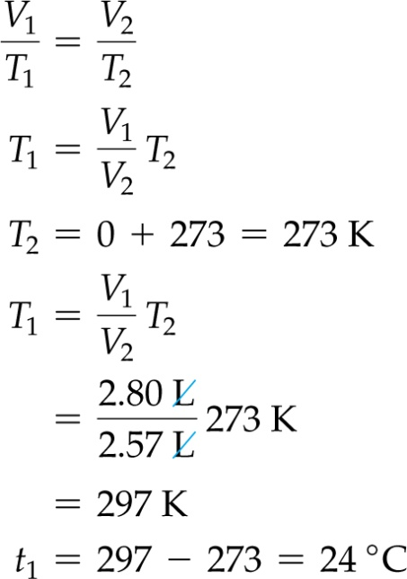
Example 11.3 Charles’s Law
Continued
RELATIONSHIPS USED
SOLVE Solve the equation for the quantity you are trying to find (T₁).
Before you substitute in the numerical values, convert the temperature to kelvins. Remember, you must always work gas law problems using Kelvin temperatures. Once you have converted the temperature to kelvins, substitute into the equation to find T₁. Convert the temperature to degrees Celsius to find t₁.
SOLUTION

Slide 49
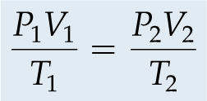
The Combined Gas Law: Pressure, Volume, and Temperature
Boyle’s law shows how P and V are related at constant temperature, and Charles’s law shows how V and T are related at constant pressure.
What if two of these variables change at once?

Slide 50
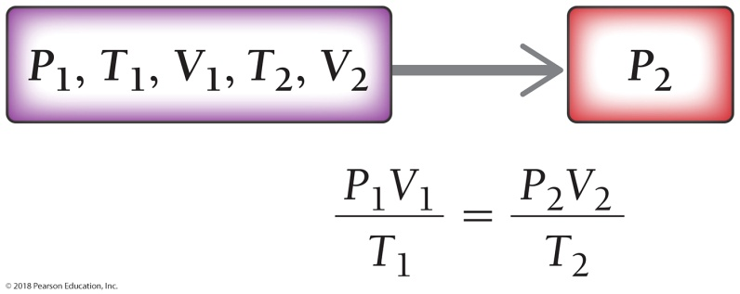
Example 11.4 The Combined Gas Law
A sample of gas has an initial volume of 158 mL at a pressure of 735 mm Hg and a temperature of 34 °C. If the gas is compressed to a volume of 108 mL and heated to a temperature of 85 °C, what is its final pressure in millimeters of mercury?
SORT You are given the initial pressure, temperature, and volume as well as the final temperature and volume. You are asked to find the final pressure.
GIVEN P₁ = 735 mm Hg
t₁ = 34 °C t₂ = 85 °C
V₁ = 158 mL V₂ = 108 mL
FIND P₂
STRATEGIZE Draw a solution map beginning with the given quantities. The combined gas law shows the relationship necessary to get to the find quantity.
SOLUTION MAP

Slide 51
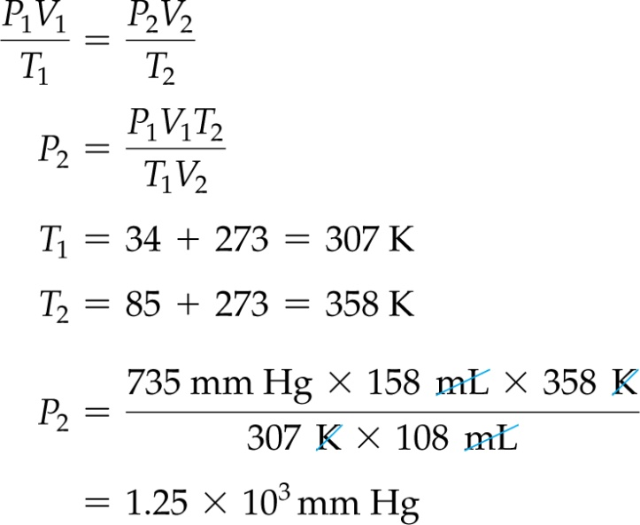
Example 11.4 The Combined Gas Law
Continued
RELATIONSHIPS USED
SOLVE Solve the equation for the quantity you are trying to find (P₂).
Before you substitute in the numerical values, you must convert the temperatures to kelvins. Once you have converted the temperature to kelvins, substitute into the equation to find P₂.
SOLUTION

Slide 52
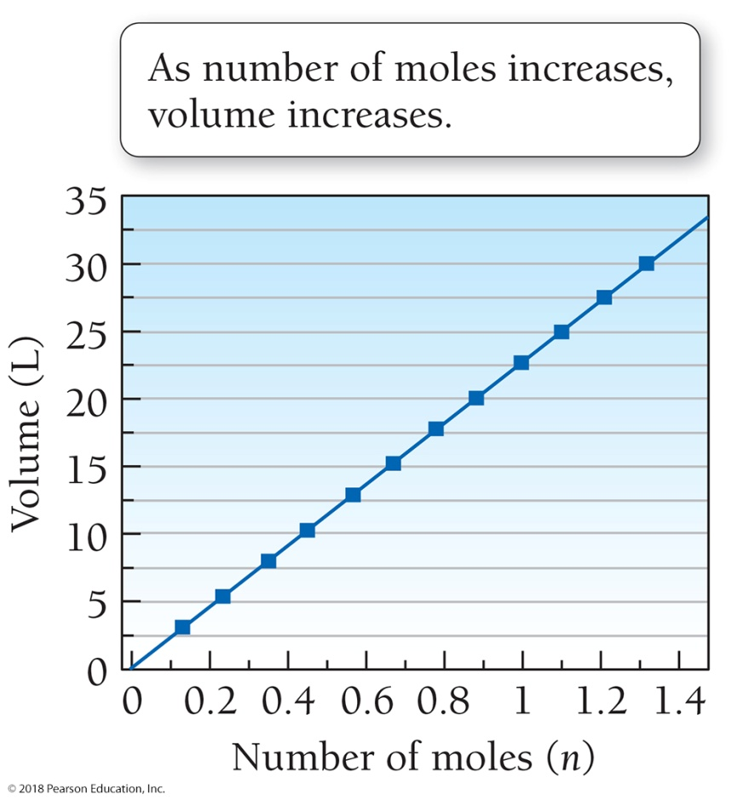
Avogadro’s Law: Volume and Moles
What happens when the amount of gas changes?
Make several measurements of the volume of a gas sample (at constant temperature and pressure) while varying the number of moles in the sample.

Slide 53
Avogadro’s Law: Volume and Moles
The volume of a gas sample increases linearly with the number of moles in the sample.
This relationship was first stated formally by Amadeo Avogadro (1776–1856) and is called Avogadro’s law.
Avogadro’s law assumes constant temperature and pressure.
Avogadro’s law: The volume of a gas and the amount of the gas in moles (n) are directly proportional.

Slide 54
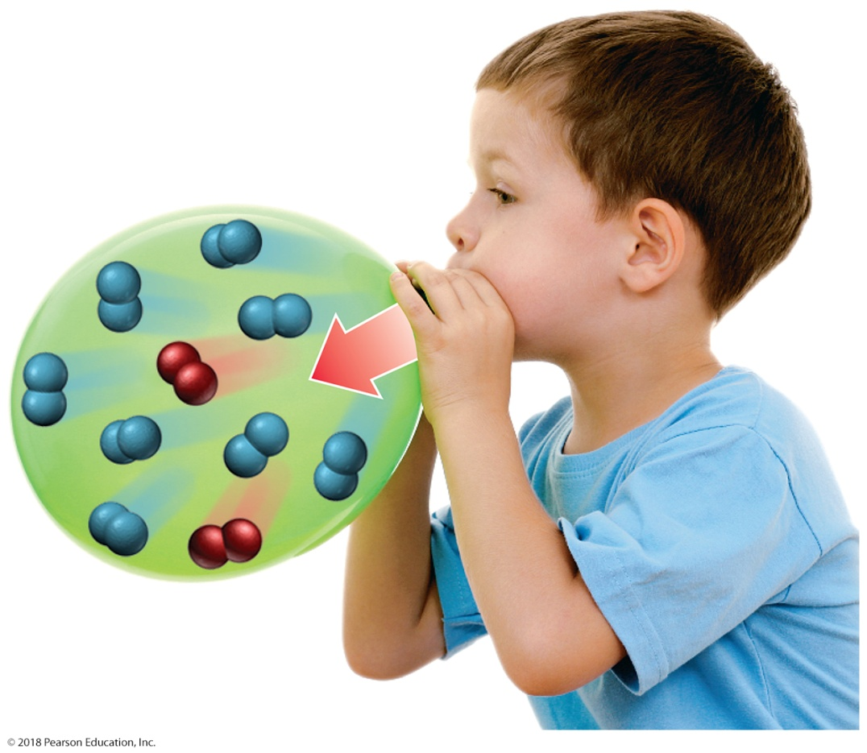
Avogadro’s Law: Volume and Moles
Avogadro’s law: The volume of a gas and the amount of the gas in moles (n) are directly proportional.
As you exhale into a balloon, you add gas molecules to the inside of the balloon, increasing its volume.

Slide 55
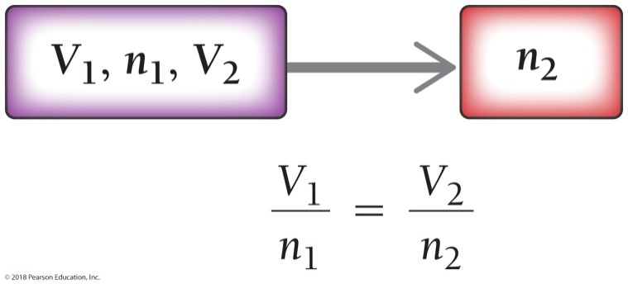
Example 11.5 Avogadro’s Law
A 4.8-L sample of helium gas contains 0.22 mol of helium. How many additional moles of helium gas should you
add to the sample to obtain a volume of 6.4 L? Assume constant temperature and pressure.
SORT You are given an initial volume, an initial number of moles, and a final volume. You are (essentially) asked to find the final number of moles.
GIVEN V₁ = 4.8 L
n₁ = 0.22 mol
V₂ = 6.4 L
FIND n₂
STRATEGIZE Draw a solution map beginning with the given quantities. Avogadro’s law addresses the relationship necessary to determine the find quantity.
SOLUTION MAP

Slide 56
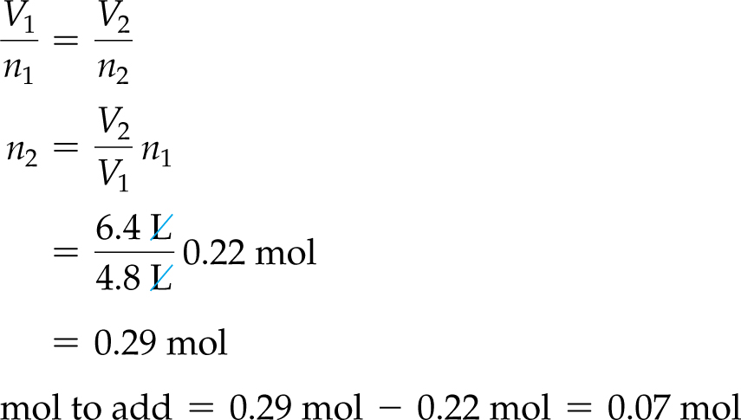
Example 11.5 Avogadro’s Law
Continued
RELATIONSHIPS USED
SOLVE Solve the equation for the quantity you are trying to find (n₂), and substitute the appropriate quantities to calculate n₂.
Since the balloon already contains 0.22 mol, subtract this quantity from the final number of moles to determine how much you must add.
SOLUTION

Slide 57
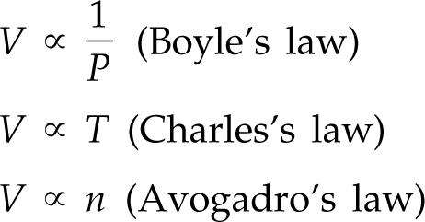
The Ideal Gas Law: Pressure, Volume, Temperature, and Moles
Boyle’s law, Charles’s law, and Avogadro’s law can be combined into a single law.
Factor in “R” a proportionality constant

Slide 58
The Ideal Gas Law: Pressure, Volume, Temperature, and Moles
The ideal gas law: PV = nRT
The value of R, the ideal gas constant, is
Each of the quantities in the ideal gas law must be expressed in the units within R.
• Pressure (P) must be expressed in atmospheres.
• Volume (V) must be expressed in liters.
• Amount of gas (n) must be expressed in moles.
• Temperature (T) must be expressed in kelvins.

Slide 59
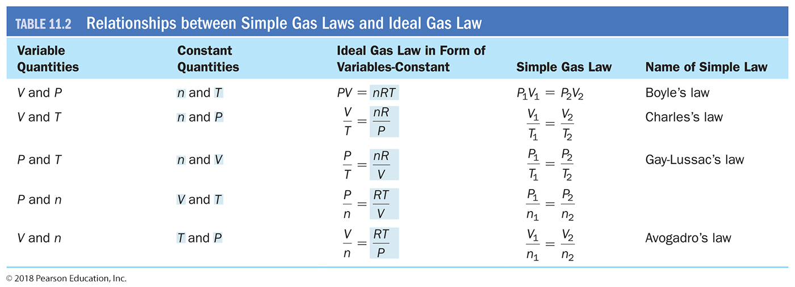

Slide 60
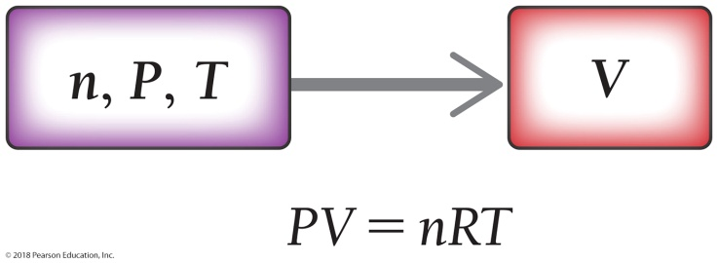
Example 11.6 The Ideal Gas Law
Calculate the volume occupied by 0.845 mol of nitrogen gas at a pressure of 1.37 atm and a temperature of 315 K.
SORT You are given the number of moles, the pressure, and the temperature of a gas sample. You are asked to find the volume.
GIVEN n = 0.845 mol
P = 1.37 atm
T = 315 K
FIND V
STRATEGIZE Draw a solution map beginning with the given quantities. The ideal gas law shows the relationship necessary to determine the find quantity.
SOLUTION MAP
RELATIONSHIPS USED
PV = nRT (ideal gas law, presented in this section)

Slide 61
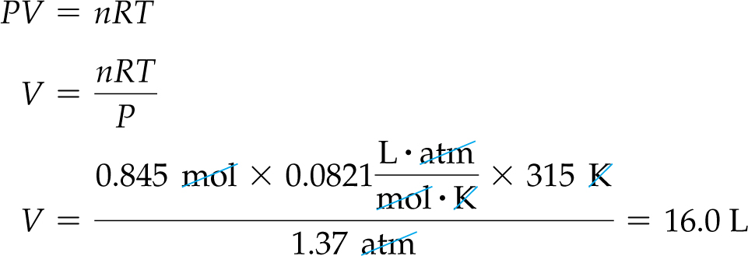
Example 11.6 The Ideal Gas Law
Continued
SOLVE Solve the equation for the quantity you are trying to find (V) and substitute the appropriate quantities to calculate V.
SOLUTION
CHECK Check your answer. Are the units correct? Does the answer make physical sense?
The answer has the correct units for volume, liters. The value of the answer is a bit more difficult to judge. However, at standard temperature and pressure (T = 0 °C or 273.15 K and P = 1 atm), 1 mol gas occupies 22.4 L (see Section 11.10). Therefore, an answer of 16.0 L seems reasonable for the volume of 0.85 mol of gas under conditions that are not too far from standard temperature and pressure.

Slide 62
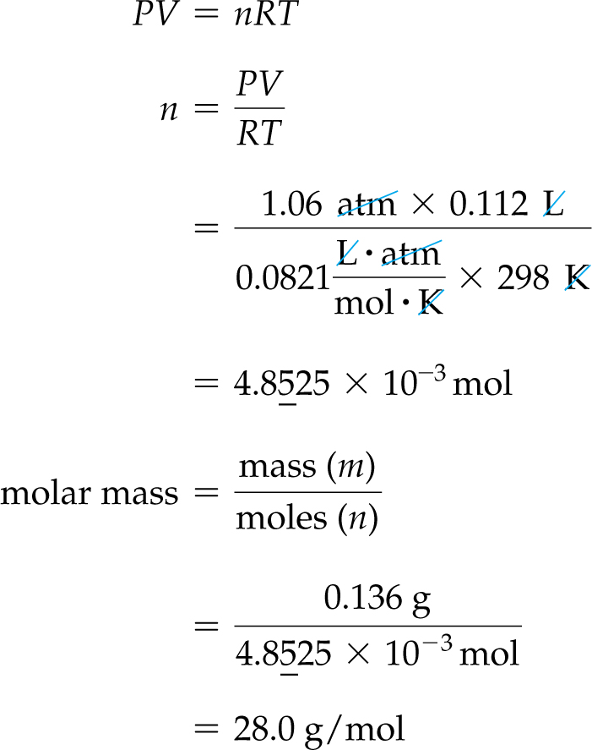
Molar Mass of a Gas from the Ideal Gas Law
Use the ideal gas law in combination with mass measurements.
A sample of gas has a mass of 0.136 g. Its volume is 0.112 L at a temperature of 298 K and a pressure of 1.06 atm. Find its molar mass.
GIVEN:
m = 0.136 g
V = 0.112 L
T = 298 K
P = 1.06 atm
CONSTANT: R
FIND: n
and molar mass
(mass/moles)
SOLUTION:

Slide 63
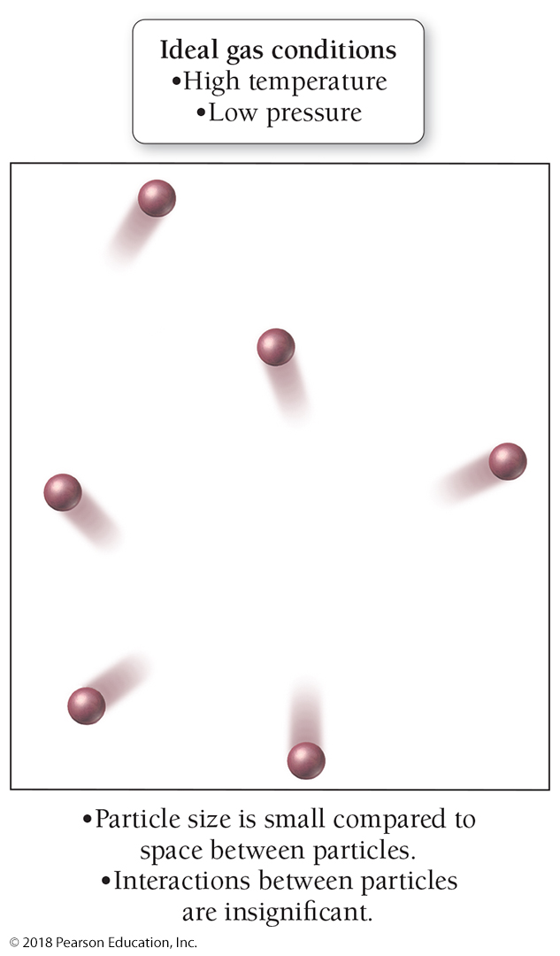
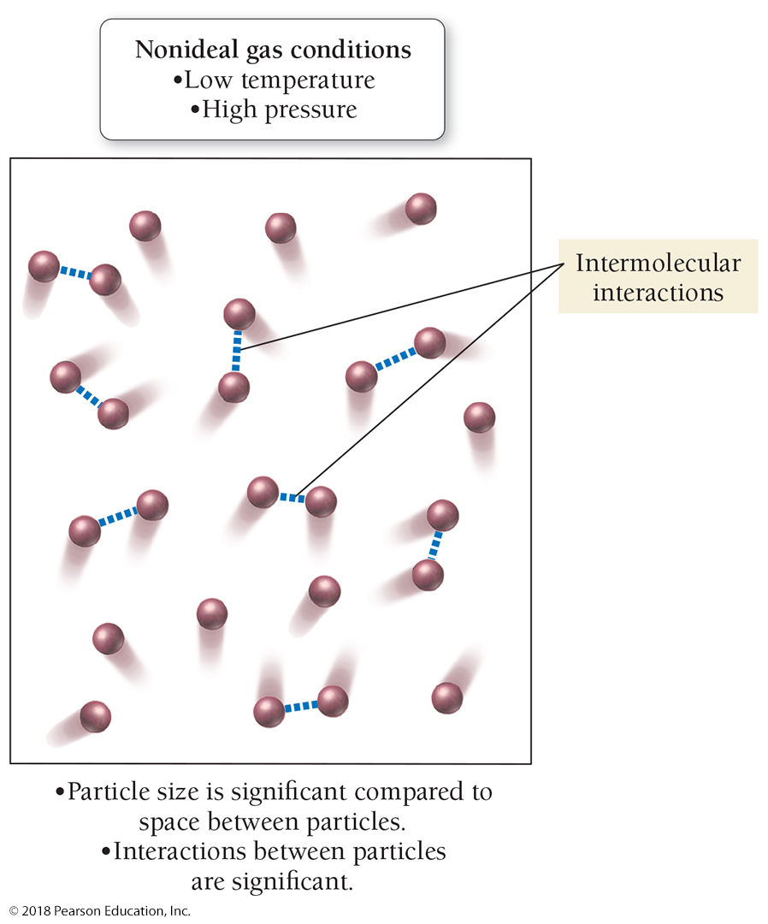
Gases Are Not Always Acting Ideally

Slide 64
Partial Pressures in Mixtures of Gases
According to the kinetic molecular theory, each of the components in a gas mixture acts independently of the others.
The pressure due to any individual component in a gas mixture is called the partial pressure of that component.
The partial pressure of any component is that component’s fractional composition times the total pressure of the mixture.
The air in our atmosphere is a mixture containing 78% nitrogen, 21% oxygen, 0.9% argon, 0.04% carbon dioxide, and a few other gases in smaller amounts.
The nitrogen molecules in air exert a certain pressure—78% of the total pressure—that is independent of the presence of the other gases in the mixture.
The oxygen molecules in air exert a certain pressure—21% of the total pressure—that is also independent of the presence of the other gases in the mixture.

Slide 65
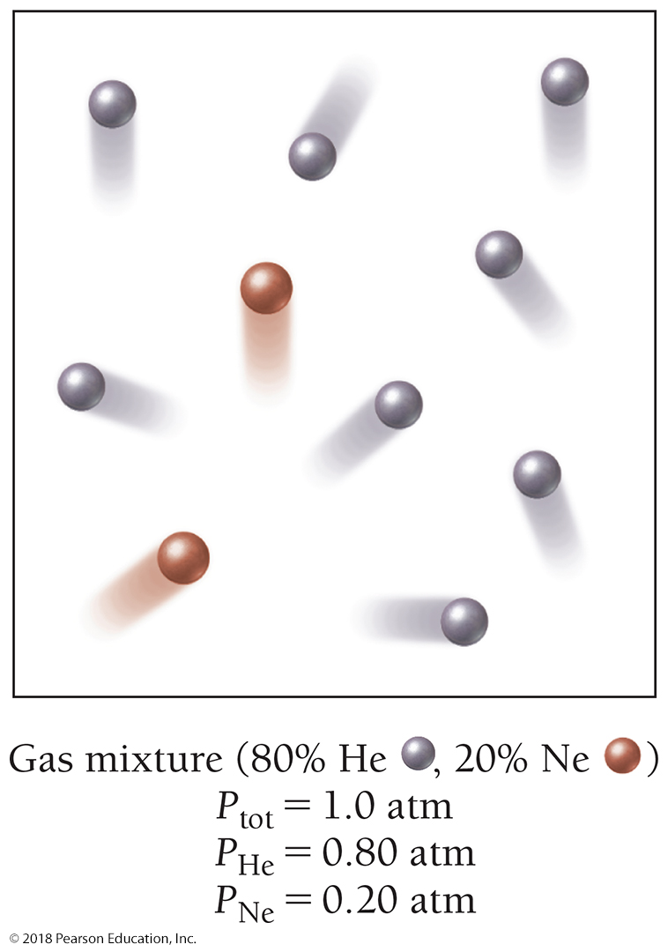
Partial Pressures
The fractional composition is the percent composition divided by 100.
Partial pressure of a component = Fractional composition of a component × Total pressure

Slide 66
Mixtures of Gases
Dalton’s law of partial pressures:
P_{tot} = P_{a} + P_{b} + P_{c} + …
where P_{tot} is the total pressure
and P_{a}, P_{b}, P_{c} are the partial pressures of the components.
For 1 atm air:
P_{tot} = P_{N2} + P_{O2} + P_{Ar}
= 0.78 atm + 0.21 atm + 0.01 atm
= 1.00 atm

Slide 67
Example 11.9 Total Pressure and Partial Pressure
A mixture of helium, neon, and argon has a total pressure of 558 mm Hg. If the partial pressure of helium is 341 mm Hg and the partial pressure of neon is 112 mm Hg, what is the partial pressure of argon?
You are given the total pressure of a gas mixture and the partial pressures of two (of its three) components. You are asked to find the partial pressure of the third component.
GIVEN P_{tot} = 558 mm Hg
P_{He} = 341 mm Hg
P_{Ne} = 112 mm Hg
FIND P_{Ar}
To solve this problem, solve Dalton’s law for the partial pressure of argon, and substitute the correct values to calculate it.
SOLUTION
P_{tot} = P_{He} + P_{Ne} + P_{Ar}
P_{Ar} = P_{tot} – P_{He} – P_{Ne}
= 558 mm Hg – 341 mm Hg – 112 mm Hg
= 105 mm Hg

Slide 68
Our Lungs Have Evolved to Breathe Oxygen at a Partial Pressure of P_{O2} = 0.21 atm
If the total pressure decreases—as happens when we climb a mountain, for example—the partial pressure of oxygen also decreases.
On the top of Mount Everest, the total pressure is 0.311 atm and the partial pressure of oxygen is only 0.065 atm. Low oxygen levels can have negative physiological effects, a condition called hypoxia, or oxygen starvation.
Mild hypoxia causes dizziness, headache, and shortness of breath.
Severe hypoxia, which occurs when P_{O2} drops below 0.1 atm, may cause unconsciousness or even death.
Climbers hoping to make the summit of Mount Everest usually carry oxygen to breathe.

Slide 69
Our Lungs Have Evolved to Breathe Oxygen at a Partial Pressure of P_{O2} = 0.21 atm
High oxygen levels have negative physiological effects.
At 30 m, a scuba diver breathes pressurized air at a total pressure of 4.0 atm, making P_{O2} about 0.84 atm.
This increased partial pressure of oxygen causes a higher density of oxygen molecules in the lungs, which results in a higher concentration of oxygen in body tissues.
When P_{O2} increases beyond 1.4 atm, the increased oxygen concentration in body tissues causes a condition called oxygen toxicity, characterized by muscle twitching, tunnel vision, and convulsions.
Divers who venture too deep without proper precautions have drowned because of oxygen toxicity.

Slide 70
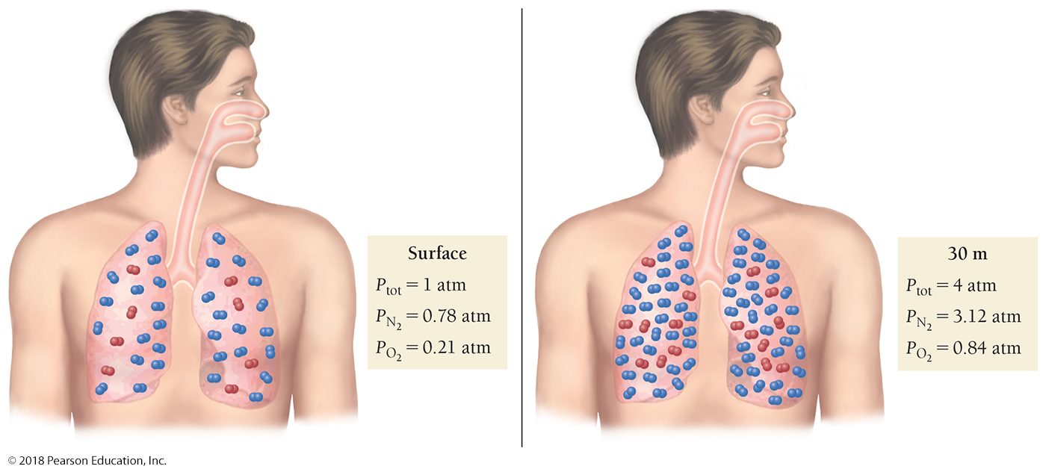
Too Much of a Good Thing
When the oxygen partial pressure increases beyond 1.4 atm, oxygen toxicity results

Slide 71
Our Lungs Have Evolved to Breathe Nitrogen at a Partial Pressure of P_{N2} = 0.78 atm
At 30 m a scuba diver breathes nitrogen at P_{N2} = 3.1 atm, which causes an increase in nitrogen concentration in bodily tissues and fluids.
When P_{N2} increases beyond about 4 atm, nitrogen narcosis, also referred to as rapture of the deep, results.
Divers describe this condition as being tipsy, and judgment may become impaired.
To avoid oxygen toxicity and nitrogen narcosis, deep-sea divers—those venturing beyond 50 m—breathe specialized mixtures of gases.
Heliox is a mixture of helium and oxygen usually at a smaller percentage of oxygen than would be found in air, thereby lowering the risk of oxygen toxicity.
Heliox contains helium instead of nitrogen, eliminating the risk of nitrogen narcosis.
A good dive shop can calculate the best mixture for the depth of your dive.

Slide 72
Example 11.10 Partial Pressure, Total Pressure, and Percent Composition
Calculate the partial pressure of oxygen that a diver breathes with a heliox mixture containing 2.0% oxygen at a
depth of 90 m where the total pressure is 10.0 atm.
You are given the percent oxygen in the mixture and the total pressure. You are asked to find the partial pressure of oxygen.
GIVEN O₂ percent = 2.0%
P_{tot} = 10.0 atm
FIND P_{O2}
The partial pressure of a component in a gas mixture is equal to the fractional composition of the component multiplied by the total pressure. Calculate the fractional composition of O₂ by dividing the percent composition by 100. Calculate the partial pressure of O₂ by multiplying the fractional composition by the total pressure.
SOLUTION

Slide 73
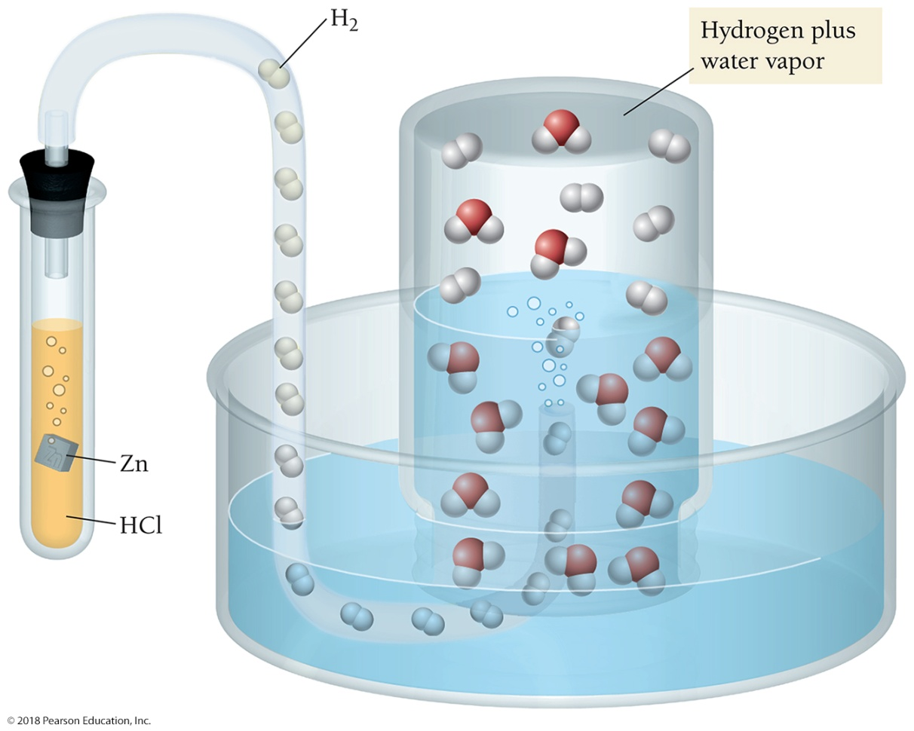
Vapor Pressure
When a gas from a chemical reaction is collected through water, water molecules become mixed with the gas molecules. The pressure of water vapor in the final mixture is the vapor pressure of water at the temperature at which the gas is collected.

Slide 74
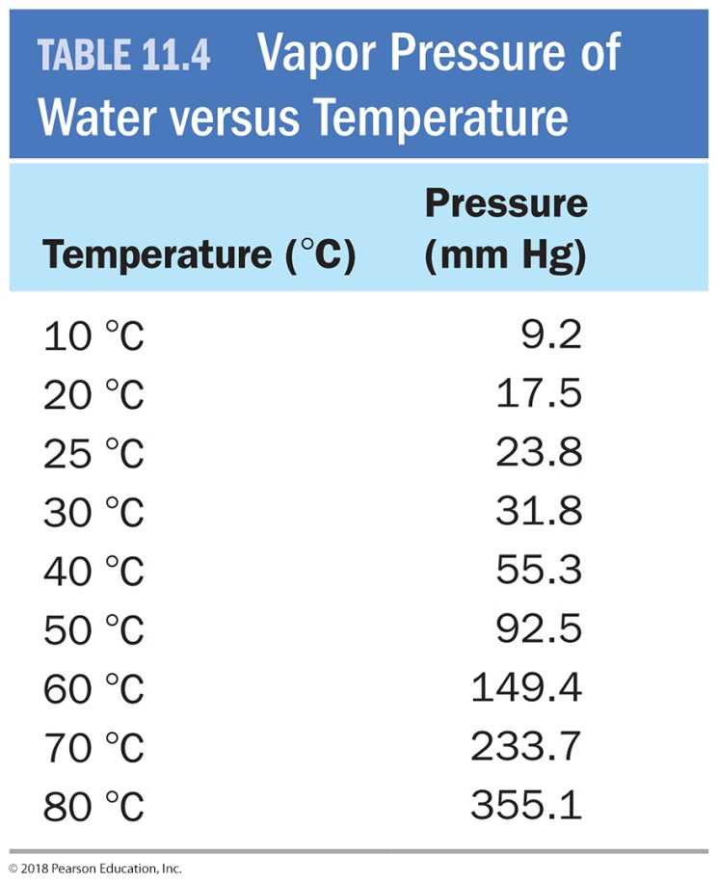
Collecting Gases Over Water
Hydrogen gas was collected over water at a total pressure of 758 mm Hg and a temperature of 25 °C. What is the partial pressure of the hydrogen gas? We look up the partial pressure of water at 25 °C = 23.8 mm Hg.
P_{tot} = P_{H2} + P_{H2O}
758 mm Hg = P_{H2} + 23.8 mm Hg
P_{H2} = 758 mm Hg − 23.8 mm Hg
P_{H2} = 734 mm Hg

Slide 75
Gases in Chemical Reactions
In reactions involving gaseous reactants or products, the amount of gas is often specified in terms of its volume (V) at a given temperature (T) and pressure (P).
Use the ideal gas law to convert pressure, volume, and temperature to moles.
Use the stoichiometric coefficients to convert to other quantities in the reaction.

Slide 76
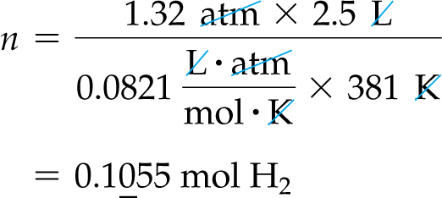
Gases in Chemical Reactions
How many moles of NH₃ are formed by the complete reaction of 2.5 L of hydrogen at 381 K and 1.32 atm? Assume that there is more than enough N₂.
GIVEN: V = 2.5 L T = 381 K P = 1.32 atm (of H₂)
CONSTANT: R FIND: mol NH₃
SOLUTION:

Slide 77
Molar Volume at Standard Temperature and Pressure
The volume occupied by 1 mol of gas at 0 °C (273.15 K) and 1 atm is 22.4 L.
These conditions are called standard temperature and pressure (STP).
The volume occupied by 1 mol of gas under these conditions is called the molar volume of an ideal gas at STP.
Under standard conditions (STP), use this ratio as a conversion factor:
1 mol : 22.4 L

Slide 78
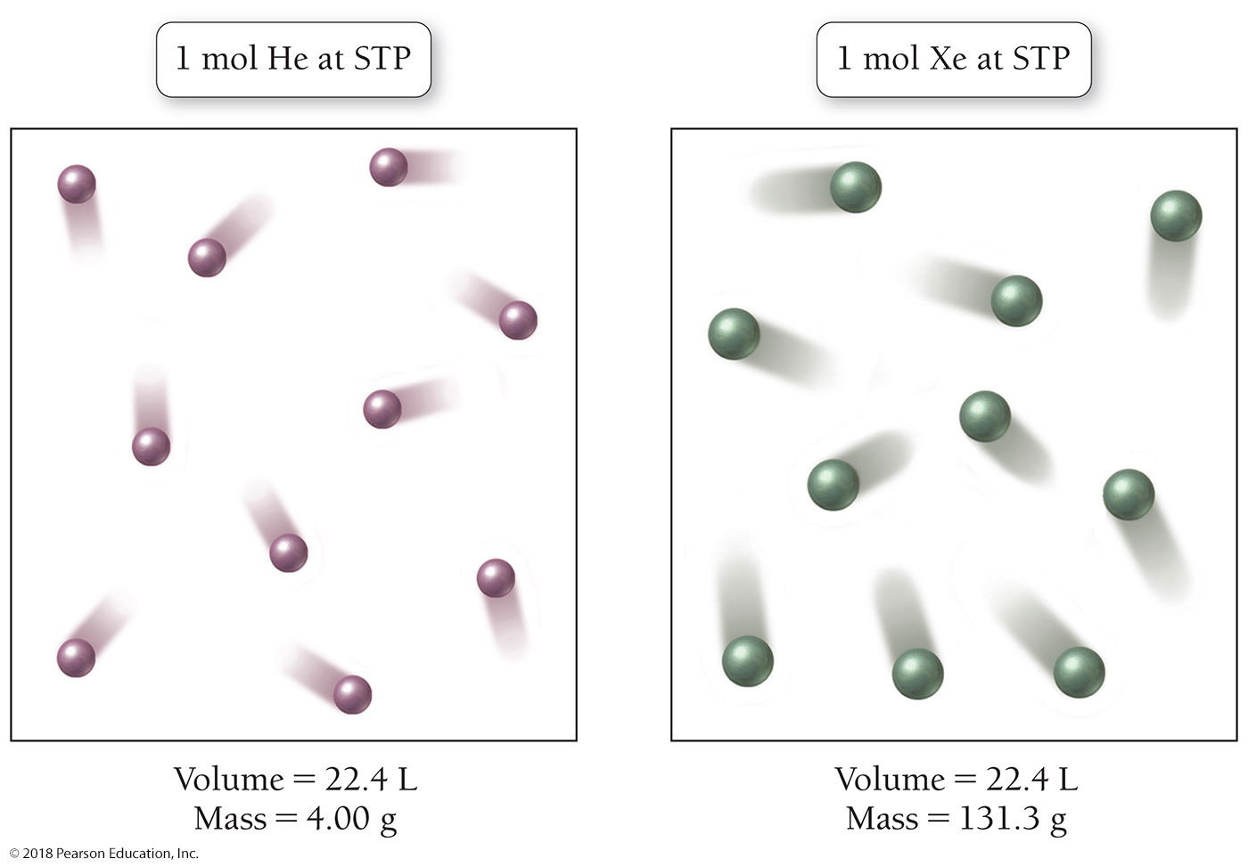
One Mole of Any Gas at Standard Temperature and Pressure (STP) Occupies 22.4 L

Slide 79
Molar Volume at Standard Temperature and Pressure
Calculate the number of liters of gas that forms at STP when 0.879 moles of CaCO₃ undergoes this reaction: CaCO₃(s) CaO(s) + CO₂(g)
GIVEN: 0.879 mol CaCO₃ FIND: CO₂(g) in liters
SOLUTION MAP:
SOLUTION:

Slide 80
Chemistry in the Environment: Air Pollution
Air pollution comes from a number of sources, including electricity generation, motor vehicles, and industrial waste.
Some of the major gaseous air pollutants are the following:
Sulfur dioxide (SO₂)—Sulfur dioxide is emitted primarily in electricity generation and industrial metal refining.
SO₂ is a lung and eye irritant that affects the respiratory system.
SO₂ is one of the main precursors of acid rain.
Carbon monoxide (CO)—Carbon monoxide is formed by the incomplete combustion of fossil fuels (petroleum, natural gas, and coal). It is emitted mainly by motor vehicles.
CO displaces oxygen in the blood and causes the heart and lungs to work harder.
At high levels, CO can cause sensory impairment, decreased thinking ability, unconsciousness, and death.

Slide 81
Chemistry in the Environment: Air Pollution
More of the major gaseous air pollutants are the following:
Ozone (O₃)—Ozone in the upper atmosphere is a normal part of our environment. Upper atmospheric ozone filters out part of the harmful UV light contained in sunlight.
Lower-atmospheric or ground-level ozone is a pollutant that results from the action of sunlight on motor vehicle emissions.
Ground-level ozone is an eye and lung irritant.
Prolonged exposure to ozone has been shown to permanently damage the lungs.
Nitrogen dioxide (NO₂)—Nitrogen dioxide is emitted by motor vehicles and by electricity generation plants.
It is an orange-brown gas that causes the dark haze often seen over polluted cities.
NO₂ is an eye and lung irritant and a precursor of acid rain.

Slide 82
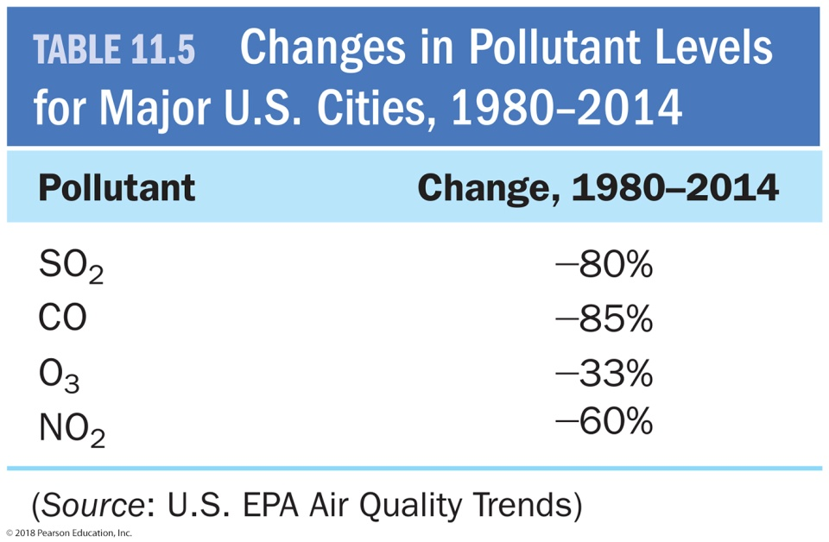
Chemistry in the Environment: Air Pollution
Beginning in the 1970s, the U.S. Congress passed the Clean Air Act and its amendments, requiring U.S. cities to reduce their pollution and maintain levels below the limits set by the EPA.
Pollutant levels in U.S. cities have decreased significantly over the last 30 years, even as the number of vehicles has increased.
According to the EPA, the levels of all four of the mentioned pollutants in major U.S cities decreased during 1980–2008.

Slide 83
Air Pollution
Air pollution plagues most large cities.
Although the levels of pollutants (especially ozone) in many cities are still above what the EPA considers safe, much progress has been made. These trends demonstrate that good legislation can clean up our environment.

Slide 84
Chapter 11 in Review
Kinetic molecular theory: A model for gases where gases are composed of widely spaced, noninteracting particles whose average kinetic energy depends on temperature.
Pressure is the force per unit area that results from the collision of gas particles with surfaces.
Gas laws: Gas laws show how one of the properties of a gas varies with another.
The combined gas law joins Boyle’s law and Charles’s law.
The ideal gas law combines the four properties of a gas—pressure (P), volume (V), temperature (T), and number of moles (n)—in a single equation showing their interrelatedness.
See Table 11.2 on page 380 for all of the gas laws.

Slide 85
Chemical Skills Learning Objectives
LO: Convert pressure units.
LO: Use simple gas laws.
LO: Use the combined gas law.
LO: Use the ideal gas law.
LO: Relate total pressure and partial pressure.
LO: Calculate stoichiometry for gases in chemical reactions.

