Slide 1
Lecture Presentation
Chapter 9
Electrons in Atoms and the Periodic Table

Slide 2
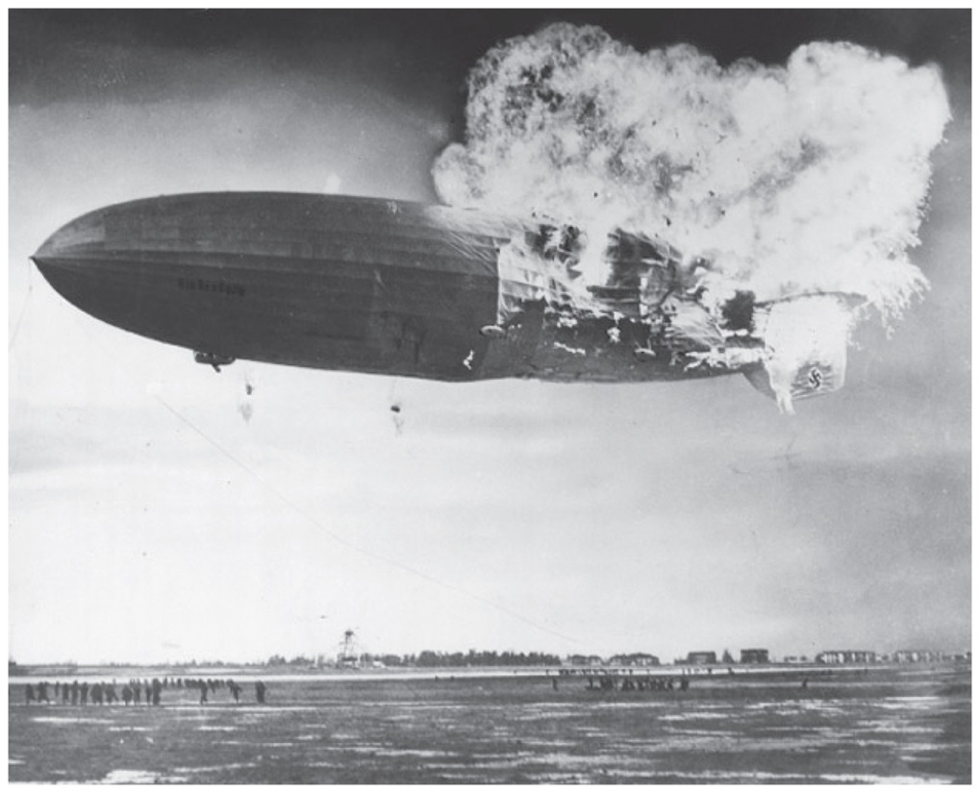
Blimps, Balloons, and Models of the Atom
On May 6, 1937, while landing in New Jersey on its first transatlantic crossing, the Hindenburg burst into flames, destroying the airship and killing 36 of the 97 passengers.
Apparently, as the Hindenburg was landing, leaking hydrogen gas ignited, resulting in an explosion that destroyed the airship.
The skin of the Hindenburg, which was constructed of a flammable material, may have also been partially to blame for its demise.
The Hindenburg was filled with hydrogen, a reactive and flammable gas. Question: What makes hydrogen reactive?

Slide 3
Blimps, Balloons, and Models of the Atom
Modern blimps are filled with helium, an inert gas.
The nucleus of the helium atom has two protons, so the neutral helium atom has two electrons—a highly stable configuration.
In this chapter, we learn about models that explain the inertness of helium and the reactivity of other elements.

Slide 4
Blimps, Balloons, and Models of the Atom
What is it about helium atoms that makes helium gas inert?
By contrast, why is hydrogen so reactive?
Elemental hydrogen exists as a diatomic element.
Hydrogen atoms are so reactive that they react with each other to form hydrogen molecules.
What is it about hydrogen atoms that make them so reactive?

Slide 5
Models Explain the Inertness and Reactivity of the Elements
Are other elements as reactive as hydrogen?
The reactivity exhibited by hydrogen is also seen in other Group 1 elements, such as lithium and sodium.
The inertness of helium is seen in neon, argon, and the other noble gases.
Mendeleev’s periodic law sums up these observations: When the elements are arranged in order of increasing atomic number, certain sets of properties recur periodically.
Models and theories help explain the observed behaviors of groups of elements such as the Group 1 metals and noble gases.

Slide 6
Electrons in Atoms and the Periodic Table
We examine two important models—the Bohr model and the quantum-mechanical model—that propose explanations for the inertness of helium, the reactivity of hydrogen, and the periodic law.
These models explain how electrons exist in atoms and how those electrons affect the chemical and physical properties of elements.

Slide 7
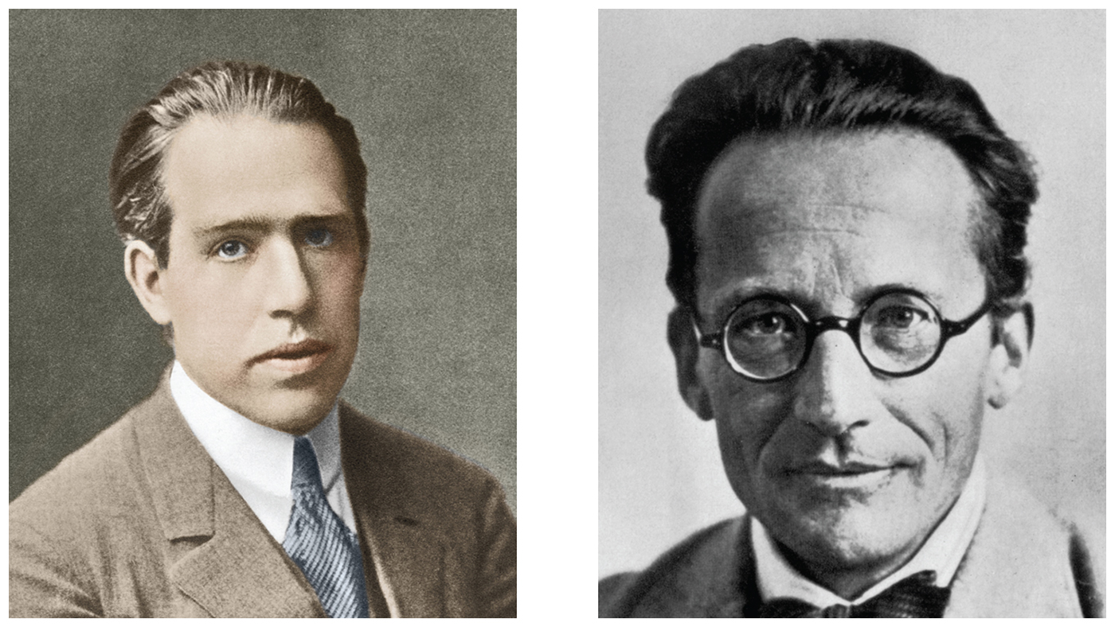
Niels Bohr and Erwin Schrödinger
Niels Bohr (left) and Erwin Schrödinger (right), along with Albert Einstein, played a role in the development of quantum mechanics, yet they were bewildered by their own theory of wave-particle duality for the electron.

Slide 8
Light: Electromagnetic Radiation
The interaction of light with atoms helped to shape scientists’ models of the atom.
Light is a form of electromagnetic radiation.
Light is a type of energy that travels through space at a constant speed of 3.0 × 10⁸ m/s (186,000 mi/s).
Light has properties of both waves and particles.

Slide 9
Light: Electromagnetic Radiation
When a water surface is disturbed, waves are created that radiate outward from the site. The wave carries energy as it moves through the water.

Slide 10
Light: Electromagnetic Radiation
Wavelength: The wavelength of light, λ (lambda, pronounced “lam-duh”), is defined as the distance between adjacent wave crests.

Slide 11
Light: Color of Light
White light, as produced by the sun or by a lightbulb, contains a spectrum of wavelengths and therefore a spectrum of color.
We see these colors—red, orange, yellow, green, blue, indigo, and violet—in a rainbow or when white light is passed through a prism.
Red light, with a wavelength of 750 nm (nanometers), has the longest wavelength of visible light.
Violet light, with a wavelength of 400 nm, has the shortest wavelength of visible light
(1 nm = 1 × 10^{–9} m).
The presence of color in white light is responsible for the colors we see in our everyday vision.

Slide 12
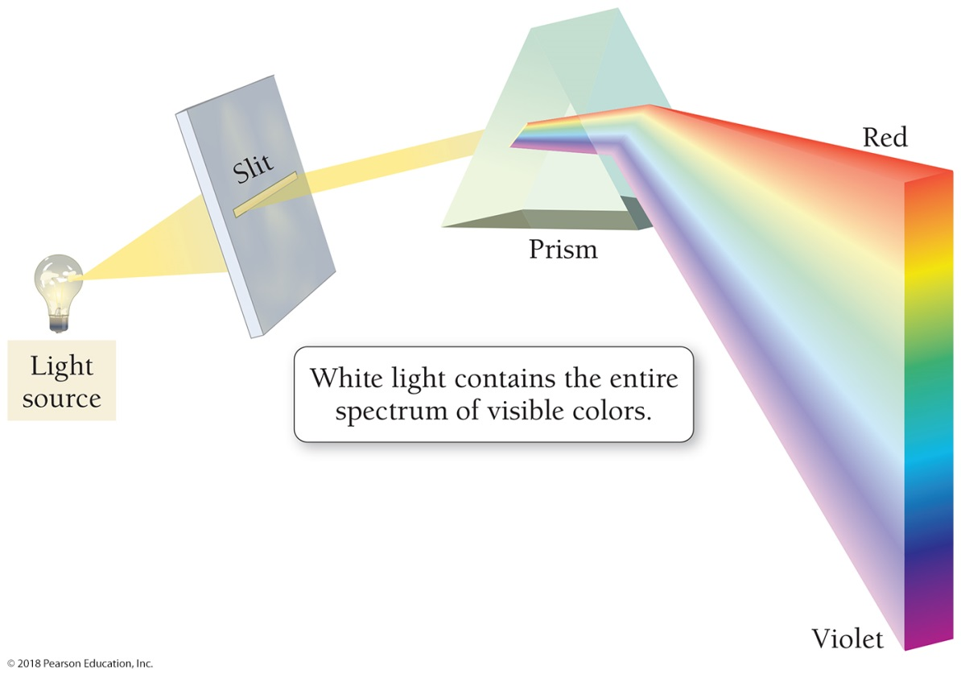
Light: Color of Light
Components of white light
R O Y G B I V
Light is separated into its constituent colors—red, orange, yellow, green, blue, indigo, and violet—when it is passed through a prism.

Slide 13
Light: Color in Objects
A red shirt appears red because it reflects red light; the shirt absorbs all of the other colors of light except the red light. Our eyes see only the reflected light, making the shirt appear red.

Slide 14
Light: Electromagnetic Radiation
Frequency: The frequency of light, ν (nu, pronounced “noo”), is defined as the number of cycles or crests that pass through a stationary point in one second.
Wavelength and frequency are inversely related—the shorter the wavelength, the higher the frequency.

Slide 15
Electromagnetic Radiation (Photons—Particles of Light)
Light can be viewed as a stream of particles.
A particle of light is called a photon.
We can think of a photon as a single packet of light energy.
The amount of energy carried in the packet depends on the wavelength of the light—the shorter the wavelength, the greater the energy.
Light waves carry more energy if their crests are closer together (higher frequency and shorter wavelength).
Violet light (shorter wavelength) carries more energy per photon than red light (longer wavelength).

Slide 16
Light: Electromagnetic Radiation
To summarize:
• Electromagnetic radiation is a form of energy that travels through space at a constant speed of 3.0 × 10⁸ m/s (186,000 mi/s) and can exhibit wavelike or particle-like properties.
• The wavelength of electromagnetic radiation determines the amount of energy carried by one of its photons. The shorter the wavelength, the greater the energy of each photon.
• The frequency and energy of electromagnetic radiation are inversely related to its wavelength.

Slide 17
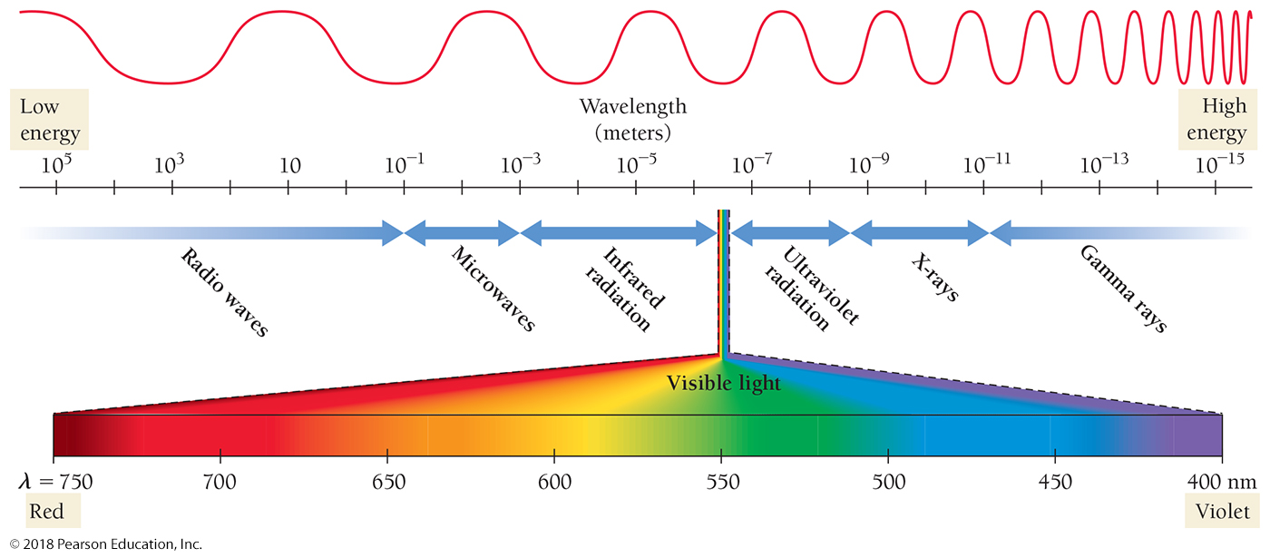
The Electromagnetic Spectrum
The entire electromagnetic spectrum, with short-wavelength, high-frequency radiation on the right and long-wavelength, low-frequency radiation on the left, is shown below. Visible light is the small sliver in the middle.

Slide 18
The Electromagnetic Spectrum
The shortest wavelength and most energetic photons are those of gamma rays.
Gamma rays are produced by the sun, by stars, and by certain unstable atomic nuclei on Earth.
Excessive human exposure to gamma rays is dangerous because the high energy of gamma-ray photons can damage biological molecules.

Slide 19
The Electromagnetic Spectrum
Next on the electromagnetic spectrum, with longer wavelengths and lower energy than gamma rays, are X-rays, familiar to us from their medical use.
X-rays pass through many substances that block visible light and are used to image internal bones and organs.
Like gamma-ray photons, X-ray photons carry enough energy to damage biological molecules.
While several yearly exposures to X-rays are relatively harmless, excessive exposure to X-rays increases cancer risk.

Slide 20
The Electromagnetic Spectrum
Between X-rays and visible light in the electromagnetic spectrum is ultraviolet or UV light, familiar to us as the component of sunlight that produces a sunburn or suntan.
While not as energetic as gamma-ray or X-ray photons, ultraviolet photons still carry enough energy to damage biological molecules.
Excessive exposure to ultraviolet light increases the risk of skin cancer and cataracts and causes premature wrinkling of the skin.

Slide 21
The Electromagnetic Spectrum
Next on the spectrum is visible light, ranging from violet (shorter wavelength, higher energy) to red (longer wavelength, lower energy).
Photons of visible light do not damage biological molecules.
Photons of visible light cause molecules in our eyes to rearrange, which sends a signal to our brains that results in vision.

Slide 22
The Electromagnetic Spectrum
Infrared light is next, with even longer wavelengths than visible light.
The heat you feel when you place your hand near a hot object is infrared light.
All warm objects, including human bodies, emit infrared light.
While infrared light is invisible to our eyes, infrared sensors can detect it and are often used in night-vision technology to “see” in the dark.
In the infrared region of the spectrum, warm objects—such as human bodies—glow, much as a lightbulb glows in the visible region of the spectrum.

Slide 23
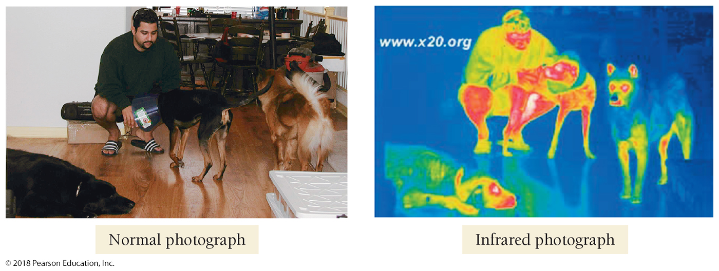
Visible Light and Infrared Radiation Images
In the infrared photograph, the warmest areas appear as red and the coolest as dark blue. (Note that the photo confirms the familiar idea that healthy dogs have cold noses.) (Source: Sierra Pacific Innovations. All rights reserved. SPI CORP, www.x20.org)

Slide 24
The Electromagnetic Spectrum
Beyond infrared light, at longer wavelengths still, are microwaves, used for radar and in microwave ovens.
Microwave light has longer wavelengths—and therefore lower energy per photon—than visible or infrared light.
Microwave light is efficiently absorbed by water and can heat substances that contain water.
Substances that contain water, such as food, are warmed by the radiation of a microwave oven, but substances that do not contain water, such as a plate, are not.
Some types of dishes contain substances that absorb microwave radiation, but most do not.

Slide 25
The Electromagnetic Spectrum
The longest wavelengths of light are radio waves, which are used to transmit the signals used by AM and FM radio, cellular telephones, television, and other forms of communication.

Slide 26
Example 9.1 Wavelength, Energy, and Frequency
Arrange these three types of electromagnetic radiation—visible light, X-rays, and microwaves—in order of increasing:
a. wavelength b. frequency c. energy per photon
a. wavelength
Figure 9.4 indicates that X-rays have the shortest wavelength, followed by visible light and then microwaves.
Solution
X-rays, visible light, microwaves

Slide 27
Example 9.1 Wavelength, Energy, and Frequency
Continued
microwaves, visible light, X-rays
microwaves, visible light, X-rays
b. frequency
Since frequency and wavelength are inversely proportional— the longer the wavelength, the shorter the frequency—the ordering with respect to frequency is exactly the reverse of the ordering with respect to wavelength
c. energy per photon
Energy per photon decreases with increasing wavelength but increases with increasing frequency; therefore, the ordering with respect to energy per photon is the same as frequency.
Skillbuilder 9.1 | Wavelength, Energy, and Frequency
Arrange these colors of visible light—green, red, and blue—in order of increasing:
a. wavelength
b. frequency
c. energy per photon
For More Practice
Example 9.9; Problems 31, 32, 33, 34, 35, 36, 37, 38.

Slide 28
Chemistry and Health Radiation Treatment for Cancer
X-rays and gamma rays are sometimes called ionizing radiation because the high energy in their photons can ionize atoms and molecules.
When ionizing radiation interacts with biological molecules, it can permanently change or even destroy them.
Doctors can use ionizing radiation to destroy molecules within unwanted cells such as cancer cells.

Slide 29
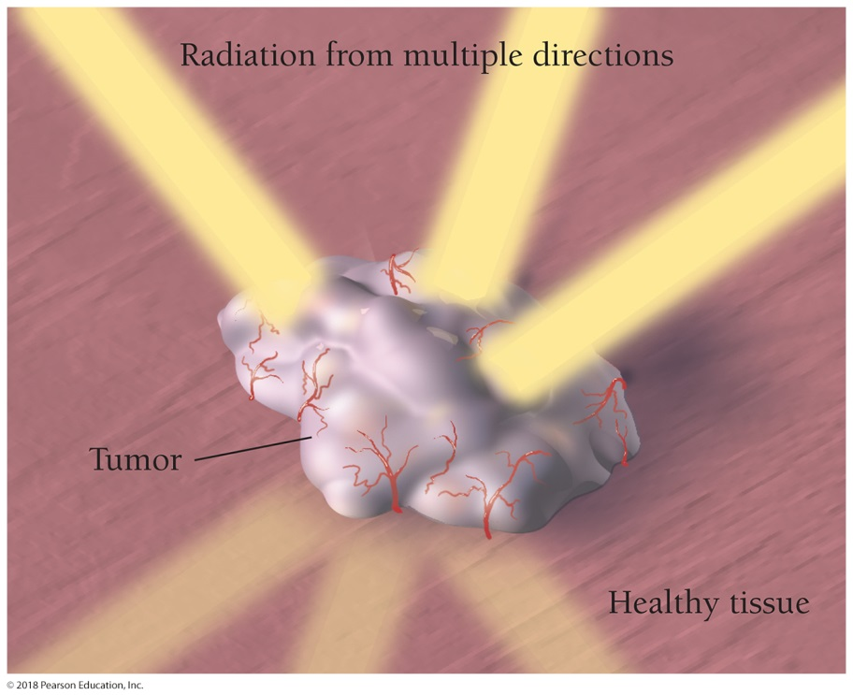
Chemistry and Health Radiation Treatment for Cancer
In radiation therapy, doctors aim X-ray or gamma-ray beams at cancerous tumors.
The ionizing radiation damages the molecules within the tumor’s cells that carry genetic information, and the cell dies or stops dividing.
Healthy cells often inadvertently sustain damage during treatments, resulting in side effects such as fatigue, skin lesions, and hair loss.
Doctors try to minimize the exposure of healthy cells by appropriate shielding and by targeting the tumor from multiple directions, minimizing the exposure of healthy cells while maximizing the exposure of cancerous cells.

Slide 30
Each Element Has Its Own Atomic Emission Spectrum of Light
Neon atoms inside a glass tube absorb electrical energy and then reemit the energy as red light.

Slide 31
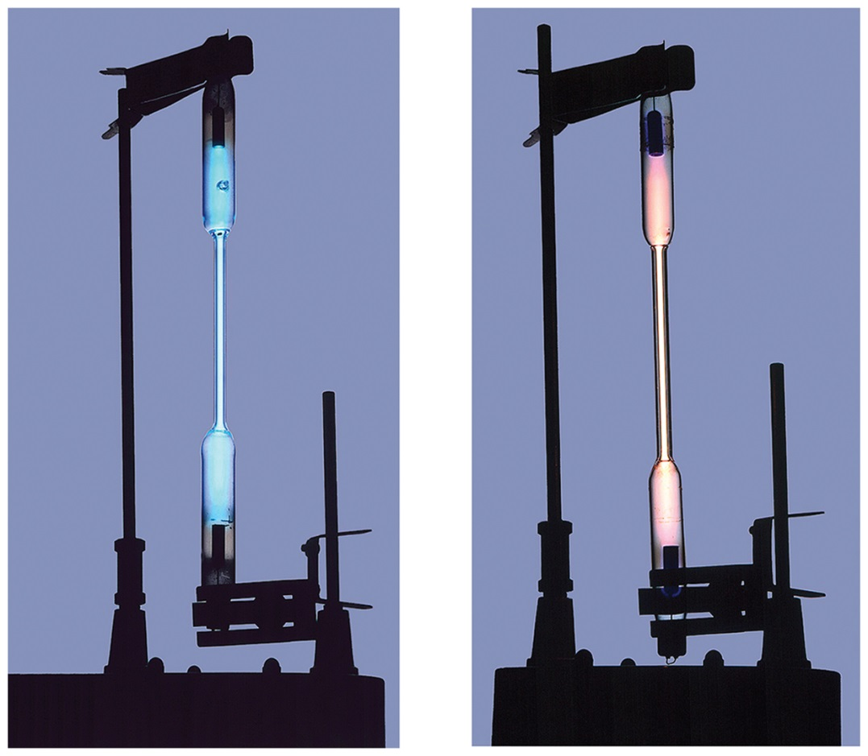
Each Element Has Its Own Atomic Emission Spectrum of Light
Light emitted from a mercury lamp (left) appears blue, and light emitted from a hydrogen lamp (right) appears pink.

Slide 32
Emission Spectra of the Elements Are Not Continuous
A white-light spectrum is continuous, with some radiation emitted at every wavelength. The emission spectrum of an individual element includes only certain specific wavelengths.

Slide 33
Light Emitted by Hydrogen Contains Distinct Wavelengths That Are Specific to Hydrogen

Slide 34
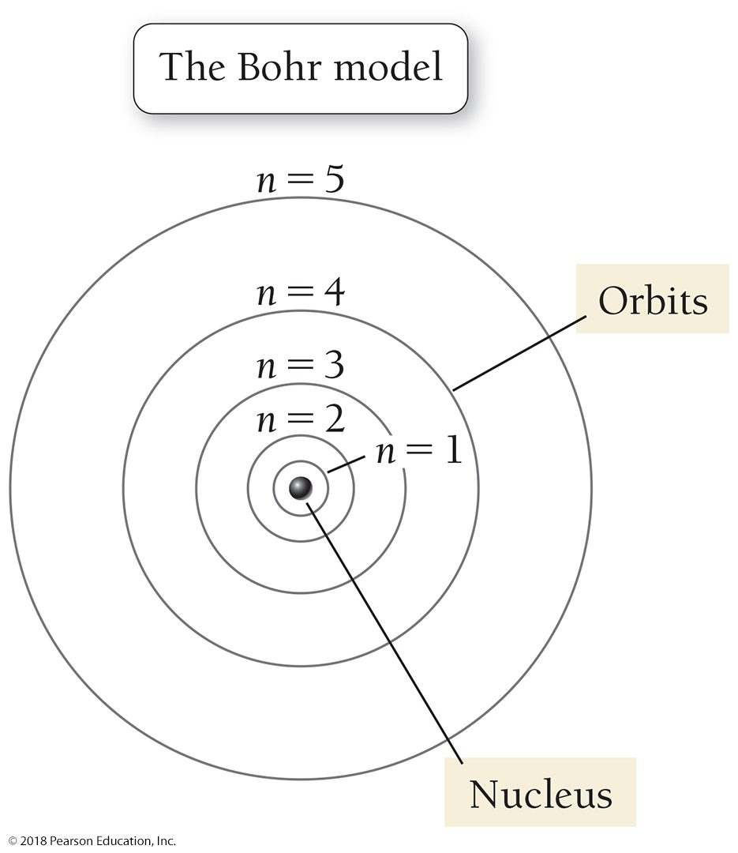
Niels Bohr Developed a Simple Model to Explain These Results

Slide 35
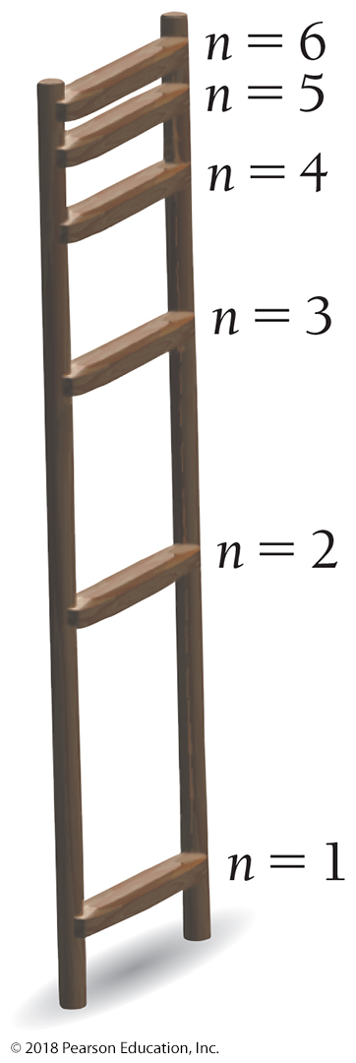
The Energy Is Quantized
The energy of each Bohr orbit, specified by a quantum number n = 1, 2, 3 is fixed, or quantized. Bohr orbits are like steps of a ladder, each at a specific distance from the nucleus and each at a specific energy. It is impossible for an electron to exist between orbits in the Bohr model.

Slide 36
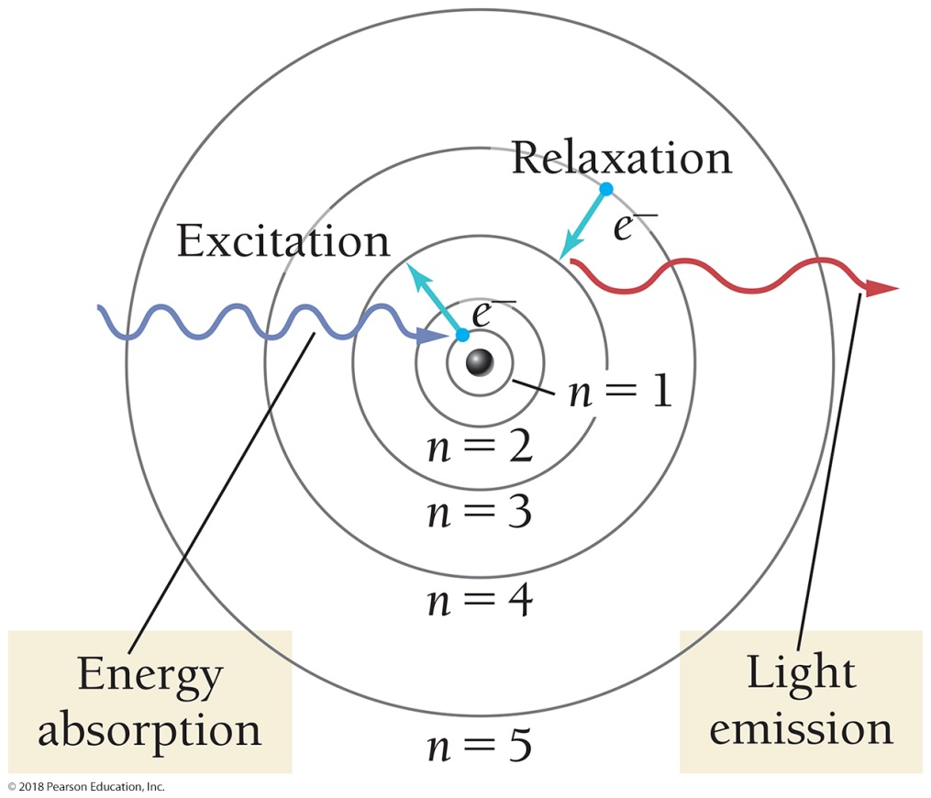
Excitation and Emission
When a hydrogen atom absorbs energy, an electron is excited to a higher-energy orbit. The electron then relaxes back to a lower-energy orbit, emitting a photon of light.

Slide 37
Hydrogen Emission Lines
Since the amount of energy in a photon is directly related to its wavelength, the photon has a specific wavelength.
The light emitted by excited atoms consists of specific lines at specific wavelengths, each corresponding to a specific transition between two orbits.
For example, the line at 486 nm in the hydrogen emission spectrum corresponds to an electron relaxing from the n = 4 orbit to the n = 2 orbit.
In the same way, the line at 657 nm (longer wavelength and lower energy) corresponds to an electron relaxing from the n = 3 orbit to the n = 2 orbit.

Slide 38
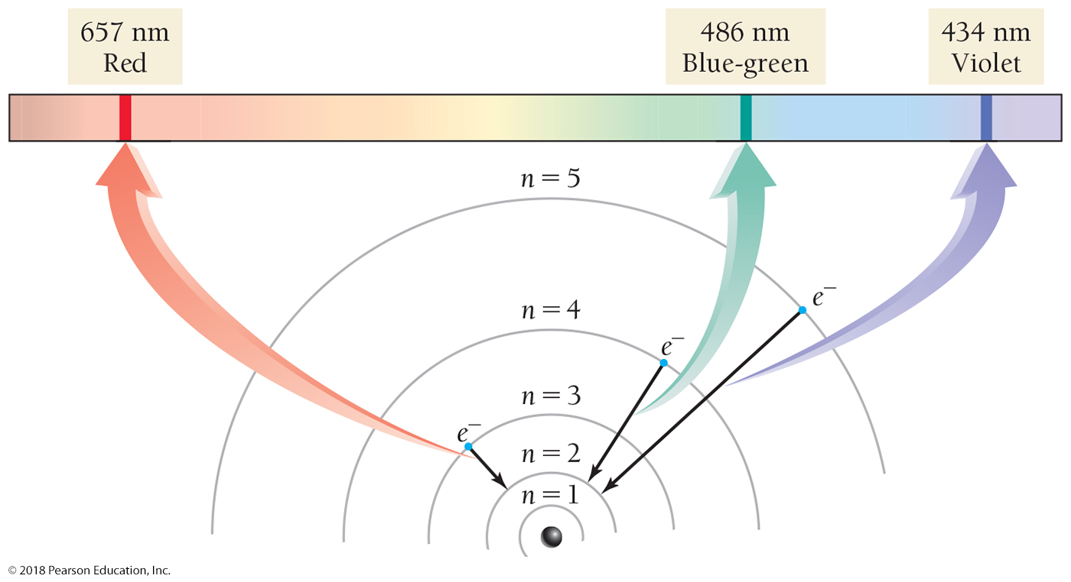
Hydrogen Emission Lines

Slide 39
The Bohr Model: Atoms with Orbits
The great success of the Bohr model of the atom was that it predicted the lines of the hydrogen emission spectrum.
However, it failed to predict the emission spectra of other elements that contained more than one electron.
For this and other reasons, the Bohr model was replaced with a more sophisticated model called the quantum-mechanical or wave-mechanical model.

Slide 40
The Quantum-Mechanical Model: Atoms with Orbitals
The quantum-mechanical model of the atom replaced the Bohr model in the early twentieth century. In the quantum-mechanical model, Bohr orbits are replaced with quantum-mechanical orbitals.
Orbitals are different from orbits in that they represent probability maps that show a statistical distribution of where the electron is likely to be found.

Slide 41
The Quantum-Mechanical Model: Atoms with Orbitals
Quantum mechanics revolutionized physics and chemistry because, in the quantum-mechanical model, electrons do not behave like particles flying through space.
We cannot, in general, describe their exact paths.
An orbital is a probability map that shows where the electron is likely to be found when the atom is probed; it does not represent the exact path that an electron takes as it travels through space.

Slide 42
Baseball Paths and Electron Probability Maps
Contrast the behavior of a baseball with that of an electron.
Imagine a baseball thrown from the pitcher’s mound to a catcher at home plate.
The baseball’s path can easily be traced as it travels from the pitcher to the catcher.

Slide 43
Baseball Paths and Electron Probability Maps
In the quantum-mechanical world of the electron, the catcher could not know exactly where the electron would cross the plate for any given throw.
He would have no way of putting his mitt in the right place to catch it.
However, if the catcher kept track of hundreds of electron throws, he could observe a reproducible, statistical pattern of where the electron crosses the plate.
He could even draw maps in the strike zone showing the probability of an electron crossing a certain area. These maps are called probability maps.

Slide 44
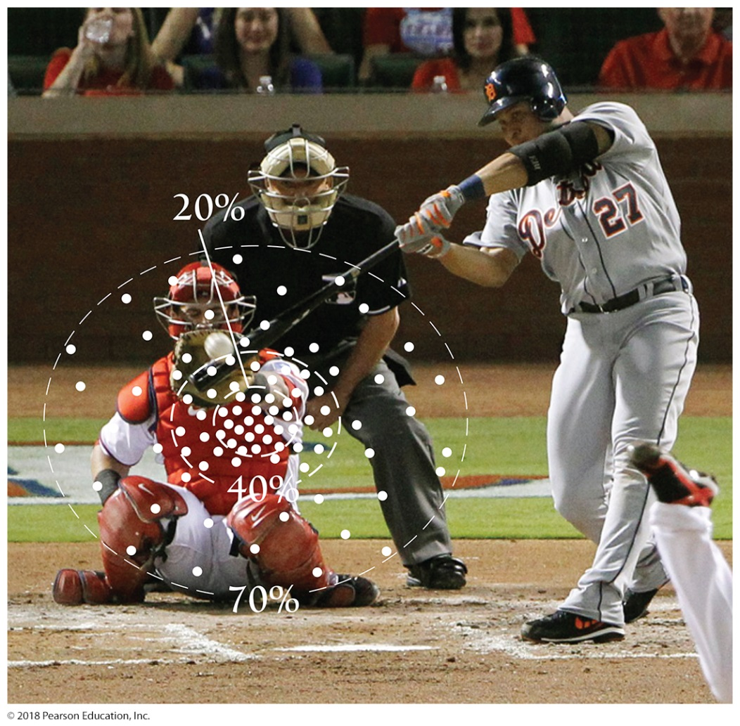
Baseball Paths and Electron Probability Maps
To describe the behavior of a “pitched” electron, you would have to construct a probability map of where it would cross home plate.

Slide 45
Principal Quantum Numbers for Orbitals
In the quantum-mechanical model, a number and a letter specify an orbital (or orbitals).
The lowest-energy orbital in the quantum-mechanical model is called the 1s orbital.
It is specified by the number 1 and the letter s.
The number is called the principal quantum number (n) and specifies the principal shell of the orbital.

Slide 46
Ground States and Excited States
The single electron of an undisturbed hydrogen atom at room temperature is in the 1s orbital.
This is called the ground state, or lowest energy state, of the hydrogen atom.
The absorption of energy by a hydrogen atom can cause the electron to jump (or make a transition) from the 1s orbital to a higher-energy orbital. When the electron is in a higher-energy orbital, the hydrogen atom is said to be in an excited state.
All the atoms of each element have one ground state and many excited states.

Slide 47
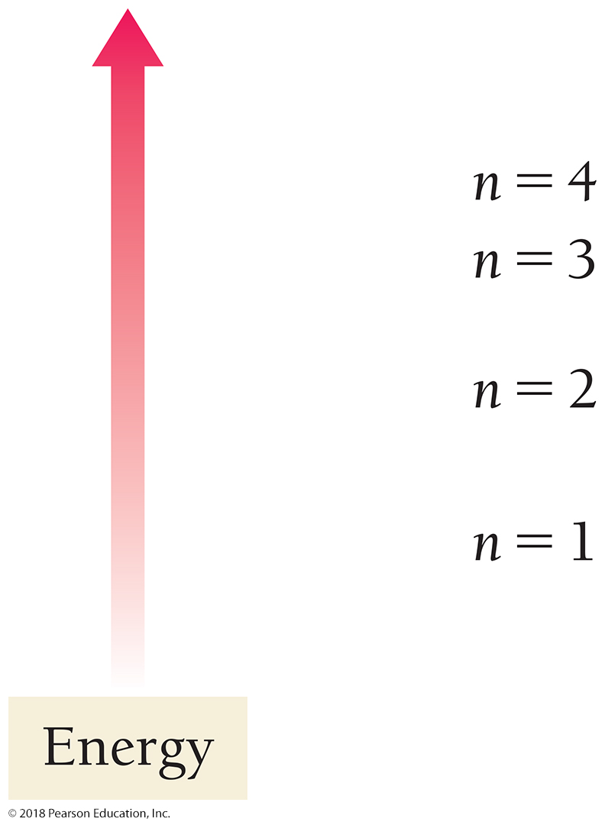
Energy Increases with Principal Quantum Number
The higher the principal quantum number, the higher the energy of the orbital.
The possible principal quantum numbers are
n = 1, 2, 3 … with energy
increasing as n increases.
Since the 1s orbital has the lowest possible principal quantum number, it is in the lowest-energy shell and has the lowest possible energy.

Slide 48
Shapes of Quantum-Mechanical Orbitals
The letter indicates the subshell of the orbital and specifies its shape.
The possible letters are s, p, d, and f, each with a different shape.
Orbitals within the s subshell have a spherical shape.

Slide 49
Representations of Orbitals
Orbitals are sometimes represented by dots, where the dot density is proportional to the probability of finding the electron.
The dot density for the 1s orbital is greatest near the nucleus and decreases farther away from the nucleus.
The electron is more likely to be found close to the nucleus than far away from it.

Slide 50
Representations of Orbitals
Orbitals can be represented as geometric shapes that encompass most of the volume where the electron is likely to be found.
The 1s orbital can be represented as a sphere that encompasses the volume within which the electron is found 90% of the time.
If we superimpose the dot representation of the 1s orbital on the shape representation, we can see that most of the dots are within the sphere, meaning that the electron is most likely to be found within the sphere when it is in the 1s orbital.

Slide 51
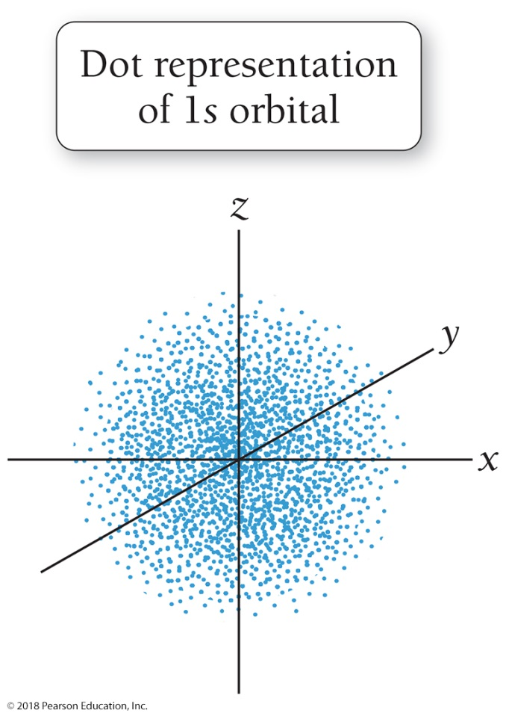
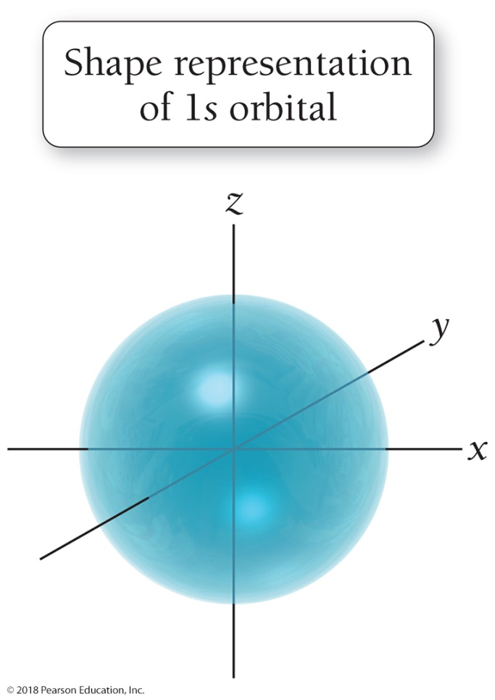
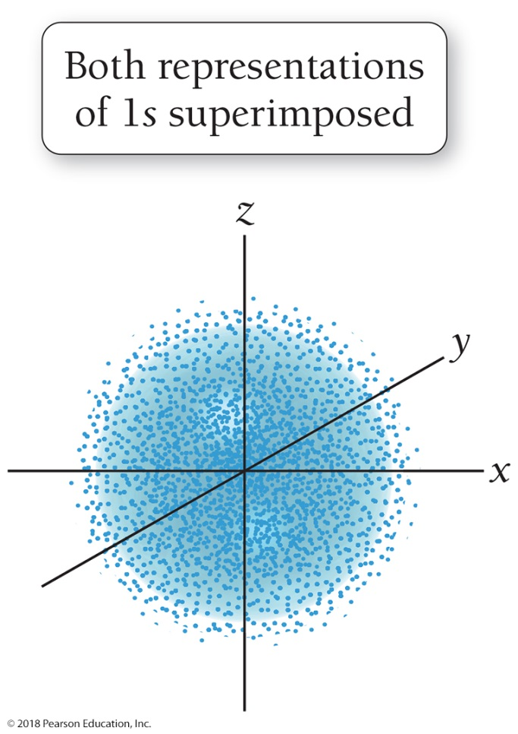
Representations of Orbitals
Dot density and shape representations of the 1s orbital: The dot density is proportional to the probability of finding the electron. The greater dot density near the middle represents a higher probability of finding the electron near the nucleus.

Slide 52
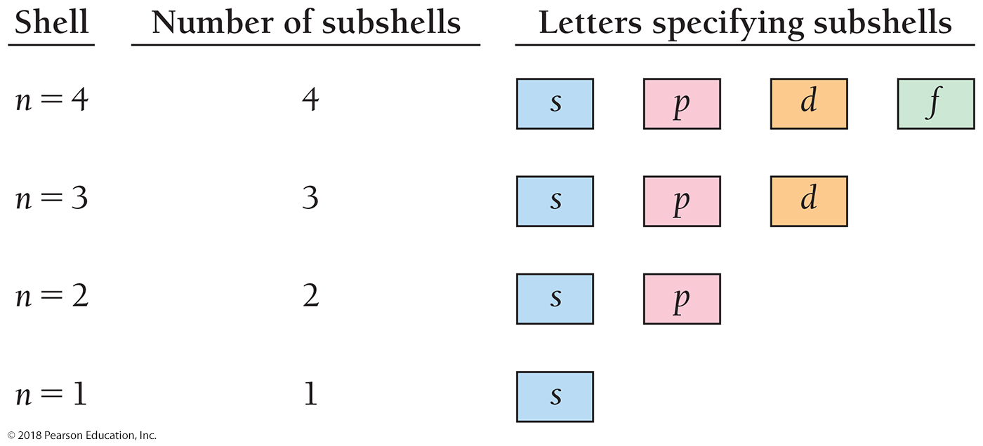
The Number of Subshells in a Given Principal Shell Is Equal to the Value of n

Slide 53
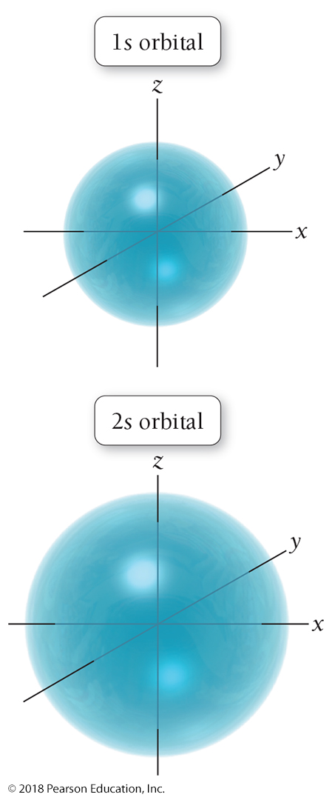
The 2s Orbital Is Similar to the 1s Orbital, but Larger in Size

Slide 54
The 2p Orbitals: This figure Shows Both the Dot Representation (Left) and Shape Representation (Right) for Each p Orbital

Slide 55
Orbitals When n = 3
The next principal shell, n = 3, contains three subshells specified by s, p, and d.
The s and p subshells contain the 3s and 3p orbitals, similar in shape to the 2s and 2p orbitals, but slightly larger and higher in energy.
The d subshell contains five d orbitals.

Slide 56
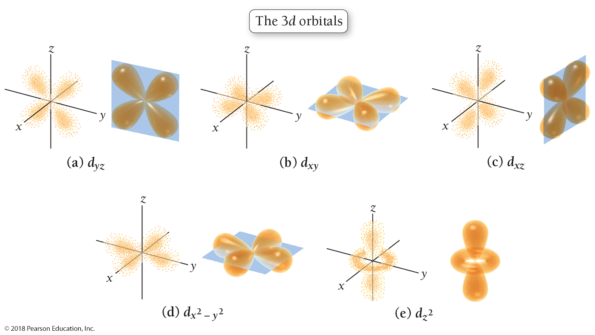
The 3d Orbitals: This Figure Shows Both the Dot Representation (Left) and Shape Representation (Right) for Each d Orbital

Slide 57
From Orbits to Orbitals
The quantum-mechanical model predicts the bright-line spectrum of hydrogen as well as the Bohr model does.
The quantum-mechanical model can predict the bright-line spectra of other elements; the Bohr model cannot predict spectra for atoms with more than one electron.
The Bohr model was replaced with a more sophisticated model called the quantum-mechanical or wave-mechanical model.
The Bohr model is still important because it provides a logical foundation to the quantum-mechanical model and reveals the historical development of scientific understanding.

Slide 58
Electron Configurations: How Electrons Occupy Orbitals
An electron configuration shows the occupation of orbitals by electrons for a particular atom.
The electron configuration for a ground-state hydrogen atom is as follows:
The electron configuration tells us that hydrogen’s single electron is in the 1s orbital.

Slide 59
Electron Configurations: Orbital Diagrams
Another way to represent this information is with an orbital diagram, which gives similar information but shows the electrons as arrows in a box representing the orbital.
The orbital diagram for a ground-state hydrogen atom is as follows:
The box represents the 1s orbital, and the arrow within the box represents the electron in the 1s orbital.

Slide 60
Electron Spin
In orbital diagrams, the direction of the arrow (pointing up or pointing down) represents electron spin, a fundamental property of electrons.
The Pauli exclusion principle states that orbitals may hold no more than two electrons with opposing spins.
We symbolize this as two arrows pointing in opposite directions.

Slide 61
Energy Ordering of Orbitals for Multi-Electron Atoms
In multi-electron atoms, the subshells within a principal shell do not have the same energy because of electron–electron interactions.
Different subshells within the same principal shell have different energies.
The 4s subshell is lower in energy than the 3d subshell, even though its principal quantum number is higher.

Slide 62
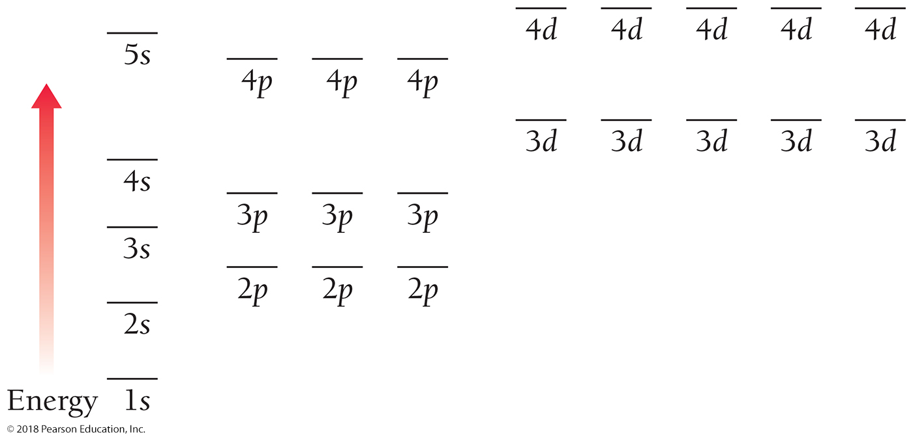
Energy Ordering of Orbitals for Multi-Electron Atoms

Slide 63
Writing Ground-State Electron Configurations
A helium atom has two electrons.
The electron configuration and orbital diagram for helium are as follows:
A lithium atom has three electrons.
The electron configuration and orbital diagram for lithium are as follows:

Slide 64
Writing Ground-State Electron Configurations
For carbon, which has six electrons, the electron configuration and orbital diagram are as follows:
The 2p electrons occupy the p orbitals (of equal energy) singly, rather than pairing in one orbital.
This is the result of Hund’s rule:
When filling orbitals of equal energy, electrons fill them singly first, with parallel spins.

Slide 65
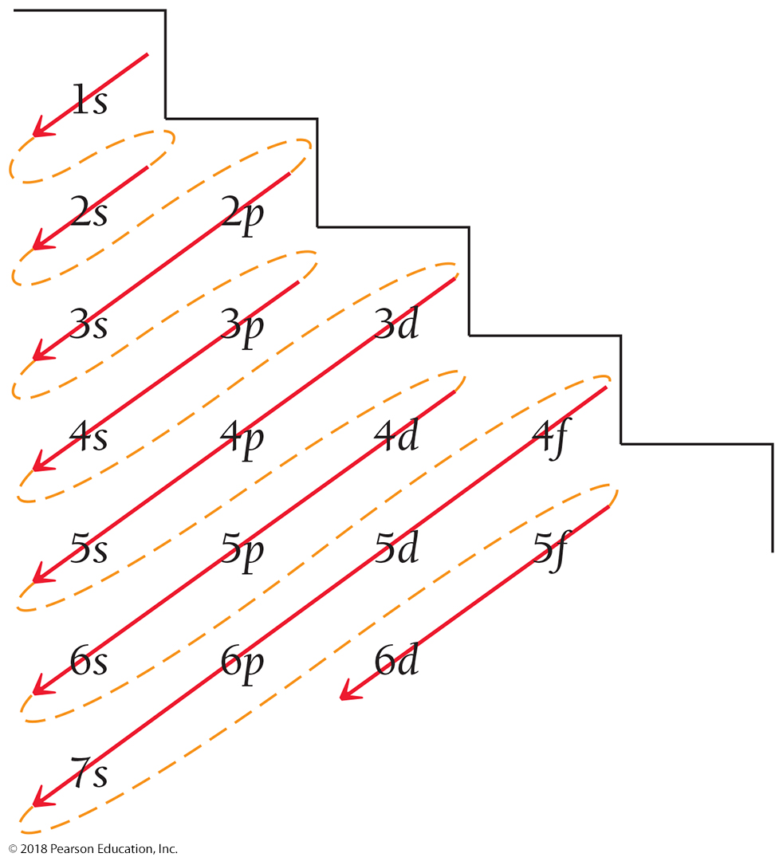
Orbitals Fill in the Following Order: 1s 2s 2p 3s 3p 4s 3d 4p 5s 4d 5p 6s

Slide 66
To Write Electron Configurations
Lower-energy orbitals fill before higher-energy orbitals.
Orbitals can hold no more than two electrons each. When two electrons occupy the same orbital, they must have opposing spins. This is known as the Pauli exclusion principle.
When orbitals of identical energy are available, all of these are first occupied singly by electrons with parallel spins rather than electrons in pairs. This is known as Hund’s rule.

Slide 67
The Electron Configuration of Neon Represents the Complete Filling of the n = 2 Principal Shell

Slide 68
The Noble Gas Core Notation
When writing electron configurations for elements beyond neon—or beyond any other noble gas—the electron configuration of the previous noble gas can be abbreviated by the symbol for the noble gas in brackets.
For sodium (11)
Na: 1s²2s²2p⁶3s¹
Na: [Ne]3s¹

Slide 69
Electron Configurations and the Periodic Table
Valence electrons are the electrons in the outermost principal shell (the principal shell with the highest principal quantum number, n).
These electrons are important because they are involved in chemical bonding.
Electrons that are not in the outermost principal shell are called core electrons.

Slide 70
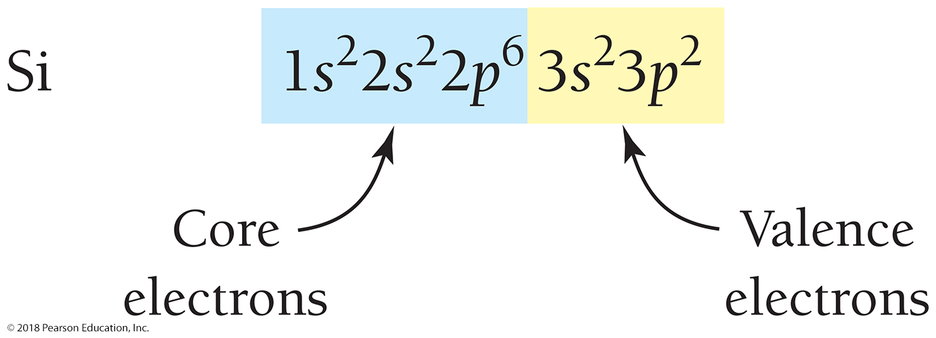
Valence Electrons and Core Electrons
Silicon has 4 valence electrons (those in the
n = 3 principal shell) and 10 core electrons.

Slide 71
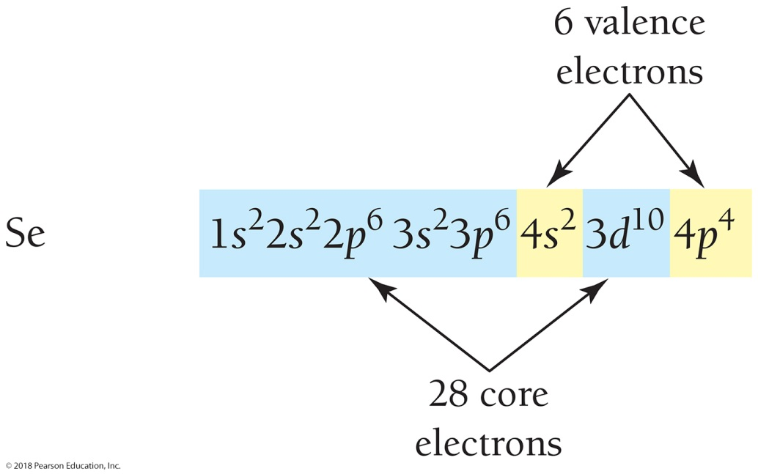
Valence Electrons and Core Electrons
Selenium has 6 valence electrons (those in the
n = 4 principal shell).
All other electrons, including those in the 3d orbitals, are core electrons.

Slide 72
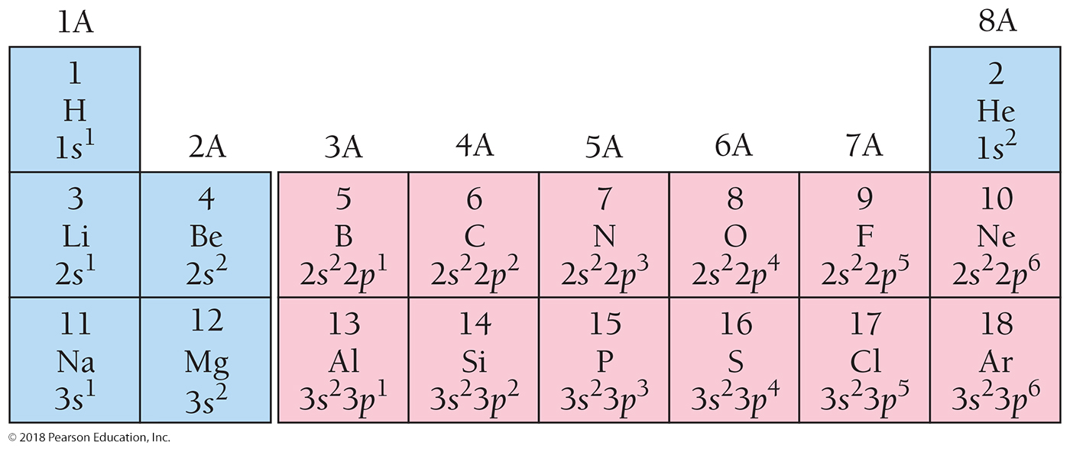
Electron Configurations and the Periodic Table
The elements within a column of the periodic table all have the same number of valence electrons and similar outer electron configurations.

Slide 73
A Pattern Exists for the Entire Periodic Table
The first two columns on the left side of the periodic table are the s block.
• The six columns on the right side of the periodic table are the p block.
• The transition metals are the d block.
• The lanthanides and actinides (also called the inner transition metals) are the f block.

Slide 74
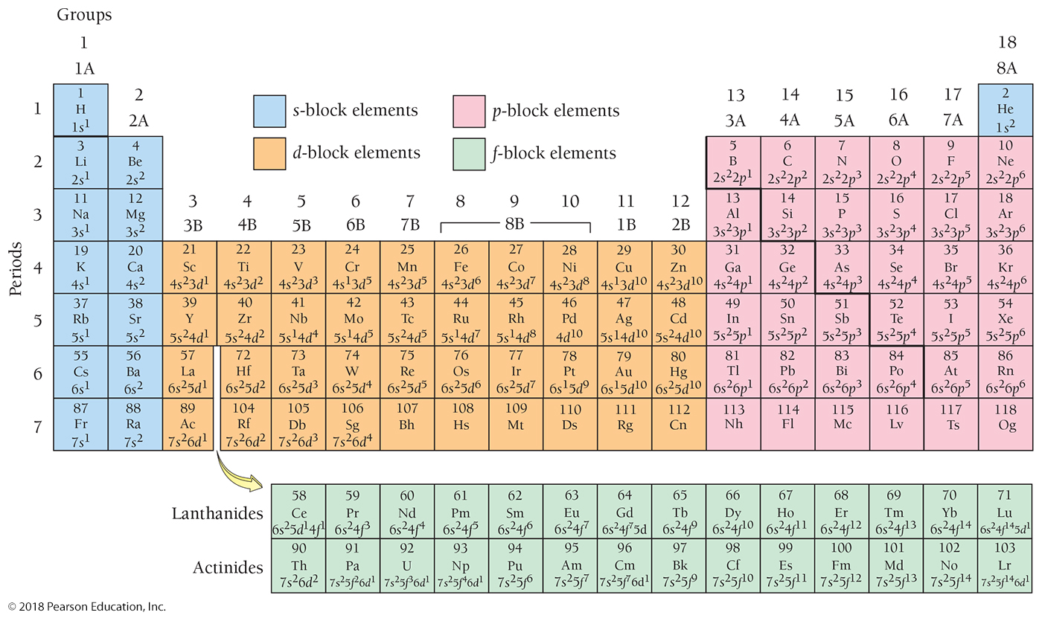
A Pattern Exists for the Entire Periodic Table

Slide 75
Periodic Trends in Electron Configurations of the Main Group Elements
The number of valence electrons for any main-group element is equal to the group number of its column. (Helium is an exception.)
Chlorine has 7 valence electrons because it is in the column with group number 7A.
The row number in the periodic table is equal to the number of the highest principal shell (n value).
Chlorine is in row 3; its highest principal shell is the n = 3 shell.
Remember that main-group elements are those in the two far left columns (1A, 2A) and the six far right columns (3A–8A) of the periodic table.

Slide 76
Periodic Trends in Electron Configurations of the Transition Series Elements
The transition metals have electron configurations with trends that differ somewhat from main-group elements.
The principal quantum number of the d orbital being filled across each row in the transition series is equal to the row number minus one.
For the first transition series, the outer configuration is 4s²3d^{x} (x = number of d electrons).
Two exceptions: Cr is 4s¹3d⁵ and Cu is 4s¹3d¹⁰.
These exceptions occur because a half-filled d subshell and a completely filled d subshell are particularly stable.

Slide 77
Periodic Trends in Electron Configurations of the Transition Series Elements
The number of outershell electrons in a transition series does not change as you move across a period.
The transition series represents the filling of core orbitals and the number of outershell electrons is mostly constant—either 2 or 1.
(2e–) for 4s²3d^{x}
(1e–) for 4s¹3d⁵ or 4s¹3d¹⁰

Slide 78
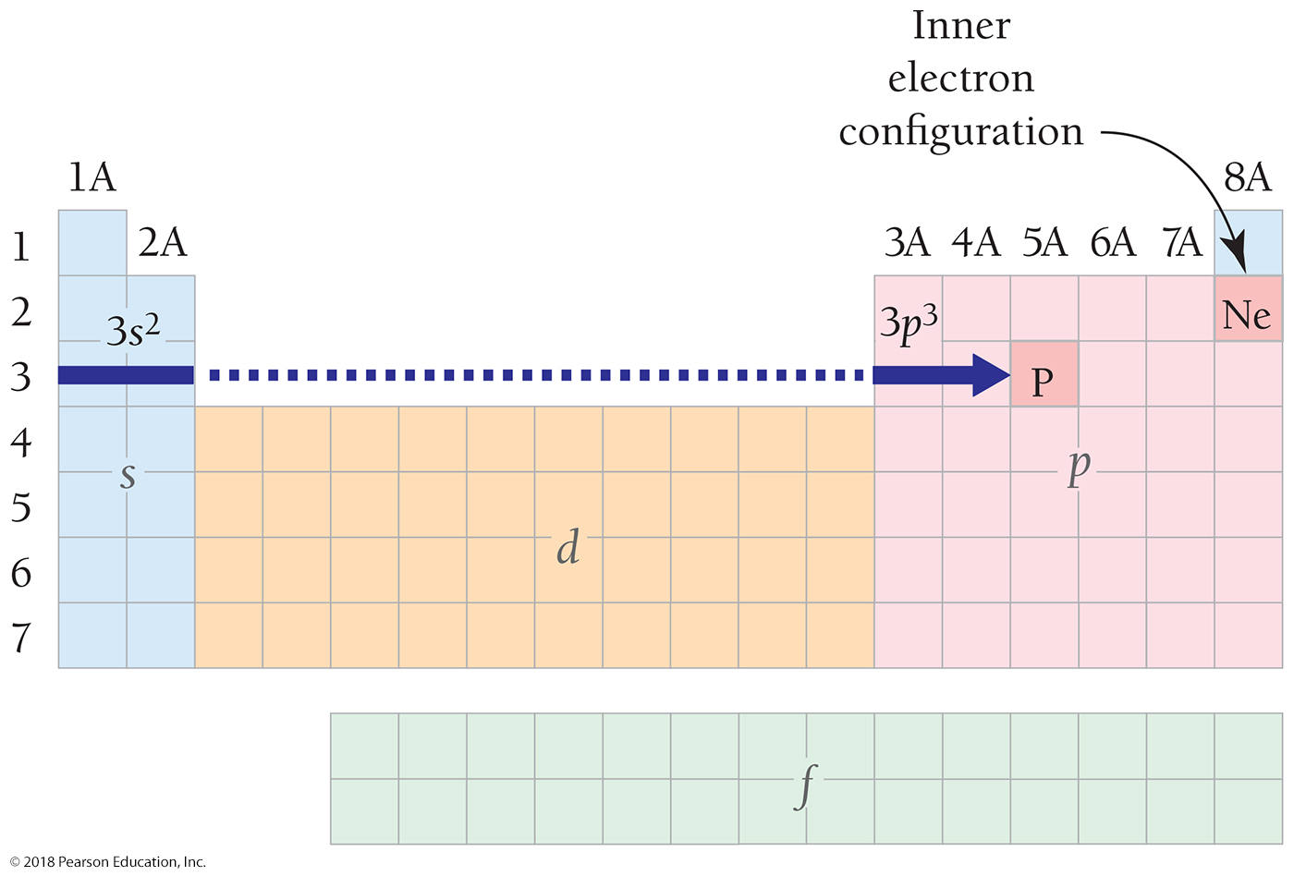
Write Electron Configuration Based on Position in the Periodic Table: Phosphorus

Slide 79
Write the Electron Configuration for Any Element Based on Its Position in the Periodic Table
• The inner electron configuration is the electron configuration of the noble gas that immediately precedes that element in the periodic table. Represent the inner configuration with the symbol for the noble gas in brackets.
• The outer electrons can be determined from the element’s position within a particular block (s, p, d, or f) in the periodic table. Trace the elements between the preceding noble gas and the element of interest, and assign electrons to the appropriate orbitals.
• The highest principal quantum number (highest n value) is equal to the row number of the element in the periodic table.
• For any element containing d electrons, the principal quantum number (n value) of the outermost d electrons is equal to the row number of the element minus 1.

Slide 80
The Explanatory Power of the Quantum-Mechanical Model
Some observations:
Sodium tends to form Na⁺ ions, and fluorine tends to form F⁻ ions.
Some elements are metals, and others are nonmetals.
The noble gases are chemically inert, and the alkali metals are chemically reactive.

Slide 81
The Explanatory Power of the Quantum-Mechanical Model
The chemical properties of elements are largely determined by the number of valence electrons they contain.
Their properties vary in a periodic fashion because the number of valence electrons is periodic.

Slide 82
The Noble Gases
Calculations show that atoms with 8 valence electrons (or 2 for helium) are predicted to be particularly low in energy and therefore stable.
The noble gases are chemically stable, and thus relatively inert or nonreactive as accounted for by the quantum model.
Elements with electron configurations close to the noble gases are the most reactive because they can attain noble gas electron configurations by losing or gaining a small number of electrons.

Slide 83
The Alkali Metals
Alkali metals (Group 1) are among the most reactive metals since their outer electron configuration (ns¹) is 1 electron beyond a noble gas configuration.
If they can react to lose the electron, they attain a noble gas configuration.
This explains why the Group 1 metals tend to form 1+ cations.

Slide 84
The Alkaline Earth Metals
The alkaline earth metals (Group 2) all have electron configurations ns² and are therefore 2 electrons beyond a noble gas configuration.
In their reactions, they tend to lose 2 electrons, forming 2+ ions and attaining a noble gas configuration.

Slide 85
The Halogens
The halogens (Group 7) all have ns²np⁵ electron configurations and are therefore 1 electron short of a noble gas configuration.
In their reactions, halogens tend to gain 1 electron, forming 1− ions and attaining a noble gas configuration.

Slide 86
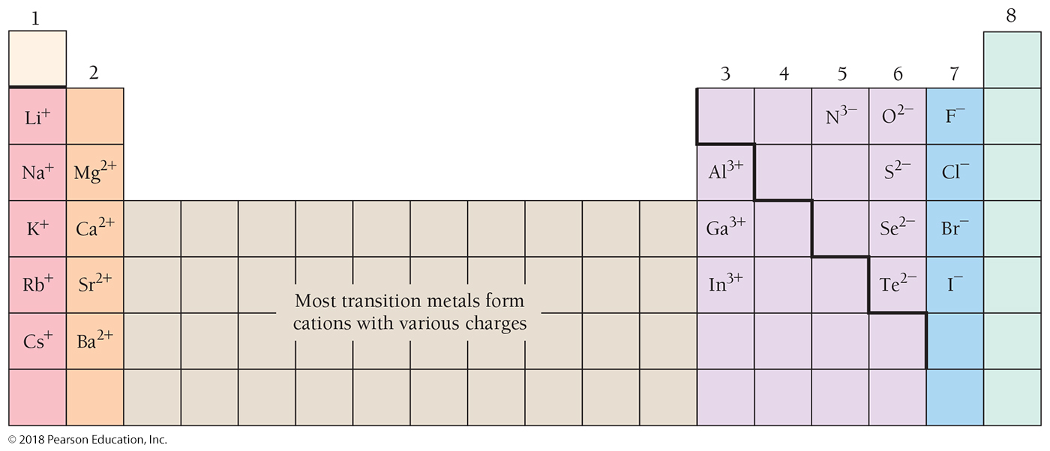
Elements That Form Predictable Ions

Slide 87
Periodic Trends: Atomic Size Has Two Factors
#1: As you move to the right across a period in the periodic table, atomic size decreases.
The atomic size of an atom is determined by the distance between the outermost electrons and the nucleus.
The size of an orbital depends on the principal quantum number.
With each step across a period, the number of protons in the nucleus is increasing.
This increase in the number of protons results in a greater pull on the electrons from the nucleus, causing atomic size to decrease.

Slide 88
Periodic Trends: Atomic Size Has Two Factors
#2: As you move down a column in the periodic table, atomic size increases.
As you move down a column in the periodic table, the highest principal quantum number, n, increases.
Since the size of an orbital increases with increasing principal quantum number, the electrons that occupy the outermost orbitals are farther from the nucleus as you move down a column.

Slide 89
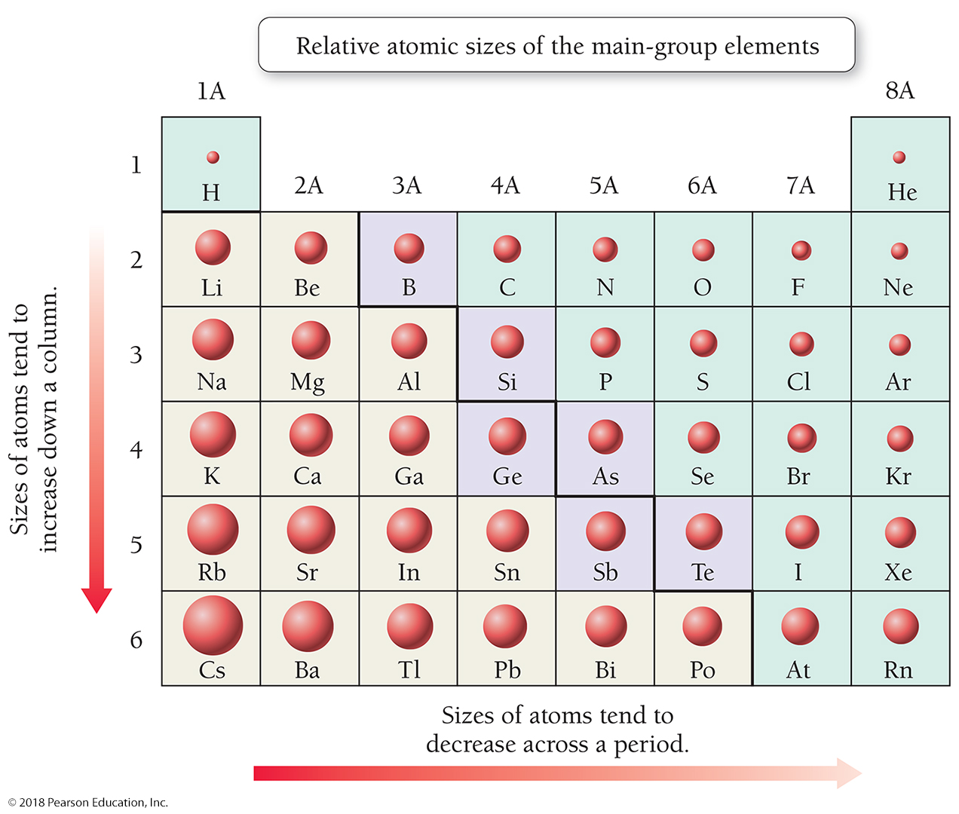
Periodic Properties: Atomic Size

Slide 90
Periodic Properties: Ionization Energy
Ionization energy increases as you move to the right across a period and decreases as you move down a column in the periodic table.

Slide 91
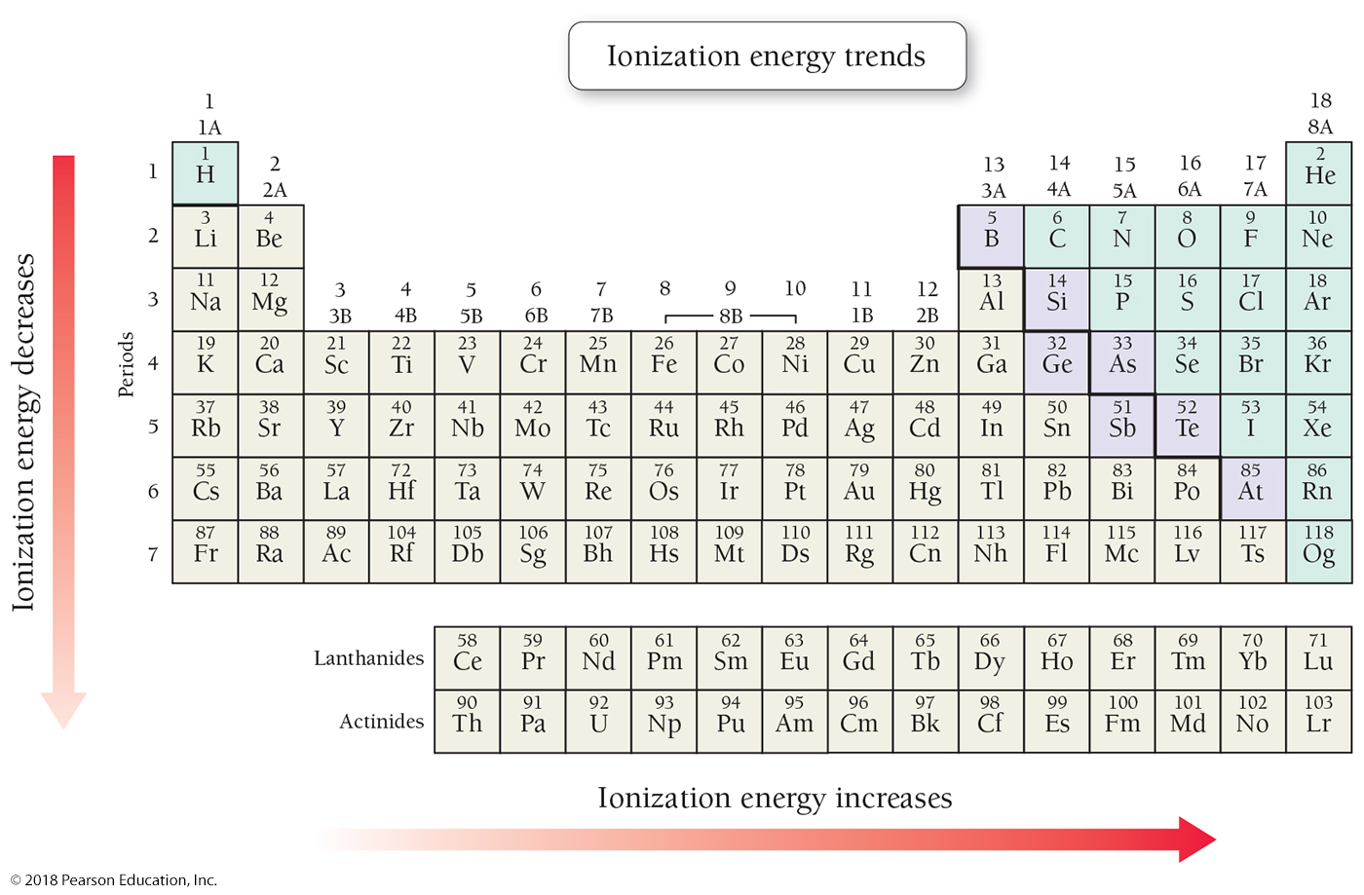
Periodic Properties: Ionization Energy

Slide 92
Periodic Properties: Metallic Character
Metals tend to lose electrons in their chemical reactions, while nonmetals tend to gain electrons.
As you move across a period in the periodic table, ionization energy increases, which means that electrons are less likely to be lost in chemical reactions.
Metallic character decreases as you move to the right across a period and increases as you move down a column in the periodic table.

Slide 93
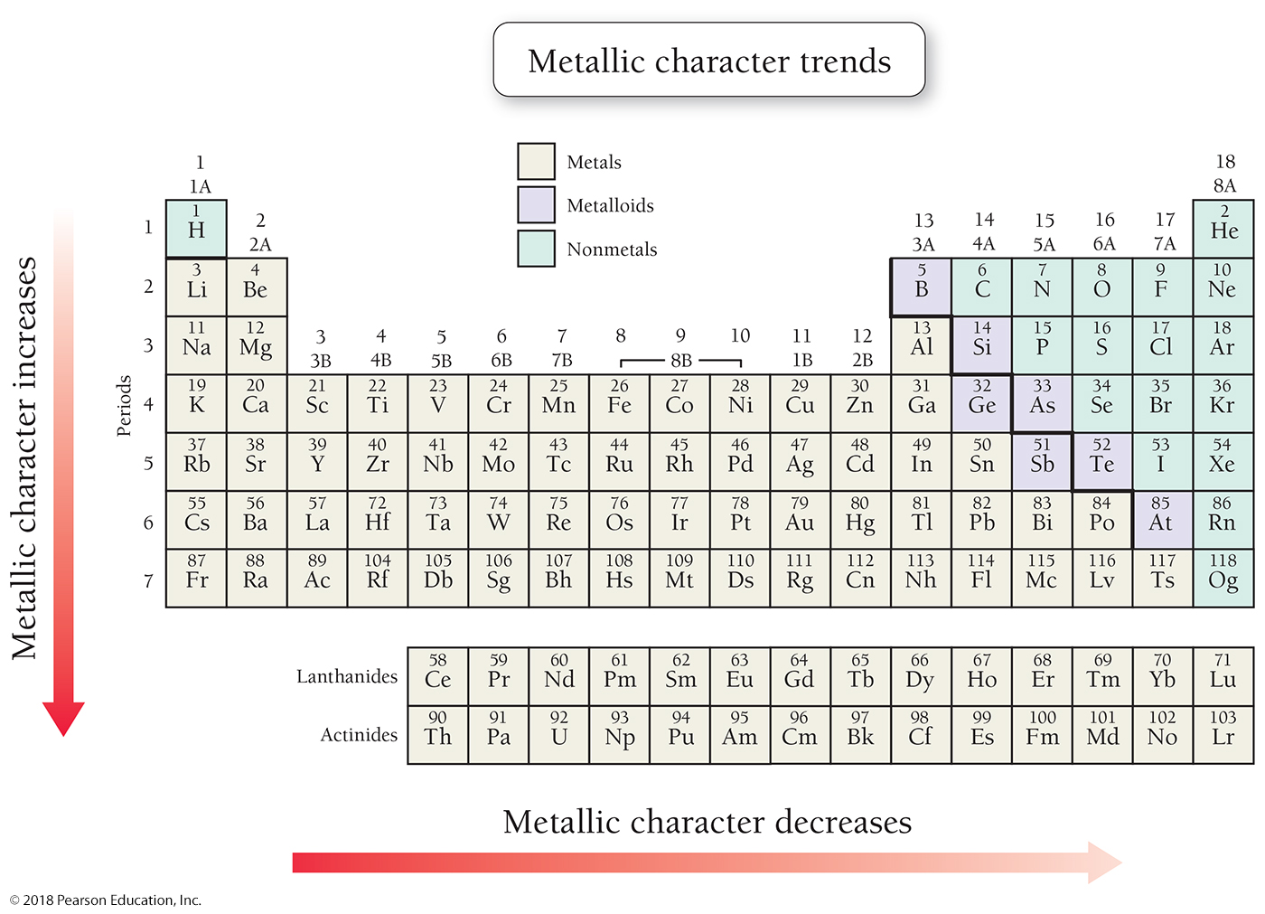
Periodic Properties: Metallic Character

Slide 94
Chapter 9 in Review
Light, a form of electromagnetic radiation, exhibits both wavelike and particle-like behavior. Particles of light are called photons.
The Bohr model: The emission spectrum of hydrogen can be explained by the Bohr model for the hydrogen atom. Each orbit is specified by a quantum number (n), which also specifies the orbit’s energy.

Slide 95
Chapter 9 in Review
The quantum-mechanical model describes electron orbitals, which are electron probability maps that show the relative probability of finding an electron in various places surrounding the atomic nucleus.
An electron configuration indicates which orbitals are occupied for a particular atom. Orbitals are filled in order of increasing energy and obey the Pauli exclusion principle (each orbital can hold a maximum of two electrons with opposing spins) and Hund’s rule (electrons occupy orbitals of identical energy singly before pairing).

Slide 96
Chapter 9 in Review
The periodic table: Elements within the same column of the periodic table have similar outer electron configurations and the same number of valence electrons and therefore have similar chemical properties.
The periodic table is divisible into blocks (s block, p block, d block, and f block) in which particular sublevels are filled.
As you move across a period to the right in the periodic table, atomic size decreases, ionization energy increases, and metallic character decreases.
As you move down a column in the periodic table, atomic size increases, ionization energy decreases, and metallic character increases.

Slide 97
Chemical Skills Learning Objectives
LO: Understand and explain the nature of electromagnetic radiation.
LO: Understand and explain the key characteristics of the Bohr model of the atom.
LO: Understand and explain the key characteristics of the quantum-mechanical model of the atom.
LO: Predict relative wavelength, energy, and frequency of different types of light.
LO: Write electron configurations and orbital diagrams for atoms.
LO: Identify valence electrons and core electrons.
LO: Write electron configurations for an element based on its position in the periodic table.
LO: Recognize that the chemical properties of elements are largely determined by the number of valence electrons they contain.
LO: Identify and understand periodic trends such as atomic size, ionization energy, and metallic character.

