Slide 1
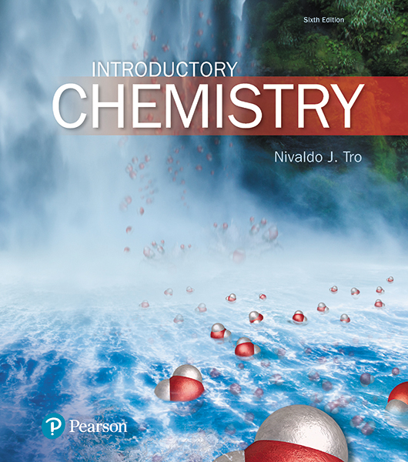
Lecture Presentation
Chapter 7
Measurement and Problem Solving
Dr. Sylvia Esjornson
Southwestern Oklahoma State University
Weatherford, OK

Slide 2
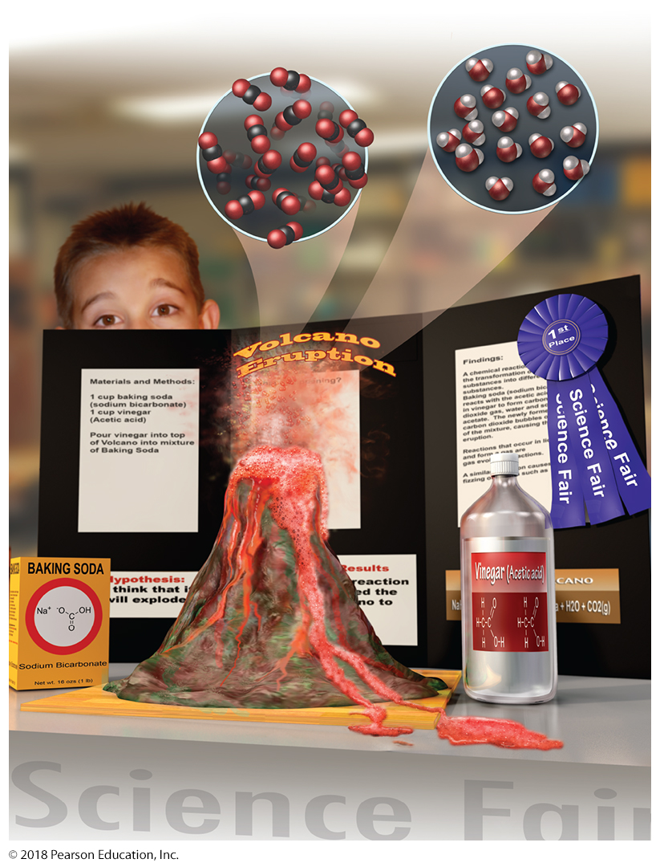
Evidence of a Chemical Reaction
In the classic grade school volcano, the baking soda (which is sodium bicarbonate) reacts with acetic acid in the vinegar to form carbon dioxide gas, water, and sodium acetate.
The newly formed carbon dioxide bubbles out of the mixture, causing the eruption.
Reactions that occur in liquids and form a gas are gas evolution reactions.
Red food coloring helps us see the bubbles.

Slide 3
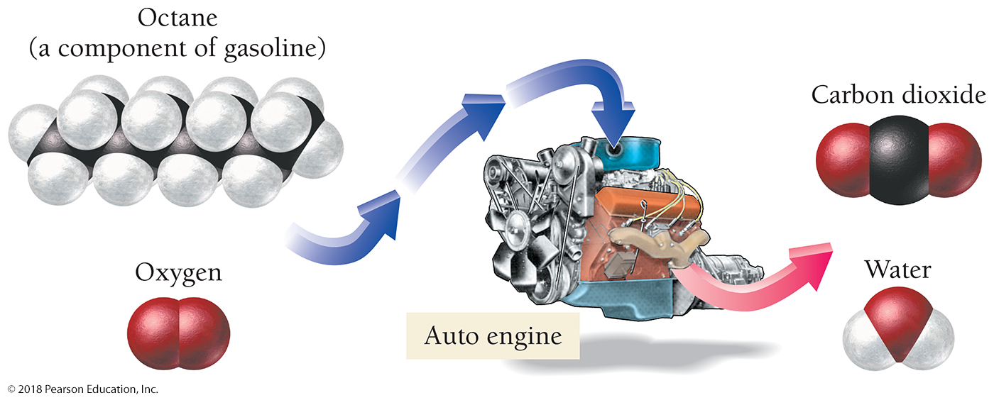
Chemical Reactions in Automobiles: Combustion
A combustion reaction In an automobile engine, hydrocarbons such as octane (C₈H₁₈) from gasoline combine with oxygen from the air and react to form carbon dioxide and water.
Combustion reactions are a subcategory of oxidation–reduction reactions, in which electrons are transferred from one substance to another.

Slide 4
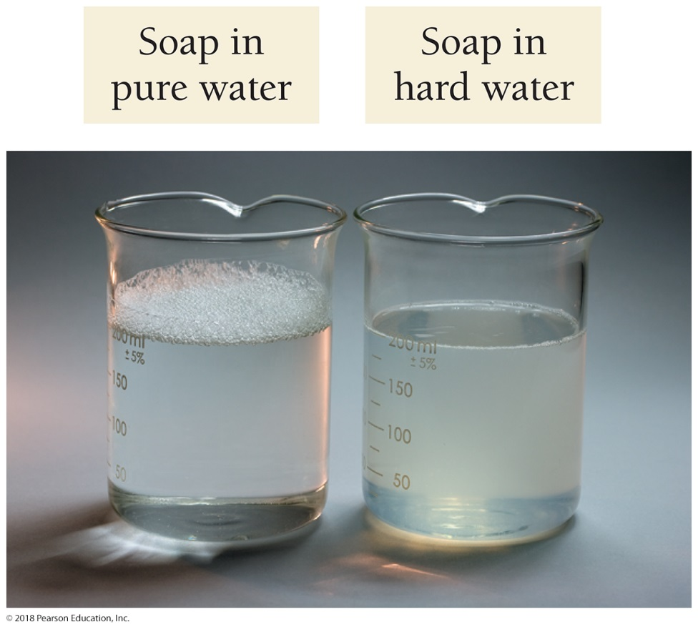
Chemical Reactions in Laundry Detergents
Laundry detergent works better than soap because it contains substances that soften hard water.
Hard water contains dissolved calcium and magnesium ions.
These ions interfere with the action of soap by reacting with it to form a gray, slimy substance called curd or soap scum.
If you have ever washed your clothes in ordinary soap, you may have noticed gray soap scum residue on your clothes.
Soap forms suds with pure water (left), but reacts with the ions in hard water (right) to form a gray residue that adheres to clothes.

Slide 5
Chemical Reactions in Laundry Detergents
Laundry detergents contain substances such as sodium carbonate (Na₂CO₃) that remove calcium and magnesium ions from the water.
The dissolved carbonate ions react with calcium and magnesium ions in the hard water to form solid calcium carbonate (CaCO₃) and solid magnesium carbonate (MgCO₃).
These solids settle to the bottom of the laundry mixture, resulting in the removal of the ions from the water.
Laundry detergents contain substances that react with the ions in hard water to immobilize them.
Reactions such as these—that form solid substances in water—are precipitation reactions.

Slide 6
Evidence of a Chemical Reaction
If we could see the atoms and molecules that compose matter, we could easily identify a chemical reaction:
Atoms combine with other atoms to form compounds.
New molecules form.
The original molecules decompose.
Atoms in one molecule change places with atoms in another.
If we could see the atoms and molecules that compose matter, we could know a chemical reaction has occurred by observing these changes.
Often, these molecular changes cause macroscopic changes that we can directly experience.

Slide 7
Evidence of a Chemical Reaction
In summary, each of the following provides evidence of a chemical reaction:
• A color change
• The formation of a solid in a previously clear (unclouded) solution
• The formation of a gas when you add a substance to a solution
• The emission of light
• The emission or absorption of heat

Slide 8
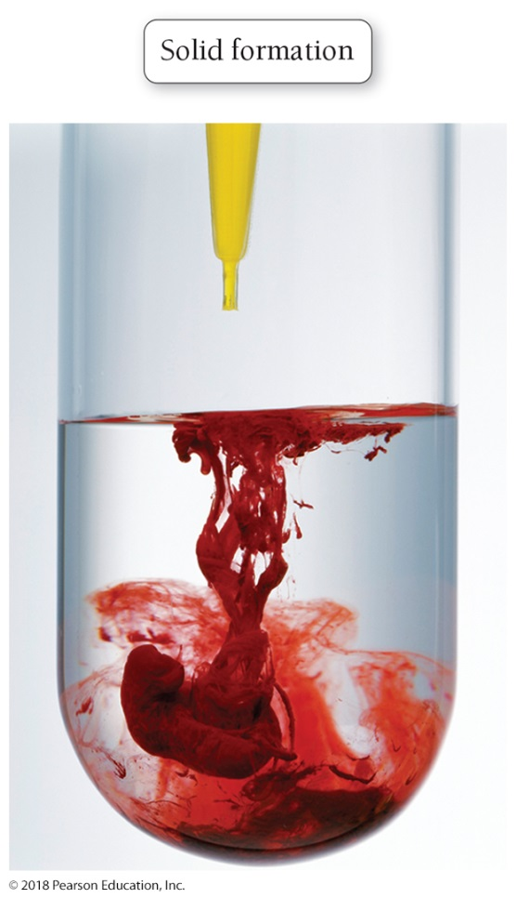
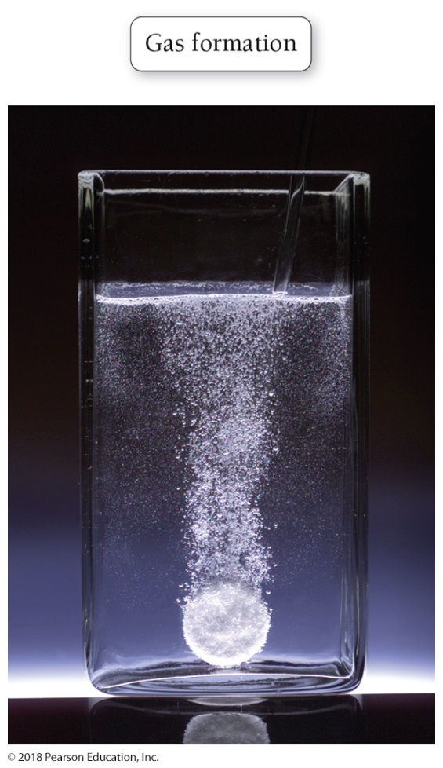
Evidence of a Chemical Reaction
(Left) A precipitation reaction: The formation of a solid in a previously clear solution is evidence of a chemical reaction.
(Right) A gas evolution reaction: The formation of a gas is evidence of a chemical reaction.

Slide 9
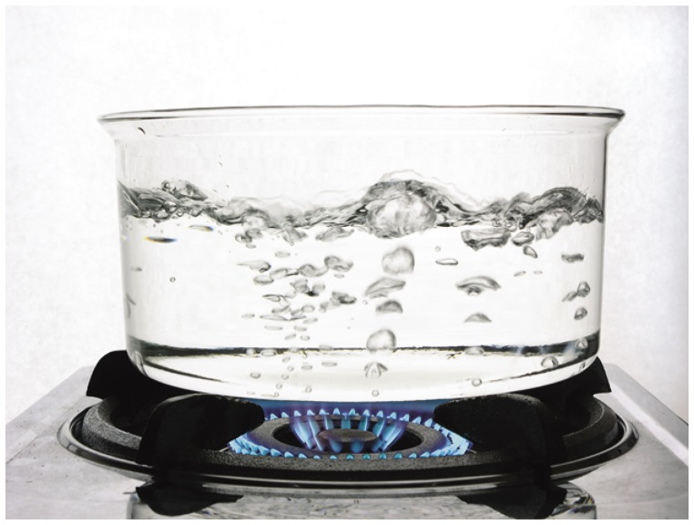
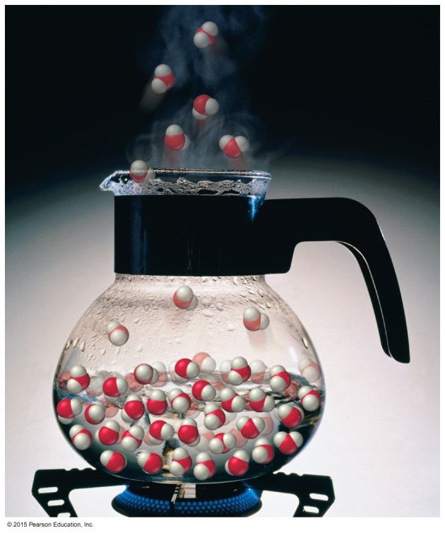
NOT Evidence of a Chemical Reaction
We can be fooled.
When water boils, bubbles form and a gas is evolved, but no chemical reaction has occurred.
Boiling water forms gaseous steam, but both water and steam are composed of water molecules—no chemical change has occurred.

Slide 10
Evidence of a Chemical Reaction: Changes Occurring at the Atomic and Molecular level Determine Whether a Chemical Reaction has Occurred
Only chemical analysis that shows that the initial substances have changed into other substances conclusively proves that a chemical reaction has occurred.
Chemical reactions may occur without any obvious signs, yet chemical analysis may show that a reaction has indeed occurred.
The changes occurring at the atomic and molecular level determine whether a chemical reaction has taken place.

Slide 11
The Chemical Equation
We represent chemical reactions with chemical equations.
The substances on the left side of the equation are the reactants, and the substances on the right side are the products.
We often specify the state of each reactant or product in parentheses next to the formula.

Slide 12
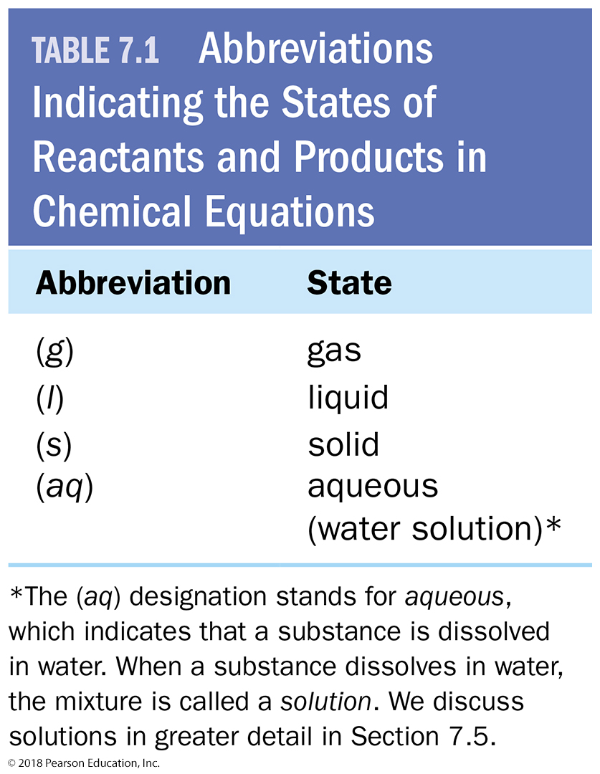
Use These Abbreviations to Add States to the Equation

Slide 13
The Chemical Equation: Combustion of Methane
The reaction occurring in a natural gas flame is methane (CH₄) reacting with oxygen (O₂) to form carbon dioxide (CO₂) and water (H₂O).
We represent this reaction with the following equation:
With states included, the equation becomes:

Slide 14
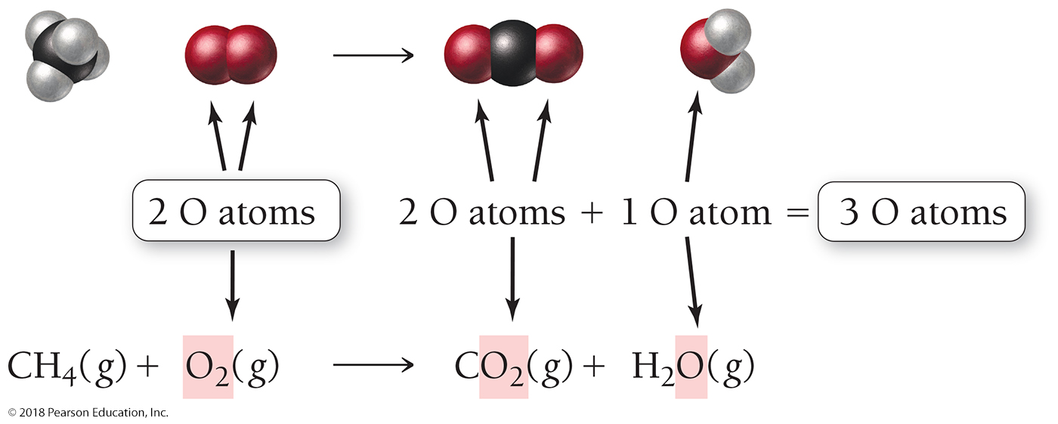
The Chemical Equation: Combustion of Methane
How many oxygen atoms are on each side of the equation?
The left side of the equation has two oxygen atoms and the right side has three.
Atoms cannot simply appear or disappear in chemical equations. We must account for the atoms on both sides of the equation.

Slide 15
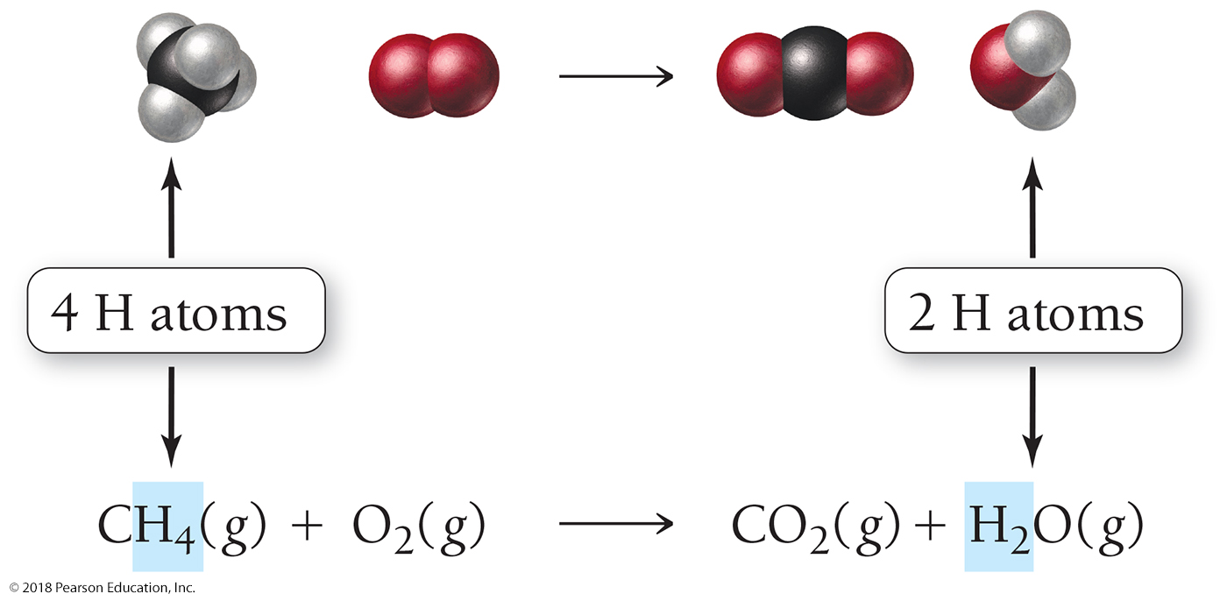
The Chemical Equation: Combustion of Methane
Notice also that the left side of the equation has four hydrogen atoms and the right side has only two.
To correct these problems, we must create a balanced equation.

Slide 16
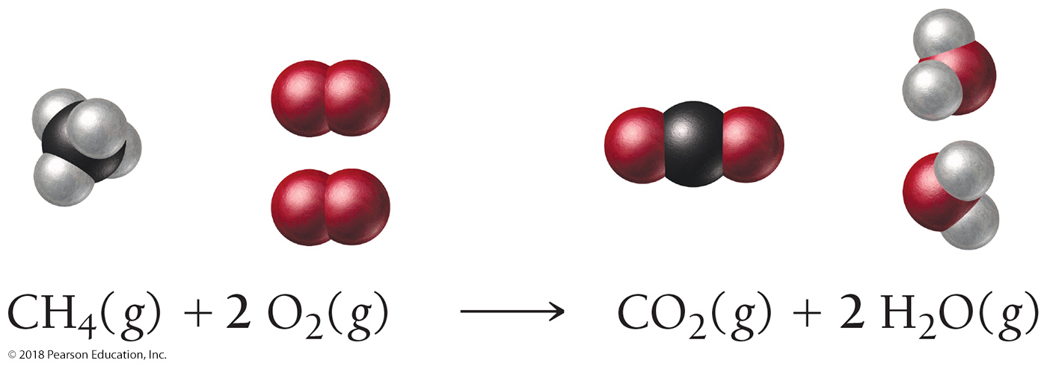
The Chemical Equation: Combustion of Methane
To balance an equation, we insert coefficients—not subscripts—in front of the chemical formulas as needed to make the number of each type of atom in the reactants equal to the number of each type of atom in the products.
The equation is now balanced because the numbers of each type of atom on both sides of the equation are equal.

Slide 17
Checking the Balanced Equation
The number of a particular type of atom within a chemical formula embedded in an equation is obtained by multiplying the subscript for the atom by the coefficient for the chemical formula.
If there is no coefficient or subscript, a 1 is implied.
The balanced equation for the combustion of natural gas is as follows:

Slide 18
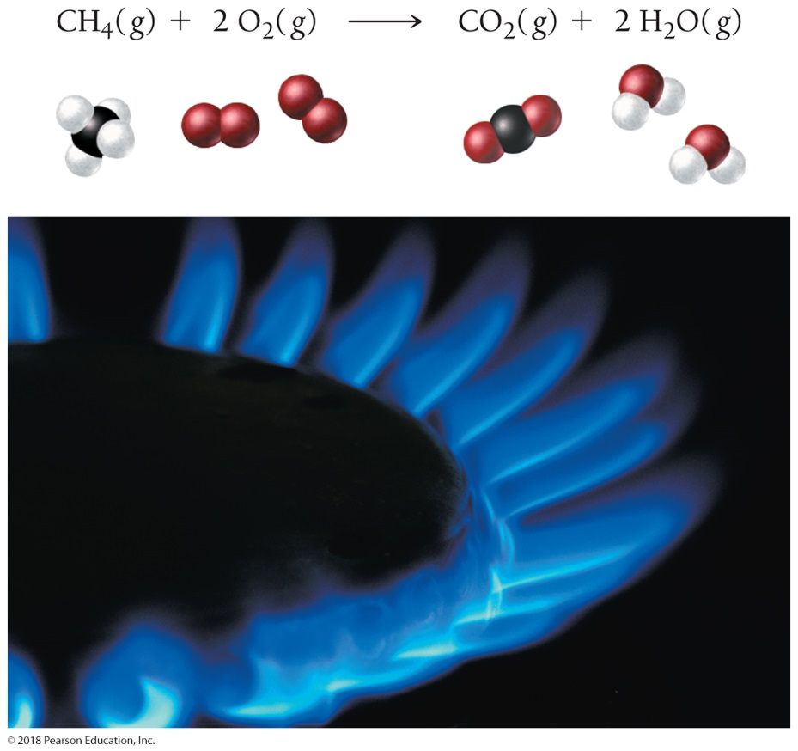
The Numbers of Each Type of Atom on Both Sides of the Equation are Equal—the Equation is Balanced
A balanced chemical equation represents a chemical reaction. In this image, methane molecules combine with oxygen to form carbon dioxide and water.

Slide 19
How to Write Balanced Chemical Equations
1. Write a skeletal equation by writing correct chemical formulas for each of the reactants and products. Review Chapter 5 for nomenclature rules. (If a skeletal equation is provided, skip this step and go to Step 2.)
2. If an element occurs in only one compound on both sides of the equation, balance it first. If there is more than one such element, balance metals before nonmetals.

Slide 20
How to Write Balanced Chemical Equations
3. If an element occurs as a free element on either side of the chemical equation, balance it last. Always balance free elements by adjusting the coefficient on the free element.
4. If the balanced equation contains coefficient fractions, change these into whole numbers by multiplying the entire equation by the appropriate factor.

Slide 21
How to Write Balanced Chemical Equations
5. Check to make certain the equation is balanced by summing the total number of each type of atom on both sides of the equation.
Remember, change only the coefficients to balance a chemical equation; never change the subscripts.

Slide 22
Example 7.4 Balancing Chemical Equations
Write a balanced equation for the reaction of solid aluminum with aqueous sulfuric acid to form aqueous aluminum sulfate and hydrogen gas.
Solution
Use your knowledge of chemical nomenclature from Chapter 5 to write a skeletal equation containing formulas
for each of the reactants and products. The formulas for each compound MUST BE CORRECT before you begin to balance the equation.
Al(s) + H₂SO₄(aq) Al₂(SO₄)₃(aq) + H₂(g)
Since both aluminum and hydrogen occur as free elements, balance those last. Sulfur and oxygen occur in only one compound on each side of the equation, so balance these first. Sulfur and oxygen are also part of a polyatomic ion that stays intact on both sides of the equation. Balance polyatomic ions such as these as a unit. There are 3 SO₄^{2–} ions on the right side of the equation, so put a 3 in front of H₂SO₄.
Al(s) + 3 H₂SO₄(aq) Al₂(SO₄)₃(aq) + H₂(g)
Balance Al next. Since there are 2 Al atoms on the right side of the equation, place a 2 in front of Al on the left side of the equation.
2 Al(s) + 3 H₂SO₄(aq) Al₂(SO₄)₃(aq) + H₂(g)

Slide 23
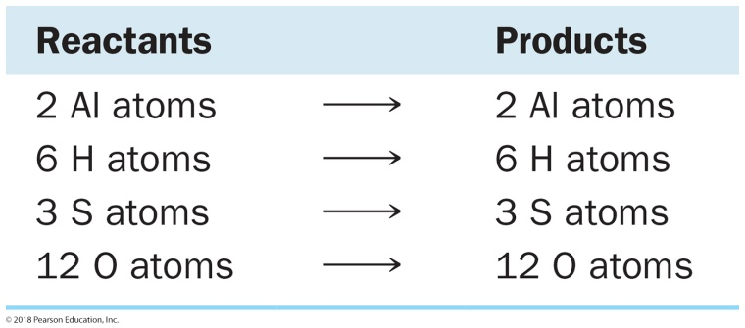
Example 7.4 Balancing Chemical Equations
Continued
Balance H next. Since there are 6 H atoms on the left side, place a 3 in front of H₂(g) on the right side.
2 Al(s) + 3 H₂SO₄(aq) Al₂(SO₄)₃(aq) + 3 H₂(g)
Finally, sum the number of atoms on each side to make sure that the equation is balanced.
2 Al(s) + 3 H₂SO₄(aq) Al₂(SO₄)₃(aq) + 3 H₂(g)
Skillbuilder 7.4 | Balancing Chemical Equations
Write a balanced equation for the reaction of aqueous lead(II) acetate with aqueous potassium iodide to form solid
lead(II) iodide and aqueous potassium acetate.
For More Practice
Problems 39, 40, 41, 42, 43, 44.

Slide 24
Aqueous Solutions and Solubility: Terminology for Compounds Dissolved in Water
A compound is soluble in a particular liquid if it dissolves in that liquid.
A compound is insoluble if it does not dissolve in the liquid.
An aqueous solution is a homogeneous mixture of a substance with water.
When ionic compounds dissolve in water, they usually dissociate into their component ions.

Slide 25
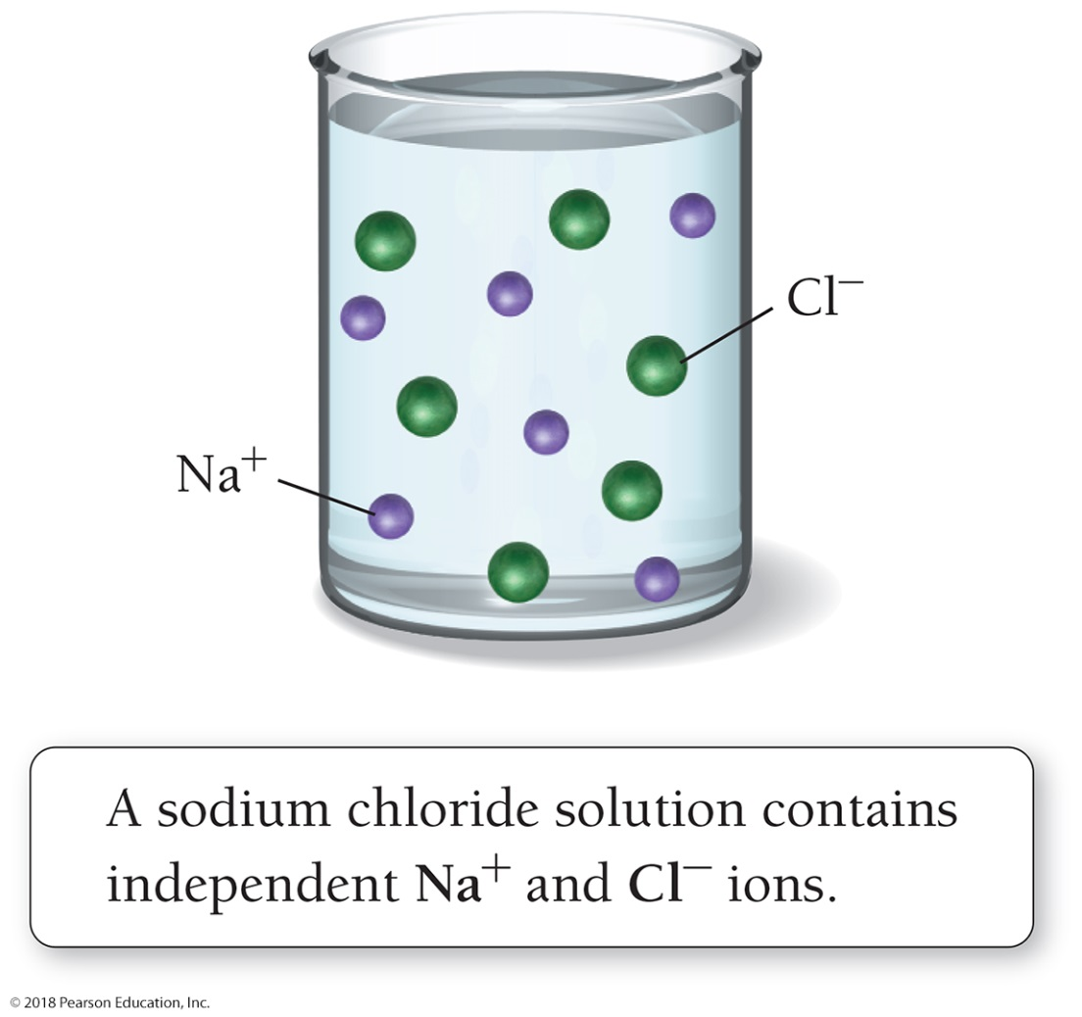
Aqueous Solutions: NaCl Dissolves in Water
A sodium chloride solution, NaCl(aq), does not contain any NaCl units.
Only dissolved Na⁺ ions and Cl⁻ ions are present.
Substances (such as NaCl) that completely dissociate into ions in solution are called strong electrolytes.

Slide 26
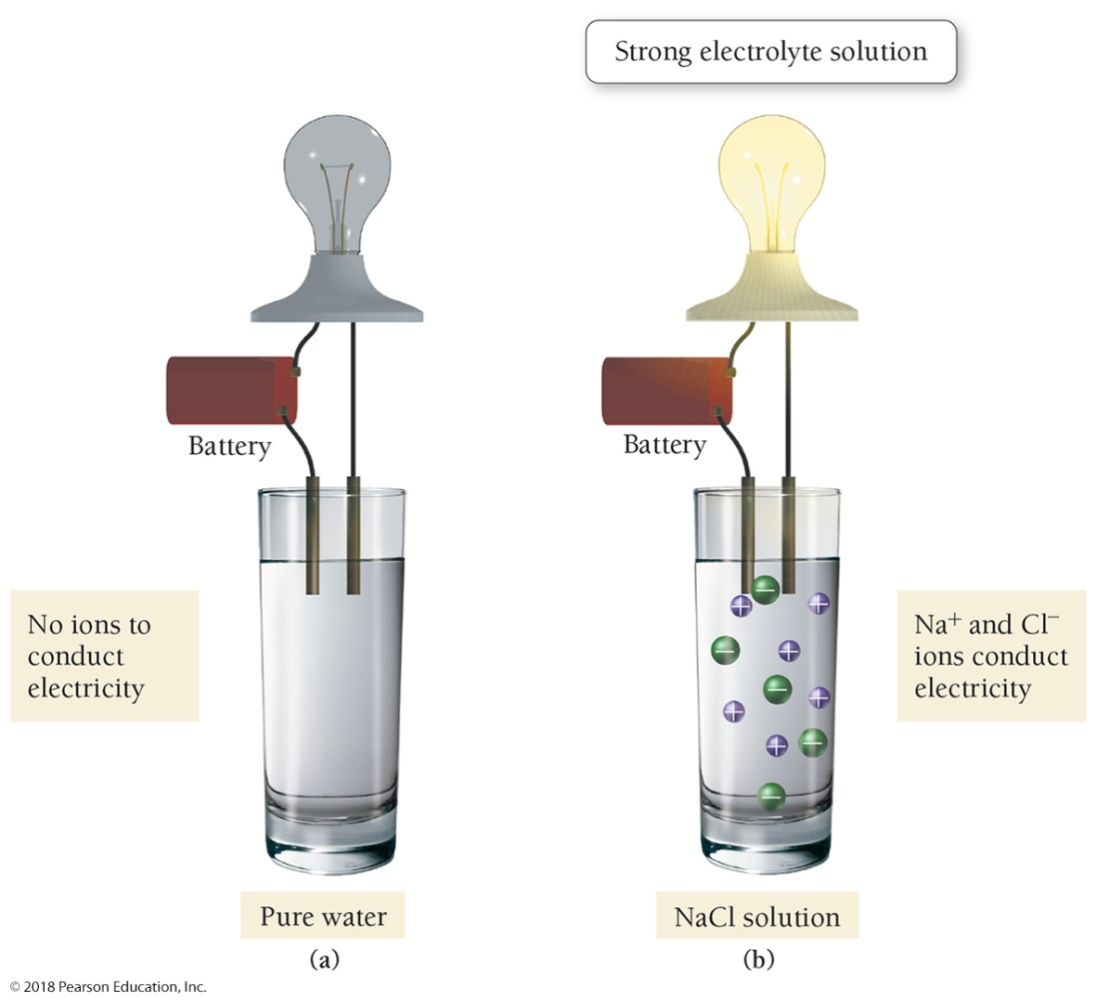
Ions as Conductors: Strong Electrolyte Solutions
(a) Pure water does not conduct electricity.
(b) Ions in a sodium chloride solution conduct electricity, causing the bulb to light.
Solutions such as NaCl(aq) are called strong electrolyte solutions.

Slide 27
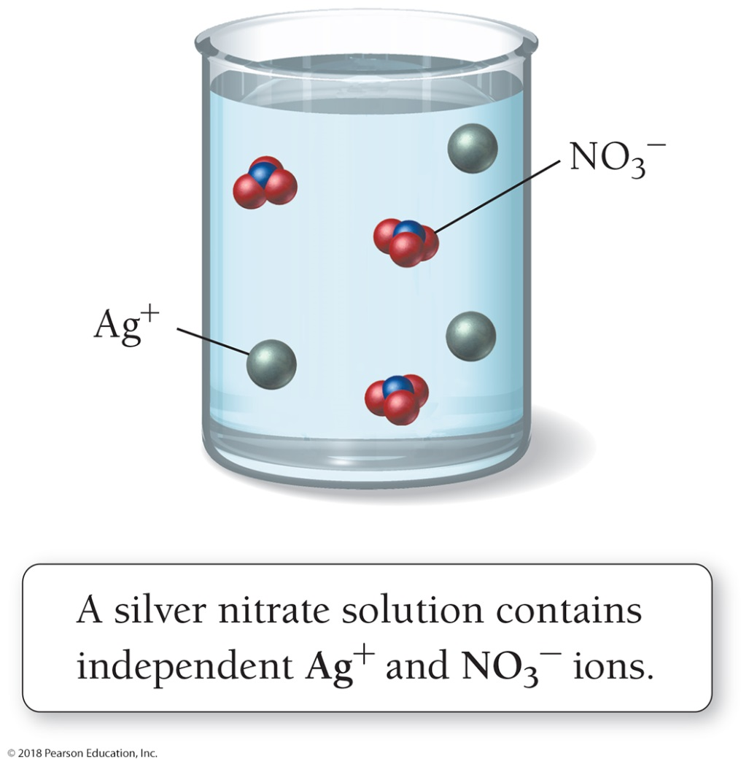
Aqueous Solutions: AgNO₃ Dissolves in Water
A silver nitrate solution, AgNO₃(aq), does not contain any AgNO₃ units.
Only dissolved Ag⁺ ions and NO₃⁻ ions are present.
AgNO₃(aq) is a strong electrolyte solution.
When compounds containing polyatomic ions such as NO₃⁻ dissolve, the polyatomic ions dissolve as intact units.

Slide 28
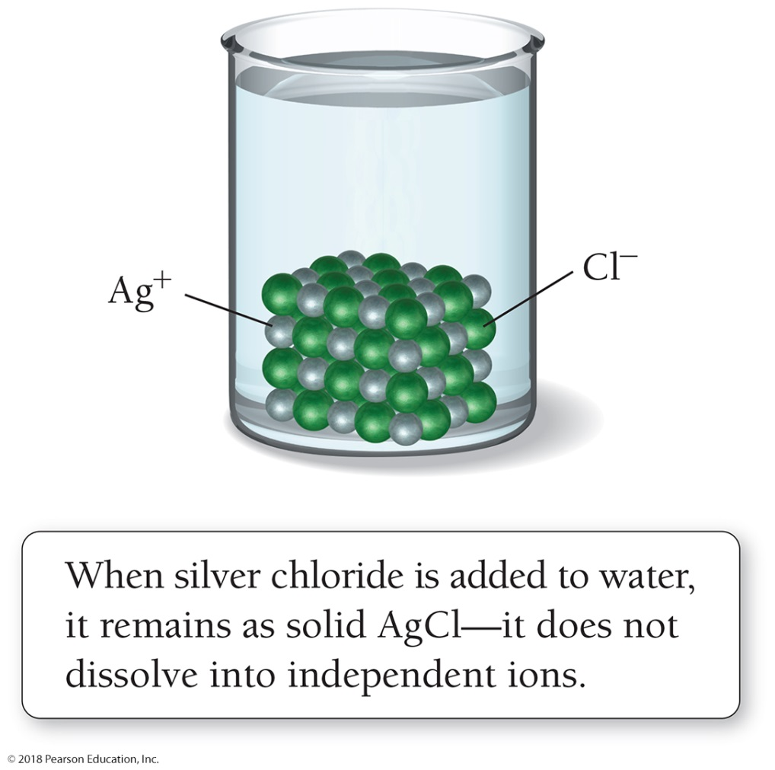
Aqueous Solutions: AgCl Does Not Dissolve in Water
Not all ionic compounds dissolve in water.
AgCl does not dissolve in water.
AgCl remains as a solid, AgCl(s), within the liquid water.
It does not dissolve into independent ions.

Slide 29
Empirical Rules of Solubility
A compound is soluble in a particular liquid if it dissolves in that liquid; a compound is insoluble if it does not dissolve in the liquid.
For ionic compounds, empirical rules of solubility have been deduced from observations of many compounds.

Slide 30
Solubility Rules

Slide 31
Solubility: Mostly Soluble
For example:
The solubility rules indicate that compounds containing the lithium ion are soluble.
Compounds such as LiBr, LiOH, and LiCO₃ dissolve in water to form strong electrolyte solutions.
The solubility rules state that compounds containing the NO₃⁻ ion are soluble.
Compounds such as AgNO₃, PbNO₃, and CaNO₃ dissolve in water to form strong electrolyte solutions.

Slide 32
Solubility Rules

Slide 33
Solubility: Mostly Insoluble
For example:
The solubility rules state that, with some exceptions, compounds containing the CO₃²⁻ ion are insoluble.
Compounds such as CaCO₃, FeCO₃, SrCO₃, and CuCO₃ do not dissolve in water.
Note that the solubility rules contain many exceptions.
For example, compounds containing CO₃²⁻ are soluble when paired with Li⁺, Na⁺, K⁺, or NH₄⁺.
Thus, Li₂CO₃, Na₂CO₃, K₂CO₃, and (NH₄)₂CO₃ are soluble.

Slide 34
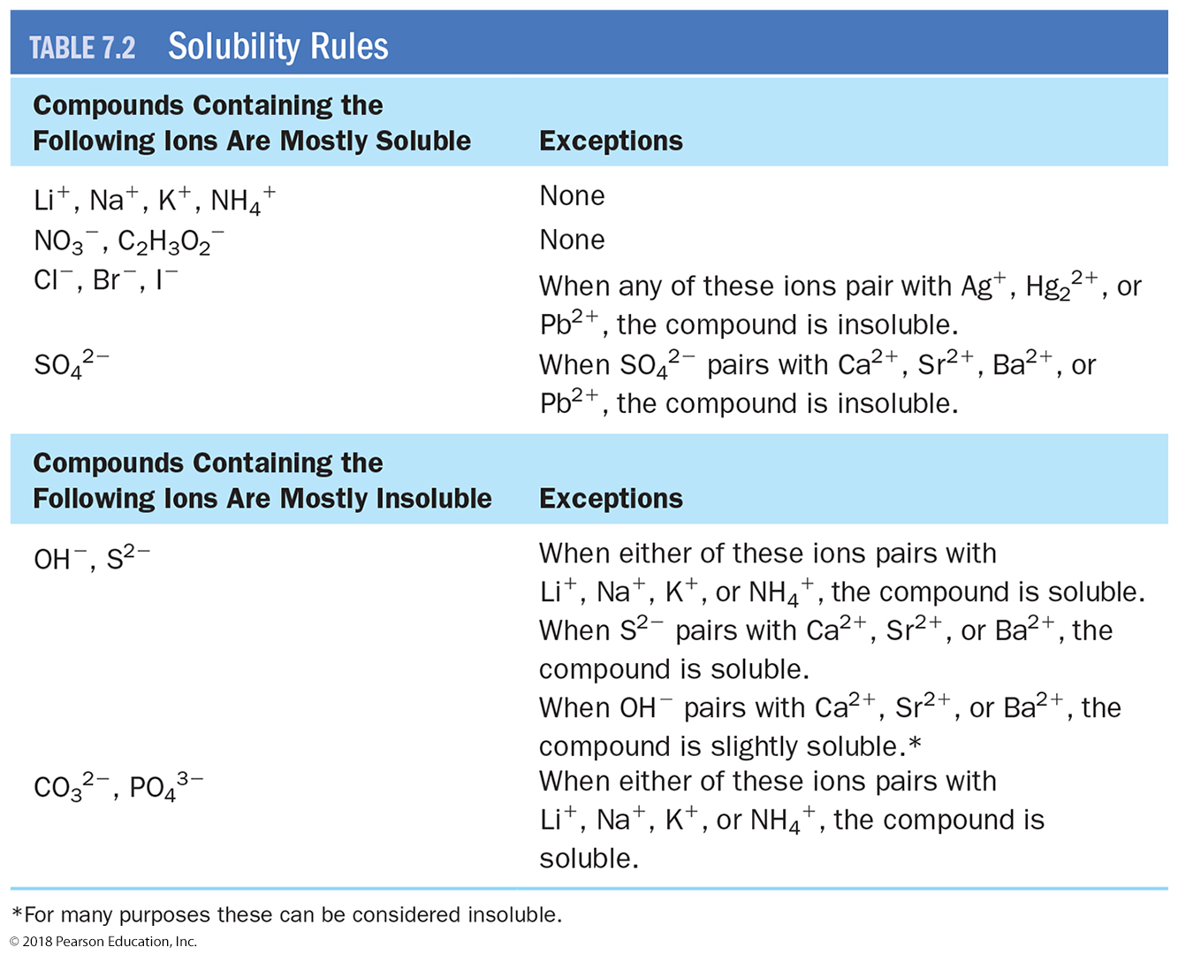
Solubility Rules

Slide 35
Precipitation Reactions: Reactions in Aqueous Solution that Form a Solid
Sodium carbonate in laundry detergent reacts with dissolved Mg²⁺ and Ca²⁺ ions to form solids that precipitate from solution.
These reactions are examples of precipitation reactions, reactions that form a solid (s), called a precipitate, upon mixing two aqueous solutions.

Slide 36
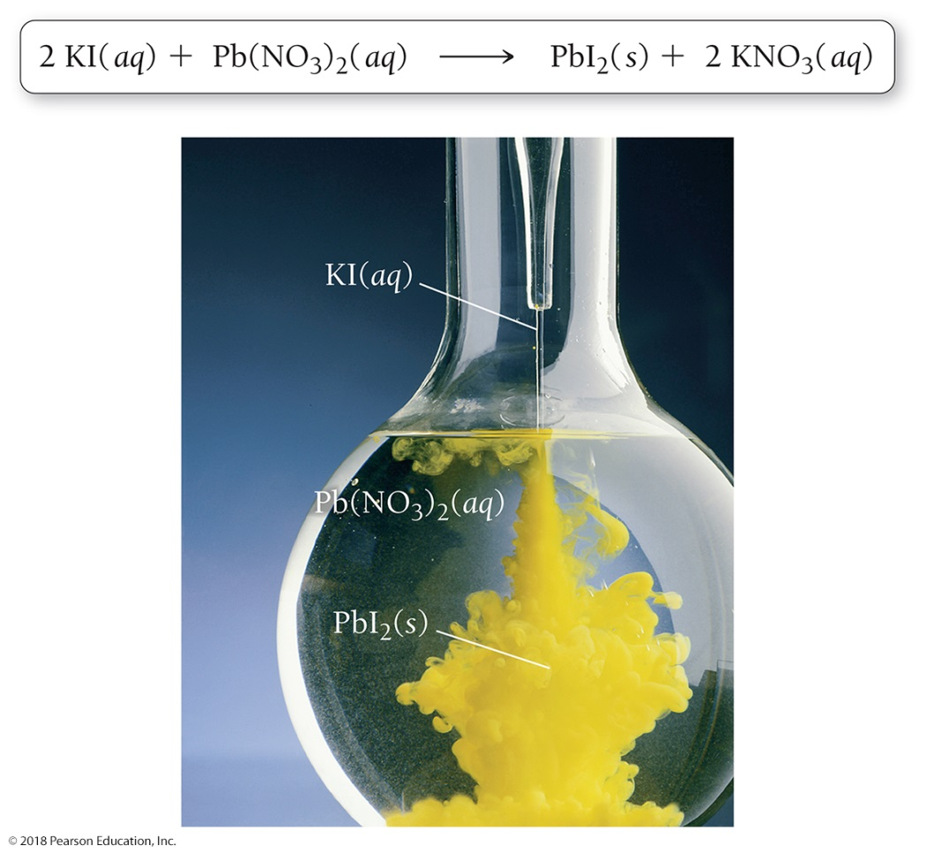
2 KI(aq) + Pb(NO₃)₂(aq) → PbI₂(s) + 2 KNO₃(aq)
Precipitation
When a potassium iodide solution is mixed with a lead(II) nitrate solution, a brilliant yellow precipitate of PbI₂(s) forms.

Slide 37
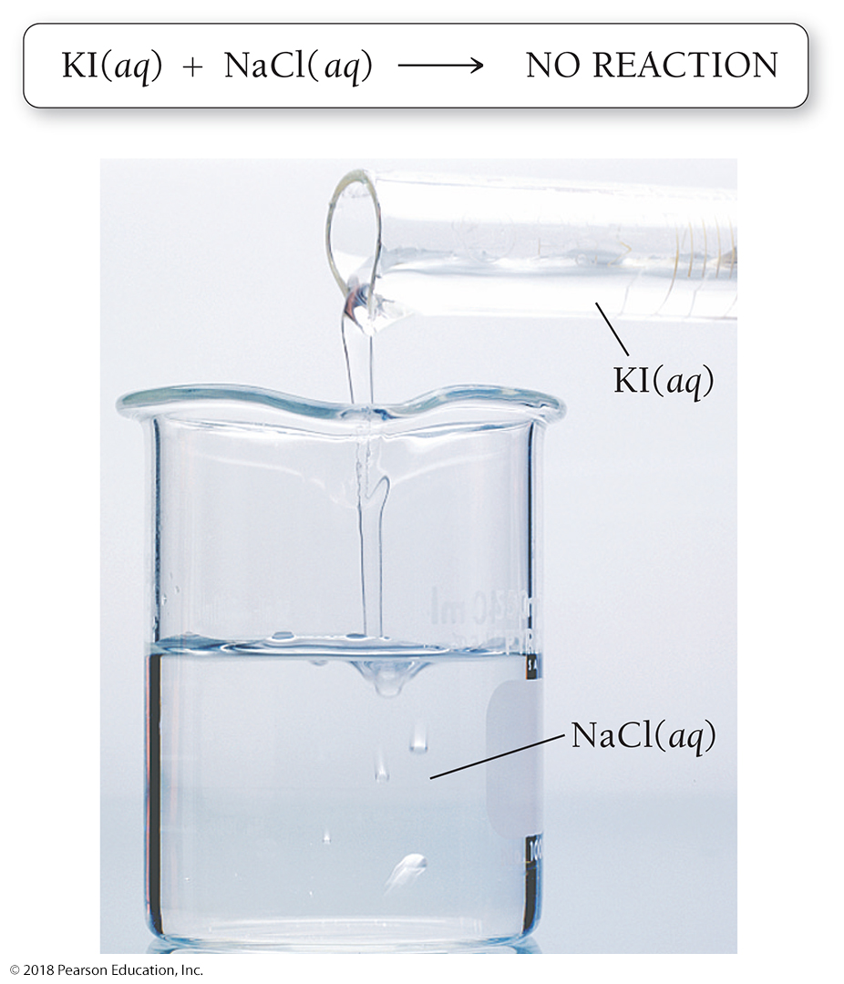
KI(aq) + NaCl(aq) → NO REACTION
Precipitation reactions do not always occur when mixing two aqueous solutions.
When a potassium iodide solution is mixed with a sodium chloride solution, no reaction occurs.

Slide 38
Predicting Precipitation Reactions
The key to predicting precipitation reactions is understanding that only insoluble compounds form precipitates.
In a precipitation reaction, two solutions containing soluble compounds combine and an insoluble compound precipitates.

Slide 39
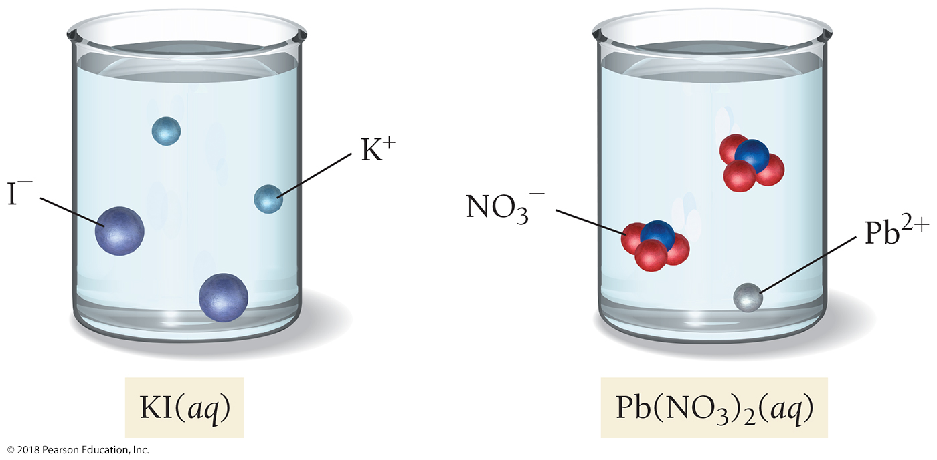
2 KI(aq) + Pb(NO₃)₂(aq) → PbI₂(s) + 2 KNO₃(aq)
Before mixing, KI(aq) and Pb(NO₃)₂(aq) are both dissociated in their respective solutions.

Slide 40
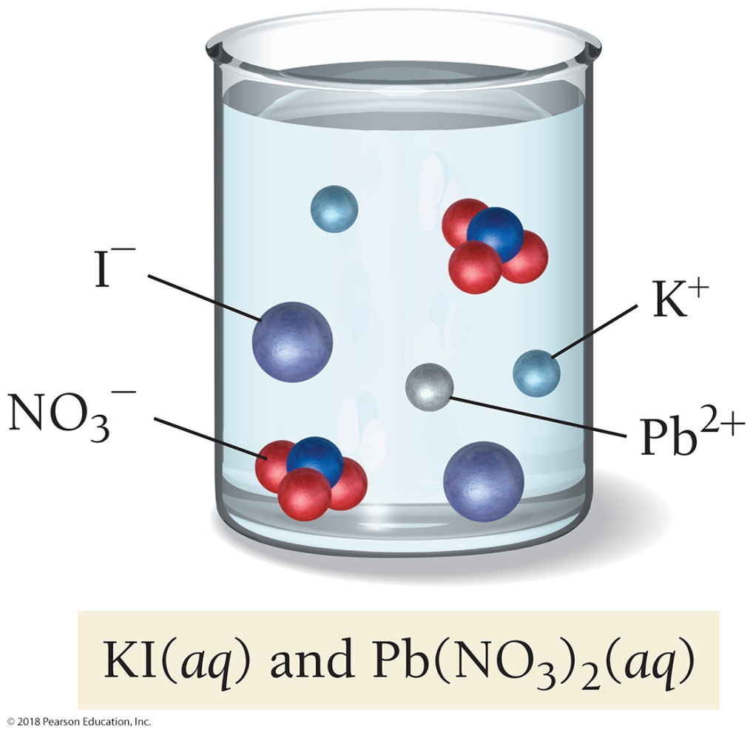
2 KI(aq) + Pb(NO₃)₂(aq) → PbI₂(s) + 2 KNO₃(aq)
The instant that the solutions are mixed, all four ions are present.

Slide 41
2 KI(aq) + Pb(NO₃)₂(aq) → PbI₂(s) + 2 KNO₃(aq)
The cation from one compound can now pair with the anion from the other compound to form new (and potentially insoluble) products.
If the potentially insoluble products are both soluble, then no reaction occurs.
If one or both of the potentially insoluble products are insoluble, a precipitation reaction occurs.

Slide 42
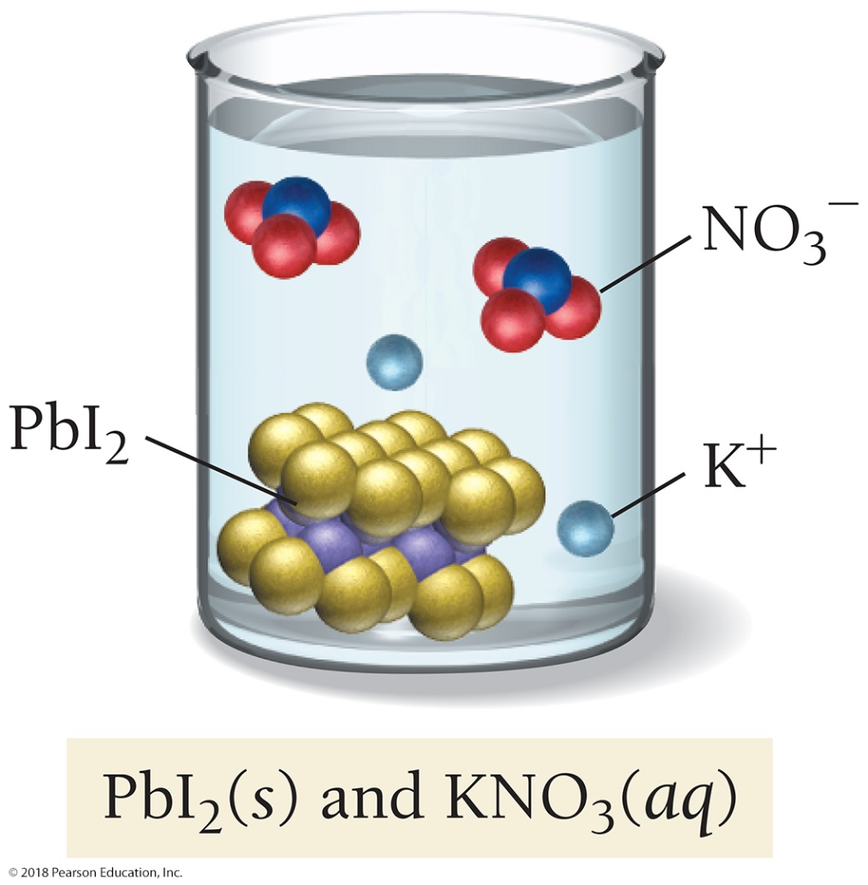
2 KI(aq) + Pb(NO₃)₂(aq) → PbI₂(s) + 2 KNO₃(aq)
In this case, KNO₃ is soluble, but PbI₂ is insoluble. Consequently, PbI₂ precipitates.

Slide 43
Example 7.7 Writing Equations for Precipitation Reactions
Write an equation for the precipitation reaction that occurs (if any) when solutions of sodium carbonate and copper(II) chloride are mixed.
Solution
1. Write the formulas of the two compounds being mixed as reactants in a chemical equation.
Na₂CO₃(aq) + CuCl₂(aq)
2. Below the equation, write the formulas of the potentially insoluble products that could form from the reactants. Obtain these by combining the cation from one reactant with the anion from the other. Make sure to write correct (charge-neutral) formulas for these ionic compounds as described in Section 5.5.
Potentially insoluble products
NaCl CuCO₃
3. Use the solubility rules from Section 7.5 to determine whether any of the potential new products are insoluble.
NaCl is soluble (compounds containing Cl– are usually soluble, and Na⁺ is not an exception).
CuCO₃ is insoluble (compounds containing CO₃^{2–} are usually insoluble, and Cu²⁺ is not an exception).

Slide 44
Example 7.7 Writing Equations for Precipitation Reactions
Continued
4. If all of the potentially insoluble products are soluble, there will be no precipitate. Write NO REACTION next to the arrow.
Because this example has an insoluble product, you proceed to the next step.
5. If one or both of the potentially insoluble products are insoluble, write their formula(s) as the product(s) of the reaction, using (s) to indicate solid. Follow any soluble products with (aq) to indicate aqueous.
Na₂CO₃(aq) + CuCl₂(aq) CuCO₃(s) + NaCl(aq)
6. Balance the equation. Remember to adjust only coefficients, not subscripts.
Na₂CO₃(aq) + CuCl₂(aq) CuCO₃(s) + 2 NaCl(aq)
Skillbuilder 7.7 | Writing Equations for Precipitation Reactions
Write an equation for the precipitation reaction that occurs (if any) when solutions of potassium hydroxide and
nickel(II) bromide are mixed.

Slide 45
Writing Chemical Equations for Reactions in Solution: Molecular and Complete Ionic Equations
A molecular equation is an equation showing the complete neutral formulas for every compound in the reaction.
AgNO₃(aq) + NaCl(aq) → AgCl(s) + NaNO₃(aq)
Complete ionic equations show aqueous ionic compounds that normally dissociate in solution as they are actually present in solution.
Ag⁺(aq) + NO₃⁻(aq) + Na+(aq) + Cl⁻(aq) → AgCl(s) + Na⁺(aq) + NO₃–(aq)
When writing complete ionic equations, separate only aqueous ionic compounds into their constituent ions.
Do NOT separate solid, liquid, or gaseous compounds.

Slide 46
Writing Chemical Equations for Reactions in Solution: Complete Ionic and Net Ionic Equations
In the complete ionic equation, some of the ions in solution appear unchanged on both sides of the equation.
These ions are called spectator ions because they do not participate in the reaction.

Slide 47
Writing Chemical Equations for Reactions in Solution: Complete Ionic and Net Ionic Equations
To simplify the equation, and to more clearly show what is happening, spectator ions can be omitted.
Equations such as this one, which show only the species that actually participate in the reaction, are called net ionic equations.
Ag⁺(aq) + Cl⁻ (aq) → AgCl(s)

Slide 48
Molecular, Complete Ionic, and Net Ionic Equations
To summarize:
A molecular equation is a chemical equation showing the complete, neutral formulas for every compound in a reaction.
A complete ionic equation is a chemical equation showing all of the species as they are actually present in solution.
A net ionic equation is an equation showing only the species that actually participate in the reaction.

Slide 49
Acid–Base Reactions
Acid–base reactions are reactions that form water upon mixing of an acid and a base.

Slide 50
Acid–Base Reactions
Acid–base reactions (also called neutralization reactions) generally form water and an ionic compound—called a salt—that usually remains dissolved in the solution.
The net ionic equation for many acid–base reactions is as follows:
H⁺(aq) + OH⁻ (aq) → H₂O(l)

Slide 51
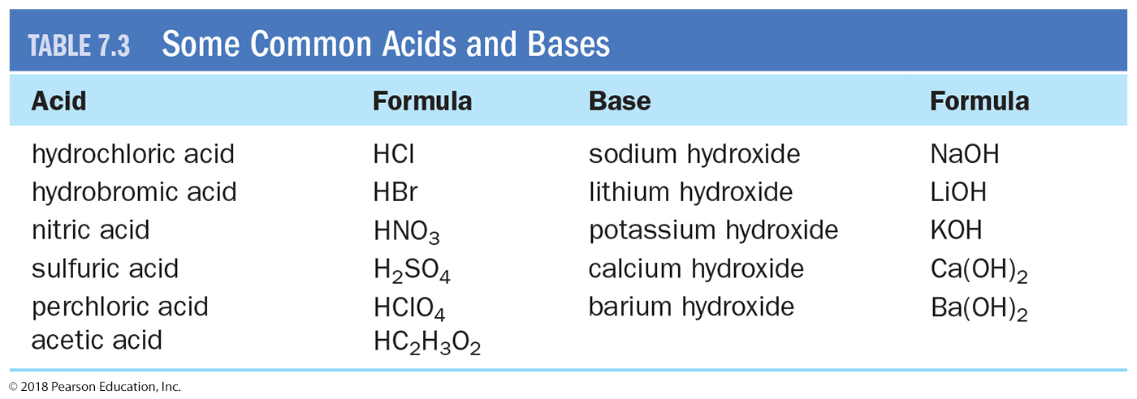
Some Common Acids and Bases

Slide 52
Gas Evolution Reactions

Slide 53
Gas Evolution Reactions

Slide 54
Gas Evolution Reactions: CO₃²⁻
Begin by writing a skeletal equation that includes the reactants and products that form when the cation of each reactant combines with the anion of the other.
HNO₃(aq) + Na₂CO₃(aq) → H₂CO₃(aq) + NaNO₃(aq)
You must recognize that H₂CO₃(aq) decomposes into H₂O(l) and CO₂(g) and write the corresponding equation.
HNO₃(aq) + Na₂CO₃(aq) → H₂O(l) + CO₂(g) + NaNO₃(aq)
Finally, balance the equation.
2 HNO₃(aq) + Na₂CO₃(aq) → H₂O(l) + CO₂(g) + 2 NaNO₃(aq)

Slide 55
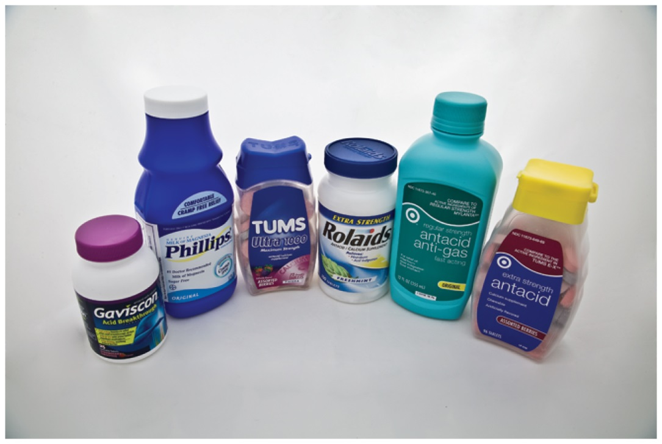
Chemistry and Health: Neutralizing Excess Stomach Acid
Your stomach normally contains acids that are involved in food digestion.
Antacids are over-the-counter medicines that work by reacting with and neutralizing stomach acid.
Antacids contain bases such as Mg(OH)₂, Al(OH)₃, and NaHCO₃.
The base in an antacid neutralizes excess stomach acid, relieving heartburn and acid stomach.

Slide 56
Oxidation–Reduction Reactions
Reactions involving the transfer of electrons are called oxidation–reduction reactions or redox reactions.
Redox reactions are responsible for the rusting of iron, the bleaching of hair, and the production of electricity in batteries.
Many redox reactions involve the reaction of a substance with oxygen.

Slide 57
Oxidation–Reduction Reactions
A fundamental definition of oxidation is the loss of electrons.
A fundamental definition of reduction is the gain of electrons.
Helpful mnemonics:
OIL RIG—Oxidation Is Loss; Reduction Is Gain.
LEO GER—Lose Electrons Oxidation; Gain Electrons Reduction.

Slide 58
Oxidation–Reduction Reactions
Notice that oxidation and reduction must occur together.
If one substance loses electrons (oxidation), then another substance must gain electrons (reduction).
For now, you simply need to be able to identify redox reactions.

Slide 59
Oxidation–Reduction Reactions
A reaction can be classified as a redox reaction if it meets any one of these requirements.
Redox reactions are those in which the following occurs:
• A substance reacts with elemental oxygen.
• A metal reacts with a nonmetal.
• More generally, one substance transfers electrons to another substance.

Slide 60
Combustion Reactions
Combustion reactions are a type of redox reaction.
Combustion reactions are characterized by the reaction of a substance with O₂ to form one or more oxygen-containing compounds, often including water.
Combustion reactions are exothermic (they emit heat).
Compounds containing carbon and hydrogen—or carbon, hydrogen, and oxygen—always form carbon dioxide and water upon combustion.
Other combustion reactions include the reaction of carbon with oxygen to form carbon dioxide.

Slide 61
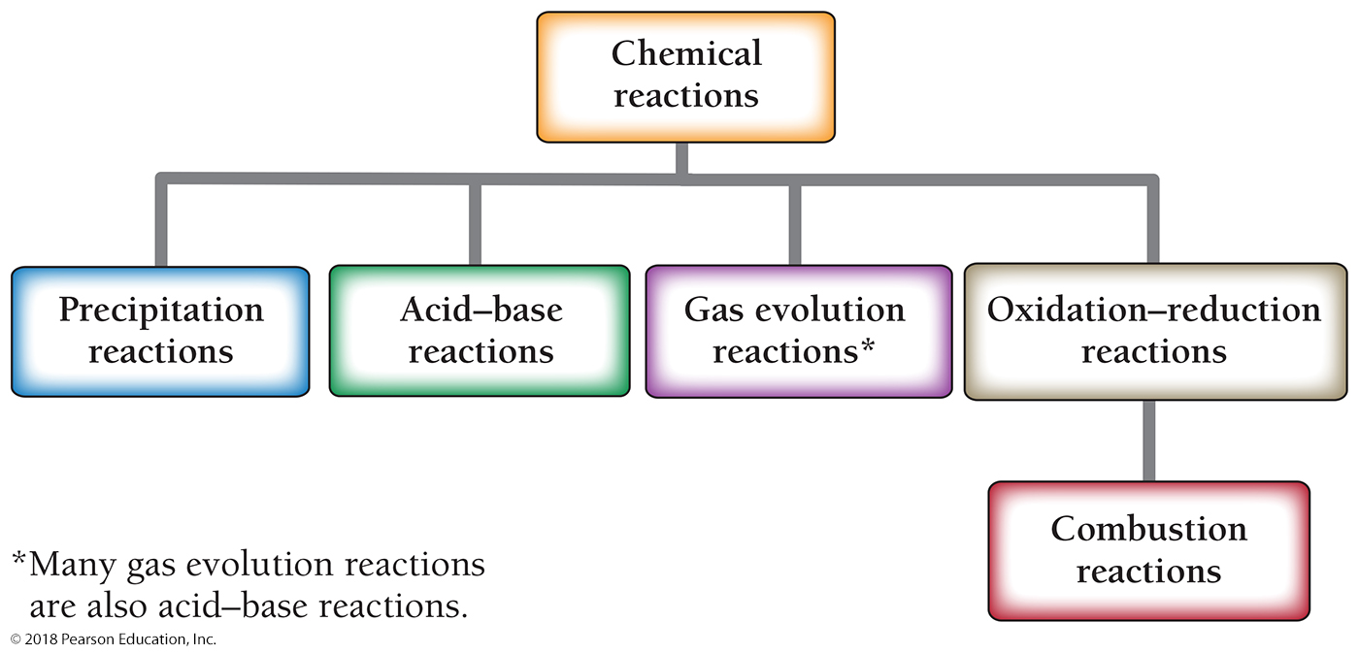
Classifying Chemical Reactions

Slide 62
Classifying Chemical Reactions by What Atoms Do

Slide 63
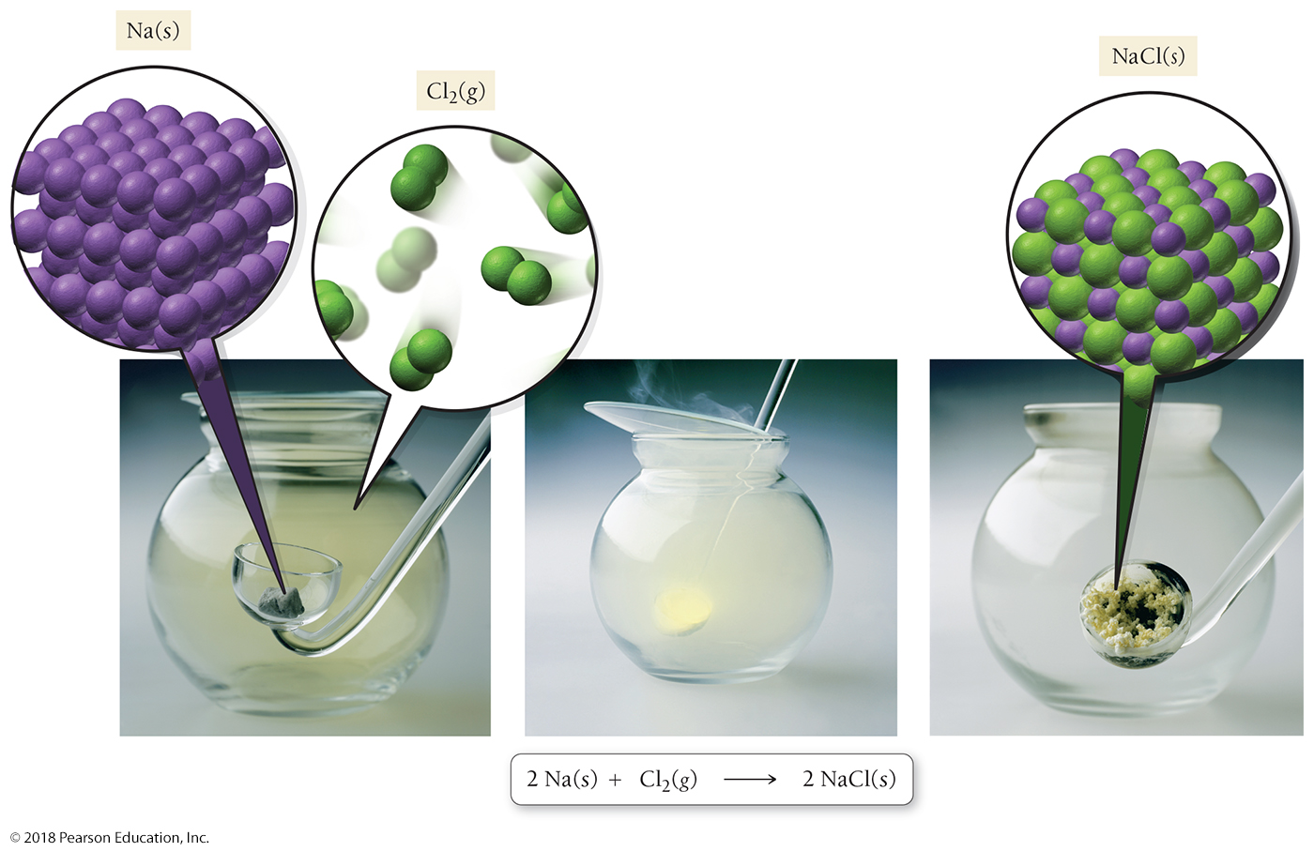
Synthesis Reactions
In a synthesis reaction, two simpler substances combine to make a more complex substance. In this series of photographs we see sodium metal and chlorine gas. When they combine, a chemical reaction occurs that forms sodium chloride.

Slide 64
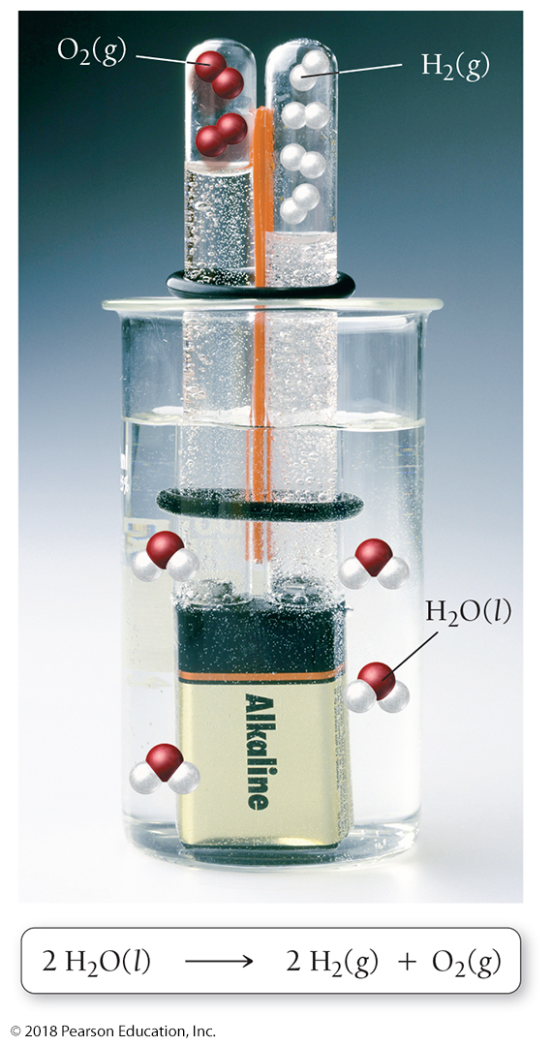
Synthesis Reactions
In a decomposition reaction, a complex substance decomposes to form simpler substances.
When electrical current is passed through water, the water undergoes a decomposition reaction to form hydrogen gas and oxygen gas.

Slide 65
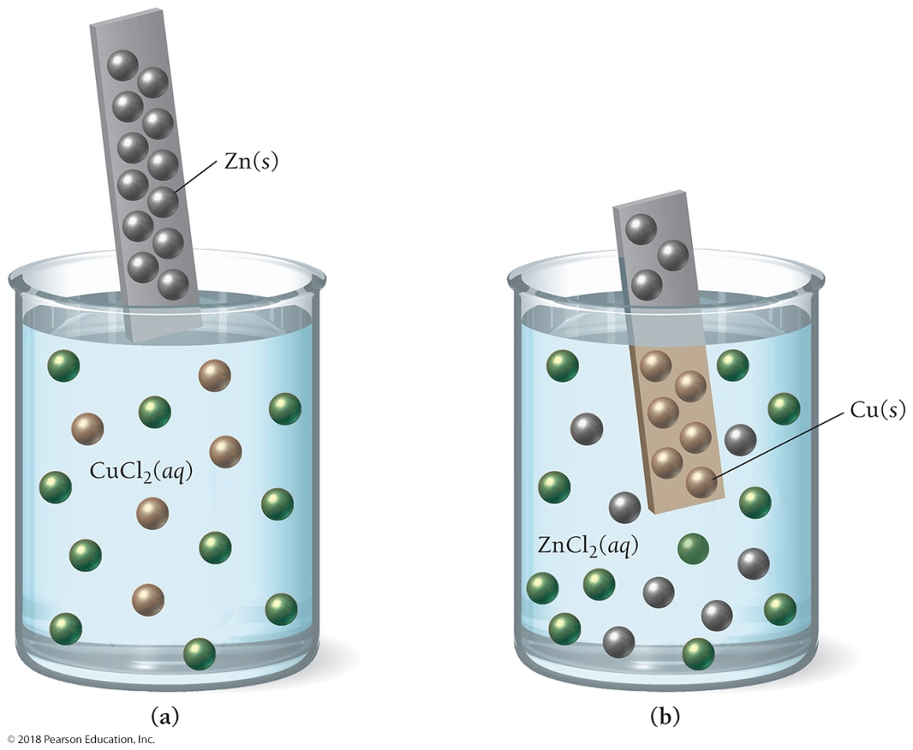
Synthesis Reactions
In a displacement or single-displacement reaction, one element displaces another in a compound.
When metallic zinc is immersed in a solution of copper(II) chloride, the zinc atoms displace the copper ions in solution.

Slide 66
Synthesis Reactions
In a double-displacement reaction, two elements or groups of elements in two different compounds exchange places to form two new compounds.
A double-displacement reaction follows the general form
AB + CD → AD + BC
The kinds of reactions that may be double displacements are precipitation reactions, acid–base reactions, and gas evolution reactions.

Slide 67
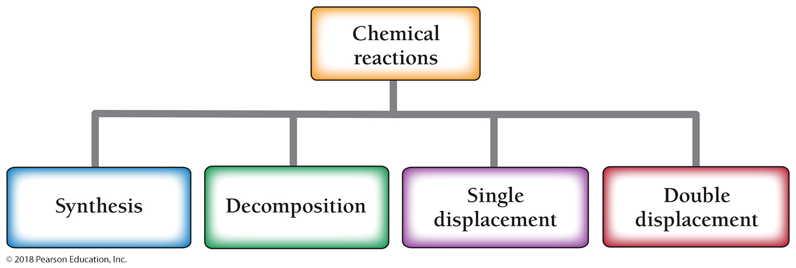
Classification Flow Chart

Slide 68
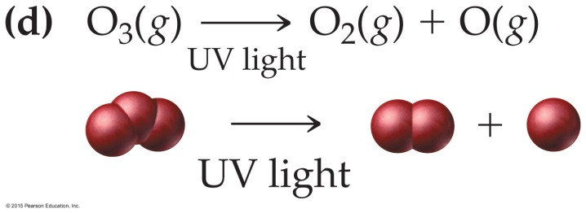
Chemistry in the Environment: The Reactions Involved in Ozone Depletion
Chlorine atoms from chlorofluorocarbons deplete the ozone layer.
In the final reaction, atomic chlorine is regenerated and can go through the cycle again to deplete more ozone.
Through this cycle of reactions, a single chlorofluorocarbon molecule can deplete thousands of ozone molecules.
Source: Chapter 6, Chemistry in the Environment: Chlorine in Chlorofluorocarbons

Slide 69
Chapter 7 in Review
Chemical reactions: One or more substances—either elements or compounds—change into a different substance.
Evidence of a chemical reaction: The only absolute evidence for a chemical reaction is chemical analysis showing that one or more substances have changed into another substance.
However, one or more of the following often accompanies a chemical reaction: a color change; the formation of a solid or precipitate; the formation of a gas; the emission of light; and the emission or absorption of heat.

Slide 70
Chapter 7 in Review
Chemical equations: Chemical equations must be balanced to reflect the conservation of matter in nature.
Aqueous solutions and solubility: If a substance dissolves in water, it is soluble.
Some specific types of reactions are precipitation reaction, acid–base reaction, gas evolution reaction, redox reaction, and combustion reaction.
Chemical reaction classifications are synthesis reaction, decomposition reaction, single-displacement reaction, and double-displacement reaction.

Slide 71
Chemical Skills Learning Objectives
LO: Identify a chemical reaction.
LO: Write balanced chemical equations.
LO: Determine if a compound is soluble.
LO: Predict and write equations for precipitation reactions.
LO: Write molecular, complete ionic, and net ionic equations.
LO: Identify and write equations for acid–base reactions.
LO: Identify and write equations for gas evolution reactions.
LO: Identify redox reactions.
LO: Identify and write equations for combustion reactions.
LO: Classify chemical reactions.

