Slide 1
Lecture Presentation
Chapter 5
Molecules and Compounds

Slide 2
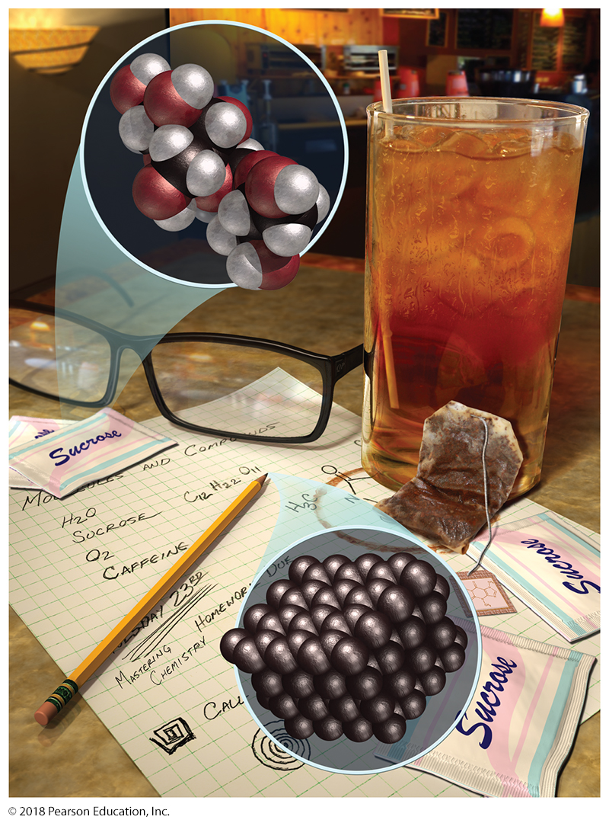
Sugar’s Properties Differ from Those of the Elements C, H, and O in Sugar
Ordinary table sugar is a compound called sucrose.
A sucrose molecule, such as the one shown here, contains carbon, hydrogen, and oxygen atoms.
The properties of sucrose are very different from those of carbon, shown here in the form of graphite, hydrogen, and oxygen.

Slide 3
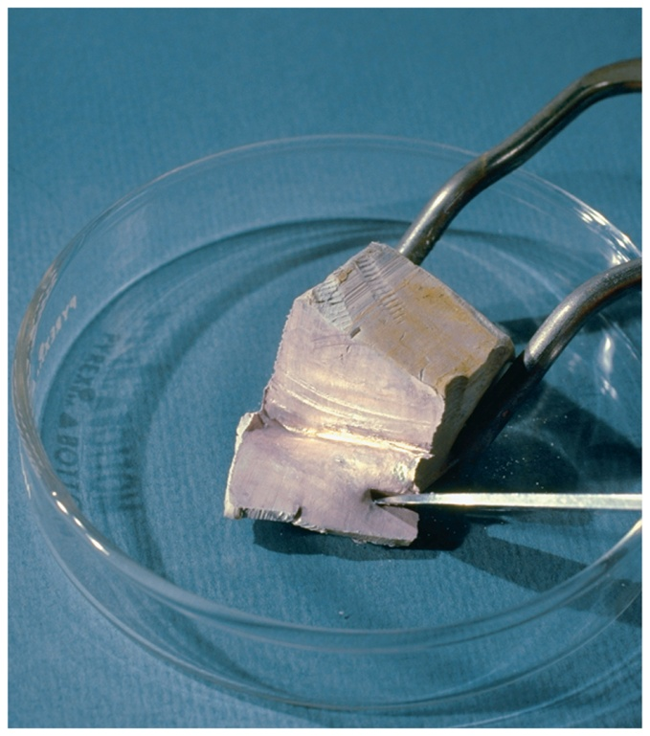
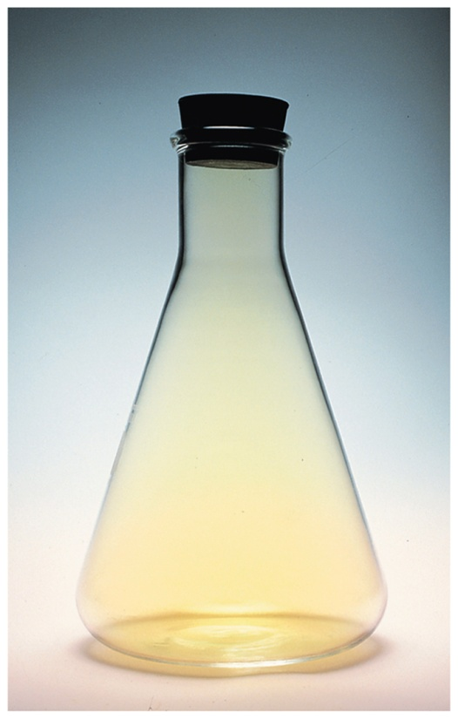
Salt’s Properties Differ from Those of the Elements Na and Cl in Salt
Elemental sodium Sodium is an extremely reactive metal that dulls almost instantly upon exposure to air.
Elemental chlorine Chlorine is a yellow gas with a pungent odor. It is highly reactive and poisonous.

Slide 4
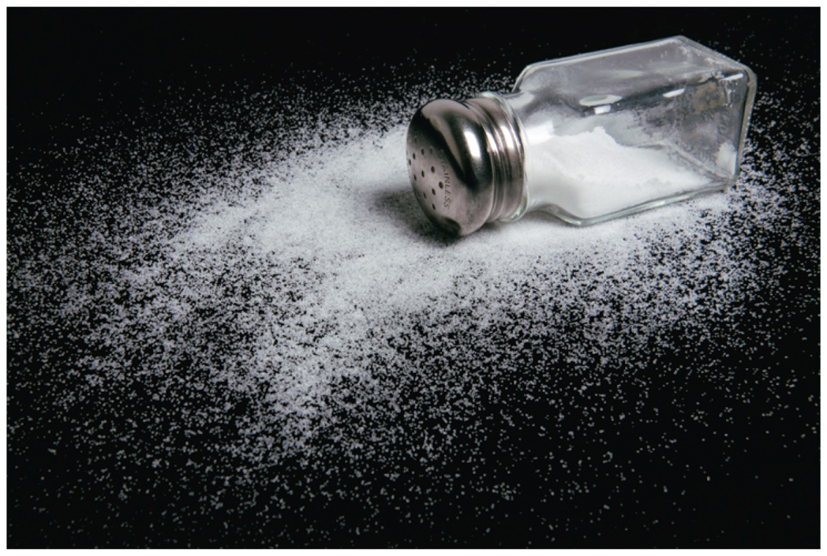
Salt’s Properties Differ from Those of the Elements Na and Cl in Salt
Sodium chloride The compound formed by sodium and chlorine is table salt.
The properties of a compound are, in general, different from the properties of the elements that compose it.

Slide 5
Many Natural Substances Are Compounds
Some of the substances we encounter in everyday life are elements.
Most are not elements—they are compounds.
Free atoms are rare in nature.
A compound is different from a mixture of elements.
In a compound, the elements combine in fixed, definite proportions.
In a mixture, they can have any proportions whatsoever.

Slide 6
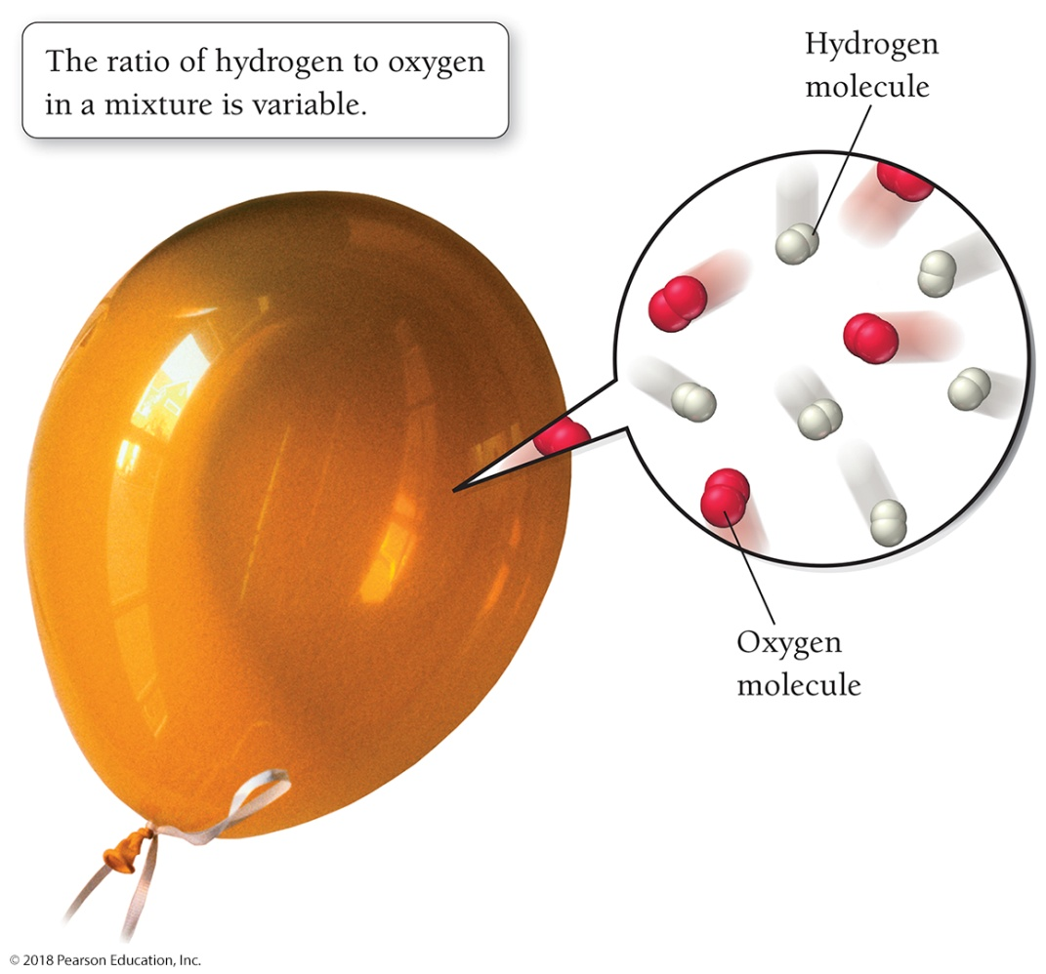
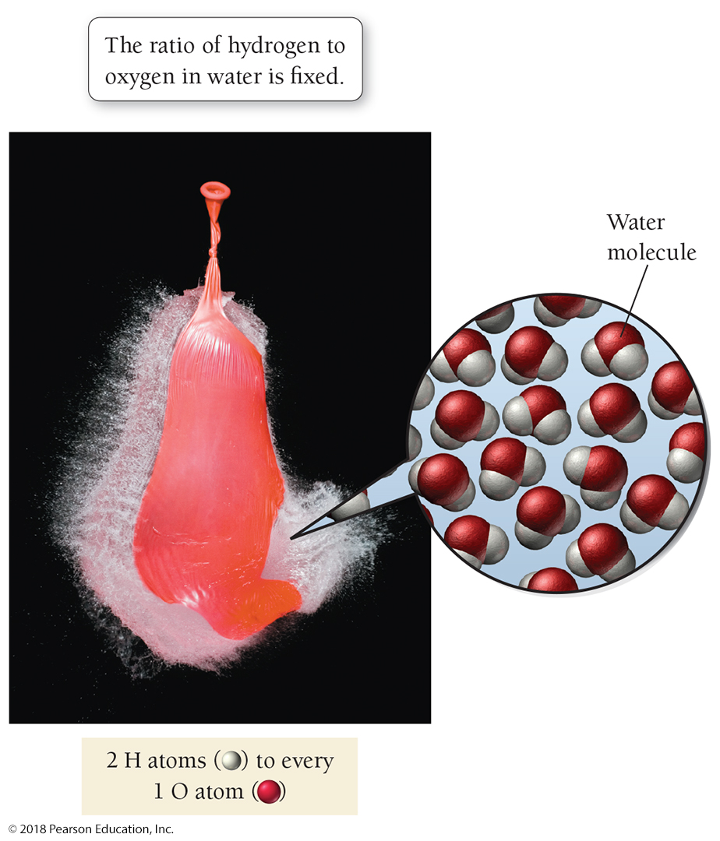
Compounds Display Constant Composition
A mixture This balloon is filled with a mixture of hydrogen and oxygen gas. The relative amounts of hydrogen and oxygen are variable.
A chemical compound This balloon is filled with water, composed of molecules that have a fixed ratio of hydrogen to oxygen. (Source: JoLynn E. Funk.)

Slide 7
Proust’s Statement of Law of Constant Composition
Joseph Proust (1754–1826) formally stated the idea that elements combine in fixed proportions to form compounds.
The law of constant composition states:
All samples of a given compound have the same proportions of their constituent elements.

Slide 8
Mass Ratio of Elements in Water Is Constant
For example, if we decompose an 18.0-g sample of water, we would get 16.0 g of oxygen and 2.0 g of hydrogen, or an oxygen-to-hydrogen mass ratio of
This is true of any sample of pure water, no matter what its origin.

Slide 9
Mass Ratio of Elements in Ammonia Is Constant
If we decompose a 17.0-g sample of ammonia, a compound composed of nitrogen and hydrogen, we would get 14.0 g of nitrogen and 3.0 g of hydrogen, or a nitrogen-to-hydrogen mass ratio of
Even though atoms combine in whole-number ratios, their mass ratios are not necessarily whole numbers.

Slide 10
Chemical Formulas: How to Represent Compounds
Compounds have constant composition with respect to mass because they are composed of atoms in fixed ratios.
A chemical formula indicates the elements present in a compound and the relative number of atoms of each.
For example, H₂O is the chemical formula for water; it indicates that water consists of hydrogen and oxygen atoms in a 2:1 ratio.
The formula contains the symbol for each element, accompanied by a subscript indicating the number of atoms of that element. By convention, a subscript of 1 is omitted.

Slide 11
By Convention, a Subscript of 1 is Omitted

Slide 12
Chemical Formulas: How to Represent Compounds
Common chemical formulas include the following:
NaCl for table salt, indicating sodium and chlorine atoms in a 1:1 ratio.
CO₂ for carbon dioxide, indicating carbon and oxygen atoms in a 1:2 ratio.
C₁₂H₂₂O₁₁ for table sugar (sucrose), indicating carbon, hydrogen, and oxygen atoms in a 12:22:11 ratio.
The subscripts in a chemical formula represent the relative numbers of each type of atom in a chemical compound; they never change for a given compound.

Slide 13
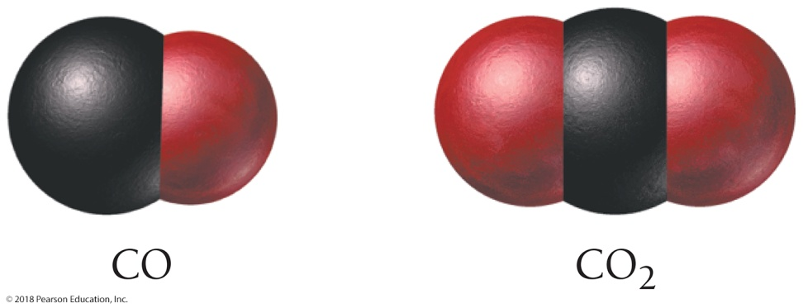
Changing a Subscript Makes a Totally Different Compound
The subscripts in a chemical formula are part of the compound’s definition—if they change, the formula no longer specifies the same compound.
CO is the chemical formula for carbon monoxide, an air pollutant with adverse health effects on humans.
If you change the subscript of the O in CO from 1 to 2, you get the formula for a totally different compound.
CO₂ is the chemical formula for carbon dioxide, the relatively harmless product of combustion and human respiration. We breathe small amounts of it all the time with no harmful effects.

Slide 14
How to List the Elements in Order in Compounds
Chemical formulas list the most metallic elements first.
The formula for table salt is NaCl, not ClNa.
In compounds that do not include a metal, the more metal-like element is listed first.
Metals are found on the left side of the periodic table and nonmetals on the upper right side.
Among nonmetals, those to the left in the periodic table are more metal-like than those to the right and are normally listed first. We write NO₂ and NO, not O₂N and ON.
Within a single column in the periodic table, elements toward the bottom are more metal-like than elements toward the top. We write SO₂, not O₂S.

Slide 15
Order to List the Nonmetal Elements in Compounds
The specific order for listing nonmetal elements in a chemical formula is shown in Table 5.1.
There are a few historical exceptions in which the most metallic element is named first, such as the hydroxide ion, which is written as OH–.

Slide 16
How to Represent Compounds with Polyatomic Ions
Some chemical formulas contain groups of atoms that act as a unit.
When several groups of the same kind are present, their formula is set off in parentheses with a subscript to indicate the number of that group.
Many of these groups of atoms have a charge associated with them and are called polyatomic ions.
To determine the total number of each type of atom in a compound containing a group within parentheses, multiply the subscript outside the parentheses by the subscript for each atom inside the parentheses.

Slide 17
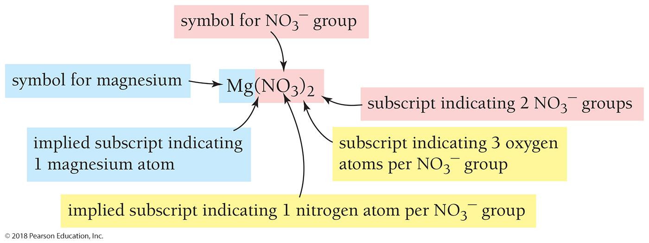
Determine the Number of Each Type of Atom in Mg(NO₃)₂
Mg(NO₃)₂ indicates a compound containing one magnesium atom (present as the Mg²⁺ ion) and two NO₃– groups.
Mg: 1 = 1 Mg
N: 1 × 2 = 2 N
O: 3 × 2 = 6 O

Slide 18
Types of Chemical Formulas
An empirical formula gives the relative number of atoms of each element in a compound.
A molecular formula gives the actual number of atoms of each element in a molecule of the compound.
For example, the molecular formula for hydrogen peroxide is H₂O₂, and its empirical formula is HO.
The molecular formula is always a whole-number multiple of the empirical formula.
For many compounds, such as H₂O, the molecular formula is the same as the empirical formula.
A structural formula uses lines to represent chemical bonds and shows how the atoms in a molecule are connected to each other.

Slide 19
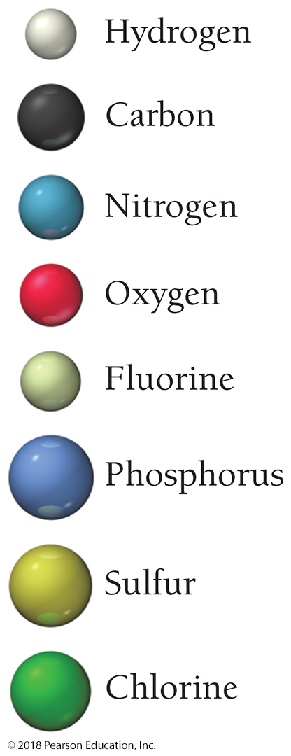
Types of Chemical Formulas
Molecular models—three-dimensional representations of molecules—are used to represent compounds.
We use two types of molecular models: ball-and-stick and space-filling.
In ball-and-stick models, we represent atoms as balls and chemical bonds as sticks.
The balls and sticks are connected to represent the molecule’s shape. The balls are color coded, and each element is assigned a color as shown in the margin.
In space-filing models, atoms fill the space between each other to more closely represent our best idea for how a molecule might appear if we could scale it to a visible size.

Slide 20
Comparison of Formulas and Models for Methane, CH₄
The molecular formula of methane indicates that methane has one carbon atom and four hydrogen atoms.
The structural formula shows how the atoms are connected: each hydrogen atom is bonded to the central carbon atom.
The ball-and-stick model and the space-filling model illustrate the geometry of the molecule: how the atoms are arranged in three dimensions.

Slide 21
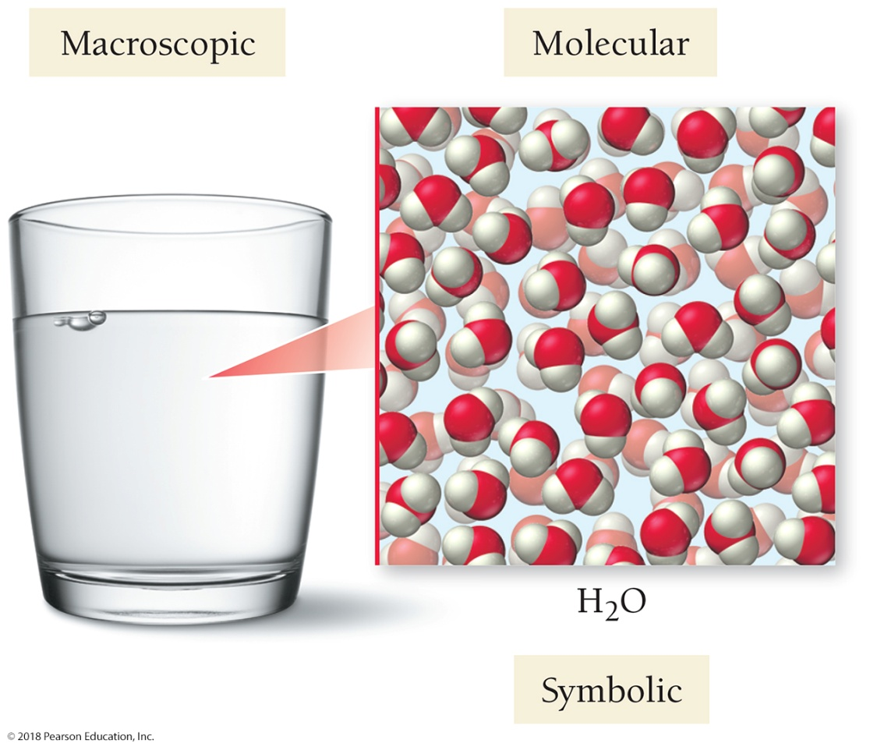
Images Make the Connection Between the World Around Us and the World of Atoms and Molecules
The macroscopic world (what we see)
The atomic and molecular world (the particles that compose matter)
The symbolic way that chemists represent the atomic and molecular world
Here is an image of water using this kind of representation.

Slide 22
A Molecular View of Elements and Compounds
Pure substances may be either elements or compounds.
Elements may be either atomic or molecular.
Compounds may be either molecular or ionic.

Slide 23
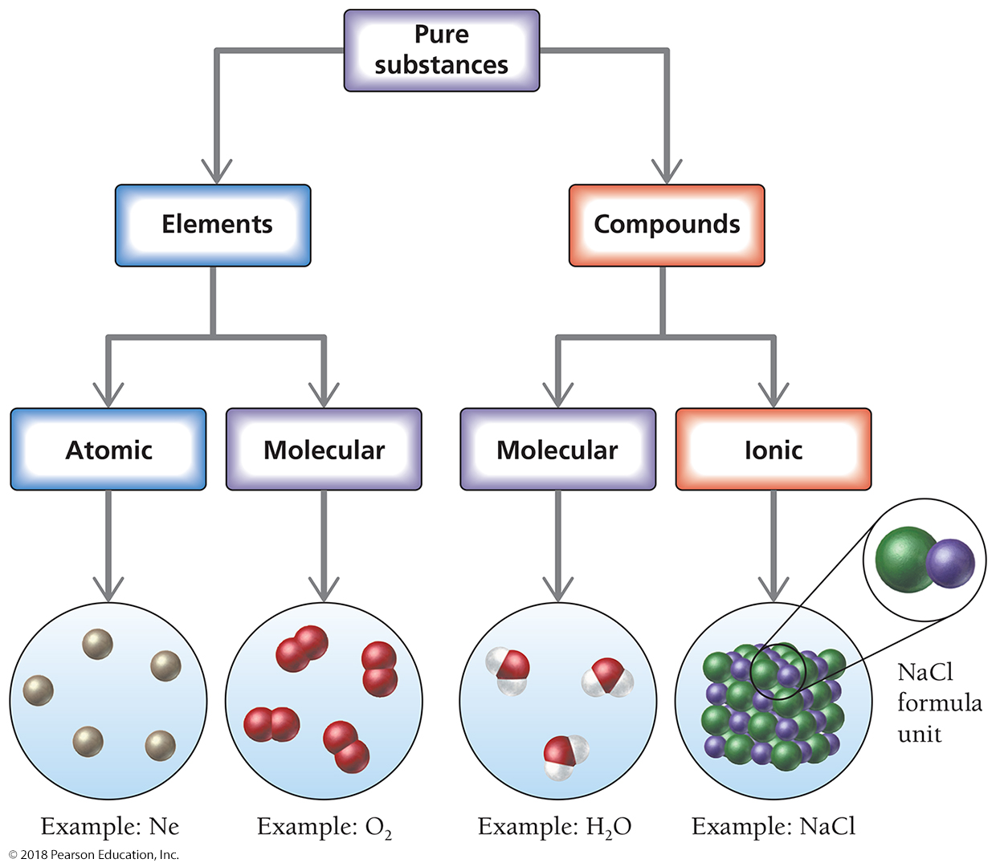
Classification of Elements and Compounds

Slide 24
Elements May Be Atomic or Molecular
Atomic elements are those that exist in nature with single atoms as their basic units. Most elements fall into this category.
Molecular elements do not normally exist in nature with single atoms as their basic units. Instead, these elements exist as diatomic molecules—two atoms of that element bonded together—as their basic units.

Slide 25
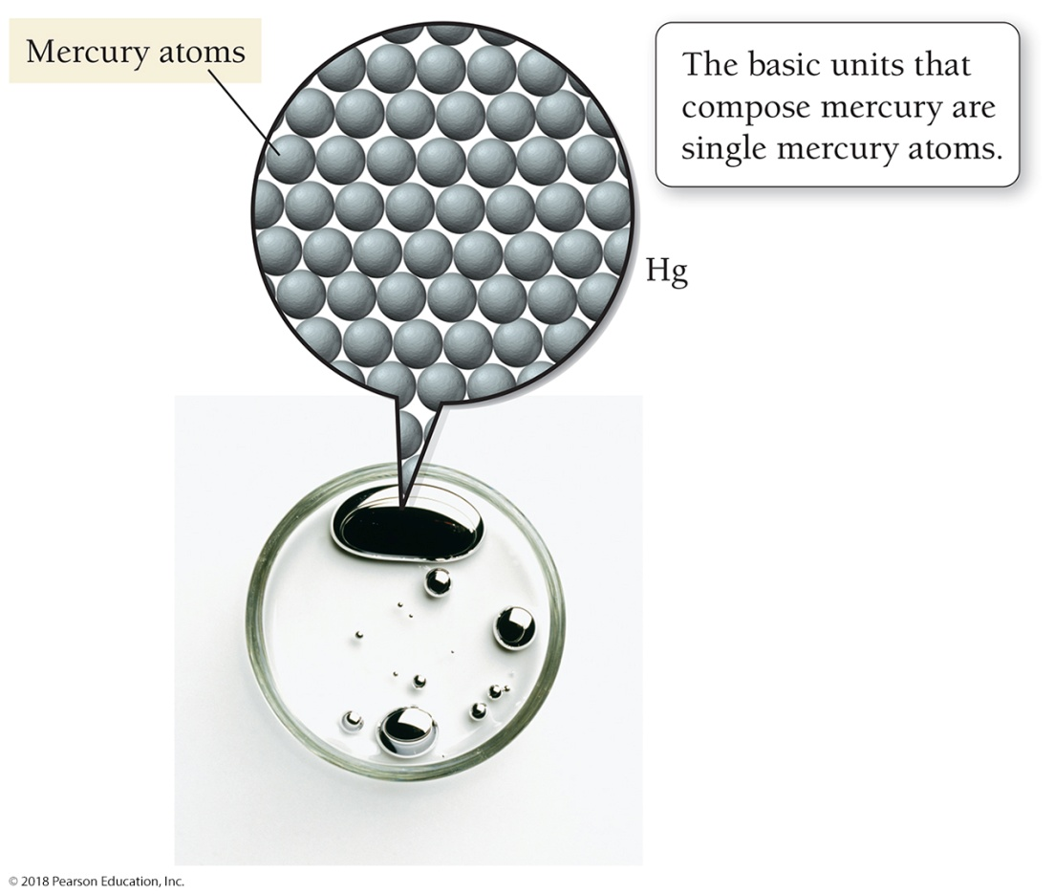
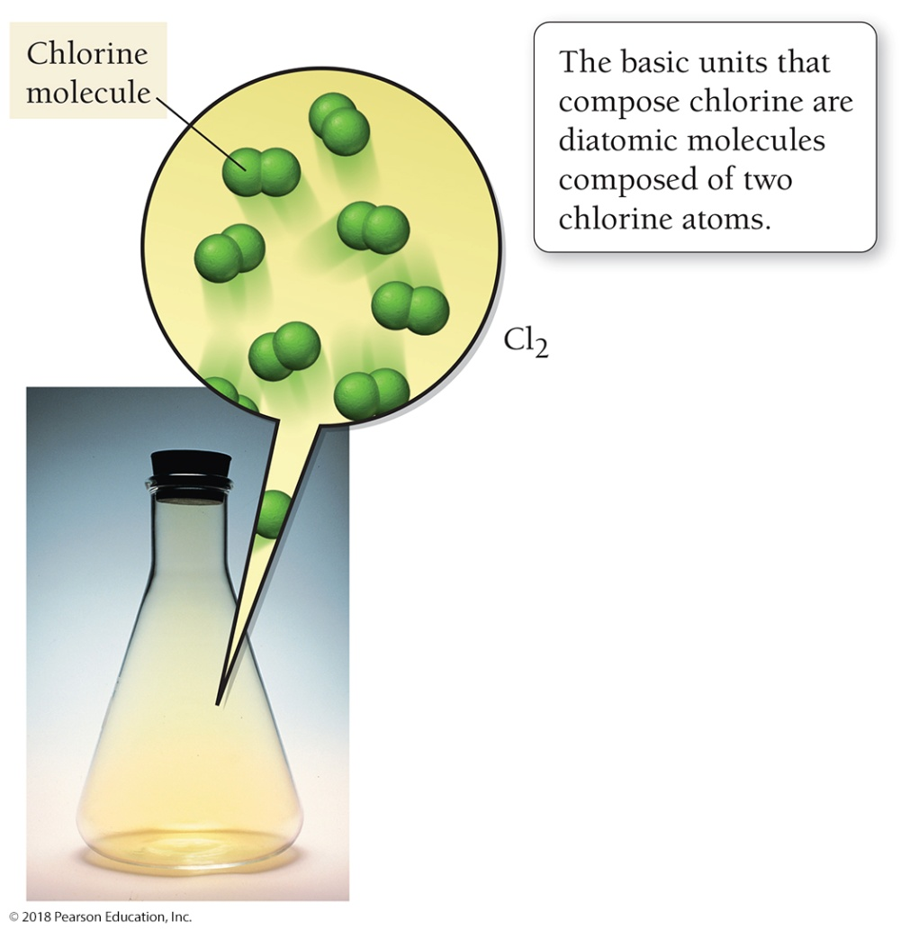
Elements May Be Atomic or Molecular
An atomic element The basic units that compose mercury, an atomic element and a metal, are single mercury atoms.
A molecular element The basic units that compose chlorine, a molecular element, are diatomic chlorine molecules, each composed of two chlorine atoms.

Slide 26
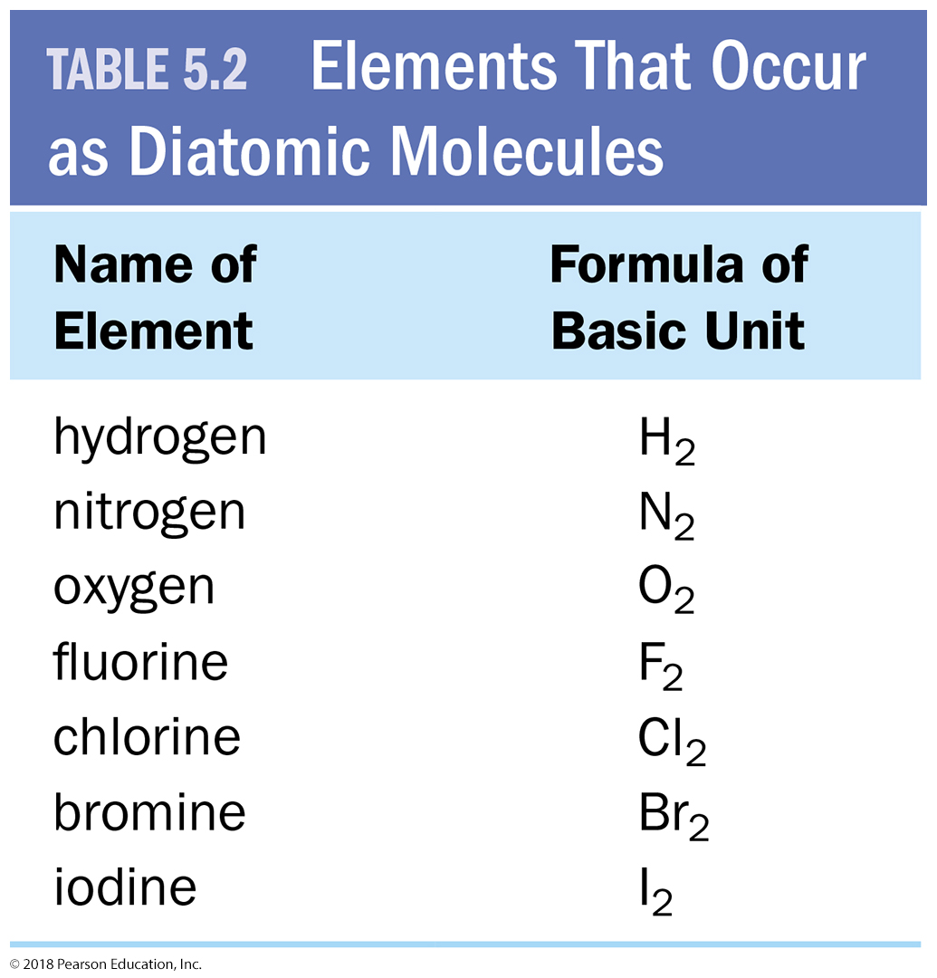
Elements that Exist as Diatomic Molecules

Slide 27
Compounds May Be Molecular or Ionic
Molecular compounds are compounds formed from two or more nonmetals. The basic units of molecular compounds are molecules composed of the constituent atoms.
Ionic compounds contain one or more cations paired with one or more anions.
In most cases, the cations are metals and the anions are nonmetals.

Slide 28
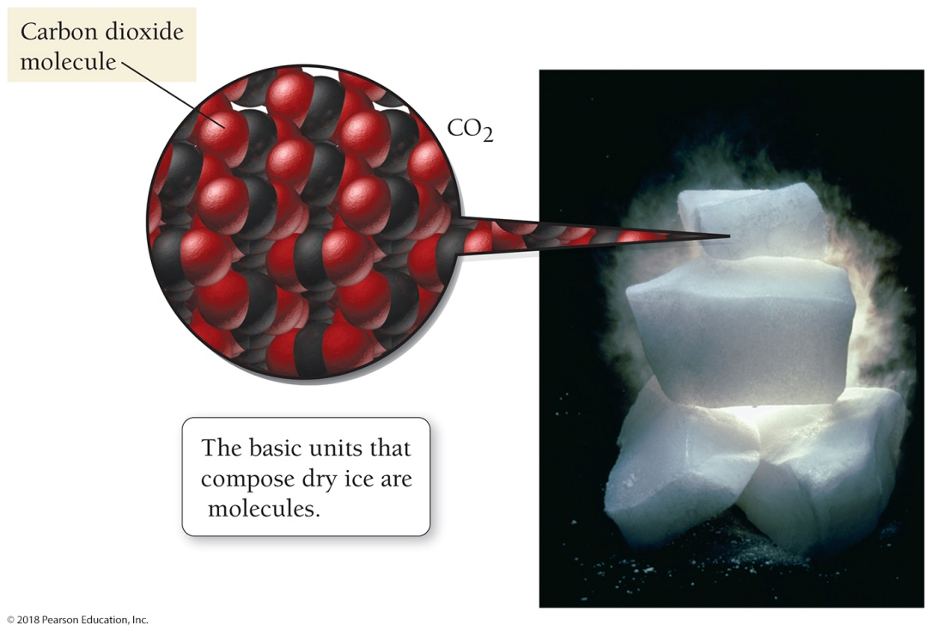
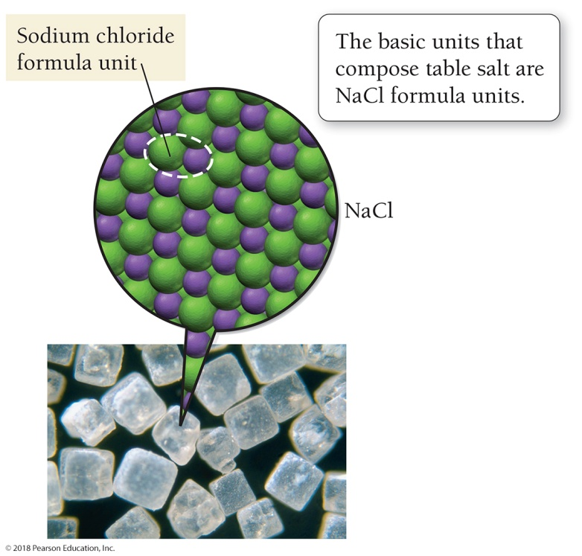
Compounds May Be Molecular or Ionic
The basic units that compose dry ice, a molecular compound, are CO₂ molecules.
The basic units that compose table salt, an ionic compound, are NaCl formula units.

Slide 29
Ionic Compounds
When a metal, which has a tendency to lose electrons, combines with a nonmetal, which has a tendency to gain electrons, one or more electrons transfer from the metal to the nonmetal, creating positive and negative ions that are attracted to each other.
A compound composed of a metal and a nonmetal is considered ionic.
The basic unit of ionic compounds is the formula unit.
Unlike molecular compounds, ionic compounds do not contain individual molecules but rather cations and anions in an alternating three-dimensional array.

Slide 30
Writing Formulas for Ionic Compounds
Review the elements that form ions with a predictable charge.
Ionic compounds always contain positive and negative ions.
In the chemical formula, the sum of the charges of the positive ions (cations) must always equal the sum of the charges of the negative ions (anions).

Slide 31
Writing Formulas for Ionic Compounds
Write the symbol for the metal and its charge followed by the symbol of the nonmetal and its charge.
Make the magnitude of the charge on each ion (without the sign) become the subscript for the other ion.
If possible, reduce the subscripts to give a ratio with the smallest whole numbers.
Check to make sure that the sum of the charges of the cations exactly cancels the sum of the charges of the anions.

Slide 32
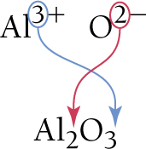
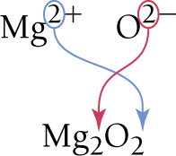
Use the Charge on One Ion as the Subscript on the Other Ion
Write formulas for ionic compounds that form from aluminum and oxygen and magnesium and oxygen.

Slide 33
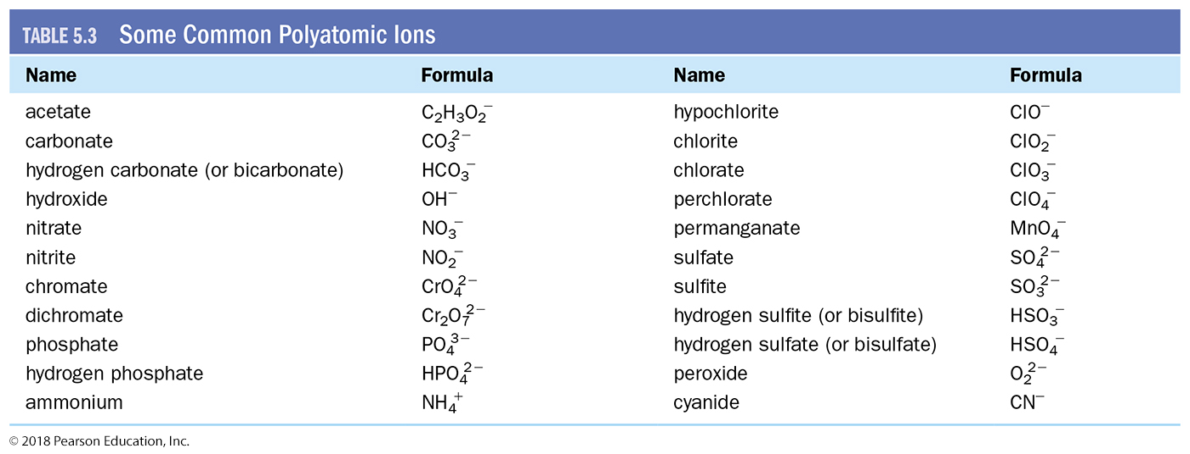
Writing Formulas for Compounds with Polyatomic Ions
Recognize polyatomic ions in a chemical formula by becoming familiar with these common polyatomic ions.

Slide 34
Nomenclature: Naming Compounds
Chemists have developed systematic ways to name compounds.
If you learn the naming rules, you can examine a compound’s formula and determine its name, and vice versa.
Many compounds also have a common name.
H₂O has the common name water and the systematic name dihydrogen monoxide.
Since water is such a familiar compound, everyone uses its common name, water, and not its systematic name.
Common names can be learned only through familiarity; there is no system.

Slide 35
Naming Ionic Compounds
The first step in naming an ionic compound is identifying it as one.
Remember, any time you have a metal and one or more nonmetals together in a chemical formula, you can assume the compound is ionic.

Slide 36
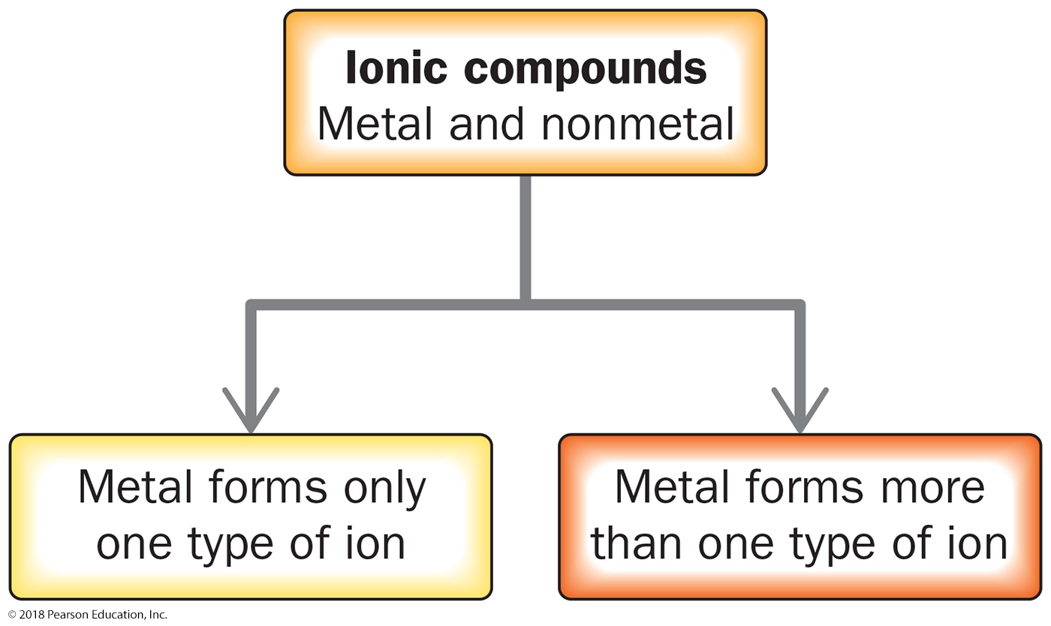
Categorizing Types of Ionic Compounds

Slide 37
Categorize Ionic Compounds Depending on the Metal
The first type (called Type I) contains a metal with an invariant charge—one that does not vary from one compound to another.
The second type of ionic compound (called Type II) contains a metal with a charge that can differ in different compounds.
Such metals are usually (but not always) found in the transition metals section of the periodic table.
Some transition metals, such as Zn and Ag, form cations with the same charge in all of their compounds: Zn²⁺, Ag⁺.
Some main group metals, such as Pb and Sn, form more than one type of cation.

Slide 38
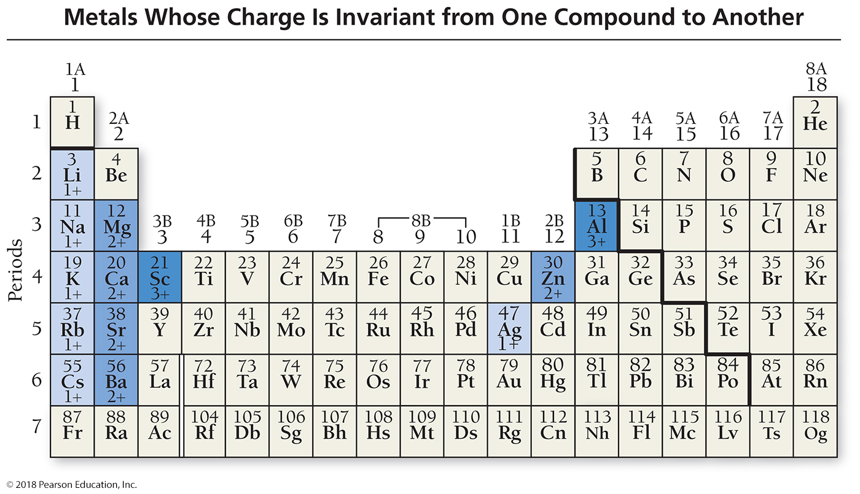
Metals Whose Charge Is Invariant

Slide 39
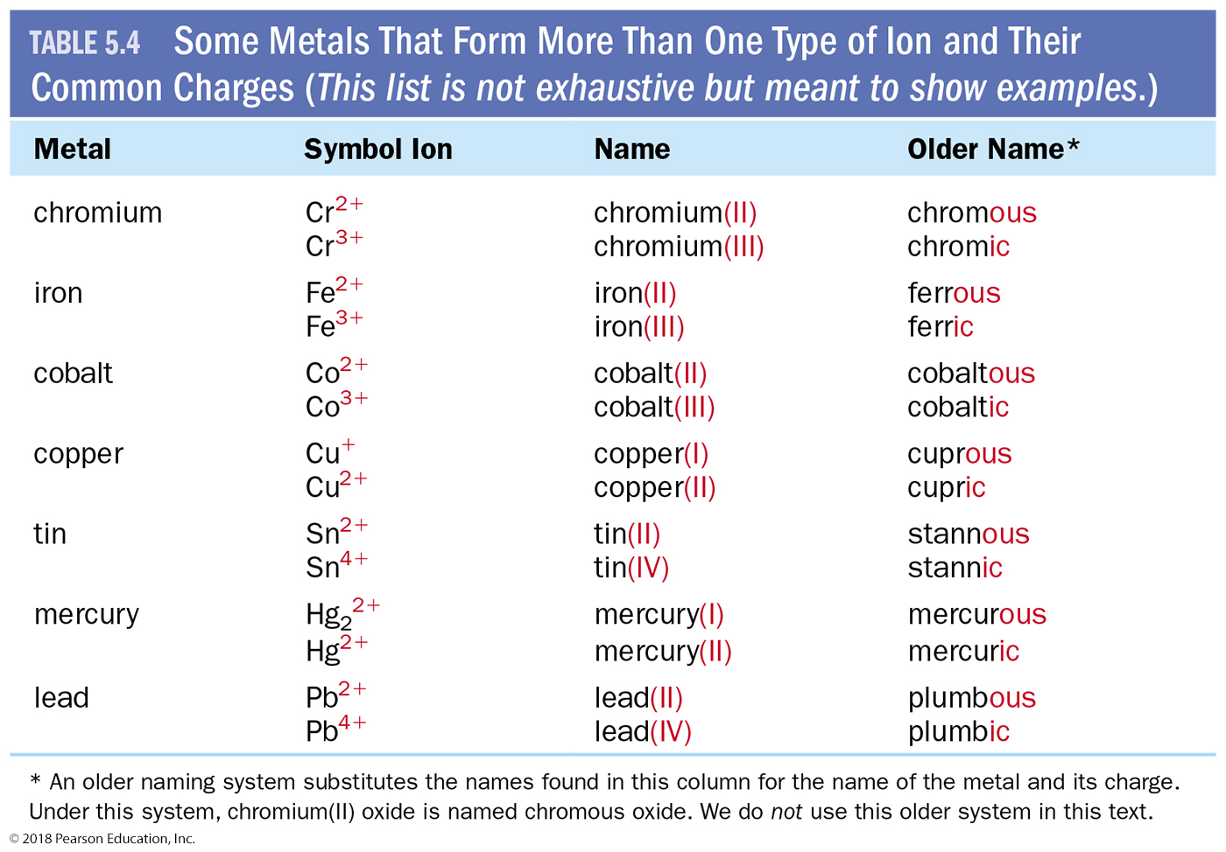
Some Metals that Form More than One Type of Ion

Slide 40
Binary Ionic Compounds with Metal of Invariant Charge
Binary compounds are those that contain only two different elements. The names for binary ionic compounds containing a metal that forms only one type of ion have the following form:
Since the charge of the metal is always the same for these types of compounds, it need not be specified in the compound’s name.

Slide 41
Binary Ionic Compounds with Metal of Invariant Charge
For example, the name for NaCl consists of the name of the cation, sodium,
followed by the base name of the anion, chlor, with the ending -ide.
The full name is sodium chloride.
NaCl sodium chloride

Slide 42
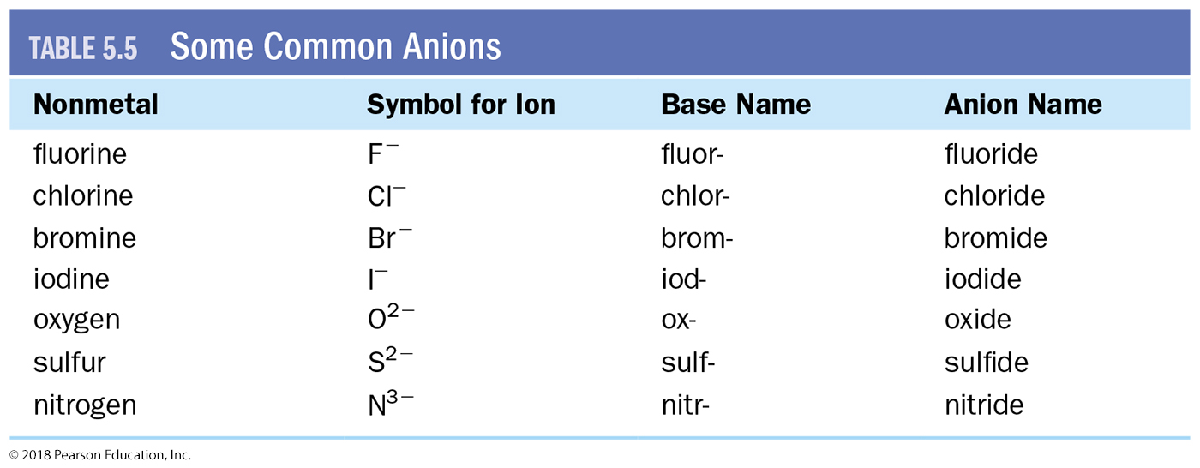
Some Common Anions
The base names for various nonmetals and their most common charges in ionic compounds

Slide 43
Binary Ionic Compounds with Metal Whose Charge May Vary
Since the charge of the metal cation in these types of compounds is not always the same, the charge must be specified in the metal’s name.
We specify the charge with a Roman numeral (in parentheses) following the name of the metal.

Slide 44
Binary Ionic Compounds with Metal Whose Charge May Vary
For example, we distinguish between Cu⁺ and Cu²⁺ by writing a (I) to indicate the 1+ ion or a (II) to indicate the 2+ ion:
Cu⁺ Copper(I)
Cu²⁺ Copper(II)

Slide 45
Binary Ionic Compounds with Metal Whose Charge May Vary
The full names for these types of compound have the following form:

Slide 46
Determine the Charge of a Metal from the Formula
We can determine the charge of the metal from the chemical formula of the compound.
The sum of all the charges must be zero.
The charge of iron in FeCl₃ must be 3⁺ for the compound to be charge-neutral with the three Cl– anions.

Slide 47
Naming Binary Ionic Compounds with Roman Numerals
The name for the compound FeCl₃ is the name of the cation, iron, followed by the specific charge of the cation in parentheses (III), followed by the base name of the anion, chlor, with the ending -ide.
The full name is iron(III) chloride.
FeCl₃ iron(III) chloride

Slide 48
Naming Ionic Compounds Containing Polyatomic Ions
Some ionic compounds contain polyatomic ions (ions that are themselves composed of a group of atoms with an overall charge).
Ionic compounds containing polyatomic ions are named using the same procedure we apply to other ionic compounds, except that we use the name of the polyatomic ion whenever it occurs.

Slide 49
Naming Ionic Compounds Containing Polyatomic Ions
For example, we name KNO₃ using its cation, K⁺, potassium, and its polyatomic anion, NO₃–, nitrate.
KNO₃ potassium nitrate
We name Fe(OH)₂ according to its cation, iron, its charge (II), and its polyatomic ion, hydroxide.
Fe(OH)₂ iron(II) hydroxide
If the compound contains both a polyatomic cation and a polyatomic anion, we use the names of both polyatomic ions.
NH₄NO₃ ammonium nitrate

Slide 50
Naming Ionic Compounds Containing Oxyanions
Many polyatomic ions are oxyanions, anions containing oxygen.
When a series of oxyanions contain different numbers of oxygen atoms, they are named systematically according to the number of oxygen atoms in the ion.
If there are two ions in the series, the one with more oxygen atoms is given the ending -ate and the one with fewer is given the ending -ite.
NO₃⁻ nitrate SO₄²⁻ sulfate NO₂⁻ nitrite SO₃²⁻ sulfite

Slide 51
Naming Ionic Compounds Containing Halo-Oxyanions
If there are more than two ions in the series, then the prefixes hypo-, meaning “less than,” and per-, meaning “more than,” are used.
ClO– hypochlorite BrO– hypobromite IO– hypoiodite ClO₂– chlorite BrO₂– bromite IO₂– iodite ClO₃– chlorate BrO₃– bromate IO₃– iodate ClO₄– perchlorate BrO₄– perbromate IO₄– periodate
When naming these ions in the homework, be sure to include the word ion in your answer, as in “perchlorate ion.”

Slide 52
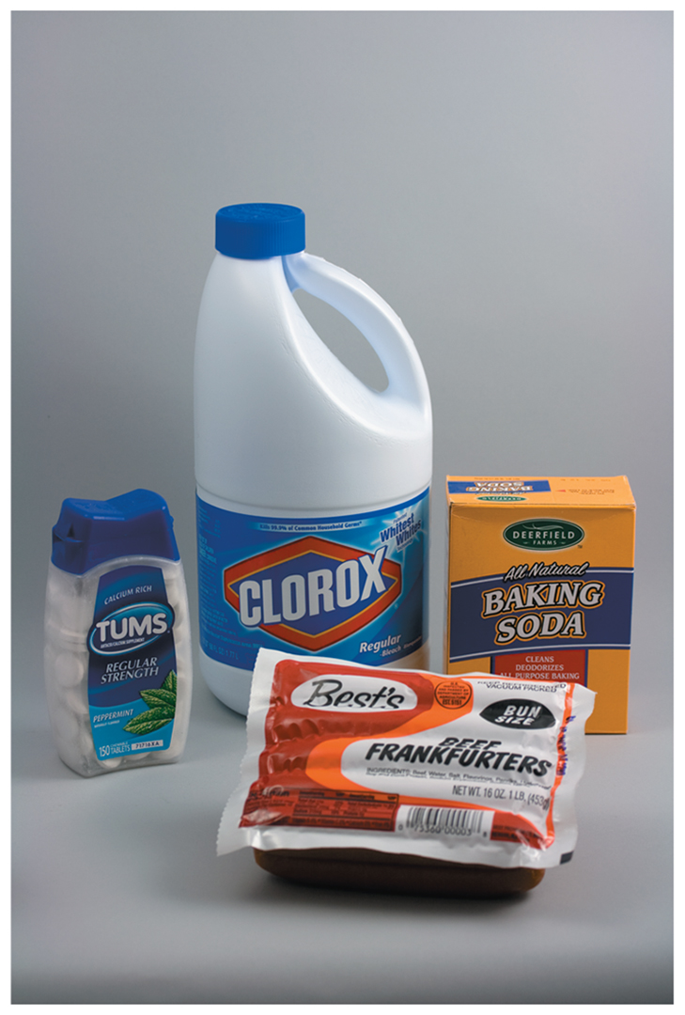
Polyatomic Ions in Everyday Chemistry
The active ingredient in household bleach is sodium hypochlorite, which acts to destroy color-causing molecules and kill bacteria.
Baking soda contains sodium bicarbonate (sodium hydrogen carbonate), which acts as a source of carbon dioxide gas in baking.
Calcium carbonate is the active ingredient in antacids such as Tums™ and Alka-Mints™. It neutralizes stomach acids.
Sodium nitrite is a food additive used to preserve packaged meats such as ham, hot dogs, and bologna. Sodium nitrite inhibits the growth of bacteria, especially those that cause botulism.

Slide 53
Naming Molecular Compounds
The first step in naming a molecular compound is identifying it as one.
Remember, nearly all molecular compounds form from two or more nonmetals.
We learn how to name binary (two-element) molecular compounds. Their names have the following form:

Slide 54
Prefixes Used when Naming Molecular Compounds
When writing the name of a molecular compound, as when writing the formula, the first element is the more metal-like one (see Table 5.1, Order of Listing Nonmetal Elements).
The prefixes given to each element indicate the number of atoms present.
mono- 1 hexa- 6
di- 2 hepta- 7
tri- 3 octa- 8
tetra- 4 nona- 9
penta- 5 deca- 10

Slide 55
Exceptions to Note when Naming Molecular Compounds
If there is only one atom of the first element, the prefix mono- is normally omitted.
CO₂ mono carbon di- ox -ide
The full name is carbon dioxide.
The compound N₂O (also called laughing gas) is named according to the first element, nitrogen, with the prefix di-, followed by the base name of the second element, ox, prefixed by mono-, and the suffix -ide.
Since mono- ends with a vowel and oxide begins with a vowel, an o is dropped and the two are combined as monoxide.
The entire name is dinitrogen monoxide.
When the prefix ends with a vowel and the base name starts with a vowel, the first vowel is sometimes dropped.
Vowel is dropped in monoxide but not in dioxide or triiodide.

Slide 56
Naming Acids
The first step in naming an acid compound is identifying it as one.
Acids are molecular compounds that form ions when dissolved in water.
They are composed of hydrogen, usually written first in their formula, and one or more nonmetals, written second.
We can categorize acids into two groups: binary acids, those containing only hydrogen and a nonmetal, and oxyacids, those containing hydrogen, a nonmetal, and oxygen.

Slide 57
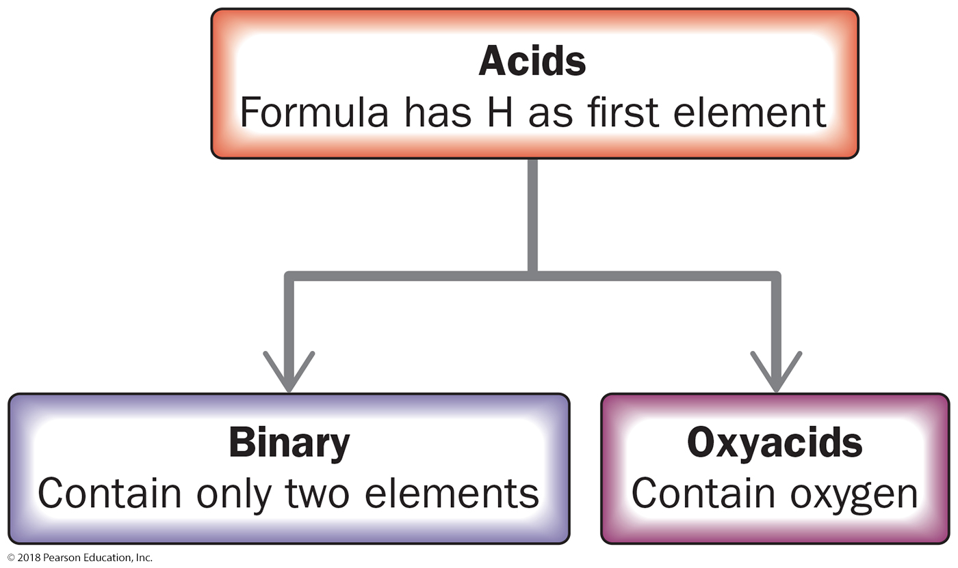
Classification of Acids

Slide 58
Naming Binary Acids
Binary acids are composed of hydrogen and a nonmetal. The names for binary acids have the following form:

Slide 59
Naming Binary Acids
HCl(aq) is hydrochloric acid.
HBr(aq) is hydrobromic acid.
HCl(g) refers to hydrogen chloride molecules in the gas phase, and not to the acid.
Give the name of H₂S(aq).
The base name of S is sulfur, so the name is hydrosulfuric acid.

Slide 60
Naming Oxyacids
Oxyacids are acids that contain oxyanions—found in the table of polyatomic ions.
HNO₃(aq) contains the nitrate (NO₃⁻) ion.
H₂SO₃(aq) contains the sulfite (SO₃²⁻) ion.
H₂SO₄(aq) contains the sulfate (SO₄²⁻) ion.
These acids are a combination of one or more H⁺ ions with an oxyanion.
The number of H⁺ ions depends on the charge of the oxyanion, so that the formula is always charge-neutral.

Slide 61
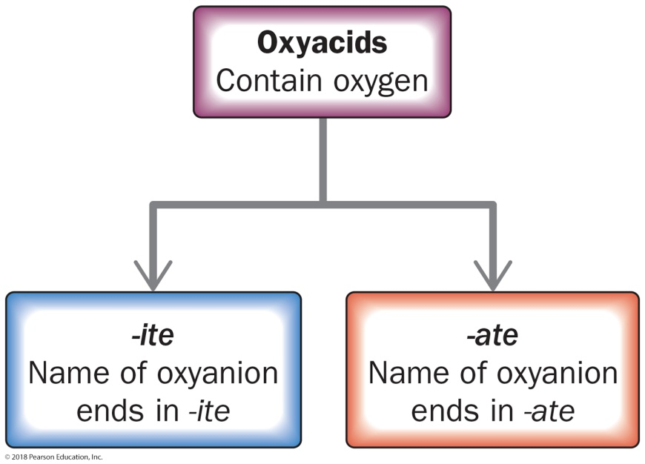
Nomenclature Flowchart
The names of acids containing oxyanions ending with -ite take this form:
The names of acids containing oxyanions ending with -ate take this form:

Slide 62
Names of Some Common Oxyacids and Their Oxyanions

Slide 63
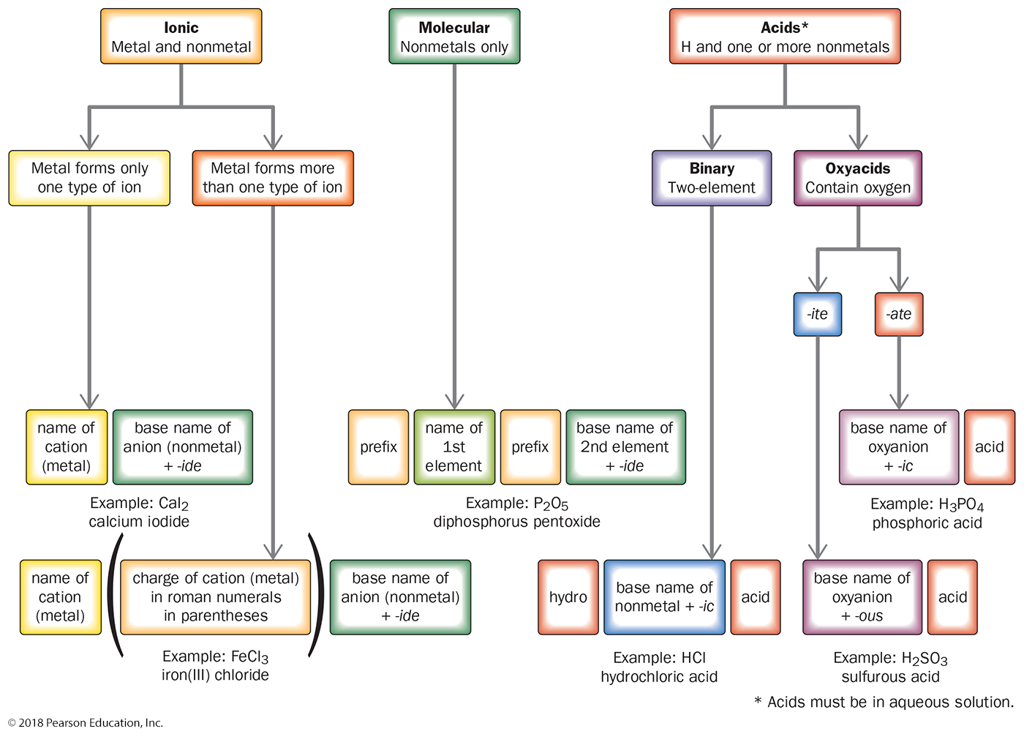

Slide 64
Example 5.14 Nomenclature Using Figure 5.17
Name each compound: CO, CaF₂, HF(aq), Fe(NO₃) ₃, HClO₄(aq), H₂SO₃(aq).
Solution
The table illustrates how to use Figure 5.17 to arrive at a name for each compound.
For More Practice
Problems 93, 94.

Slide 65
Chemistry in the Environment: Acid Rain
Acid rain occurs when rainwater mixes with air pollutants—such as NO, NO₂, and SO₂—that form acids.
NO and NO₂, primarily from vehicular emission, combine with water to form HNO₃(aq).
SO₂, primarily from coal-powered electricity generation, combines with water and oxygen in air to form H₂SO₄(aq).
HNO₃(aq) and H₂SO₄(aq) both cause rainwater to become acidic.
When acid rain flows into lakes and streams, some species of aquatic animals cannot tolerate the increased acidity and die.
Acid rain weakens trees by dissolving nutrients in the soil and by damaging their leaves.
Acid rain also damages building materials.

Slide 66
Formula Mass: The Mass of a Molecule or Formula Unit
For any compound, the formula mass is the sum of the atomic masses of all the atoms in its chemical formula:

Slide 67
Chapter 5 in Review
Chemical Principles:
Compounds display constant composition. The elements that compose a particular compound are in fixed, definite proportions in all samples of the compound.
Chemical formulas indicate the elements present in the compound and the relative number of atoms of each. These formulas represent the basic units that compose a compound.
Chemical nomenclature: The names of simple ionic compounds, molecular compounds, and acids can all be written by examining their chemical formula.
Formula mass of a compound is the sum of the atomic masses of all the atoms in the chemical formula for the compound.

Slide 68
Chemical Skills Learning Objectives
LO: Restate and apply the law of constant composition.
LO: Write chemical formulas.
LO: Determine the total number of each type of atom in a chemical formula.
LO: Classify elements as atomic or molecular.
LO: Classify compounds as ionic or molecular.
LO: Write formulas for ionic compounds.

Slide 69
Chemical Skills Learning Objectives
LO: Name binary ionic compounds containing a metal that forms only one type of ion.
LO: Name binary ionic compounds containing a metal that forms more than one type of ion.
LO: Name ionic compounds containing a polyatomic ion.
LO: Name molecular compounds.
LO: Name binary acids.
LO: Name oxyacids containing an oxyanion ending in -ate.
LO: Name oxyacids containing an oxyanion ending in -ite.
LO: Calculate formula mass.

