Slide 1
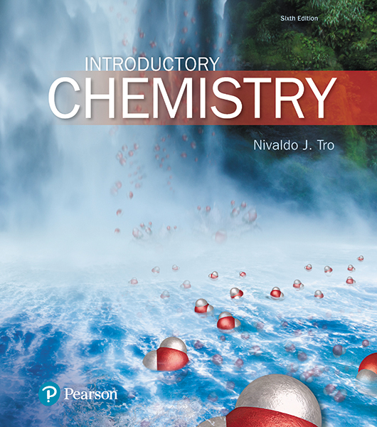
Lecture Presentation
Chapter 6
Chemical Composition

Slide 2
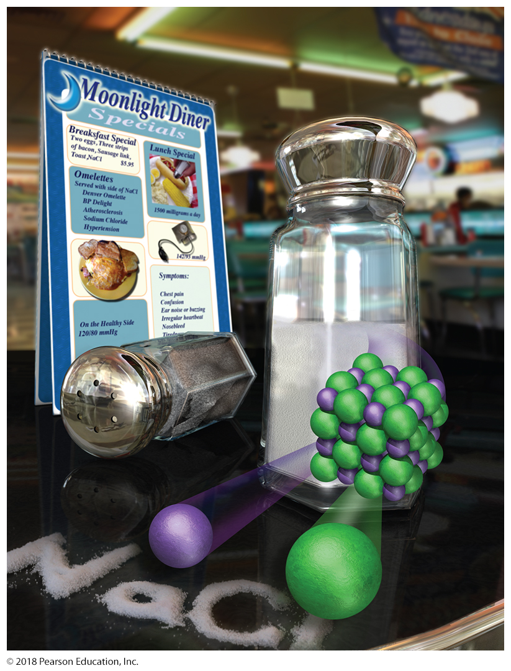
How Much Sodium?
Sodium is an important dietary mineral that we eat in our food, primarily as sodium chloride (table salt).
Sodium is involved in the regulation of body fluids, and eating too much of it can lead to high blood pressure.

Slide 3
How Much Sodium in Sodium Chloride?
The FDA recommends a person consume less than 2.4 g (2400 mg) of sodium per day.
The mass of sodium that we eat is not the same as the mass of sodium chloride that we eat.
How many grams of sodium chloride can we consume and still stay below the FDA recommendation for sodium?
The chemical composition of sodium chloride is given in its formula, NaCl.
There is one sodium ion to every chloride ion.
Since the masses of sodium and chlorine are different, the relationship between the mass of sodium and the mass of sodium chloride is not clear from the chemical formula alone.
We need to calculate the amount of a constituent element in a given amount of a compound.

Slide 4
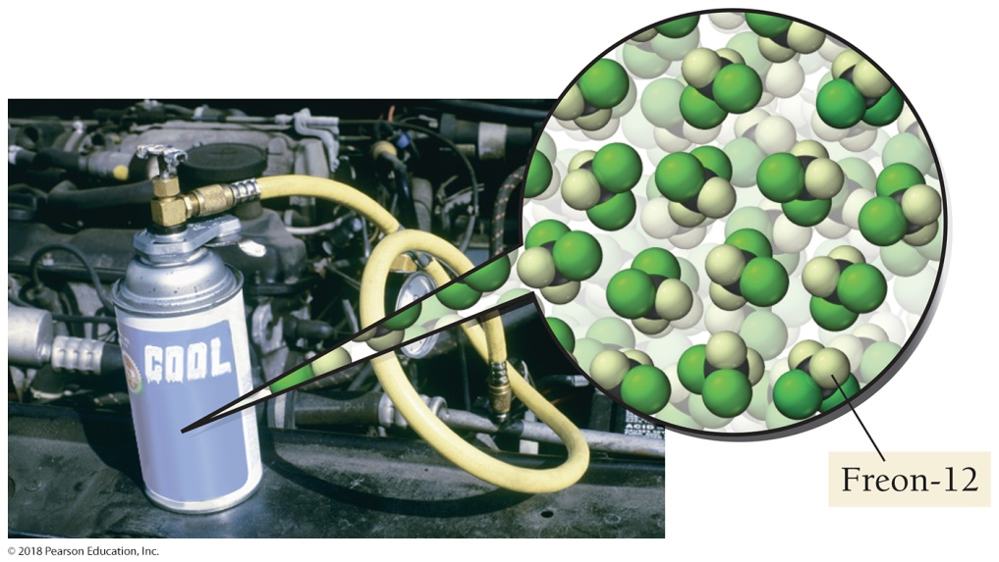
The Information in a Chemical Formula, Along with Atomic and Formula Masses, Can Be Used to Calculate the Amount of a Constituent Element in a Compound
How much iron is in a given amount of iron ore?
How much chlorine is in a given amount of a chlorofluorocarbon?

Slide 5
Counting by Weighing: Nails by the Pound
Some hardware stores sell nails by the pound, which is easier than selling them by the nail.
This problem is similar to asking how many atoms are in a given mass of an element.

Slide 6
A customer buys 2.60 lb of medium-sized nails, and a dozen of these nails weigh 0.150 lb. How many nails did the customer buy?
The solution map for the problem is as follows:
We convert from pounds to number of nails:

Slide 7
Counting by Weighing: Nails by the Pound
The conversion factor for the first part is the weight per dozen nails.
0.150 lb nails = 1 doz nails
The conversion factor for the second part is the number of nails in one dozen.
1 doz nails = 12 nails

Slide 8
Counting by Weighing: Atoms by the Gram
With atoms, we must use their mass as a way to count them.
Atoms are too small and too numerous to count individually.
Even if you could see atoms and counted them 24 hours a day as long as you lived, you would barely begin to count the number of atoms in something as small as a grain of sand.

Slide 9
Counting by Weighing: Atoms by the Gram
With nails, we used a dozen as a convenient number in our conversions.
A dozen is too small to use with atoms.
We need a larger number because atoms are so small.
The chemist’s “dozen” is called the mole (mol).
1 mol = 6.022 × 10²³

Slide 10
Avogadro’s Number
One mole of anything is 6.022 × 10²³ units of that thing.
This number is called Avogadro’s number, named after Amadeo Avogadro (1776–1856).
One mole of marbles corresponds to
6.022 × 10²³ marbles.
One mole of sand grains corresponds to
6.022 × 10²³ sand grains.

Slide 11
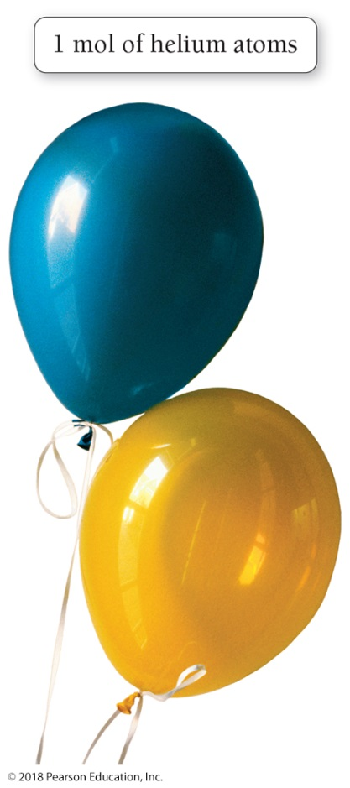
One Mole of Atoms, Ions, or Molecules Generally Makes Up Objects of Reasonable Size
Twenty-two real copper pennies contain about 1 mol of copper (Cu) atoms.
Two large helium balloons contain approximately 1 mol of helium (He) atoms.

Slide 12
The Size of the Mole is a Measured Quantity
The numerical value of the mole is defined as being equal to the number of atoms in exactly 12 g of pure carbon-12.
This definition of the mole establishes a relationship between mass (grams of carbon) and number of atoms (Avogadro’s number).
This relationship allows us to count atoms by weighing them.

Slide 13
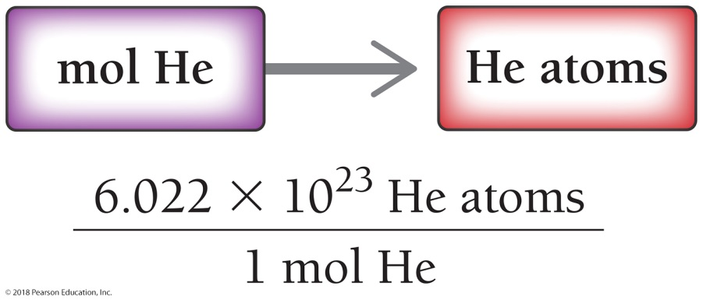
Converting Moles to Number of Atoms: Convert 3.5 mol helium to the number of helium atoms.
GIVEN: 3.5 mol He
FIND: He atoms
RELATIONSHIPS USED
1 mol He = 6.022 × 10²³ He atoms
SOLUTION MAP
SOLUTION

Slide 14
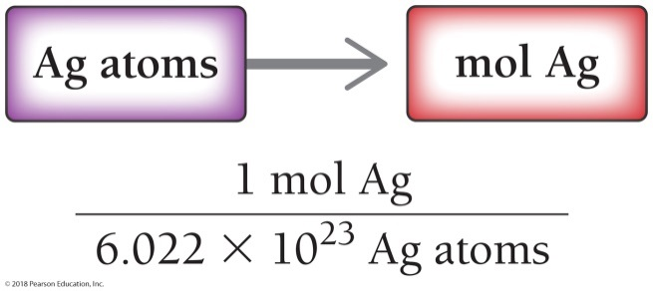
Example 6.1 Converting between Moles and Number of Atoms
A silver ring contains 1.1 × 10²² silver atoms. How many moles of silver are in the ring?
SORT You are given the number of silver atoms and asked to find the number of moles.
GIVEN 1.1 × 10²² Ag atoms
FIND mol Ag
STRATEGIZE Draw a solution map, beginning with silver atoms and ending at moles. The conversion factor is Avogadro’s number.
SOLUTION MAP
RELATIONSHIPS USED
1 mol Ag = 6.022 × 10²³ Ag atoms
(Avogadro’s number)

Slide 15
Example 6.1 Converting between Moles and Number of Atoms
Continued
SOLVE Follow the solution map to solve the problem. Beginning with 1.1 × 10²² Ag atoms, use the conversion factor to determine the moles of Ag.
SOLUTION
CHECK Are the units correct? Does the answer make physical sense?
The units, mol Ag, are the desired units. The magnitude of the answer is orders of magnitude smaller than the given quantity because it takes many atoms to make a mole, so you expect the answer to be orders of magnitude smaller than the given quantity.
Skillbuilder 6.1 | Converting between Moles and Number of Atoms
How many gold atoms are in a pure gold ring containing 8.83 × 10^{–2} mol Au?
For More Practice
Example 6.14; Problems 17, 18, 19, 20.

Slide 16
These pictures have the same number of nails. The weight of one dozen nails changes for different nails.

Slide 17
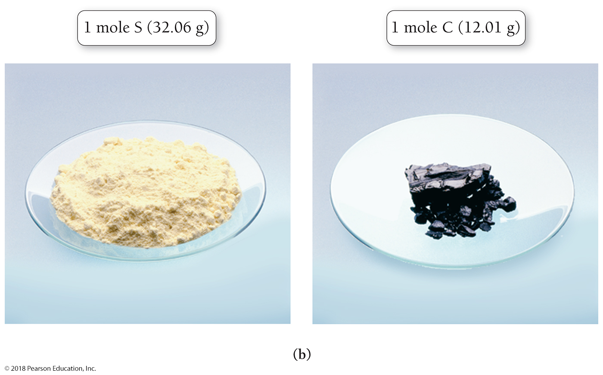
These pictures have the same number of atoms. The weight of one mole of atoms changes for different elements.

Slide 18
Molar Mass and Atomic Mass
The atomic mass unit (amu) is defined as one-twelfth of the mass of a carbon-12 atom.
The molar mass of any element—the mass of 1 mol of atoms of that element—is equal to the atomic mass of that element expressed in atomic mass units.
One copper atom has an atomic mass of 63.55 amu.
1 mol of copper atoms has a mass of 63.55 g.
The molar mass of copper is 63.55 g/mol.

Slide 19
The Mass of 1 mol of Atoms of an Element is Its Molar Mass
The mass of 1 mol of atoms changes for different elements:
32.07 g sulfur = 1 mol sulfur = 6.022 × 10²³ S atoms
12.01 g carbon = 1 mol carbon = 6.022 × 10²³ C atoms
6.94 g lithium = 1 mol lithium = 6.022 × 10²³ Li atoms
The lighter the atom, the less mass in 1 mol of that atom.

Slide 20
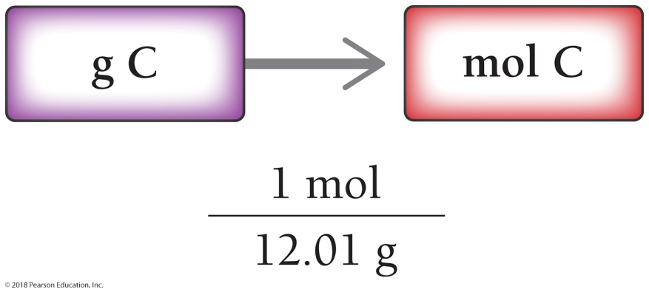
Converting Between Grams and Moles: Calculate the number of moles of carbon in 0.58-g diamond.
GIVEN: 0.58 g C
FIND: mol C
SOLUTION MAP
RELATIONSHIPS USED
12.01 g C = 1 mol C (molar mass of carbon, from periodic table)
SOLUTION

Slide 21
Converting Grams to Moles to Atoms: Calculate the number of atoms of carbon in 0.58-g diamond.

Slide 22
Example 6.3 The Mole Concept—Converting between Grams and Number of Atoms
How many aluminum atoms are in an aluminum can with a mass of 16.2 g?
SORT You are given the mass of aluminum and asked to find the number of aluminum atoms.
GIVEN 16.2 g Al
FIND Al atoms
STRATEGIZE The solution map has two steps. In the first step, convert from g Al to mol Al. In the second step, convert from mol Al to the number of Al atoms. The required conversion factors are the molar mass of aluminum and the number of atoms in a mole.
SOLUTION MAP
RELATIONSHIPS USED
26.98 g Al = 1 mol Al (molar mass of aluminum, from periodic table)
6.022 × 10²³ = 1 mol (Avogadro’s number)

Slide 23
Example 6.3 The Mole Concept—Converting between Grams and Number of Atoms
Continued
SOLVE Follow the solution map to solve the problem, beginning with 16.2 g Al and multiplying by the appropriate
conversion factors to arrive at Al atoms.
SOLUTION
CHECK Are the units correct? Does the answer make physical sense?
The units, Al atoms, are correct. The answer makes sense because the number of atoms in any macroscopic-sized sample of matter is very large.
Skillbuilder 6.3 | The Mole Concept—Converting between Grams and Number of Atoms
Calculate the mass of 1.23 × 10²⁴ helium atoms.
For More Practice
Example 6.16; Problems 35, 36, 37, 38, 39, 40, 41, 42.

Slide 24
Counting Molecules by the Gram
For elements, the molar mass is the mass of 1 mol of atoms of that element.
For compounds, the molar mass is the mass of 1 mol of molecules or formula units of that compound.
Ionic compounds do not contain individual molecules.
We convert between the mass of a compound and moles of the compound, and then we calculate the number of molecules (or formula units) from moles.

Slide 25
Converting Between Grams and Moles of a Compound Requires the Molar Mass of the Compound
The molar mass of a compound in grams per mole is numerically equal to the formula mass of the compound in atomic mass units.
The formula mass for a compound is the sum of the atomic masses of all of the atoms in a chemical formula.

Slide 26
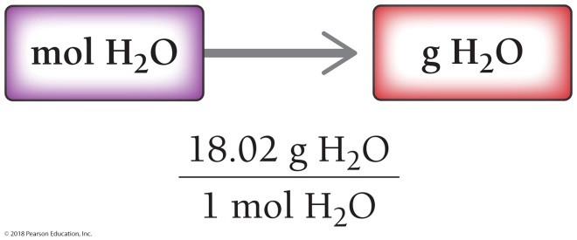
Example 6.4 The Mole Concept—Converting between Grams and Moles for Compounds
Calculate the mass (in grams) of 1.75 mol of water.
SORT You are given moles of water and asked to find the mass.
GIVEN 1.75 mol H₂O
FIND g H₂O
STRATEGIZE Draw a solution map showing the conversion from mol H₂O to g H₂O. The conversion factor is the molar mass of water, which you can determine by summing the atomic masses of all the atoms in the chemical formula.
SOLUTION MAP
RELATIONSHIPS USED
H₂O molar mass = 2(atomic mass H) + 1(atomic mass O)
= 2(1.01) + 1(16.00)
= 18.02 g/mol

Slide 27
Example 6.4 The Mole Concept—Converting between Grams and Moles for Compounds
Continued
SOLVE Follow the solution map to solve the problem. Begin with 1.75 mol of water and use the molar mass to convert to grams of water.
SOLUTION
CHECK Check your answer. Are the units correct? Does the answer make physical sense?
The units (g H₂O) are the desired units. The magnitude of the answer makes sense because 1 mol of water has a mass of 18.02 g; therefore, 1.75 mol should have a mass that is slightly less than 36 g.
Skillbuilder 6.4 | The Mole Concept—Converting between Grams and Moles
Calculate the number of moles of NO₂ in 1.18 g of NO₂.
For More Practice
Problems 47, 48, 49, 50.

Slide 28
Example 6.5 The Mole Concept—Converting between Mass of a Compound and Number of Molecules
What is the mass of 4.78 × 10²⁴ NO₂ molecules?
SORT You are given the number of NO₂ molecules and asked to find the mass.
GIVEN 4.78 × 10²⁴ NO₂ molecules
FIND g NO₂
STRATEGIZE The solution map has two steps. In the first step, convert from molecules of NO₂ to moles of NO₂. In the second step, convert from moles of NO₂ to mass of NO₂. The required conversion factors are the molar mass of NO₂ and the number of molecules in a mole.
SOLUTION MAP

Slide 29
Example 6.5 The Mole Concept—Converting between Mass of a Compound and Number of Molecules
Continued
RELATIONSHIPS USED
6.022 × 10²³ molecules = 1 mol (Avogadro’s number)
NO₂ molar mass = 1(atomic mass N) + 2(atomic mass O)
= 14.01 + 2(16.00)
= 46.01 g/mol
SOLVE Using the solution map as a guide, begin with molecules of NO₂ and multiply by the appropriate conversion factors to arrive at g NO₂.
SOLUTION
CHECK Check your answer. Are the units correct? Does the answer make physical sense?
The units, g NO₂, are correct. Because the number of NO₂ molecules is more than one mole, the answer should be more than one molar mass (more than 46.01 g), which it is; therefore, the magnitude of the answer is reasonable.

Slide 30
Example 6.5 The Mole Concept—Converting between Mass of a Compound and Number of Molecules
Continued
Skillbuilder 6.5 | The Mole Concept—Converting between Mass and Number of Molecules
How many H₂O molecules are in a sample of water with a mass of 3.64 g?
For More Practice
Problems 51, 52, 53, 54.

Slide 31
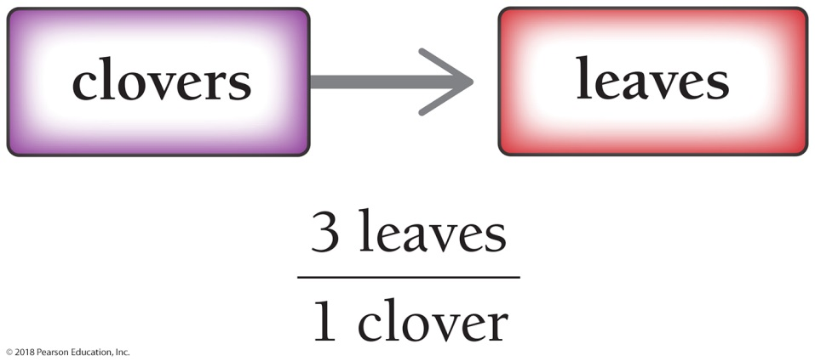
Chemical Formulas as Conversion Factors 3-Leaf Clover Analogy: How Many Leaves on 14 Clovers?
3 leaves : 1 clover

Slide 32
Chemical Formulas as Conversion Factors
The formula for carbon dioxide, CO₂, means there are two O atoms per one CO₂ molecule.
We write this as follows:
2 O atoms : 1 CO₂ molecule
Similarly,
2 dozen O atoms : 1 dozen CO₂ molecules
And
2 mol O: 1 mol CO₂

Slide 33
The Conversion Factor Comes Directly from the Chemical Formula

Slide 34
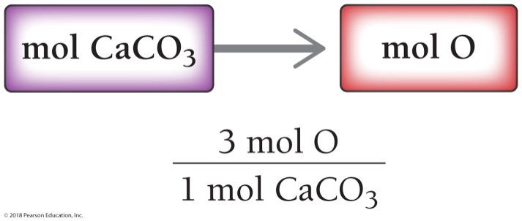
Example 6.6 Chemical Formulas as Conversion Factors—Converting between Moles of a Compound and Moles of a Constituent Element
Determine the number of moles of O in 1.7 mol of CaCO₃.
SORT You are given the number of moles of CaCO₃ and asked to find the number of moles of O.
GIVEN 1.7 mol CaCO₃
FIND mol O
STRATEGIZE The solution map begins with moles of calcium carbonate and ends with moles of oxygen. Determine the conversion factor from the chemical formula, which indicates three O atoms for every CaCO₃ unit.
SOLUTION MAP
RELATIONSHIPS USED
3 mol O : 1 mol CaCO₃ (from chemical formula)

Slide 35
Example 6.6 Chemical Formulas as Conversion Factors—Converting between Moles of a Compound and Moles of a Constituent Element
Continued
SOLVE Follow the solution map to solve the problem. The subscripts in a chemical formula are exact, so they never limit significant figures.
SOLUTION
CHECK Check your answer. Are the units correct? Does the answer make physical sense?
The units (mol O) are correct. The magnitude is reasonable as the number of moles of oxygen should be larger than the number of moles of CaCO₃ (because each CaCO₃ unit contains 3 O atoms).
Skillbuilder 6.6 | Chemical Formulas as Conversion Factors—Converting between Moles of a Compound and Moles of a Constituent Element
Determine the number of moles of O in 1.4 mol of H₂SO₄.
For More Practice
Example 6.17; Problems 63, 64.

Slide 36
Converting Between Grams of a Compound and Grams of a Constituent Element: Find the mass of sodium in 15 g of NaCl.
GIVEN: 15 g NaCl
FIND: g Na
SOLUTION MAP
SOLUTION

Slide 37
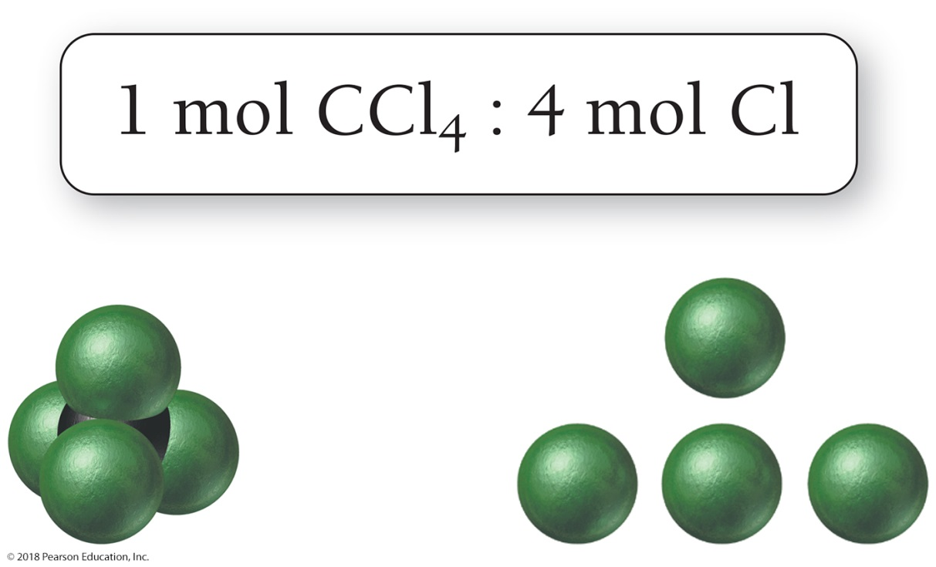
Mole Relationships from a Chemical Formula
The relationships inherent in a chemical formula allow us to convert between moles of the compound and moles of a constituent element (and vice versa).

Slide 38
Mass Percent Composition of Compounds
The mass percent composition, or mass percent, of an element is the element’s percentage of the total mass of the compound.

Slide 39
Finding Mass Percent Composition
A 0.358-g sample of chromium reacts with oxygen to form 0.523 g of the metal oxide.
The mass percent of chromium is as follows:

Slide 40
Finding Mass Percent Composition
We can use mass percent composition as a conversion factor between grams of a constituent element and grams of the compound.
The mass percent composition of sodium in sodium chloride is 39%.
This can be written as follows:
39 g sodium : 100 g sodium chloride

Slide 41
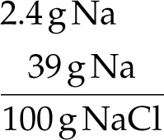
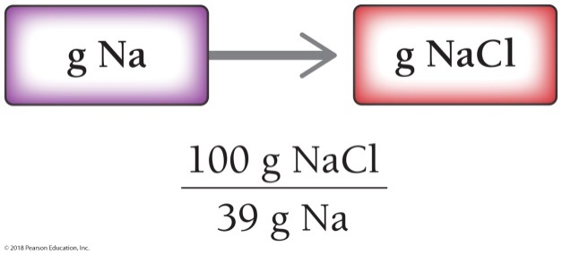
Example 6.8 Using Mass Percent Composition as a Conversion Factor
The FDA recommends that adults consume less than 2.4 g of sodium per day. How many grams of sodium chloride
can you consume and still be within the FDA guidelines? Sodium chloride is 39% sodium by mass.
SORT You are given the mass of sodium and the mass percent of sodium in sodium chloride. When mass percent is given, write it as a fraction. Percent means per hundred, so 39% sodium indicates that there are 39 g Na per 100 g NaCl. You are asked to find the mass of sodium chloride that contains the given mass of sodium.
GIVEN
FIND g NaCl
STRATEGIZE Draw a solution map that starts with the mass of sodium and uses the mass percent as a conversion
factor to get to the mass of sodium chloride.
SOLUTION MAP

Slide 42
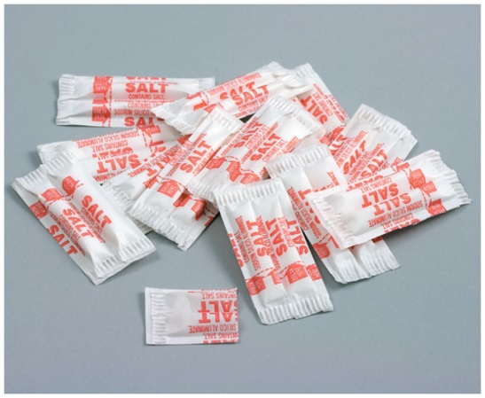
Example 6.8 Using Mass Percent Composition as a Conversion Factor
Continued
RELATIONSHIPS USED
39 g Na : 100 g NaCl (given in the problem)
SOLVE Follow the solution map to solve the problem, beginning with grams Na and ending with grams of NaCl. The amount of salt you can consume and still be within the FDA guideline is 6.2 g NaCl.
SOLUTION
CHECK Check your answer. Are the units correct? Does the answer make physical sense?
The units, g NaCl, are correct. The answer makes physical sense
because the mass of NaCl should be larger than the mass of Na. The mass of a compound containing a given mass of a particular
element is always larger than the mass of the element itself.

Slide 43
Example 6.8 Using Mass Percent Composition as a Conversion Factor
Continued
Skillbuilder 6.8 | Using Mass Percent Composition as a Conversion Factor
If a woman consumes 22 g of sodium chloride, how much sodium does she consume? Sodium chloride is 39%
sodium by mass.
For More Practice
Example 6.19; Problems 75, 76, 77, 78.

Slide 44
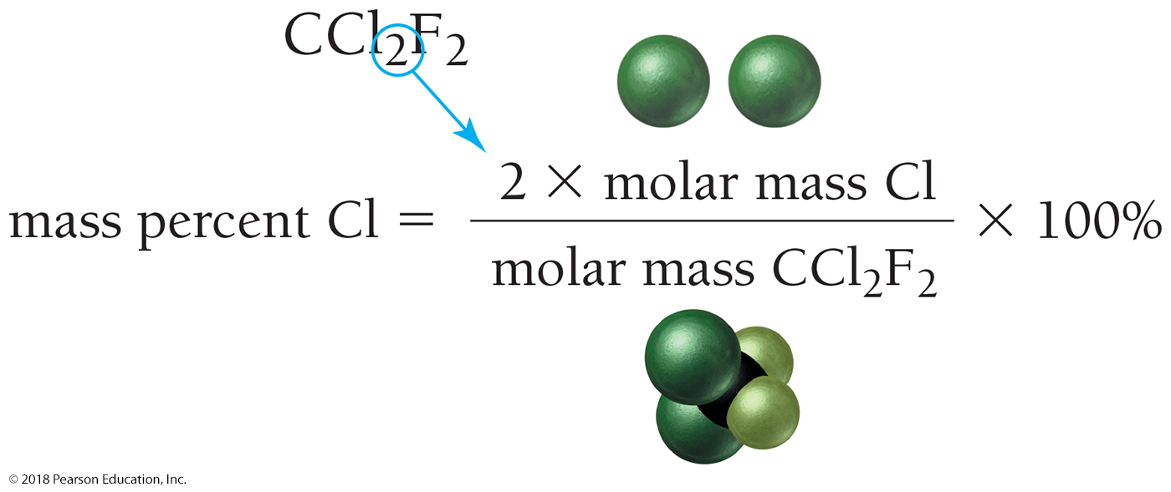
Mass Percent Composition from a Chemical Formula
Based on the chemical formula, the mass percent of element Cl in compound CCl₂F₂ is as follows:

Slide 45
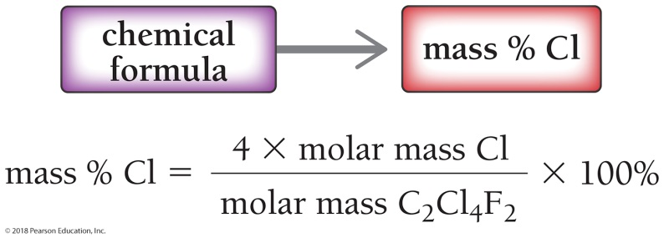
Example 6.9 Mass Percent Composition
Calculate the mass percent of Cl in freon-114 (C₂Cl₄F₂).
SORT You are given the molecular formula of freon-114 and asked to find the mass percent of Cl.
GIVEN C₂C_{l4}F₂
FIND Mass % Cl
STRATEGIZE You can use the information in the chemical formula to substitute into the mass percent equation and obtain the mass percent Cl.
SOLUTION MAP
RELATIONSHIPS USED

Slide 46
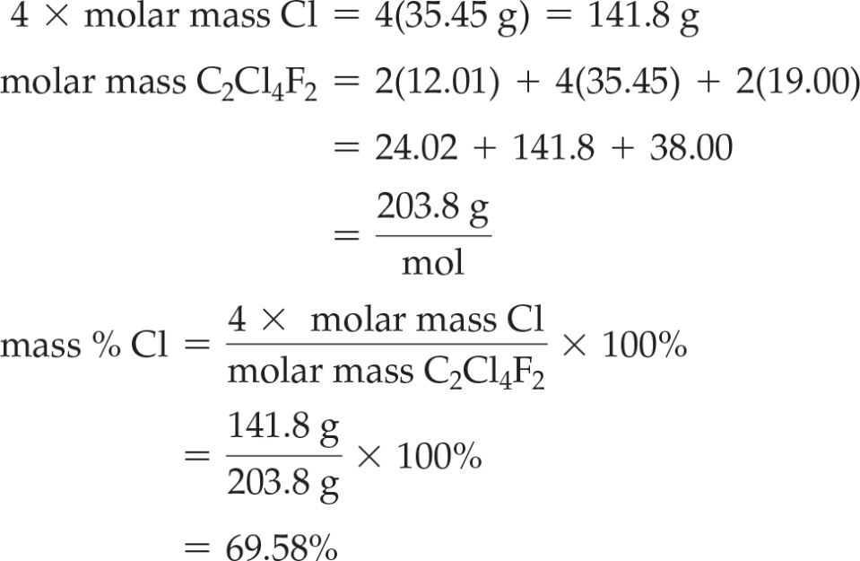
Example 6.9 Mass Percent Composition
Continued
SOLVE Calculate the molar mass of freon-114 and substitute the values into the equation to find mass percent Cl.
SOLUTION
CHECK Check your answer. Are the units correct? Does the answer make physical sense?
The units (%) are correct. The answer makes physical sense. Mass percent composition should never exceed 100%. If your answer is greater than 100%, you have made an error.

Slide 47
Example 6.9 Mass Percent Composition
Continued
Skillbuilder 6.9 | Mass Percent Composition
Acetic acid (HC₂H₃O₂) is the active ingredient in vinegar. Calculate the mass percent composition of O in acetic acid.
For More Practice
Example 6.20; Problems 79, 80, 81, 82, 85, 86.

Slide 48
Chemistry and Health: Fluoridation of Drinking Water
Fluoride strengthens tooth enamel, which prevents tooth decay.
Too much fluoride can cause teeth to become brown and spotted, a condition known as dental fluorosis.
Extremely high levels can lead to skeletal fluorosis.
The scientific consensus is that, like many minerals, fluoride shows some health benefits at certain levels—about 1–4 mg/day for adults—but can have detrimental effects at higher levels.
Adults who drink between 1 and 2 L of water per day would receive the beneficial amounts of fluoride from the water.

Slide 49
Chemistry and Health: Fluoridation of Drinking Water
Fluoride is often added to water as sodium fluoride (NaF).
What is the mass percent composition of F⁻ in NaF?
How many grams of NaF should be added to 1500 L of water to fluoridate it at a level of 1.0 mg F⁻/L?

Slide 50
Empirical Formulas from Mass Percent Composition
An empirical formula gives only the smallest whole-number ratio of each type of atom in a compound, not the specific number of each type of atom in a molecule.
The molecular formula is always a whole-number multiple of the empirical formula.
For example, the molecular formula for hydrogen peroxide is H₂O₂ and its empirical formula is HO.
Molecular formula = Empirical × n , where n = 1, 2, 3 . . .
n = 2 for hydrogen peroxide.

Slide 51
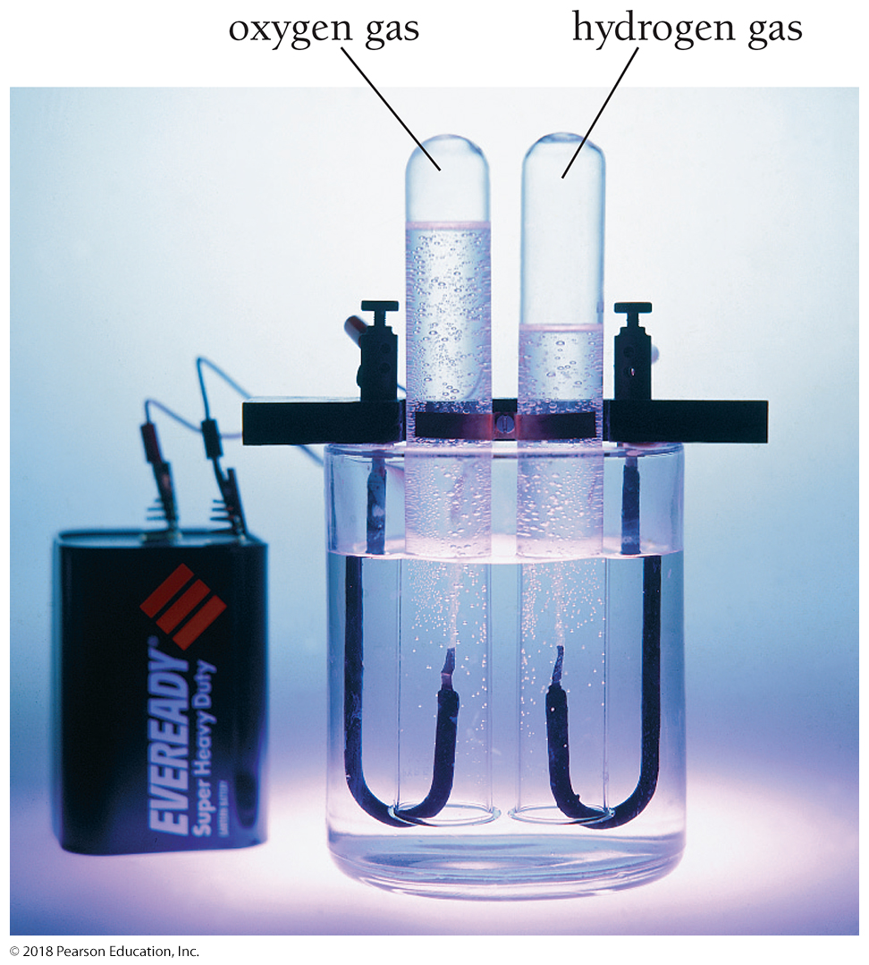
Calculating an Empirical Formula from Experimental Data: Decomposition of Water
We decompose a sample of water in the laboratory and find that it produces 3.0 g of hydrogen and 24 g of oxygen.
How do we determine an empirical formula from these data?

Slide 52
Calculating an Empirical Formula from Experimental Data: Decomposition of Water to 3.0 g H and 24 g O
How many moles of each element are formed during the decomposition of water?
Divide the experimental mass of each element by the molar mass of that element.
There are 3 mol of H for every 1.5 mol of O.

Slide 53
Calculating an Empirical Formula from Experimental Data: Decomposition of Water to 3.0 g H and 24 g O
Write a pseudo-formula for water: H₃O_{1.5}
To get whole-number subscripts in our formula, divide all the subscripts by the smallest one, in this case 1.5.
Our empirical formula for water, which in this case also happens to be the molecular formula, is H₂O.

Slide 54
Obtaining an Empirical Formula from Experimental Data
Write down (or calculate) as given the masses of each element present in a sample of the compound. If you are given mass percent composition, assume a 100-g sample and calculate the masses of each element from the given percentages.
Convert each of the masses in Step 1 to moles by using the appropriate molar mass for each element as a conversion factor.
Write down a pseudo-formula for the compound, using the moles of each element (from Step 2) as subscripts.
Divide all the subscripts in the formula by the smallest subscript.
If the subscripts are not whole numbers, multiply all the subscripts by a small whole number (see the following table) to arrive at whole-number subscripts.

Slide 55
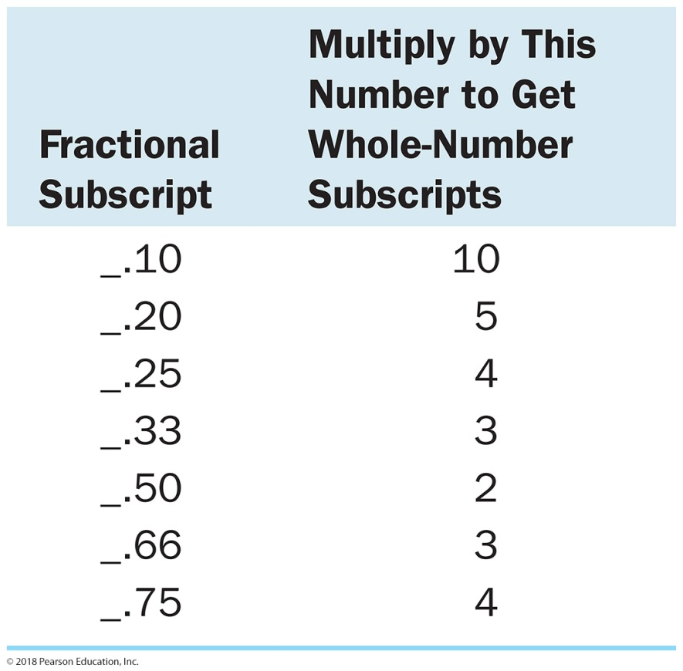
Conversion of Fractional Subscripts to Whole Numbers
If, after dividing by the smallest number of moles, the subscripts are not whole numbers, multiply all the subscripts by a small whole number to arrive at whole-number subscripts.

Slide 56
Example 6.12 Calculating an Empirical Formula from Reaction Data
A 3.24-g sample of titanium reacts with oxygen to form 5.40 g of the metal oxide. What is the empirical formula of
the metal oxide?
You are given the mass of titanium and the mass of the metal oxide that forms. You are asked to find the empirical formula. You need to recognize this problem as one requiring a special procedure and apply that procedure, which is outlined below.
GIVEN 3.24 g Ti
5.40 g metal oxide
FIND empirical formula
1. Write down (or calculate) the masses of each element present in a sample of the compound.
In this case, you are given the mass of the initial Ti sample and the mass of its oxide after the sample reacts with oxygen. The mass of oxygen is the difference between the mass of the oxide and the mass of titanium.
SOLUTION
3.24 g Ti
mass O = mass oxide – mass titanium
= 5.40 g – 3.24 g
= 2.16 g O

Slide 57
Example 6.12 Calculating an Empirical Formula from Reaction Data
Continued
2. Convert each of the masses in Step 1 to moles by using the appropriate molar mass for each element as a conversion factor.
3. Write down a pseudoformula for the compound, using the moles of each element obtained in Step 2 as subscripts.
Ti_{0.0677}O_{0.135}
4. Divide all the subscripts in the formula by the smallest subscript.

Slide 58
Example 6.12 Calculating an Empirical Formula from Reaction Data
Continued
5. If the subscripts are not whole numbers, multiply all the subscripts by a small whole number to arrive at whole-number subscripts.
As the are already whole numbers, this last step is unnecessary. The correct empirical formula is TiO₂.
Skillbuilder 6.12 | Calculating an Empirical Formula from Reaction Data
A 1.56-g sample of copper reacts with oxygen to form 1.95 g of the metal oxide. What is the formula of the metal oxide?
For More Practice
Problems 95, 96, 97, 98.

Slide 59
Calculating Molecular Formulas for Compounds from Empirical Formulas and Molar Masses
The molecular formula is always a whole-number multiple of the empirical formula.
We need to find n in the expression
Molecular formula = CH₂O × n
We can find n in the expression
Molar mass = Empirical formula molar mass × n
Solving for n,

Slide 60
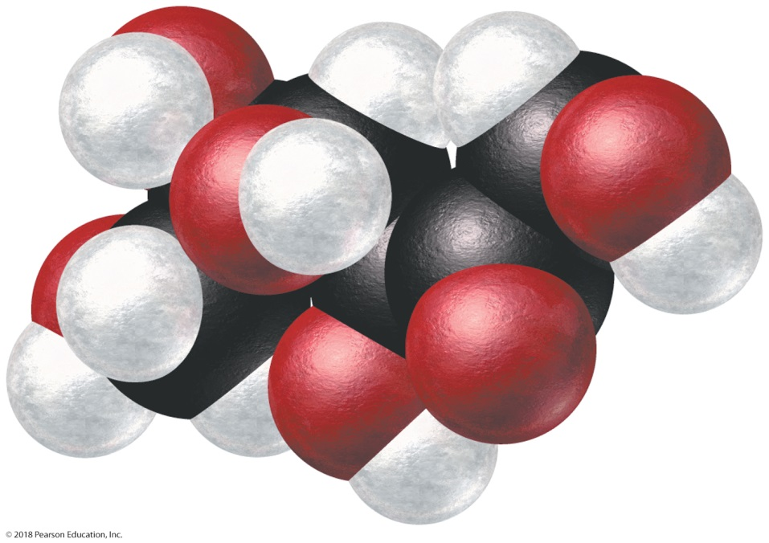
Calculating Molecular Formulas for Compounds: Fructose
Find the molecular formula for fructose (a sugar found in fruit) from its empirical formula, CH₂O, and its molar mass, 180.2 g/mol.
The molecular formula is a whole-number multiple of CH₂O.

Slide 61
Calculating Molecular Formulas for Compounds: Fructose
For fructose, the empirical formula molar mass is as follows:
Empirical formula molar mass = 1(12.01) + 2(1.01) + 16.00 = 30.03 g/mol
Therefore, n is
We can then use this value of n to find the molecular formula.
Molecular formula = CH₂O × 6 = C₆H₁₂O₆

Slide 62
Calculating Molecular Formulas for Compounds
Use the molar mass (which is given) and
the empirical formula molar mass (which you can calculate based on the empirical formula)
to determine n (the integer by which you must multiply the empirical formula to get the molecular formula).
Multiply the subscripts in the empirical formula by n to arrive at the molecular formula.

Slide 63
Chapter 6 in Review
The Mole Concept:
The mole is a specific number (6.022 × 10²³) that allows us to easily count atoms or molecules by weighing them.
One mole of any element has a mass equivalent to its atomic mass in grams.
One mole of any compound has a mass equivalent to its formula mass in grams.
The mass of 1 mol of an element or compound is its molar mass.

Slide 64
Chapter 6 in Review
Chemical Formulas and Chemical Composition:
Chemical formulas indicate the relative number of each kind of element in a compound.
These numbers are based on atoms or moles.
By using molar masses, the information in a chemical formula can be used to determine the relative masses of each kind of element in a compound.
The total mass of a sample of a compound can be related to the masses of the constituent elements contained in the compound.

Slide 65
Chapter 6 in Review
Empirical and Molecular Formulas from Laboratory Data:
We can refer to the relative masses of each kind of element within a compound to determine the empirical formula of the compound.
If the chemist also knows the molar mass of the compound, he or she can also determine its molecular formula.

Slide 66
Chemical Skills Learning Objectives
LO: Convert between moles and number of atoms.
LO: Convert between grams and moles.
LO: Convert between grams and number of atoms or molecules.
LO: Convert between moles of a compound and moles of a constituent element.
LO: Convert between grams of a compound and grams of a constituent element.
LO: Use mass percent composition as a conversion factor.
LO: Determine mass percent composition from a chemical formula.
LO: Determine an empirical formula from experimental data.
LO: Calculate a molecular formula from an empirical formula and molar mass.

