Slide 1
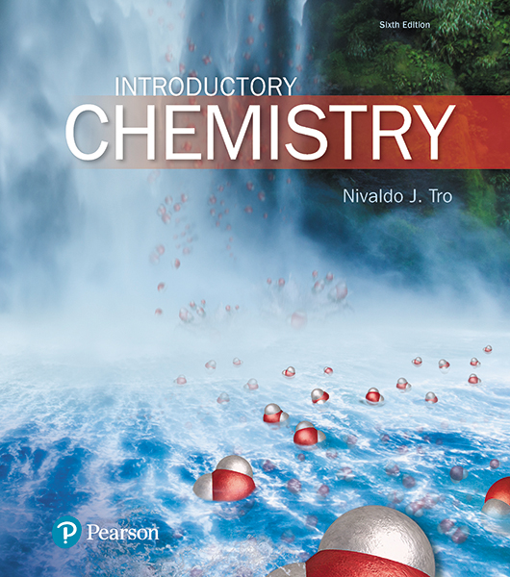
Lecture Presentation
Chapter 15
Chemical Equilibrium

Slide 2
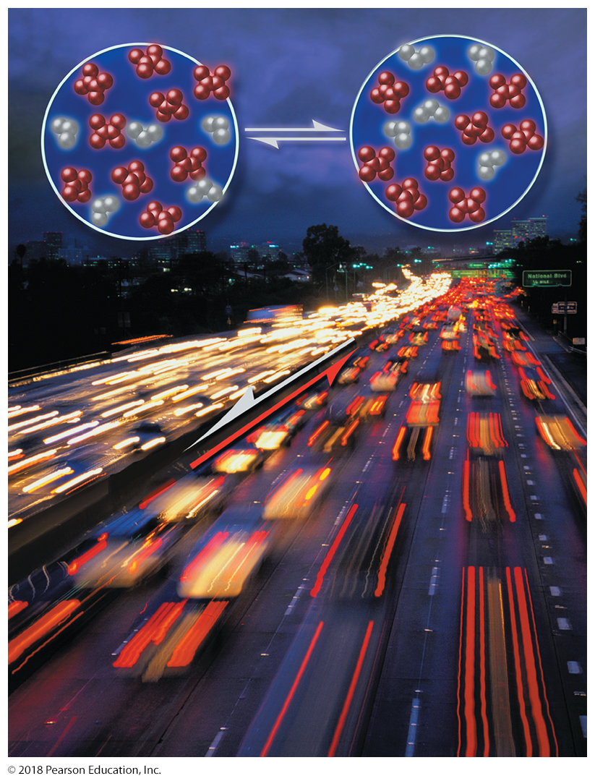
Dynamic Equilibrium
Dynamic equilibrium involves two opposing processes occurring at the same rate.
This image draws an analogy between a chemical equilibrium,
in which the two opposing reactions occur at the same rate, and a freeway with traffic moving in opposing directions at the same rate.

Slide 3
Equilibrium Involves Sameness and Constancy
We can think of equilibrium as sameness and constancy.
When an object is in equilibrium with its surroundings, some property of the object has reached sameness with the surroundings and is no longer changing.
A cup of hot water is not in equilibrium with its surroundings with respect to temperature.
If left undisturbed, the cup of hot water will slowly cool until it reaches equilibrium with its surroundings.
At that point, the temperature of the water is the same as that of the surroundings (sameness) and no longer changes (constancy).

Slide 4
Life: Controlled Disequilibrium
Part of a definition for living things is that living things are not in equilibrium with their surroundings.
Our body temperature is not the same as the temperature of our surroundings.
Living things, even the simplest ones, maintain some measure of disequilibrium with their environment.
We add the concept of control to complete our definition of life with respect to equilibrium.

Slide 5
Life: Controlled Disequilibrium
A cup of hot water is in disequilibrium with its environment, yet it is not alive.
The cup of hot water has no control over its disequilibrium and will slowly come to equilibrium with its environment.
In contrast, living things—as long as they are alive—maintain and control their disequilibrium.
Your body maintains your temperature within a specific range that is not in equilibrium with the surrounding temperature.
So one definition for life is that living things are in controlled disequilibrium with their environment.
A living thing comes into equilibrium with its surroundings only after it dies.

Slide 6
The Rate of a Chemical Reaction
We examine the concept of equilibrium, especially chemical equilibrium—the state that involves sameness and constancy.
Reaction rates are related to chemical equilibrium because a chemical system is at equilibrium when the rate of the forward reaction equals the rate of the reverse reaction.

Slide 7
The Rate of a Chemical Reaction
The rate of a chemical reaction—a measure of how fast the reaction proceeds—is defined as the amount of reactant that changes to product in a given period of time.
In a reaction with a fast rate, the reactants react to form products in a short period of time.
In a reaction with a slow rate, the reactants react to form products over a long period of time.
Reaction rates can be controlled if we understand the factors that influence them.

Slide 8
Collision Theory of Chemical Reactions
Chemical reactions occur through collisions between molecules or atoms.
If the collision occurs with enough energy—that is, if the colliding molecules are moving fast enough—the reaction can proceed to form the products.
If the collision occurs with insufficient energy, the reactant molecules bounce off one another without reacting.
Since gas-phase molecules have a wide distribution of velocities, collisions occur with a wide distribution of energies.
High-energy collisions lead to products; low-energy collisions do not.

Slide 9
Collision Theory of Chemical Reactions
Higher-energy collisions are more likely to lead to products because most chemical reactions have an activation energy.
Activation energy is an energy barrier that must be overcome for the reaction to proceed.
The activation energy may be the energy required to begin to break the bonds of the reactants.
If molecules react via high-energy collisions, then the factors that influence the rate of a reaction must be the same factors that affect the number of high-energy collisions that occur per unit time.
The two most important factors are the concentration of the reacting molecules and the temperature of the reaction mixture.

Slide 10
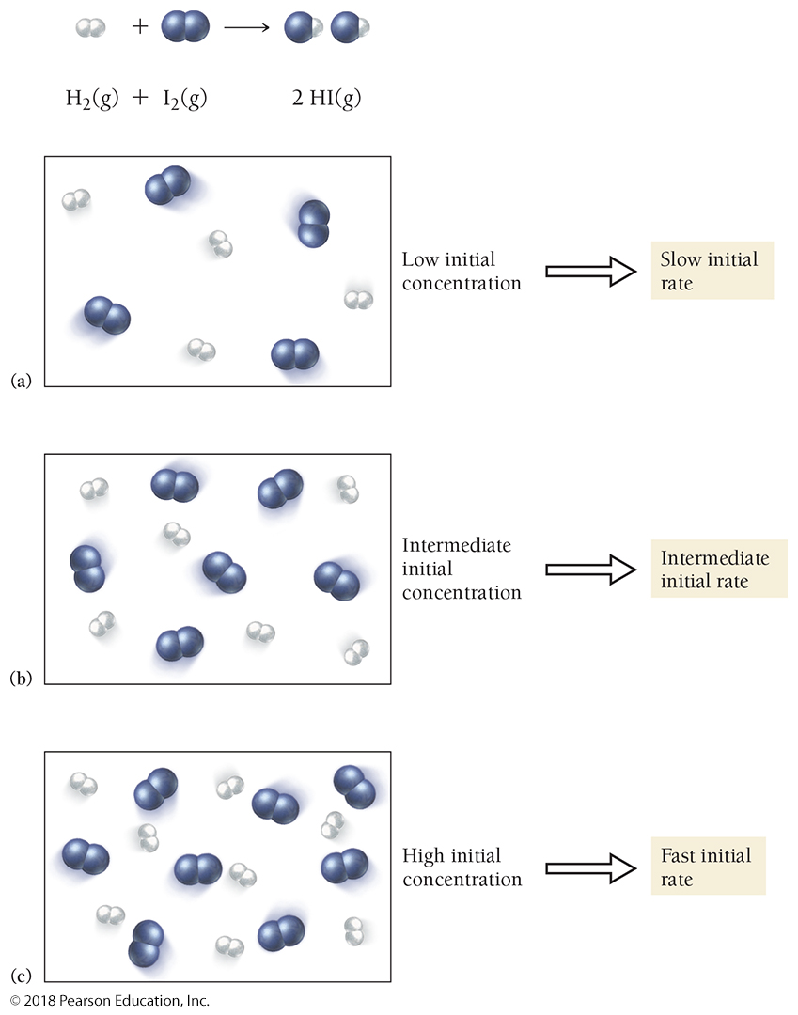
How Concentration Affects the Rate of a Reaction
The rate of a chemical reaction generally increases with increasing concentration of the reactants.
The exact relationship between increases in concentration and increases in reaction rate varies for different reactions and is the subject of studies in chemical kinetics.

Slide 11
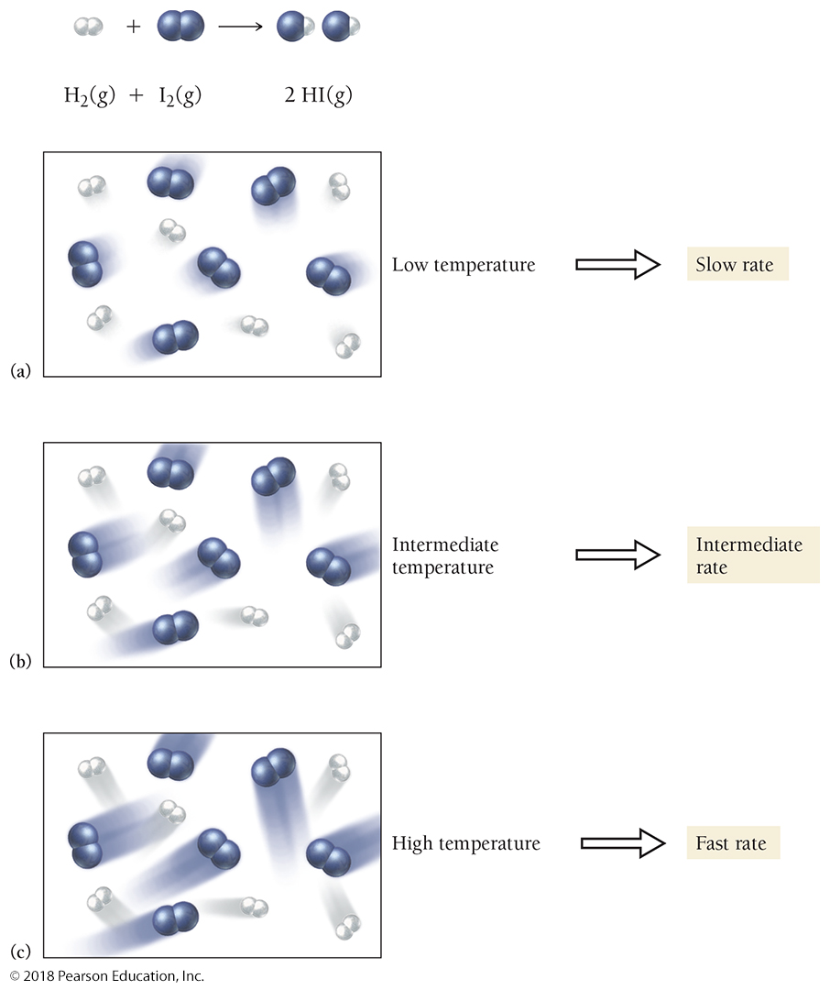
How Temperature Affects the Rate of a Reaction
Raising the temperature makes the molecules move faster.
More collisions occur per unit time, resulting in a faster reaction rate.
A higher temperature results in more collisions that are of higher energy.
Since it is the high-energy collisions that result in products, this also produces a faster rate.

Slide 12
Collision Theory of Chemical Reactions
To summarize:
• Reaction rates generally increase with increasing reactant concentration.
• Reaction rates generally increase with increasing temperature.
• Reaction rates generally decrease as a reaction proceeds.

Slide 13
The Idea of Dynamic Chemical Equilibrium
A reaction that can proceed in both the forward and reverse directions is a reversible reaction.
In a chemical reaction, the condition in which the rate of the forward reaction equals the rate of the reverse reaction is called dynamic equilibrium.
This condition is not static—it is dynamic because the forward and reverse reactions are still occurring but at the same constant rate.
When dynamic equilibrium is reached, the concentrations of reactants and products no longer change.
The reactants and products are being depleted at the same rate at which they are being formed.

Slide 14
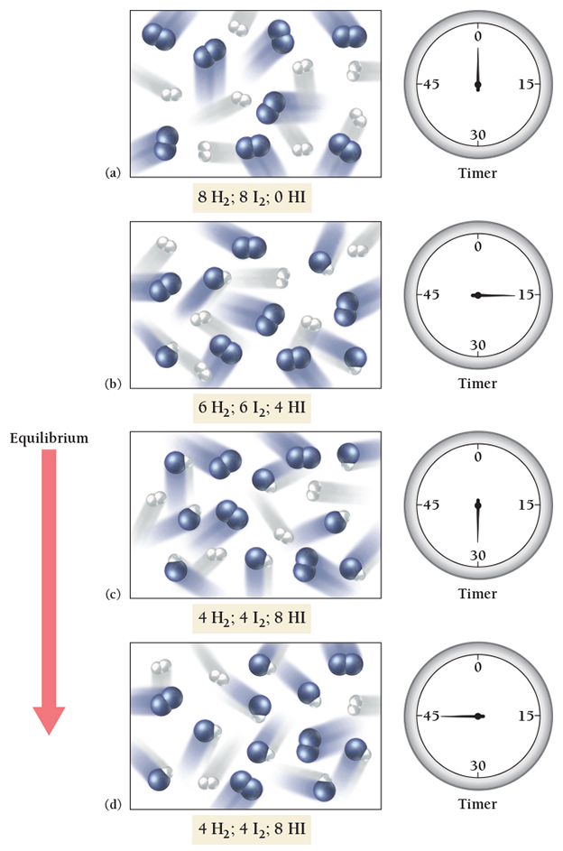
Equilibrium
When the concentrations of the reactants and products no longer change, equilibrium has been reached.

Slide 15
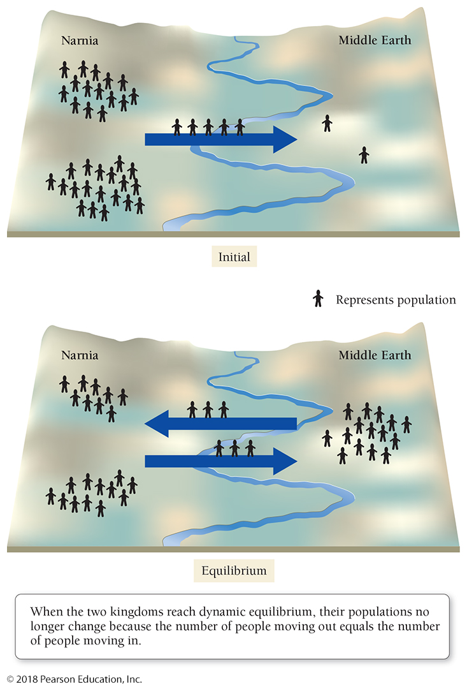
Population Analogy for a Chemical Reaction Proceeding to Equilibrium
Eventually, the rate of people moving out of Narnia (which has been slowing down as people leave) equals the rate of people moving back to Narnia (which has been increasing as Middle Earth gets more crowded).
Dynamic equilibrium has been reached.

Slide 16
The Equilibrium Constant K_{eq}
A way to quantify the relative concentrations of the reactants and products at equilibrium
When dynamic equilibrium is reached, the forward reaction rate is the same as the reverse reaction rate (sameness).
Because the reaction rates are the same, the concentrations of the reactants and products no longer change (constancy).
The constancy of concentrations of reactants and products at equilibrium does not imply that the concentrations of reactants and products are equal to one another at equilibrium.
Some reactions reach equilibrium only after most of the reactants have formed products.
Other reactions reach equilibrium when only a small fraction of the reactants have formed products.
The amounts of reactants and products depend on the reaction and can be expressed numerically by the equilibrium constant K_{eq}.

Slide 17
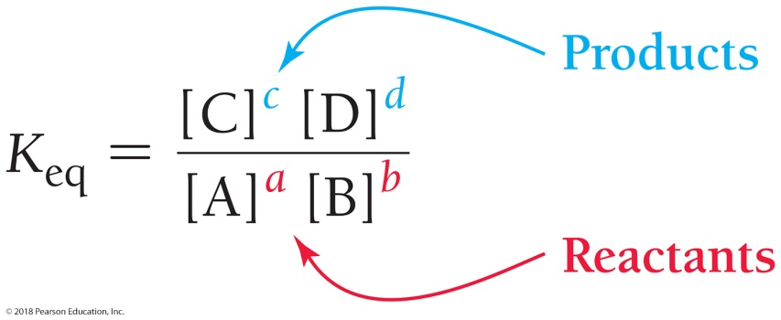
The Equilibrium Constant K_{eq}
Consider the generic chemical reaction
where A and B are reactants, C and D are products, and a, b, c, and d are the respective stoichiometric coefficients in the chemical equation.
The equilibrium constant for the reaction is defined as the ratio—at equilibrium—of the concentrations of the products raised to their stoichiometric coefficients divided by the concentrations of the reactants raised to their stoichiometric coefficients.

Slide 18
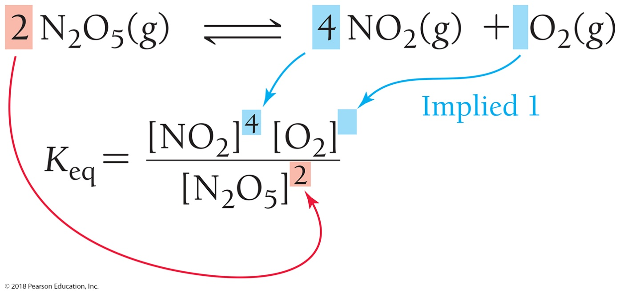
Writing Equilibrium Expressions for Chemical Reactions
Write an equilibrium expression for the reaction
Notice that the coefficients in the chemical equation become the exponents in the equilibrium expression.

Slide 19
The Significance of the Equilibrium Constant
K_{eq} is large:
K_{eq} is small:

Slide 20
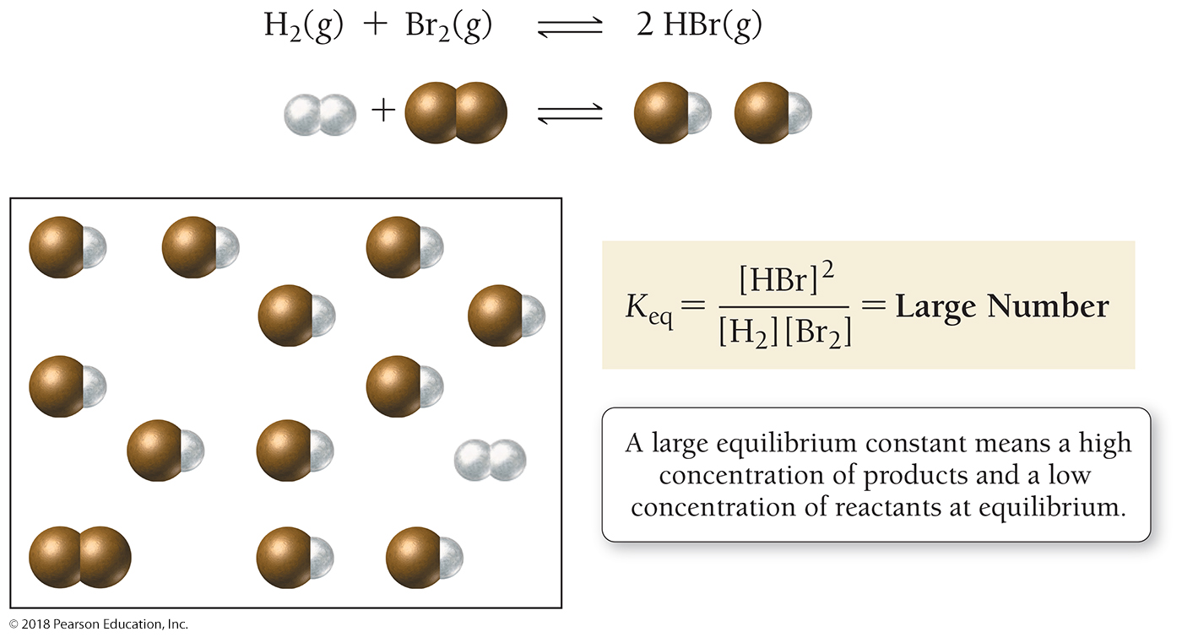
The Meaning of a Large Equilibrium Constant
There will be a high concentration of products and a low concentration of reactants at equilibrium.

Slide 21
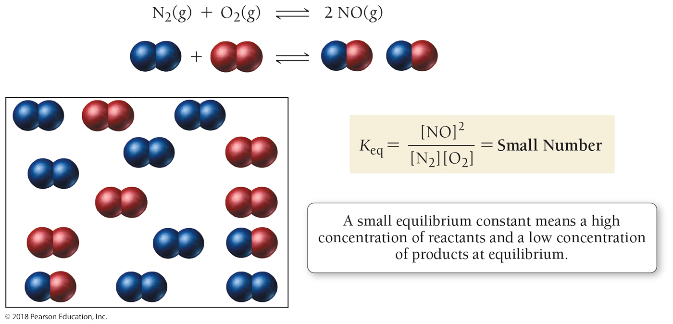
The Meaning of a Small Equilibrium Constant
There will be a high concentration of reactants and a low concentration of products at equilibrium.

Slide 22
What Does an Equilibrium Constant Imply about a Reaction?
To summarize:
K_{eq} << 1 Reverse reaction is favored; forward reaction does not proceed very far.
K_{eq} ≈ 1 Neither direction is favored; forward reaction proceeds about halfway (significant amounts of both reactants and products are present at equilibrium).
K_{eq} >> 1 Forward reaction is favored; forward reaction proceeds virtually to completion.

Slide 23
Heterogeneous Equilibria: The Equilibrium Expression for Reactions Involving a Solid or a Liquid
The concentrations of pure solids and pure liquids are excluded from equilibrium expressions because they are constant.
Since CaCO₃(s) and CaO(s) are both solids, they are omitted from the equilibrium expression.

Slide 24
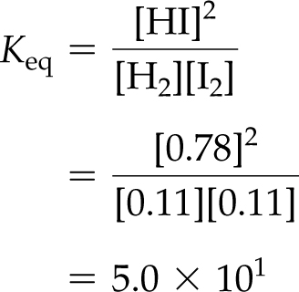
Calculating Equilibrium Constants
GIVEN:
[H₂] = 0.11 M
[I₂] = 0.11 M
[HI] = 0.78 M
FIND: K_{eq}

Slide 25
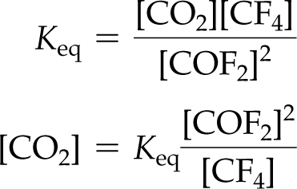
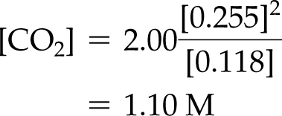
Using Equilibrium Constants in Calculations
GIVEN:
[COF₂] = 0.255 M
[CF₄] = 0.118 M
K_{eq} = 2.00
FIND: [CO₂]

Slide 26
Disturbing a Reaction at Equilibrium: Le Châtelier’s Principle
When a chemical system at equilibrium is disturbed, the system shifts in a direction that minimizes the disturbance.

Slide 27
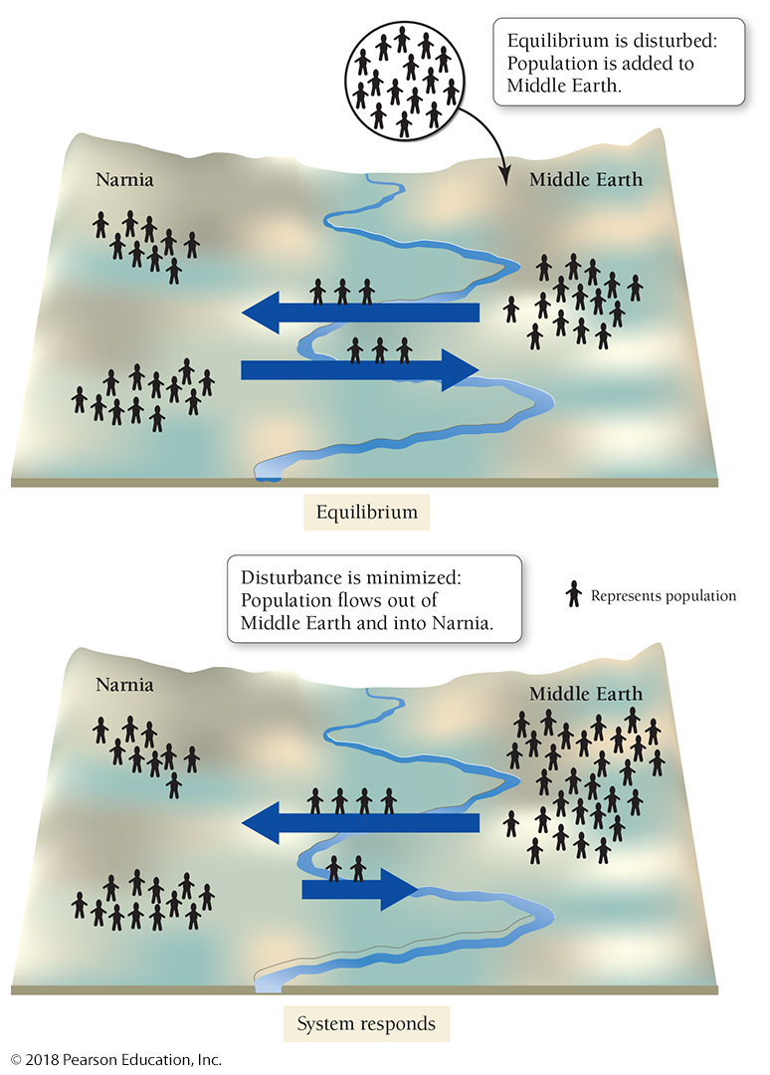
Population Analogy for Le Châtelier’s Principle
When a system at equilibrium is disturbed, it shifts to minimize the disturbance. In this case, adding population to Middle Earth (the disturbance) causes population to move out of Middle Earth (minimizing the disturbance).

Slide 28
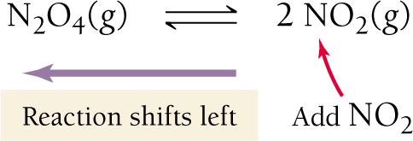
Disturb a System by Adding Products
Figure 15.9 Le Châtelier’s principle in action I: When a system at equilibrium is disturbed, it changes to minimize the disturbance: Adding NO₂ (the disturbance) causes the reaction to shift left, consuming NO₂ by forming more N₂O₄.

Slide 29
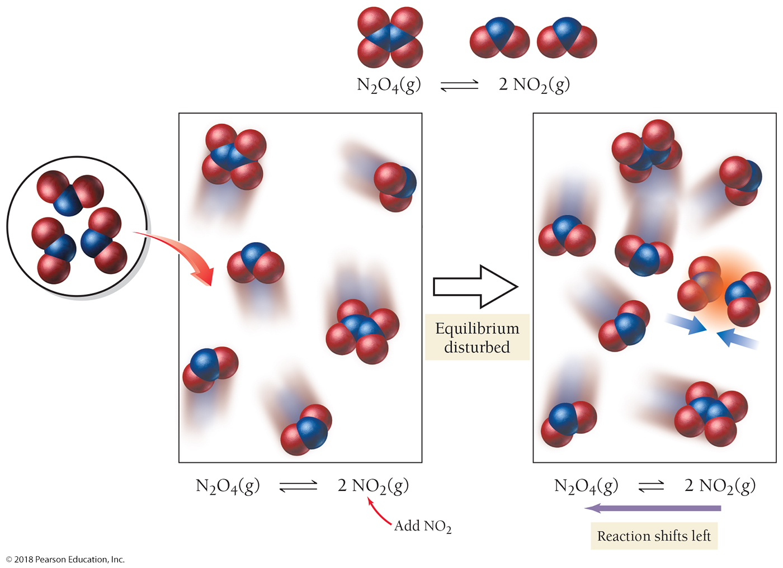
Disturb a System by Adding Products

Slide 30
Disturb a System by Adding Reactants
Figure 15.10 Le Châtelier’s principle in action II: When a system at equilibrium is disturbed, it changes to minimize the disturbance: Adding N₂O₄ (the disturbance) causes the reaction to shift right, consuming N₂O₄ by producing more NO₂.

Slide 31
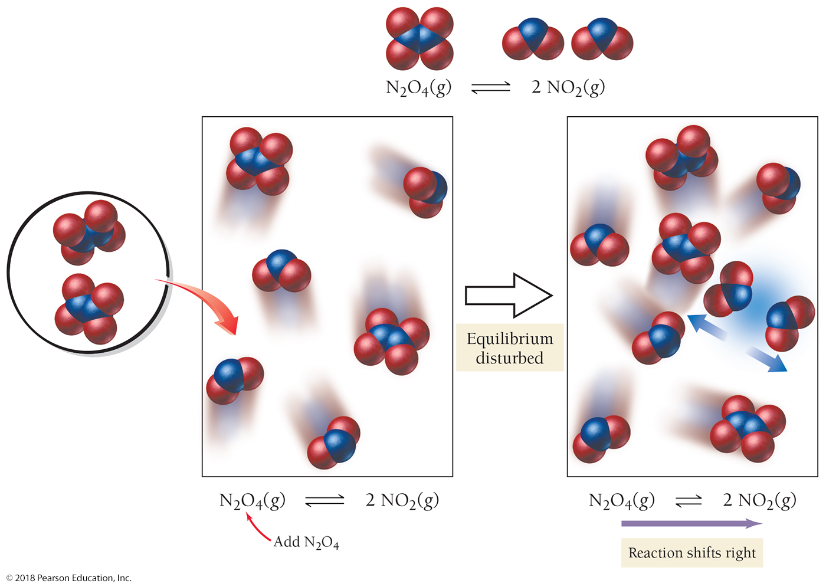
Disturb a System by Adding Reactants

Slide 32
The Effect of a Volume Change on Equilibrium
Changing the volume of a gas (or a gas mixture) results in a change in pressure.
A decrease in volume causes an increase in pressure, and an increase in volume causes a decrease in pressure.
From the ideal gas law, PV = nRT, we can see that lowering the number of moles of a gas (n) results in a lower pressure (P) at constant temperature and volume.
A system can respond to a disturbance by changing the moles of gas present to relieve a pressure change.

Slide 33
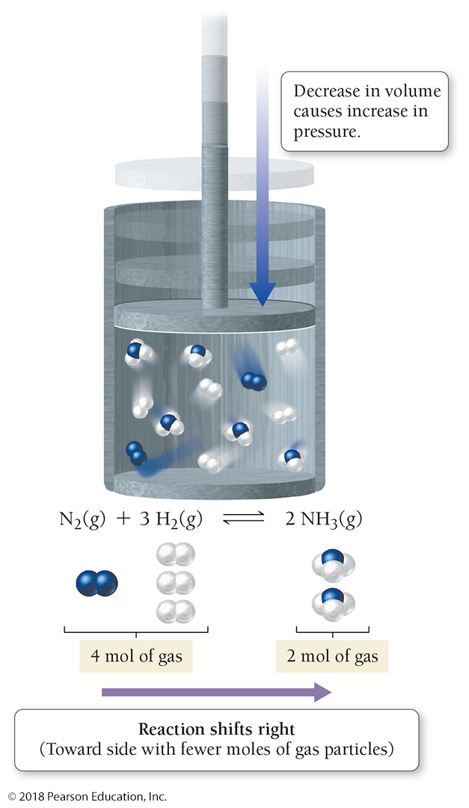
Effect of Volume Decrease on Equilibrium
When the volume of an equilibrium mixture decreases, the pressure increases. The system responds (to bring the pressure back down) by shifting to the right, the side of the reaction with the fewer moles of gas particles.

Slide 34
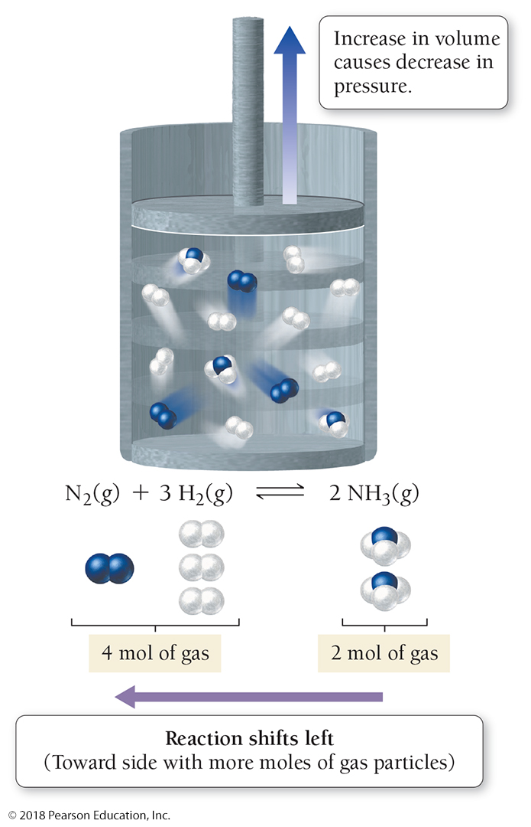
Effect of Volume Increase on Equilibrium
When the volume of an equilibrium mixture increases, the pressure decreases. The system responds (to raise the pressure) by shifting to the left, the side of the reaction with more moles of gas particles.

Slide 35
The Effect of a Volume Change on Equilibrium
To summarize, if a chemical system is at equilibrium, the effects of volume change are as follows:
• Decreasing the volume causes the reaction to shift in the direction that has fewer moles of gas particles.
• Increasing the volume causes the reaction to shift in the direction that has more moles of gas particles.
• Notice that if a chemical reaction has an equal number of moles of gas particles on both sides of the chemical equation, a change in volume has no effect.

Slide 36
Chemistry and Health: How a Developing Fetus Gets Oxygen from Its Mother
Hemoglobin (Hb) reacts with oxygen according to the equilibrium equation:
The equilibrium constant for this reaction is neither large nor small. Consequently, the reaction shifts toward the right or the left depending on the concentration of oxygen.

Slide 37
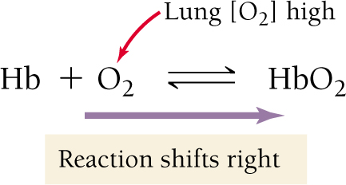
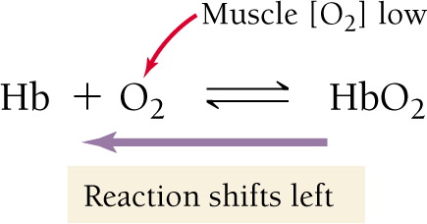
Chemistry and Health: How a Developing Fetus Gets Oxygen from Its Mother
As blood flows through the lungs, where oxygen concentrations are high, the equilibrium shifts to the right—hemoglobin loads oxygen.
As blood flows through muscles and organs that are using oxygen (where oxygen concentrations have been depleted), the equilibrium shifts to the left—hemoglobin unloads oxygen.

Slide 38
Chemistry and Health: How a Developing Fetus Gets Oxygen from Its Mother
Fetal hemoglobin (HbF) is slightly different from adult hemoglobin. Like adult hemoglobin, fetal hemoglobin is in equilibrium with oxygen.
The equilibrium constant for fetal hemoglobin is larger than the equilibrium constant for adult hemoglobin.
Fetal hemoglobin will load oxygen at a lower oxygen concentration than adult hemoglobin.
When the mother’s hemoglobin flows through the placenta, it unloads oxygen into the placenta.
Nature has engineered a chemical system in which the mother’s hemoglobin can in effect hand off oxygen to the baby’s hemoglobin.

Slide 39
The Effect of a Temperature Change on Equilibrium
In an exothermic reaction, we can think of heat as a product. Raising the temperature of an exothermic reaction—think of this as adding heat to the product side—causes the reaction to shift left.
In an endothermic reaction, we can think of heat as a reactant. Raising the temperature of an endothermic reaction—think of this as adding heat to the reactant side—causes the reaction to shift right.

Slide 40
In an Exothermic Reaction, We Can Think of Heat as a Product

Slide 41
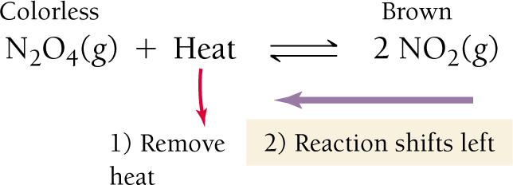
In an Endothermic Reaction, We Can Think of Heat as a Reactant

Slide 42
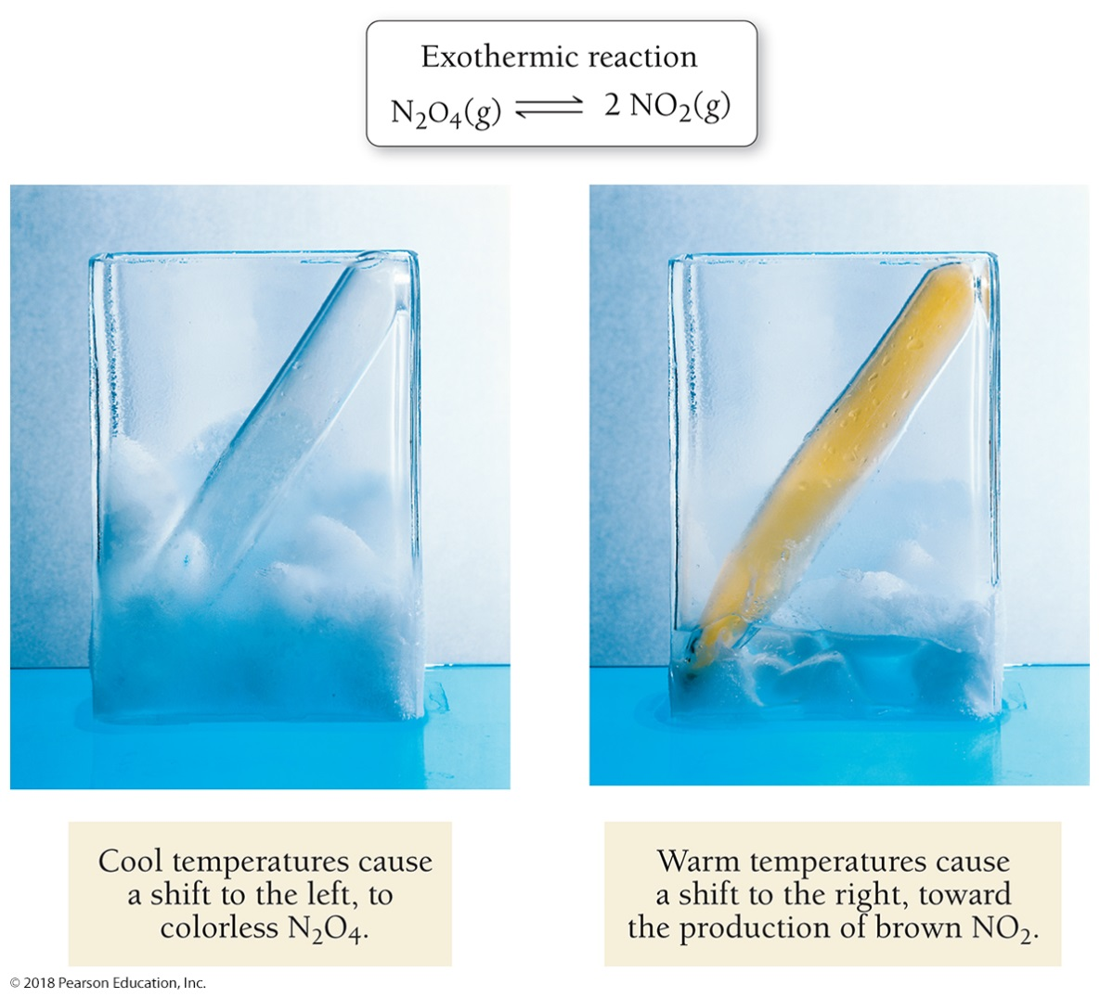
Equilibrium as a Function of Temperature
Since the reaction is endothermic, warm temperatures cause a shift to the right, toward the production of brown NO₂. Cool temperatures cause a shift to the left, to colorless N₂O₄.

Slide 43
The Effect of a Temperature Change on Equilibrium
To summarize:
In an exothermic chemical reaction, heat is a product and the effects of temperature change are as follows:
• Increasing the temperature causes the reaction to shift left (in the direction of the reactants).
• Decreasing the temperature causes the reaction to shift right (in the direction of the products).
In an endothermic chemical reaction, heat is a reactant and the effects of temperature change are as follows:
• Increasing the temperature causes the reaction to shift right (in the direction of the products).
• Decreasing the temperature causes the reaction to shift left (in the direction of the reactants).

Slide 44
The Solubility-Product Constant
The process by which an ionic compound dissolves is an equilibrium process.
The equilibrium expression for a chemical equation that represents the dissolving of an ionic compound is the solubility-product constant K_{sp}.
Solids are omitted from the equilibrium expression.
A large K_{sp} (forward reaction favored) means that the compound is very soluble. A small K_{sp} (reverse reaction favored) means that the compound is not very soluble.

Slide 45
Writing Expressions for K_{sp}
To write the expression for K_{sp}, first write the chemical reaction showing the solid compound in equilibrium with its dissolved aqueous ions. Then, write the equilibrium expression based on this equation.

Slide 46
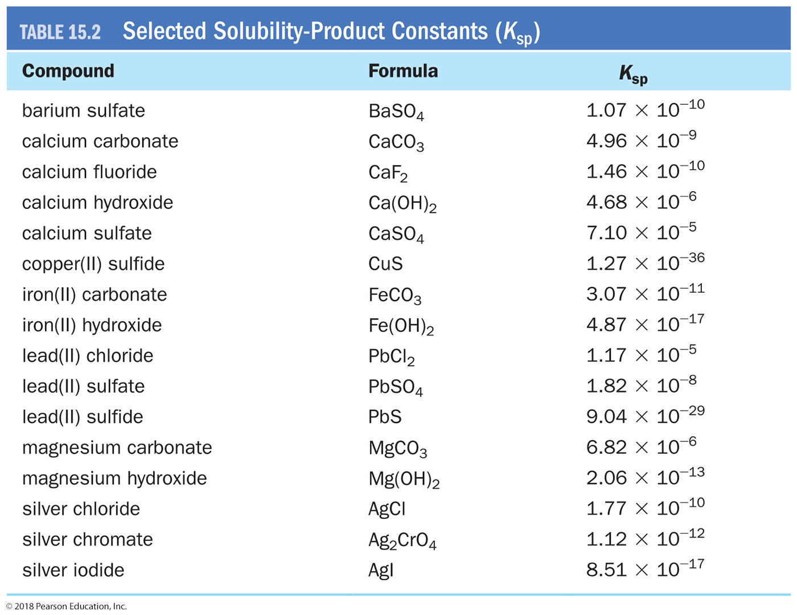
The K_{sp} Value Is a Measure of the Solubility of a Compound

Slide 47
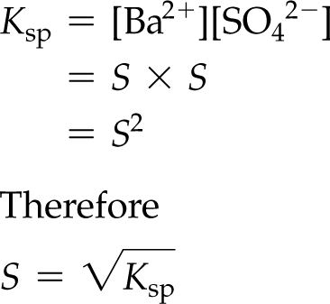
Example 15.9 Calculating Molar Solubility from K_{sp}
Calculate the molar solubility of BaSO₄.
Solution
Begin by writing the reaction by which solid BaSO₄ dissolves into its constituent aqueous ions.
BaSO₄(s) Ba²⁺(aq) + SO₄^{2–}(aq)
Next, write the expression for K_{sp}.
K_{sp} = [Ba²⁺][SO₄^{2–}]
Define the molar solubility (S) as [Ba²⁺] or [SO₄^{2–}] at equilibrium.
S = [Ba²⁺] = [SO₄^{2–}]
Substitute S into the equilibrium expression and solve for it.

Slide 48
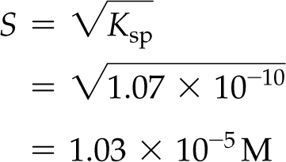
Example 15.9 Calculating Molar Solubility from K_{sp}
Continued
Finally, look up the value of K_{sp} in Table 15.2 and calculate S. The molar solubility of BaSO₄ is 1.03 × 10^{–5} mol/L.
Skillbuilder 15.9 | Calculating Molar Solubility from K_{sp}
Calculate the molar solubility of CaSO₄.
For More Practice
Example 15.15; Problems 85, 86, 87, 88.

Slide 49
Everyday Chemistry: Hard Water
Because of their relatively low solubility-product constants, water can easily become saturated with CaCO₃ and MgCO₃.
A drop of water becomes saturated with CaCO₃ and MgCO₃ as the water evaporates.
A saturated solution such as this precipitates some of its dissolved ions.
These precipitates show up as scaly deposits on faucets, sinks, and cookware. Washing cars or dishes with hard water leaves spots of CaCO₃ and MgCO₃ as these solids precipitate out of drying drops of water.

Slide 50
The Path of a Reaction and the Effect of a Catalyst
The equilibrium constant describes how far a chemical reaction will go. The reaction rate describes how fast it will get there.
The activation energy (or activation barrier) for a reaction is the energy barrier that must be overcome in order for the reactants to be converted into products.
Activation energies exist for most chemical reactions because the original bonds must begin to break before new bonds begin to form, and this requires energy.

Slide 51
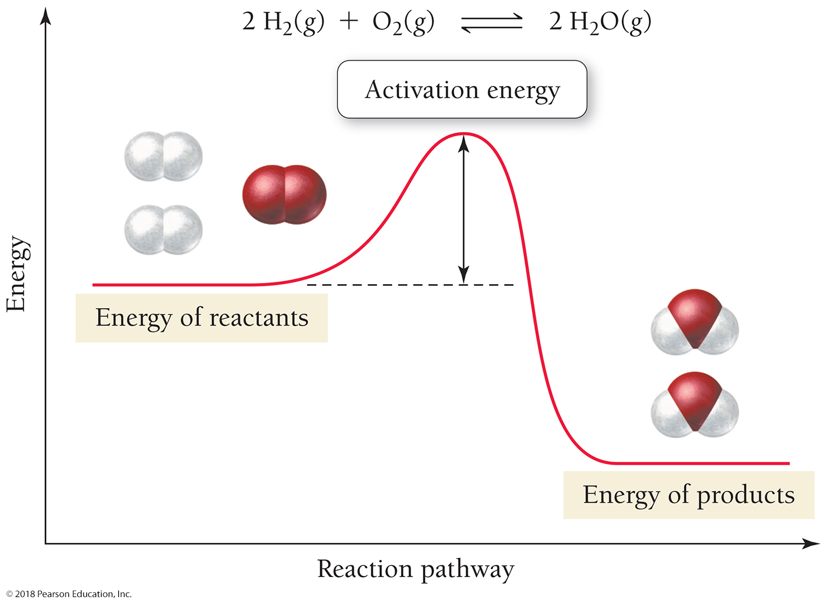
How Activation Energies Affect Reaction Rates

Slide 52
Are There Any Ways to Speed Up a Slow Reaction (One with a High Activation Barrier)?
For chemical reactions, the higher the activation energy, the fewer the number of reactant molecules that make it over the barrier, and the slower the reaction rate.
In general: At a given temperature, the higher the activation energy for a chemical reaction, the slower the reaction rate.
Are there any ways to speed up a slow reaction?
Increase the concentrations of the reactants, which results in more collisions per unit time.
Increase the temperature, which results in more collisions per unit time, and also in higher energy collisions.
Use a catalyst, which lowers the activation energy barrier.

Slide 53
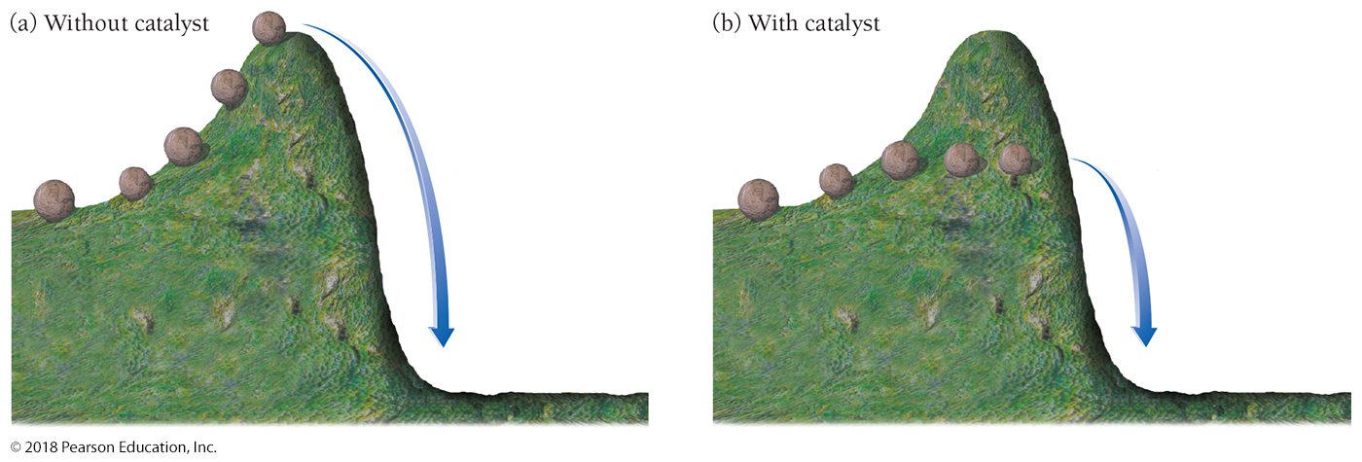
Hill Analogy for Effect of a Catalyst on Activation Energy
(a) One way to increase reaction rate is to push harder—this is analogous to an increase in temperature for a chemical reaction.
(b) Another way is to find a path that goes around the hill—this is analogous to the role of a catalyst for a chemical reaction.

Slide 54
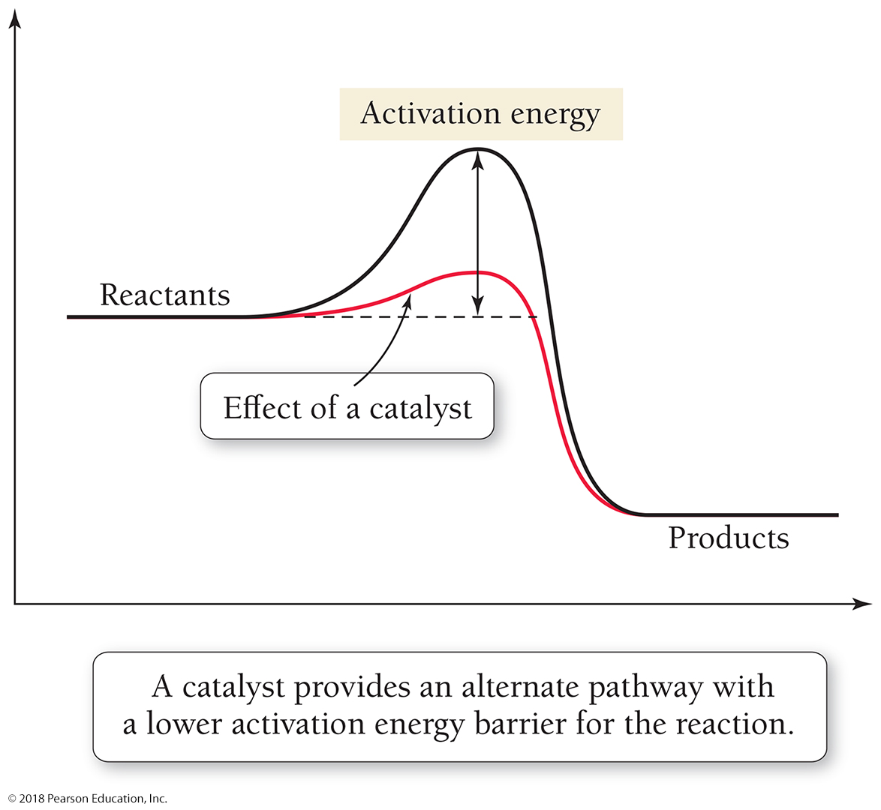
Function of a Catalyst
A catalyst provides an alternate pathway with a lower activation energy barrier for the reaction.

Slide 55
Catalytic Destruction of Upper-Atmospheric Ozone
Upper-atmospheric ozone forms a shield against harmful ultraviolet light that would otherwise enter Earth’s atmosphere.
Consider the noncatalytic destruction of ozone in the upper atmosphere.
O₃ + O 2 O₂
We have a protective ozone layer because this reaction has a fairly high activation barrier and therefore proceeds at a fairly slow rate. The ozone layer does not rapidly decompose into O₂.
However, the addition of Cl (from synthetic chlorofluorocarbons) to the upper atmosphere has resulted in another pathway by which O₃ can be destroyed.
The first step in this pathway—called the catalytic destruction of ozone—is the reaction
Cl + O₃ ClO + O₂
In the case of the catalytic destruction of ozone, the catalyst speeds up a reaction that we do not want to happen.
A catalyst does not change the position of equilibrium, only how fast equilibrium is reached.

Slide 56
Enzymes: Biological Catalysts
Many reactants are thermally sensitive—increasing the temperature often destroys them. The only way to carry out many reactions is to use catalysts.
Most of the thousands of reactions that must occur for a living organism to survive would be too slow at normal temperatures. So living organisms use enzymes, biological catalysts that increase the rates of biochemical reactions.

Slide 57
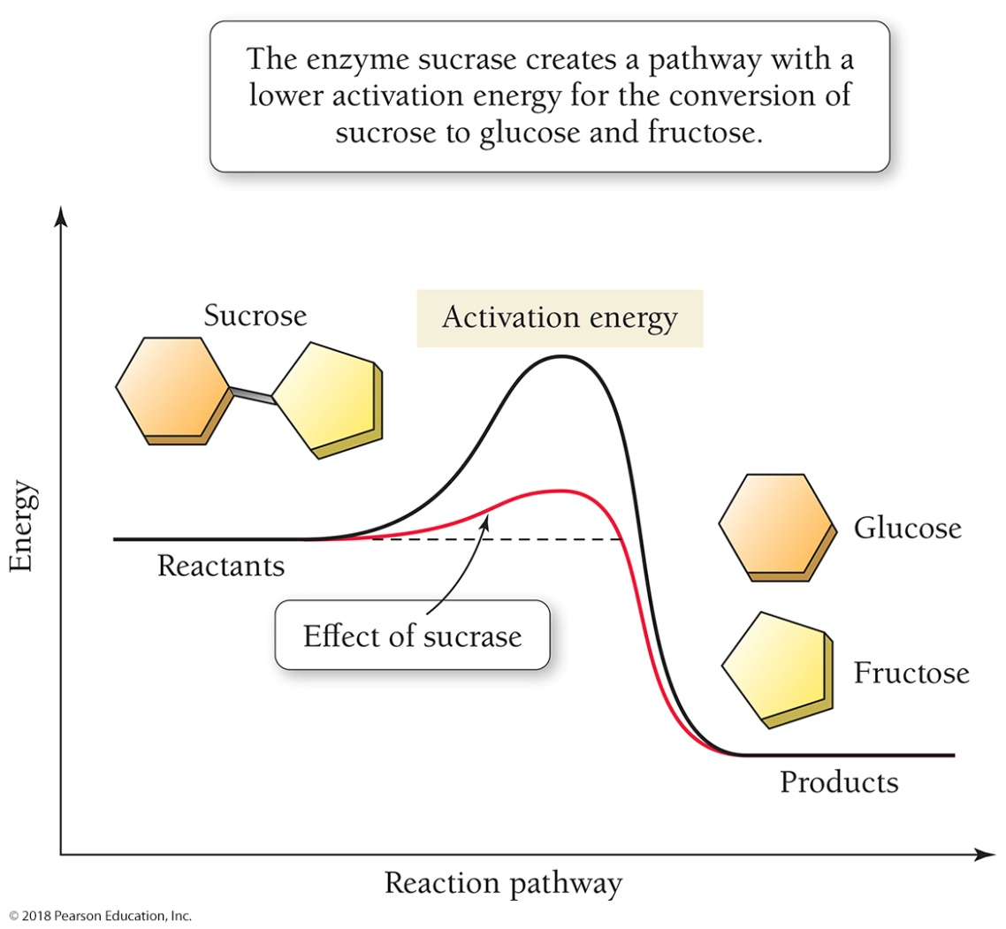
Figure 15.17 An Enzyme Catalyst
The enzyme sucrase creates a pathway with a lower activation energy for the conversion of sucrose to glucose and fructose.

Slide 58
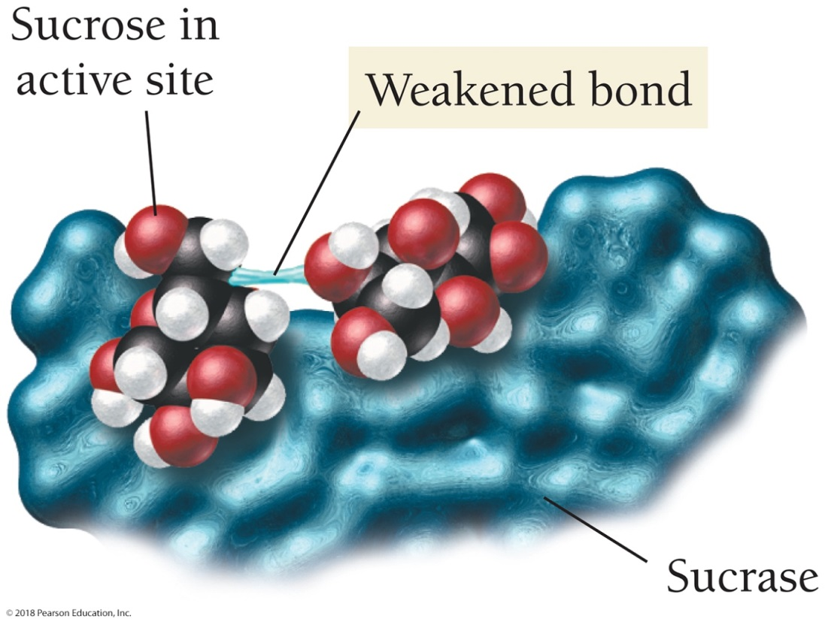
How an Enzyme Works
When Sucrose is in the Active Site, the bond between the glucose and fructose units weakens, lowering the activation energy for the reaction and increasing the reaction rate.

Slide 59
Chapter 15 in Review
Equilibrium involves the ideas of sameness and constancy.
The rate of a chemical reaction is the amount of reactant(s) that goes to product(s) in a given period of time.
Dynamic chemical equilibrium occurs when the rate of the forward reaction equals the rate of the reverse reaction.
In the equilibrium constant, K_{eq}, only the concentrations of gaseous or aqueous reactants and products are included—the concentrations of solid or liquid reactants or products are omitted.

Slide 60
Chapter 15 in Review
Le Châtelier’s principle states that when a chemical system at equilibrium is disturbed, the system shifts in a direction that minimizes the disturbance.
The solubility-product constant, K_{sp}, describes the dissolving of an ionic compound.
Most chemical reactions must overcome an activation energy. A catalyst—a substance that increases the rate of the reaction but is not consumed by it—lowers the activation energy.

Slide 61
Chemical Skills Learning Objectives
LO: Write equilibrium expressions for chemical reactions.
LO: Calculate equilibrium constants.
LO: Use the equilibrium constant to find the concentration of a reactant or product at equilibrium.
LO: Apply Le Châtelier’s principle.
LO: Write an expression for the solubility-product constant.
LO: Use K_{sp} to determine molar solubility.

